Slide 1

TITLE SLIDE: TSDS ODS 3.x Project
Updates
STATE PERFORMANCE PLAN INDICATOR-14 (SPPI-14)
New User Certification Training

Slide 2
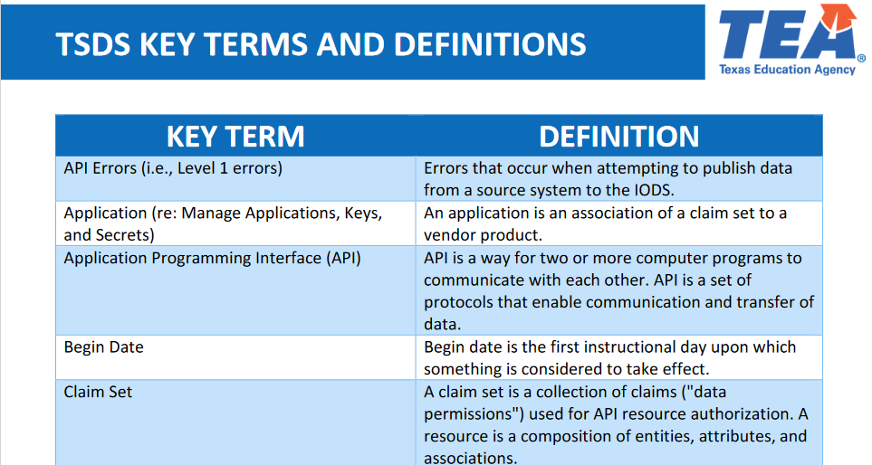
KEY TERMS
Please take a moment to familiarize yourself with common terminology by accessing the Key Terms and Definitions Document.

Slide 3
LEARNING OBJECTIVES
  By the end of this course, the users will be able to explain:
  The requirements for the State Performance Plan Indicator 14 (SPPI-14) submission.
  The data that comprises the SPPI-14 Submission.
  The TSDS reports for SPPI-14.

Slide 4
WHY IS THIS COURSE IMPORTANT
To understand the purpose of the SPPI-14 data submission and who will be submitting this data.
To understand that SPPI-14 is one of the State Performance Plan Indicators that provides information to the United States Department of Education's Office of Special Education Programs.

Slide 5

COURSE AGENDA
Getting Started
TSDS Architecture and TEAL Roles
Key Concepts
SPPI-14 Overview and Reports
Training Activity
Practice, Troubleshooting, & Knowledge Checks
Wrap Up
Key Takeaways, Resources, and Next Steps

Slide 6


GETTING STARTED
TSDS Architecture and TEAL Roles

Slide 7
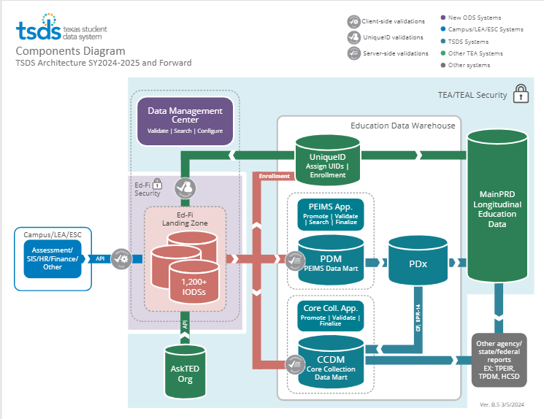
TSDS ARCHITECTURE

Slide 8
TEAL ROLES – SPPI-14
Core LEA Data Viewer
This role monitors data promotions and data validations and generates reports.
Core LEA Data Promoter
  This role schedules and monitors promotions, schedules and monitors validations, and generates reports.
Core LEA Data Completer
  This role formally certifies the completeness and accuracy of the data and finalizes the submission. In addition, this role also schedules and monitors promotions, schedules and monitors validations, and generates reports.
Core LEA Data Approver
This role will be for the superintendent or his/her designee at the LEA. This role requests an extension if needed.
Notes:
The role the LEA staff would request will depend on the individual’s level of responsibility.

Slide 9
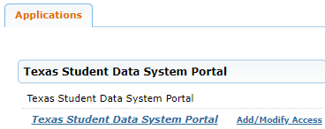
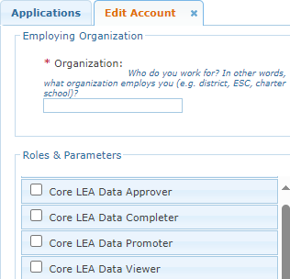
APPLY FOR SPPI-14 ROLE
Login to your TEAL account; Click Add/Modify Access.
Enter your Employing Organization and select the appropriated Core LEA TEAL role.

Slide 10
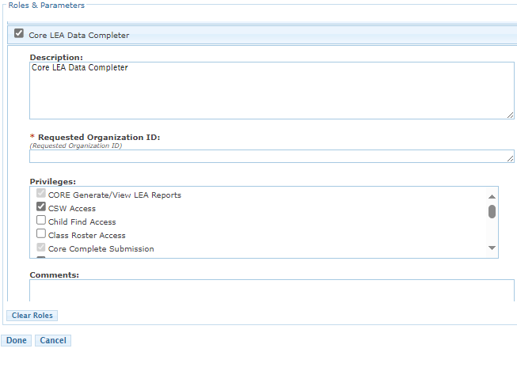
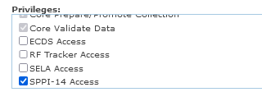

SPPI-14 TEAL ROLE & PRIVILEGE
Users will check the appropriate role based on their level of responsibility at the LEA and in the Requested Organization ID enter their Organization ID.
Next, check the Privilege “SPPI-14 Access” and click Done.
The final step is to click Save Changes on the next screen.
Notes:
Check SPPI-14 Access under the Privileges.

Slide 11
ESC ROLE FOR SPPI-14
Core ESC Data Viewer
  This role will be able to view and monitor SPPI-14 activity in TSDS for the LEAs the ESC supports.
Notes:
The ESC Data Viewer role will allow the ESC to monitor the data promotions for RFT for the LEAs in their region.

Slide 12


KEY CONCEPTS
SPPI-14 Overview, Data Validations, and SPPI-14 Reports

Slide 13
SPPI-14
Of the seventeen State Performance Plan Indicators this submission will focus on Indicator 14. This indicator requires that a Post-School Outcome Survey be distributed to persons who received special education services prior to exiting high school to monitor these students as they transition from high school to adult life.
The SPPI-14 data submission collects student and parent/guardian contact information for students who were served through the Special Education Program in the prior school year and who did not return to the LEA in the current school year.
This data is sent to a third-party vendor who then sends a survey to a random sampling of the students submitted by the LEA.
Notes:
This data submission is to meet the Federal mandate that a Post-School Outcome Survey be distributed to persons who received SPED services prior to exiting high school.
SPPI-14 collects information on students served through the SPED program in the prior year who did not return to the LEA in the current school year.
The TSDS SPPI-14 data is sent to a third-party vendor who sends the survey to a random sampling of students who were submitted on the SPPI-14 data submission to monitor SPED students as they transition from high school to adult life.

Slide 14
SPPI-14 DATA SURVEY
The third-party vendor survey results are submitted to the Office of Special Education Programs at the U.S. Department of Education with annual progress reports related to the State Performance Plan.

Slide 15
SPPI-14 STUDENTS
SPPI-14 data will be collected for students who:
  Were identified as having received special education services during the prior school year and
  Who are not enrolled at the LEA as of the last Friday in October in the current school year.
  ExitWithdrawType that will be collected for SPPI-14 include:
    01 Graduated,
    24 Withdrew to enroll in college to pursue associate’s or bachelor’s degree,
    88 Court ordered to a GED program, has not earned GED,
    90 Graduated from another state under provisions of the Interstate Compact on Educational Opportunity for Military Children, or
    98 Other.
Notes:
Only five leaver codes will be considered for SPPI-14.
01 – graduated
24 – withdrew to enroll in college to pursue associate’s or bachelor’s degree
88 – court ordered to a GED program and the student has not earned the GED
90 – graduated from another state under the provisions of the Interstate Compact on Educational Opportunity for Military Children
98 - other

Slide 16
SPPI-14 TIMELINE
State Performance Plan Indicator 14 Submission
SPPI-14 ready for users to complete | Late October
SPPI-14 Submission due to TEA | Late February
Notes:
SPPI-14 is due to TEA on the third Thursday in February.

Slide 17
DOMAIN DEFINITIONS
Education Organization Domain – provides information about any public or charter school, education service center, organization, or agency.
Alternative & Supplemental Services Domain – provides program information such as Title I, Special Education, Emergent Bilingual, and Residential Facility. (SPED services for SPPI-14 reporting will be based on services received during the prior school year. This data will be retrieved from the TEA’s main database.)
Student Identification and Demographics Domain – provides the characteristics and demographics of a student.
Prior Year Leaver (TX) Domain – represents student leavers in grades 7-12 during the prior school year. (For the 2024-2025 and 2025-2026 school years, all student demographics and student contact information for the SPPI-14 Submission will come from this domain instead of Student Identification and Demographics.)
Notes:
In the 2024-25 school year all student data for SPPI-14 will come from the Prior Year Leaver (TX) Domain. As we move forward, the student data will be from the domains listed above. All domains are published to the LEA's IODS, with the applicable data for SPPI-14 on these Domains being promoted for the SPPI-14 submission.

Slide 18
SPPI-14 SPECIFIC DATA
Domain – Prior Year Leaver (TX)
Entity – PriorYearLeaver (TX)
    Data Elements
  E1113-E1455 Student Contact Information
  E3028 – ExitWithdrawDate
  E1001 – ExitWithdrawType
    E3033 – Language
    E3035 – LanguageUse
      Entity – PriorYearLeaverParent
      Data Elements
      E3078-E1455 Parent Contact Information
  Entity – PriorYearStudentParentAssociation
  Data Elements
  E1423 Relation
  E1427 ContactPriority
      Domain – Alternative and Supplemental Services
      Entity – Program
          Data Elements
  E1337 ProgramType (33 Special Education)
  Review the Texas Education Data Standards (TEDS) via the TSDS Web-Enabled Data Standards (TWEDS) for all business validations for SPPI-14.
Notes:
Data elements that are specific to the SPPI-14 submission.

Slide 19
CATEGORIES TO PROMOTE
Categories
  Education Organization
  Parent
  Student
Sub-Categories
  Campus, Local Education Agency
  Parent Basic Information
  School Leaver, SPED Programs, Student Basic, Student Contact
TSDS Data Collection Documentation
Notes:
Categories and Sub-Categories that will be promoted to TSDS for SPPI-14

Slide 20
LEVELS OF VALIDATIONS
LEVEL 1
(Vendor Source System)
Includes basic data integrity checks that occur during the process of loading data via API transactions into the Individual Operational Data Store (IODS) in the Landing Zone. Data that fails Level 1 validations does not enter the IODS.
LEVEL 1.5
(DMC: DMC Data Monitor)
Includes filters that prevent invalid or non-TSDS data from being loaded into TSDS. These filters include Unique ID checks, descriptor value checks, Do Not Report flag checks, and Course ID checks.
LEVEL 3
(PEIMS/Core: Existing TEAL Roles)
Business rules that are executed in TSDS. Level 3 validations contain all Level 2 validations, plus any additional validations required for the TSDS submissions. Fatal errors prevent TSDS submissions from being completed or finalized.
LEVEL 2
(DMC: DMC L2 Validations)
Business rules that are executed on the data destined for TSDS. Fatal, Special Warning, and Warning validation errors do not prevent data from being loaded to TSDS.
Prevents data from loading to IODS
Prevents data from loading to TSDS
Does not prevent loading to TSDS.
Fatals prevent from completing submission

Slide 21
SPPI-14 VALIDATIONS
As part of checking your data validations, check with your DMC Technical Steward to make sure that none of your SPPI-14 data is appearing in L1.5 filters.
Additionally, check your staff and student Unaffiliated Reports.
Notes:
Note:
There are no validations that define a duplicated Unique ID.
Review the business validations in TEDS for CSW.
All Fatal warnings must be cleared up to complete the submissions.
Special Warnings and Warnings should be reviewed carefully, and corrections made as needed to ensure accurate and complete data is reported.

Slide 22
SPPI-14 VALIDATIONS (cont’d)
  SPPI-14 includes business validations such as:
    40203-0024 If ExitWithdrawType is “01”, “24”, “88”, “90”, or “98”, then PriorYearLeaverParent address information should be provided.
    49010-0010 For a particular student, if information is provided for more than one parent, then ContactPriority must not be blank.
      Review the Texas Education Data Standards (TEDS) via the TSDS Web-Enabled Data Standards (TWEDS) for all business validations for SPPI-14.
Notes:
As users are reviewing their validation errors, TSDS will provide details about the specific data that caused the error to fire in Identifying Info. such as the student's name and the data the LEA reported that is triggering the error.
40203-0024 – If the student has one of the five leaver reasons that are specified for SPPI-14 (E1001), then Parent/Contact information (E3078-E1455) must be provided.
The LEA will make the needed correction in their SIS and this will published on the next scheduled API call. The user will then promote the data again and verify that they are no longer getting this error.
49010-0010 – If information is provided for more than one parent (E3078-E1455) for the student, then Contact Priority (E1427) must not be blank.
The LEA will make the needed correction in their SIS and this will published on the next scheduled API call. The user will then promote the data again and verify that that they are no longer getting this error.
Review TWEDS for all the business rule validations for SPPI-14.

Slide 23
SPPI-14 REPORTS

Slide 24
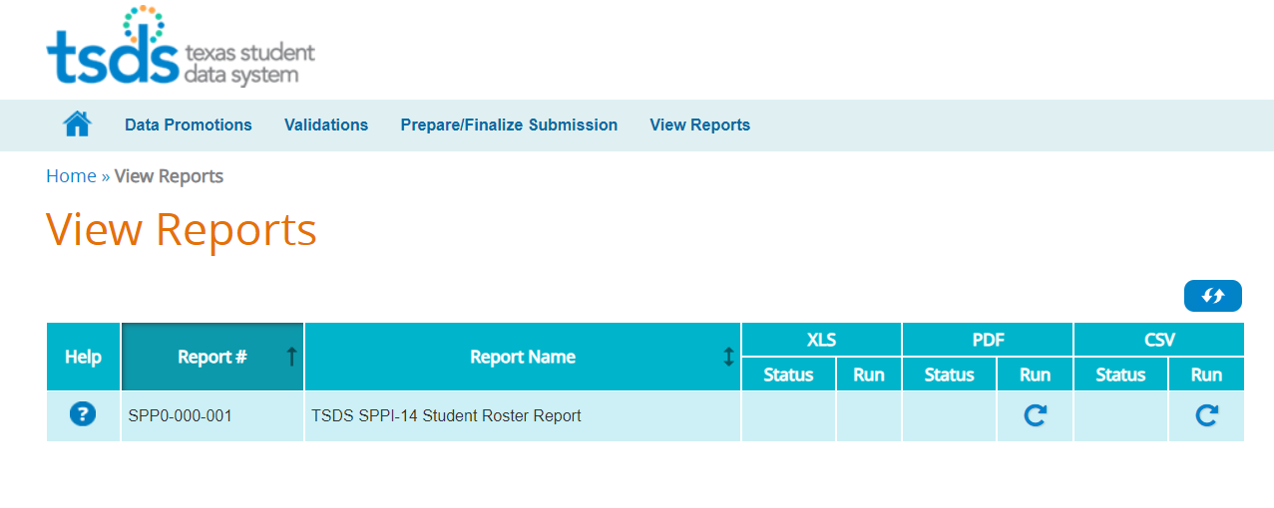
SPPI-14 REPORT
Notes:
There is only one report for SPPI-14. LEAs should review the report carefully for accuracy and completeness.

Slide 25
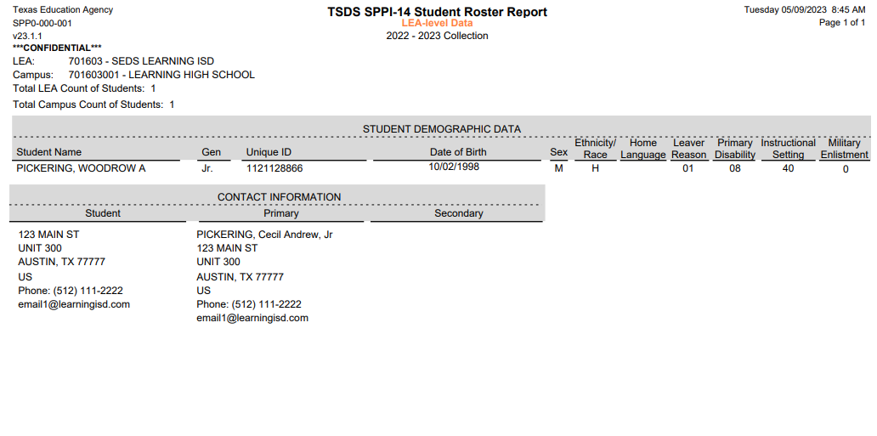
SPP0-000-001
TSDS SPPI-14 Student Roster Report (LEA level report)
2023-2024 Collection
98
Notes:
The SPPI-14 report will have a detailed listing for each student who was reported as receiving special education services in the prior school year and who have one of the five exit withdraw type codes.
The report shows some basic student demographic information.
The report shows the Leaver Reason Code for the student.
The report will list the parent information with address, phone number, and email address.
Adding Home Language to this report so third-party vendor can send the survey in the language spoken in the home. Only LanguageUse 01 (home language) will be promoted for SPPI-14. The survey for Woodrow will be sent in English since his home language is 98.

Slide 26
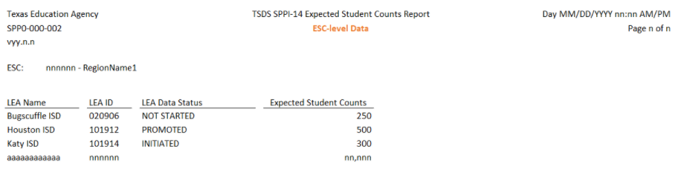
SPP0-000-002 – ESC REPORT
TSDS SPPI-14 Expected Student Counts Report
The SPP0-000-002 report will display the following:
  LEA Name
  LEA ID
  LEA SPPI-14 Submission Status – the current status of the LEA’s SPPI-14 data submission.
  Expected Student Counts – the number of students should match the number of students in the PEIMS current and prior data.
LEA SPPI-14 Submission Status
Notes:
NEW ESC and TEA level report.

Slide 27

TRAINING ACTIVITY
Practice, Troubleshooting, and Knowledge Checks

Slide 28
PRACTICE EXERCISE
Task 1: Promote SPPI-14 data.
Task 2: Monitor Data Promotions.
Ready
Set
Go

Slide 29
TROUBLESHOOTING 1
Scenario 1: Johnny was enrolled last year and received SPED services. His ExitWithdraw Type is 82.
Resolution Steps:
Johnny is not on the SPPI-14 report.
Verify Johnny’s ExitWithdrawType code.
Did Johnny withdraw because he was moving out of state?
Remember only 5 ExitWithdrawType codes are reported for SPPI-14 (01, 24, 88, 90, and 98)
Was Johnny enrolled at the LEA as of the last Friday in October in the current school year?

Slide 30
TROUBLESHOOTING 2
Scenario 2: Why am I not seeing any of my elementary and middle school students on the SPPI-14 report?
Resolution Steps:
No students are listed on my SPPI-14 report in grades PK-8.
SPPI-14 data is collected only for students in grades 9-12 in the previous school year.
Who received special education services and
  Who have one of the five ExitWithdrawType codes.

Slide 31
KNOWLEDGE CHECK 1
1. The function of the Approver role for all Core Collections (including SPPI-14) is to:
  Promote the data.
  Approve the submission.
  Request an extension.
  Validate the submission.
  Note: The Core Collections do not need to be Approved or Accepted. Once the Completer clicks the Complete button, the submission is finalized and goes to TEA.
Notes:
NOTE
To see the answer, you must be in presentation mode.

Slide 32
KNOWLEDGE CHECK 2
What is the following Fatal error informing the LEA?
“For a particular student, if information is promoted for more than one parent, the CONTACT PRIORITY must not be blank for any associated parents.”
  This is nothing to worry about, just ignore the fatal error.
  The student has no parents or guardians.
  The LEA failed to code/publish the contact priority on the student’s parents in their SIS.
  The student does not have a valid Student Unique ID number.
Notes:
NOTE
To see the answer, you must be in presentation mode.

Slide 33
KNOWLEDGE CHECK 3
3. SPPI-14 collects data for SPED students who are reported as prior year leavers. SPPI-14 will utilize data for students with any of the 19 leaver descriptor values on the C163 Descriptor Table in TEDS.
  True
  False
  Note: SPPI-14 only collects data for students with one of these five leaver codes:
  01 Graduated
  24 Withdrew to enroll in college to pursue associate’s or bachelor’s degree
  88 Court ordered to a GED program, has not earned GED
  90 Graduated from another state under provisions of the Interstate Compact on Educational Opportunity for Military Children
  98 Other
Notes:
NOTE
To see the answer, you must be in presentation mode.

Slide 34
KNOWLEDGE CHECK 4
4. The results of the SPPI-14 survey conducted by the third-party vendor will go to:
  The Local Education Agency
  TEA
  The Office of Special Education Programs at the U.S. Department of Education
  Local newspapers.
Notes:
NOTE
To see the answer, you must be in presentation mode.

Slide 35
KNOWLEDGE CHECK 5
5. The Student Home Language will be used by the third-party vendor when sending the survey so that they can send the survey in the language that is spoken in the student's home.
  True
  False
Notes:
NOTE
To see the answer, you must be in presentation mode.

Slide 36

WRAP UP
Key Takeaways, Resources, and Next Steps

Slide 37

KEY TAKEAWAYS
SPPI-14 data is submitted through TSDS.
Only LEAs having students who received Special Education services but did not return during the current school year will submit SPPI-14.
SPPI data is sent to a third-party vendor who then sends a survey to a random sampling of the students submitted by the LEA.
The survey results will be sent to Office of Special Education Programs at the U.S. Department of Education.
TRAINING RESOURCES
        Key Terms and Definitions
        SPPI-14 Reference Guide

Slide 38
TECHNICAL RESOURCES
Texas Education Data Standards Resources
    TSDS Web-Enables Data Standards (TWEDS)
TEA Website and Communication Resources
    SPPI-14 – TSDS website
    Email Special Education Division at TEA spp@tea.texas.gov
    Support Resources
    KB Articles
      TSDSKB-592 – SPPI-14 Promotion Questions
      TSDSKB-660 – TSDS Domain Dependency

Slide 39
NEXT STEPS
Attend Common Steps for Core Collection Training
  Complete a Teach Back Exercise
  Complete SPPI-14 Certification Test – Part 1
  Complete Core Collection Certification Test – Part 2
Attend TSDS Continuing Education Trainings (CET)
Participate in TSDS Just-in-Time Trainings (JIT)
Attend Field Coordination Network (FCN) webinars for updates and changes

Slide 40
WRAP UP
  In this training we talked about:
  The requirements for the State Performance Plan Indicator 14 (SPPI-14) Submission.
  The data that comprises the SPPI-14 Submission.
  How to promote SPPI-14 data.
  The TSDS reports for SPPI-14.

Slide 41

QUESTIONS

