Slide 1

TITLE SLIDE: TSDS ODS 3.x Project
Updates
SPECIAL EDUCATION DATA SYSTEM (SPEDS) SUMMER
State Performance Plan Indicator (SPPI) - 7
New User Certification Training

Slide 2
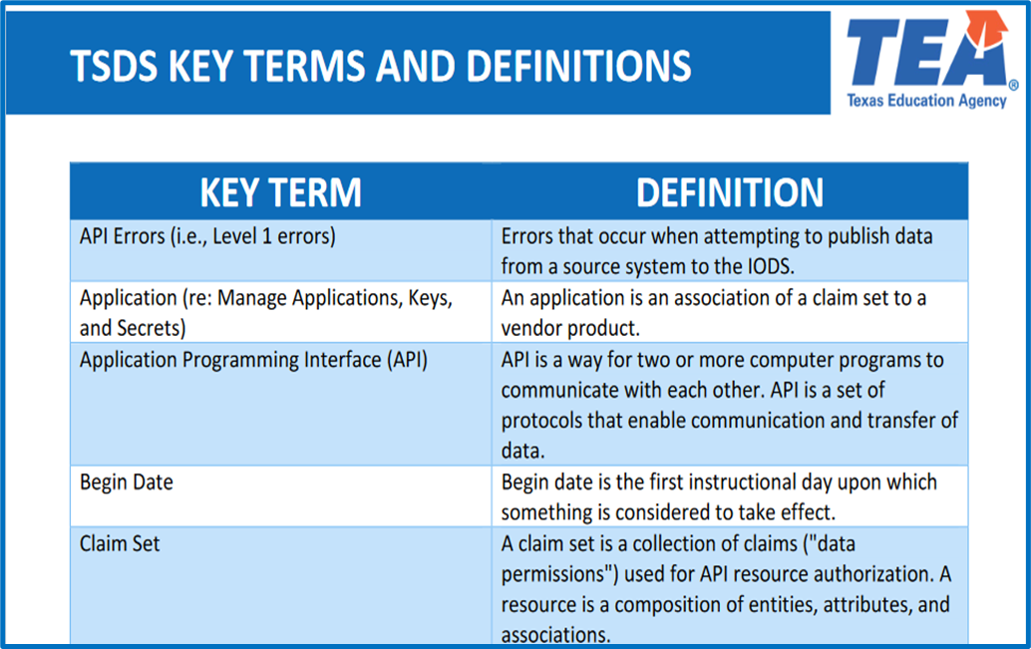
KEY TERMS
Please take a moment to familiarize yourself with common terminology by accessing the Key Terms and Definitions Document.
Access the Key Terms and Definitions Document.

Slide 3
LEARNING OBJECTIVES
By the end of this course, the users will be able to explain:
The federal and state requirements for SPPI-7 as part of the SPEDS Summer Submission.
The data elements required for SPPI-7 as part of the SPED Summer Submission.
The SPPI-7 reports in the SPEDS Summer Submission.

Slide 4
WHY IS THIS COURSE IMPORTANT
To understand that the United States Department of Education (USDE) requires accurate reporting of early childhood outcomes through SPPI-7 to ensure compliance with IDEA requirements.
To understand how children who meet SPPI-7 criteria are assessed at entry and exit in Early Childhood Special Education (ECSE) program, and how this data is reported in the SPEDS Summer Submissions.
To understand the data elements that are unique to the SPPI-7 indicator that will be included in the SPEDS Summer Submission.
Notes:
See slide.

Slide 5

COURSE AGENDA
Getting Started
Prerequisite Training Materials
Key Concepts
SPPI-7 Overview, Data Validations, and Reports
Training Activity
Troubleshooting and Knowledge Checks
Wrap Up
Key Takeaways, Resources, and Next Steps

Slide 6


GETTING STARTED
Prerequisite Training Materials

Slide 7
PREREQUISITE
Complete the ‘Introduction to TSDS SPEDS Summer’ training before completing this training.
The above prerequisite training provides the foundational knowledge needed for this training module.
Click Here to Access Training
Notes:
Please ensure learners complete the Introduction to TSDS SPEDS Summer training.

Slide 8


KEY CONCEPTS
SPPI-7 Overview, Measurements, Validations, and Reports

Slide 9
SPPI-7 BACKGROUND
SPPI-7 (Early Childhood Outcomes) measures the demonstrated improvement for preschool children aged 3-5 (not in kindergarten) with an Individual Education Program (IEP) who receive ECSE services for six months or more during the school year.
Improvement measurements will be reported for:
1. Positive Social-Emotional Skills
2. Acquisition and Use of Knowledge and Skills
3. Use of Appropriate Behaviors to Meet Needs

Slide 10
SPPI-7 STUDENTS
SPPI-7 students are preschool children aged 3-5 who are not yet in kindergarten that are being served through the ECSE program for six months or more between July 1 and June 30 of a given school year.
The LEA will evaluate the ECSE students when they enter the ECSE program and again when they exit the ECSE program to assess improvement.
SPPI-7 students will receive a rating on a scale of 1-7 based on criteria outlined in the Texas Education Data Standards via TWEDS when they enter the ECSE program and when they exit.

Slide 11
SPPI-7 SPECIFIC DATA ELEMENTS
Data Elements
E3098 – PreschoolOutcomesReporting
E3100 – ECSESocialEmotionalEntrySkillsRating
E3105 – ECSEExitSocialEmotionalNewSkills
E3104 – ECSESocialEmotionalExitSkillsRating
E3101 – ECSEKnowledgeEntrySkillsRating
E3107 – ECSEExitKnowledgeNewSkills
E3106 – ECSEKnowledgeExitSkillsRating
E3102 – ECSEAppropriateFunctioningEntrySkillsRating
E3109 – ECSEExitAppropriateFunctioningNewSkills
E3108 – ECSEAppropriateFunctioningExitSkillsRating
E3103 – ECSEServiceExitReason
Note: More information about the data elements can be found in the Texas Education Data Standards (TEDS) via the TSDS Web-Enabled Data Standards (TWEDS).
Notes:
TWEDS
Go to the TSDS website at https://www.texasstudentdatasystem.org
Hover over the TEDS Data Standards tab.
Next, click on ‘TWEDS Upgrade’
Finally, click on the “XXXX-XXXX Texas Education Data Standards via TWEDS” hyperlink.

Slide 12
ECSE REPORTING FOR SPPI-7
Student Exited from ECSE between 7/1 and 6/30 of the current school year
Student Served for AT LEAST 6 months
Student NOT Served for at least 6 months
LEA should report:
Student will trigger Special Warning 41163-0104.
Social Emotional E3100 E3104 E3105
Appropriate Functioning E3102
E3108 E3109
Knowledge
E3101
E3106 E3107
LEA should verify that the student was not served for at least 6 months.
Progress Measure Calculated
Progress Measure Calculated
Progress Measure Calculated
Notes:
Students who were not served for at least 6 months but who are reported with all the entry/exit ratings will trigger the Special Warning. Verify the data for the student. These students will not be included in the LEA’s SPPI-7 progress measure calculations.

Slide 13
SPPI-7 ENTRY/EXIT SKILLS RATING
ECSE entry and exit ratings will be reported for:
1. Positive Social-Emotional Skills (E3100)
2. Acquisition and Use of Knowledge and Skills (E3101)
3. Use of Appropriate Behaviors to Meet Needs (E3102)
Entry and exit skills ratings (C357) & (C359):
Descriptor | Short Description | Long Description*
01 | Not Yet | Child does not yet function in ways that would be considered age-expected or immediate foundational in this outcome area.
02 | Not Yet/Emerging | Child occasionally uses immediate foundational skills across settings and situations.
03 | Emerging | Child uses immediate foundational skills most of the time across settings and situations.
04 | Emerging/Somewhat | Child occasionally uses age-expected skills across settings and situations.
05 | Somewhat | Child functions using a mix of skills with more skills that are age-expected than not age-expected, across settings and situations.
06 | Somewhat/Completely | Child’s functioning generally is considered age-expected, but there are some significant concerns about the child’s functioning in this outcome area.
07 | Completely | Child functions in ways that are age-expected in all or most all everyday situations that are part of the child’s life.
Notes:
*Note – Review more details about the skills and the complete long descriptions in the Texas Education Data Standards via the TSDS Web-Enabled Data Standards (TWEDS).
Calculations are performed by TEA based on the entry and exit rating data the LEA sends and are reflected in the reports.
Note – TEA SPPI-7 website
Preschool Outcomes | Texas Education Agency

Slide 14
SPPI-7 MEASUREMENT
SPPI-7 measures the percent of preschool children aged 3 through 5 with Individualized Education Programs (IEPs) who demonstrate improved:
Positive social-emotional skills,
Acquisition and use of knowledge and skills, and
Use of appropriate behaviors to meet their needs.
The percentages are calculated based on the entry level evaluations and the exit level evaluations submitted in the SPEDS Summer Submission.
Notes:
For more information visit the TEA SPPI-7 website
Preschool Outcomes | Texas Education Agency

Slide 15

PROGRESS MEASURE 7A
7A Calculation - % not improving
Number of preschool children who did not improve functioning
Divided by
Number of preschool children with IEPs assessed
Multiplied by
100
Equals
% not improving functioning.
Notes:
Note – These calculations are performed by TSDS based on the data the LEA submits on the SPEDS Summer Submission and are reflected in the reports.
For more information visit the TEA SPPI-7 website
Preschool Outcomes | Texas Education Agency

Slide 16

PROGRESS MEASURE 7B
7B Calculation - % improved slightly
Number of preschool children who improved functioning but not sufficient to move nearer to functioning comparable to same-aged peers
Divided by
Number of preschool children with IEPs assessed
Multiplied by
100
Equals
% improved functioning but not sufficient to move nearer to functioning comparable to same-aged peers.
Notes:
Note – These calculations are performed by TSDS based on the data the LEA sends and are reflected in the reports.
Note – TEA SPPI-7 website
Preschool Outcomes | Texas Education Agency

Slide 17

PROGRESS MEASURE 7C
7C Calculation - % improved to near age level
Number of preschool children who improved functioning to a level nearer to same-aged peers
Divided by
Number of preschool children with IEPs assessed
Multiplied by
100
Equals
% improved functioning to a level nearer to same-aged peers.
Notes:
Note – These calculations are performed by TSDS based on the data the LEA sends and are reflected in the reports.
Note – TEA SPPI-7 website
Preschool Outcomes | Texas Education Agency

Slide 18

PROGRESS MEASURE 7D
7D Calculation - % improved to age level
Number of preschool children who improved functioning to reach a level comparable to same-aged peers
Divided by
Number of preschool children with IEPs assessed
Multiplied by
100
Equals
% improved functioning to reach a level comparable to same-aged peers.
Notes:
Note – These calculations are performed by TSDS based on the data the LEA sends and are reflected in the reports.
Note – TEA SPPI-7 website
Preschool Outcomes | Texas Education Agency

Slide 19

PROGRESS MEASURE 7E
7E Calculation - % maintained at age level
Number of preschool children who maintained functioning at a level comparable to same-aged peers
Divided by
Number of preschool children with IEPs assessed
Multiplied by
100
Equals
% maintained functioning at a level comparable to same-aged peers.
Notes:
Note – These calculations are performed by TSDS based on the data the LEA sends and are reflected in the reports.
Note – TEA SPPI-7 website
Preschool Outcomes | Texas Education Agency

Slide 20
SPEDS SUMMER VALIDATIONS

Slide 21
SPEDS SUMMER VALIDATIONS
SPPI-7 specific business validations such as:
10010-00025 – If an LEA reports that it does not have any eligible students in an early childhood special education (ECSE) program that meet the criteria for reporting SPPI-7 then this LEA must not report any students with entry or exit rating data in StudentSpecialEducationProgramAssociation, StudentEarlyChildhoodOutcomesEntrySet, or StudentSpecialEductionProgramAssociation StudentEarlyChildhoodOutcomesExitSet. (The PreschoolOutcomesReporting (E3098) will be TRUE if the LEA is not reporting any students for SPPI-7.)
41153-0107 – If ECSEServiceExitReason is applicable to the student being reported for SPPI-7, then age must be 3, 4, or 5.
41163-0108 – Students reported for SPPI-7 must not be reported with data resulting in a calculated value for Progress Measure equal to ‘na’. Verify this student’s values for entry skills ratings, exit skills ratings, and new skills to ensure they are a valid combination that leads to a valid progress measure.

Slide 22
SPEDS SUMMER REPORTS

Slide 23
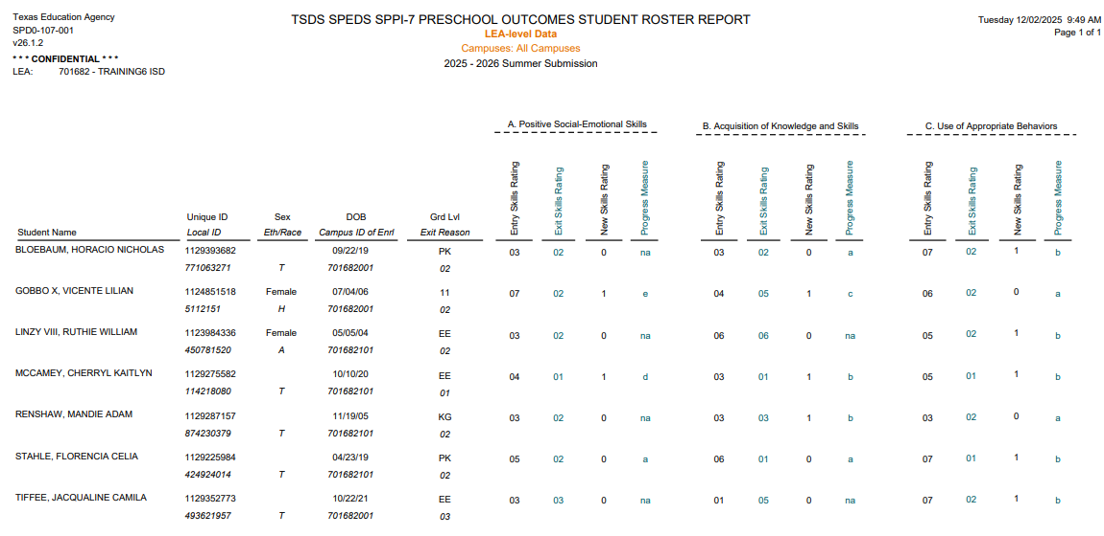
SPD0-107-001
Notes:
The SPPI-7 Preschool Outcomes Student Roster Report displays a roster of SPPI-7 student level data.
New Skills Rating indicates if the child has shown any new skills or behaviors since the LEA’s initial skills rating
Progress Measure score displays if the child has shown any progress during their time in the program. “a” = did not improve ; “b” = improved but not sufficient to move nearer to functioning comparable to same-aged peers; “c” = improved to a level nearer to same-aged peers but did not reach it; “d” = improved functioning to reach a level comparable to same-aged peers; “e” = maintained functioning comparable to same-aged peers; “na” is used for no data reported. (NA will trigger fatal error 41163-0108.)
The LEAs will use this report for review and documentation purposes.

Slide 24
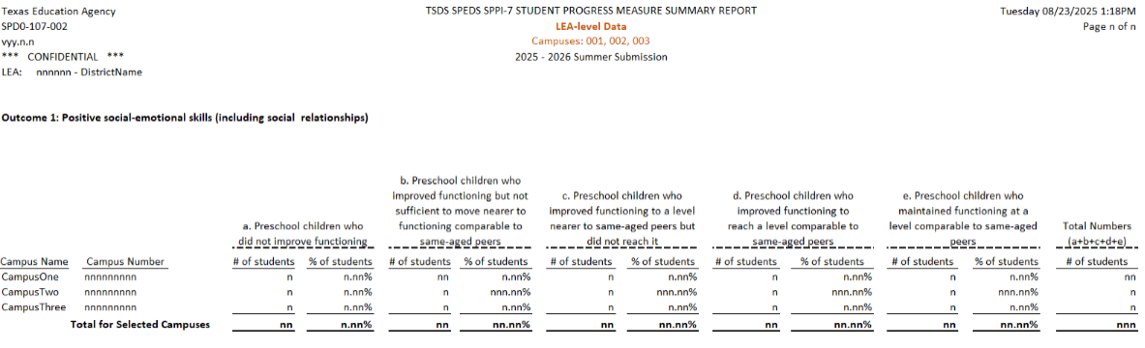
SPD0-107-002
Outcome 1: Positive Social-Emotional Skills
Outcome 2: Acquisition of Knowledge and Skills
Outcome 3: Use of Appropriate Behaviors
Notes:
The SPPI-7 Student Progress Measure Summary Report provides a summary of the student progress in the following areas by campus for the SPPI-7 students aged three through five years:
Positive social-emotional skills
Acquisition of Knowledge and skills
Use of appropriate behaviors
The LEAs will use this report to review and validate their data prior to completing the collection.
The Special Education Department will use the collected SPPI-7 data for federal reporting.

Slide 25

TRAINING ACTIVITY
Troubleshooting and Knowledge Checks

Slide 26
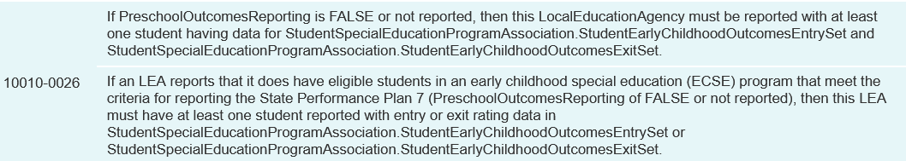
TROUBLESHOOTING
Scenario 1: Why am I getting this fatal error: 10010-0026
Resolution Steps:
Does the LEA have any students age 3-5 who are not in kindergarten who received ECSE services for at least 6 months during the school year.
Verify if the entry/exit ratings were entered in your local source system.
If both of the above prove to be valid, the entry for E3098 should be FALSE.
If the LEA does not have any students that meet the criteria for SPPI-7 reporting, E3098 should be TRUE.
The error occurs when the LEA reports the data element E3098 (PreschoolOutcomesReporting) as FALSE but does not report at least one student with entry/exit rating data for SPPI-7.

Slide 27
KNOWLEDGE CHECK 1
All students age 3-5 who are not yet in kindergarten and who have received ECSE services for at least 6 months during the current school year should be reported for SPPI-7.
True
False
Note: Each student should be reported with entry level ratings and exit level ratings for Positive Social-Emotional Skills, Acquisition and Use of Knowledge and Skills, and Use of Appropriate Behaviors to meet needs.
Notes:
NOTE
To see the answer, you must be in presentation mode.

Slide 28
KNOWLEDGE CHECK 2
The school year for the data reported for the SPPI-7 indicator is from September 1 through April 30.
True
False
Note: The school year for SPEDS Summer (including SPPI-7) begins on July 1 and goes through June 30. The SPEDS Summer Submission is due to TEA at the end of July.

Slide 29

WRAP UP
Key Takeaways, Resources, and Next Steps

Slide 30

KEY TAKEAWAYS
Students served through the ECSE program for at least 6 months and who are age 3-5 and not in kindergarten will be reported on the SPEDS Summer Submission for the SPPI-7 indicator.
The LEA will evaluate the ECSE students when they enter the ECSE program and again when they exit the ECSE program to assess improvement.
SPPI-7 data is submitted through TSDS as part of the SPEDS Summer Submission.
TRAINING RESOURCES
Key Terms and Definitions
SPEDS Summer Reference Guide

Slide 31
TECHNICAL RESOURCES
TEA SPPI-7 Website
Preschool Outcomes | Texas Education Agency
Texas Education Data Standards Resources
TSDS Web-Enabled Data Standards (TWEDS)
Notes:
TWEDS
•Go to the TSDS website at https://www.texasstudentdatasystem.org
•Hover over the TEDS Data Standards tab.
•Next, click on ‘TWEDS Upgrade’
•Finally, click on the “XXXX-XXXX Texas Education Data Standards via TWEDS” hyperlink.

Slide 32
NEXT STEPS
Complete a Teach Back Exercise
Complete SPEDS Summer Certification Test – Part 1
Complete Core Collection Certification Test – Part 2
Attend TSDS Continuing Education Trainings (CET)
Participate in TSDS Just-in-Time Trainings (JIT)
Attend Field Coordination Network (FCN) webinars for updates and changes

Slide 33
WRAP UP
In this training we talked about:
The federal and state requirements for SPPI-7 as part of the SPEDS Summer Submission.
The data elements required for SPPI-7 as part of the SPED Summer Submission.
The SPPI-7 reports in the SPEDS Summer Submission.

Slide 34

QUESTIONS

