Slide 1

TITLE SLIDE: TSDS ODS 3.x Project
Updates
SPECIAL EDUCATION DATA SYSTEM (SPEDS) SUMMER
State Performance Plan Indicator (SPPI) - 13
New User Certification Training

Slide 2
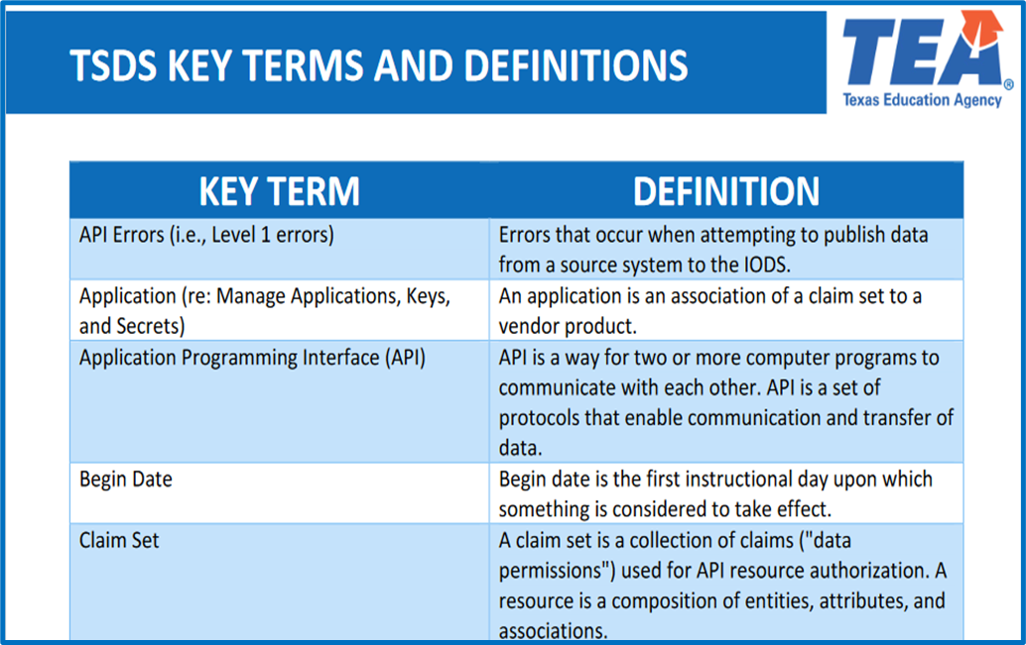
KEY TERMS
Please take a moment to familiarize yourself with common terminology by accessing the Key Terms and Definitions Document.
Access the Key Terms and Definitions Document.

Slide 3
LEARNING OBJECTIVES
By the end of this course, the users will be able to explain:
The federal and state requirements for SPPI-13 as part of the SPEDS Summer Submission.
The data elements required for SPPI-13 as part of the SPEDS Summer Submission.
The SPPI-13 reports in the SPEDS Summer Submission.

Slide 4
WHY IS THIS COURSE IMPORTANT
To understand that United States Department of Education (USDE) requires that IDEA Part B (SPPI-13) secondary transition data be reported with completeness and accuracy, and that the federal target is 100% compliance with IDEA requirements.
To learn how to correctly complete the SPPI-13 checklist and avoid common data submission errors.
To understand the data elements that are unique to the SPPI-13 indicator that will be included in the SPEDS Summer Submission.
Notes:
See slide.

Slide 5

COURSE AGENDA
Getting Started
Prerequisite Training Materials
Key Concepts
SPPI-13 Overview, Data Validations, and Reports
Training Activity
Troubleshooting and Knowledge Checks
Wrap Up
Key Takeaways, Resources, and Next Steps

Slide 6


GETTING STARTED
Prerequisite Training Materials

Slide 7
PREREQUISITE
Complete the ‘Introduction to TSDS SPEDS Summer’ training before completing this training.
The above prerequisite training provides the foundational knowledge needed for this training module.
Click Here to Access Training
Notes:
Please ensure learners complete the Introduction to TSDS SPEDS Summer training before attending this new user training for SPPI indicators 13. In this session, we will cover SPPI-13 indicator, which are part of the TSDS SPEDS Summer Submission.

Slide 8


KEY CONCEPTS
SPPI-13 Overview, Calculations, Validations, and Reports

Slide 9
SPPI-13 BACKGROUND
While Texas law requires transition planning to begin at age 14 (19 Texas Administrative Code §89.1055), the federal State Performance Plan Indicator (SPPI)-13 specifically measures the percentage of youth with individualized education programs (IEPs) aged 16 and older who have appropriate transition planning documented in their IEPs. Therefore, for federal reporting purposes, SPPI-13 only includes students age 16 and above, while state requirements mandate transition planning to begin at age 14.

Slide 10
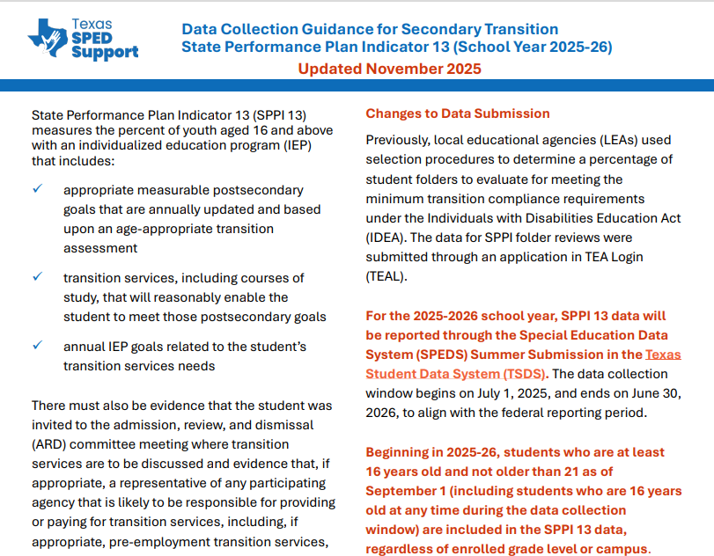
DATA COLLECTION GUIDANCE
Access the Data Collection Guidance for Secondary Transition.
Notes:
ESC Region trainer should take the time to review the guidance from this document in detail.

Slide 11
SPPI-13 SPECIFIC DATA ELEMENTS
Data Elements
E3110 – SecondaryTransitionARDMeetingDate
E3099 – SecondaryTransitionIEPReviewDate
E3111 – MeasurableSecondaryGoals
E3112 – UpdatedSecondaryGoals
E3113 – TransitionAssessment
E3114 – IEPTransitionServices
E3115 – CourseStudySecondaryGoals
E3116 – TransitionServiceNeeds
E3117 – ARDInvitedStudent
E3118 – ARDInvitedRepresentative
Note: More information about the data elements can be found in the Texas Education Data Standards (TEDS) via the TSDS Web-Enabled Data Standards (TWEDS).
Notes:
TWEDS
Go to the TSDS website at https://www.texasstudentdatasystem.org
Hover over the TEDS Data Standards tab.
Next, click on ‘TWEDS Upgrade’
Finally, click on the “XXXX-XXXX Texas Education Data Standards via TWEDS” hyperlink.

Slide 12
SPPI-13 VALIDATIONS
SPPI-13 specific business validations such as:
10010-0031 – If an LEA reports that it does not have any eligible students that meet the criteria for reporting the State Performance Plan 13 (SecondaryTransitionReporting of TRUE), then this LEA must not have any students reported with StudentSpecialEducationProgramAssociation.StudentSecondaryTransitionSet data.
10010-0032 – If an LEA reports that it does have eligible students that meet the criteria for reporting the State Performance Plan 13 (SecondaryTransitionReporting of FALSE or not reported), then this LEA must have at least one student reported with StudentSpecialEducationProgramAssociation.StudentSecondaryTransitionSet data.

Slide 13
SPPI-13 CALCULATION

Slide 14
SPPI-13 MEASURES
State Performance Plan Indicator (SPPI)-13 measures the percent of youth with individualized education programs (IEPs) aged 16 and above that includes:
Appropriate measurable postsecondary goals that are annually updated and based upon an age-appropriate transition assessment;
Transition services, including courses of study, that will reasonably enable the student to meet those postsecondary goals; and
Annual IEP goals related to the student's transition services needs.
There must be evidence of the following:
The student was invited to the admission, review, and dismissal (ARD) committee meeting where transition services are to be discussed.
A representative of any participating agency that is likely to be responsible for providing or paying for transition services was invited to the ARD meeting with the prior consent of the parent or student who has reached the age of majority.
Notes:
For more information visit the TEA SPPI-13 website
Secondary Transition | Texas Education Agency

Slide 15
SPPI-13 CHECKLIST
Questions | Checklist
Question 1 | Are there appropriate measurable postsecondary goals in the areas of training, education, employment, and, where appropriate, independent living skills?
Question 2 | Are the postsecondary goals updated annually?
Question 3 | Is there evidence that the measurable postsecondary goals were based on age-appropriate transition assessment(s)?
Question 4 | Are there transition services in the IEP that will reasonably enable the student to meet his or her postsecondary goals?
Question 5 | Do the transition services include courses of study that will reasonably enable the student to meet his or her postsecondary goals?
Question 6 | Is (are) there annual IEP goal(s) related to the student’s transition service needs?
Question 7 | Is there evidence that the student was invited to the ARD committee meeting where transition services were discussed?
Question 8 | If appropriate, is there evidence that a representative of any participating agency was invited to the ARD committee meeting with the prior consent of the parent or student who has reached the age of majority?

Slide 16
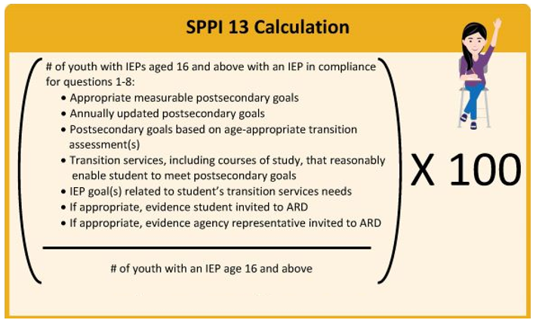
COMPLIANCE CALCULATION

Slide 17
SPEDS SUMMER REPORTS

Slide 18
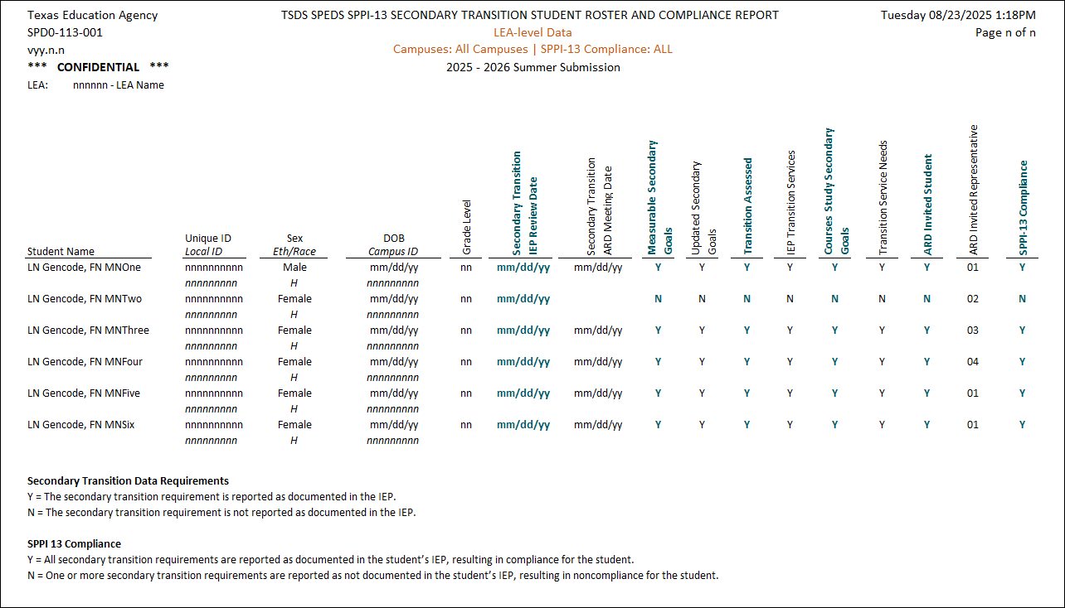
SPD0-113-001
Notes:
SPD0-113-001 – SPPI-13 Secondary Transition Student Roster and Compliance Report – this report can be generated at the Campus, LEA, or ESC Region level.
The SPPI-13 Secondary Transition Student Roster and Compliance Report displays a roster and compliance results of the SPPI-13 students.
Secondary transition refers to the planned and coordinated process of preparing Students aged 16 through 21 to successfully achieve their post-secondary goals.

Slide 19
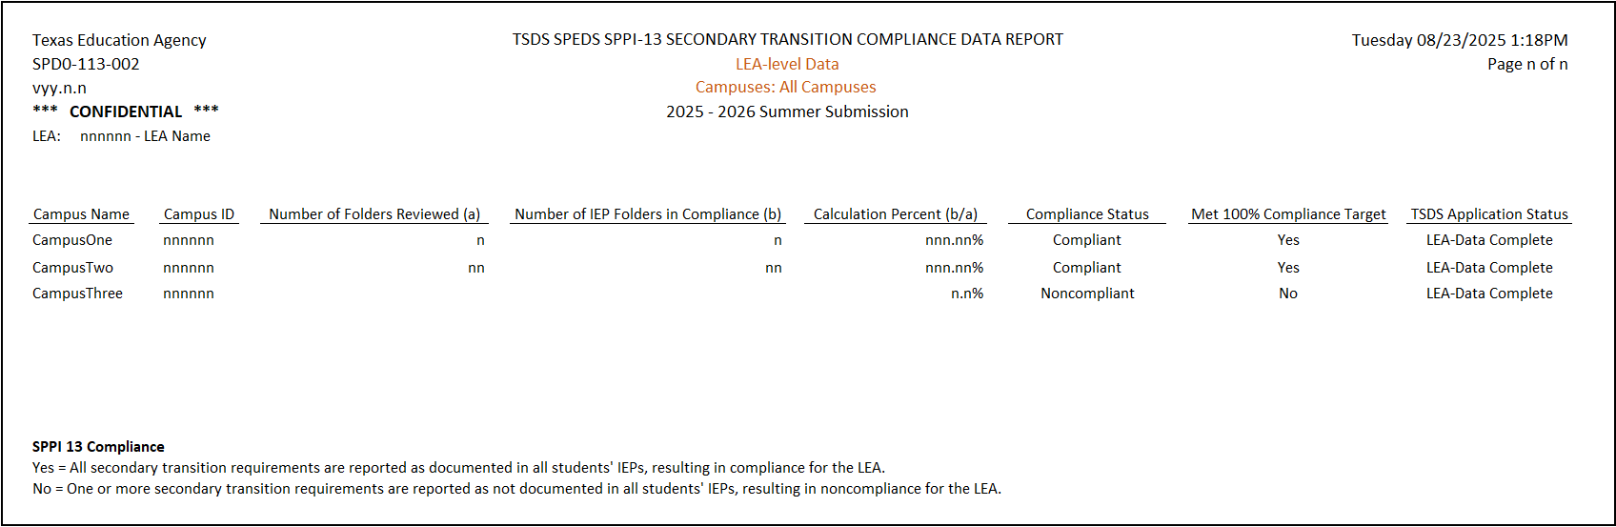
SPD0-113-002
Notes:
SPD0-113-002 – SPPI-13 Secondary Transition Compliance Data Report – this report can be generated at the Campus, LEA, or ESC Region level.
The SPPI-13 Secondary Transition Compliance Data Report displays a summary of the data reported for each LEA submitting SPPI-13.

Slide 20

TRAINING ACTIVITY
Troubleshooting and Knowledge Checks

Slide 21
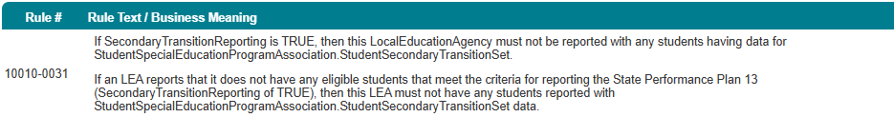
TROUBLESHOOTING
Scenario 1: Why am I getting this fatal error: 10010-0031
Resolution Steps:
The error occurs when you report the data element E3128 (SecondaryTransitionReportin) as TRUE, but you have at least one student who meets the criteria for reporting SPPI-13.
Determine if the LEA has any students to report based on the criteria for SPPI-13.
If not, then the Boolean value for E3128 should be changed to TRUE/No.

Slide 22
KNOWLEDGE CHECK 1
Which report displays a roster and compliance results for SPPI-13 students at the campus, LEA, or ESC region level?
SPD0-113-001 Secondary Transition Student Roster and Compliance Report
SPD0-113-002 Secondary Transition Compliance Data Report
SPPI-13 Data Element Report
Notes:
NOTE
To see the answer, you must be in presentation mode.

Slide 23
KNOWLEDGE CHECK 2
For SPPI-13 compliance, the IEP must include measurable postsecondary goals, transition services, and annual IEP goals related to the student’s transition service needs.
True
False

Slide 24
KNOWLEDGE CHECK 3
What is the formula for calculating SPPI-13 compliance percentage?
(Number of youth with IEPs age 16+ in compliance / Total number of youth with IEPs age 16+) × 100
(Number of youth with IEPs age 14+ in compliance / Total number of youth with IEPs age 14+) × 100
(Number of youth with transition services / Total number of youth in the district) × 100

Slide 25
KNOWLEDGE CHECK 4
Which of the following is NOT required for SPPI-13 compliance in a student’s IEP?
Evidence the student was invited to the ARD committee meeting
Annual IEP goals related to transition service needs
Parent signature on every transition assessment

Slide 26
KNOWLEDGE CHECK 5
SPPI-13 federal reporting only includes students aged 16 and above, even though Texas law requires transition planning to begin at age 14.
True
False

Slide 27

WRAP UP
Key Takeaways, Resources, and Next Steps

Slide 28

KEY TAKEAWAYS
State Performance Plan Indicator (SPPI)-13 measures the percent of youth with individualized education programs (IEPs) aged 16 and above.
Reminder: The IEP should include measurable postsecondary goals, transitions services, and annual IEP goals related to the student’s transition services needs.
SPPI-13 data is submitted through TSDS as part of the SPEDS Summer Submission.
TRAINING RESOURCES
Key Terms and Definitions
SPEDS Summer Reference Guide

Slide 29
TECHNICAL RESOURCES
TEA SPPI-13 Website
Secondary Transition | Texas Education Agency
Texas Education Data Standards Resources
TSDS Web-Enabled Data Standards (TWEDS)
Notes:
TWEDS
Go to the TSDS website at https://www.texasstudentdatasystem.org
Hover over the TEDS Data Standards tab.
Next, click on ‘TWEDS Upgrade’
Finally, click on the “XXXX-XXXX Texas Education Data Standards via TWEDS” hyperlink.

Slide 30
NEXT STEPS
Complete a Teach Back Exercise
Complete SPEDS Summer Certification Test – Part 1
Complete Core Collection Certification Test – Part 2
Attend TSDS Continuing Education Trainings (CET)
Participate in TSDS Just-in-Time Trainings (JIT)
Attend Field Coordination Network (FCN) webinars for updates and changes

Slide 31
WRAP UP
In this training we talked about:
The federal and state requirements for SPPI-13 as part of the SPEDS Summer Submission.
The data elements required for SPPI-13 as part of the SPEDS Summer Submission.
The SPPI-13 reports in the SPEDS Summer Submission.

Slide 32

QUESTIONS

