Slide 1

Special Education Data System (SPEDS) Summer
State Performance Plan Indicator (SPPI) - 11 & 12
New User Certification Training
Notes:
Prerequisite Training
Prior to this course, leaners should have completed:
TSDS Overview and Key Concepts
Provides foundational information about TSDS.
Common Steps for Core Collections
Explains the process for preparing and finalizing the TSDS SPEDS Summer Submission in the Core application, including:
High-level overview of TWEDS and TIMS
Running and accessing Level 2 validations in the DMC
3. Introduction to SPEDS Summer Submission
Next Steps After This Training: Participants will explore the following topics:
SPPI-7
SPPI-13

Slide 2
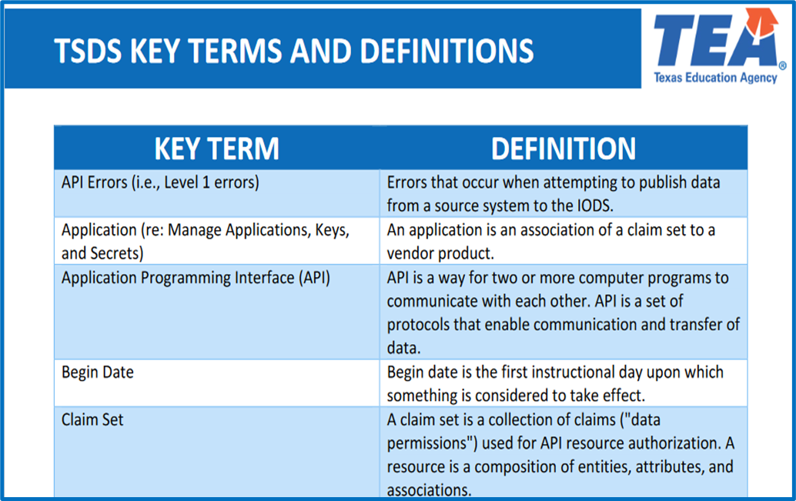
KEY TERMS
Please take a moment to familiarize yourself with common terminology by accessing the Key Terms and Definitions Document.
Access the Key Terms and Definitions Document.

Slide 3
LEARNING OBJECTIVES
  By the end of this course, the users will be able to explain:
  The federal and state compliance requirements for SPPI-11 and 12 indicators.
  The purpose and importance of submitting SPPI-11 and 12 data for IDEA compliance.
  The data elements required for SPPI-11 and 12 in the SPEDS Summer Submission.
  The SPPI-11 & 12 reports in the SPEDS Summer Submission.
2

Slide 4
WHY IS THIS COURSE IMPORTANT
To understand that the United States Department of Education (USDE) requires that IDEA Part B (SPPI-11) and Part C (SPPI-12) data be reported with completeness and accuracy, and that the federal target is 100% compliance with IDEA requirements.
To understand the state-established timeframes for an LEA to evaluate and determine special education services to remain in compliance for SPPI-11 and 12.
To understand the data elements that are unique to SPPI-11 and 12 indicators that will be included in the SPEDS Summer Submission.
3

Slide 5

COURSE AGENDA
Getting Started
Prerequisite Training Materials
Key Concepts
SPPI-11 & 12 Overview, Validations, and Reports
Training Activity
Troubleshooting and Knowledge Checks
Wrap Up
Key Takeaways, Resources, and Next Steps
4

Slide 6


GETTING STARTED
Prerequisite Training Materials

Slide 7
PREREQUISITE
Complete the ‘Introduction to TSDS SPEDS Summer’ training before completing this training.
  The above prerequisite training provides the foundational knowledge needed for this training module.
Click here to Access Training
Notes:
Please ensure learners complete the Introduction to TSDS SPEDS Summer training before attending this new user training for SPPI indicators 11 and 12.
In this session, we will cover SPPI-11 and SPPI-12 indicators, which are part of the TSDS SPEDS Summer Submission.
NOTE: SPPI-11 and 12 were previously part of the TSDS Child Find submission, which is no longer collected. It has been replaced by TSDS SPEDS Summer, which now includes indicators 11, 12, 7, and 13.

Slide 8


KEY CONCEPTS
SPPI-11 & 12 Overview, Validations, and Reports

Slide 9
SPPI-11 BACKGROUND
The Individuals with Disabilities Education Act (IDEA) is a federal mandate. It requires local education agencies (LEAs), which include public school districts and charter schools, to identify, locate, and evaluate all children with disabilities residing within their jurisdictions who need special education and related services.

Slide 10
SPPI-11
SPPI-11A: Full and Individual Initial Evaluation (FIIE)
SPPI-11B: Eligibility Determination (ED)

Slide 11
SPPI-11 SPECIFIC DATA ELEMENTS
Data Elements
    Unique to SPPI-11:
      E1711 EvaluationDelayDays
    Reported for both SPPI-11 and 12
      E1738 ConsentToEvaluationReceivedDate
      E1715 EligibilityEvaluationDate
      E1718 EvaluationDelayReason
      E1716 EligibilityDeterminationDate
      E1717 IDEAIndicator
Note: More information about the data elements can be found in the Texas Education Data Standards (TEDS) via the TSDS Web-Enabled Data Standards (TWEDS).
Notes:
Review the Texas Education Data Standards (TEDS) via the TSDS Web-Enabled Data Standards (TWEDS) for more information.

Slide 12

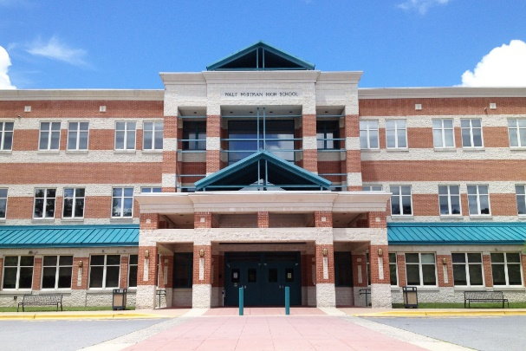


SPPI-11A: FIIE
If not within 45 Instructional days, must report E1718 EVALUATION-DELAY-REASON
SPPI-11
LEA receives parental consent to evaluate a child for special education services
(E1738 – ConsentToEvaluation
ReceivedDate)
LEA has 45 Instructional Days to complete FIIE starting the first instructional after the consent to evaluate is received.
If LEA completes FIIE within 45 Instructional Days, then LEA is in compliance for SPPI-11.
(E1715 – EligibilityEvaluationDate)
If not within 45 instructional days, must report (E1718) EvaluationDelayReason
Notes:
SPPI-11A: Full and Individual Initial Evaluation
Ages 3–21
Measures whether the Full and Individual Initial Evaluation (FIIE) is completed on time after parental consent is received.

Slide 13
SPPI-11A: FIIE (EXCEPTIONS)
Exception # 1: If there are more than or equal to 45 or less than 35 instructional days from end of school year and the student has 3 or more absences, then FIIE must be completed within 45 instructional days + number of days absent.
  Exception # 2: If there are less than 45 but more than or equal to 35 instructional days left in school year and the student has less than 3 absences, then FIIE must be completed by June 30th.
  Exception # 3: If there are less than 45 but more than or equal to 35 instructional days left in school year and the student has 3 or more absences, then FIIE must be completed within 45 instructional days + number of days absent.
SPEDS Summer Interactive Flow Chart
Notes:
The Child Find Interactive Flow Chart for SPPI-11 & 12 will be updated to TSDS SPEDS Summer submission. The information in the flow chart is still relevant and can be used to determine compliance/compliance outcomes for SPPI-11 and 12.

Slide 14

SPPI-11B: ED
FIIE
Eligibility Determination
LEA has 30 Calendar Days to complete eligibility determination starting the date after the completed FIIE.
If LEA completes eligibility determination within 30 calendar days, then LEA is in compliance for eligibility determination.
(E1716 - EligibilityDeterminationDate)
After FIIE is completed, LEA must complete the eligibility determination for the child.
If not within 30 calendar days, must report (E1731) EligibilityDelayReason
Notes:
SPPI-11B: Eligibility Determination
Ages 3–21
Measures if the ARD (Admission, Review, and Dismissal) committee determines eligibility for special education services on time after evaluation is completed.

Slide 15
SPPI-11B: ED (EXCEPTIONS)
Exception # 1: If a student’s Eligibility Determination period falls during the Summer, then LEA must complete the Eligibility Determination by 15th instructional day of the next school year.
Exception # 2: If there are less than 45 but more than or equal to 35 days left in school year and the student has less than 3 absences, then FIIE must be completed by June 30th.
  Eligibility Determination must be completed by the 15th instructional day of the next school year.
SPEDS Summer Interactive Flow Chart

Slide 16
SPPI-12 BACKGROUND
Refers to children who are referred from Part C of IDEA prior to age 3, found eligible for Part B of IDEA, and have an individualized education plan (IEP) developed and implemented by their third birthday to receive early childhood special education (ECSE) services at an LEA.

Slide 17
SPPI-12 SPECIFIC DATA ELEMENTS
Data Elements
    Unique to SPPI-12:
      E1737 OriginalECIServicesDate
      E1712 TransitionNotificationDate
      E1713 TransitionConferenceDate
    Reported for both SPPI-11 and 12
      E1717 IDEAIndicator
      E1731 EligibilityDelayReason
Note: More information about the data elements can be found in the Texas Education Data Standards (TEDS) via the TSDS Web-Enabled Data Standards (TWEDS).

Slide 18
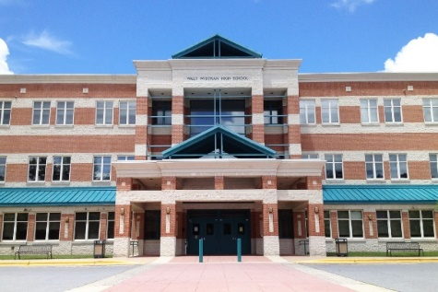
SPPI-12
SPPI-12
Was the child receiving Early Childhood Intervention (ECI) services for at least 90 days prior to their 3rd birthday?
(E1737 – OriginalECIServices
Date)
LEA receives parental consent to evaluate the child for special education services
(E1738 – ConsentToEvaluation ReceivedDate)
LEA must complete evaluation and eligibility determination by child’s 3rd birthday.
If LEA completes evaluation and eligibility determination by child’s 3rd birthday, then LEA is in compliance for SPPI-12.
(E1715 – EligibilityEvaluationDate)
(E1716 – EligibilityDeterminationDate)

Slide 19
SPPI-12 (EXCEPTIONS)
Standard Timeframe: LEA must complete the evaluation and eligibility determination by child’s 3rd birthday.
  If in ECI for less than 90 days prior to child’s 3rd birthday, a student’s compliance calculation would fall under the SPPI-11 criteria.
SPEDS Summer Interactive Flow Chart

Slide 20
SPEDS SUMMER VALIDATIONS

Slide 21
SPEDS SUMMER VALIDATIONS
  SPEDS Summer includes business validations such as:
    41163-0085 - If SPPI-11 Compliance (calculated value) is "Y", then EvaluationDelayReason must be either not reported, "05", or "07".
    41163-0086 - If SPPI-11 Compliance (calculated value) is "N", then EvaluationDelayReason must be reported and must not be "05" or "07".
    41163-0087 - If SPPI-12 Initial Evaluation Compliance (calculated value) is "Y", then EvaluationDelayReason must be either not reported, "05", or "07".
    41163-0088 - If SPPI-12 Initial Evaluation Compliance (calculated value) is "N", then EvaluationDelayReason must be reported and must not be "05" or "07".
20
Notes:
If LEA uses delay codes “05” or “07”, these are considered acceptable delays and will show ‘Y’ for SPPI-11 - FIIE compliance.
05- Parent Delay (Detailed Records Maintained By LEA Regarding A Parent Of A Child Who Repeatedly Fails Or Refuses To Produce The Child For The Evaluation Or Eligibility Determination)
07 - LEA Agreement With Parent To Timeframe (Detailed Records Maintained By LEA)

Slide 22
SPEDS SUMMER REPORTS

Slide 23
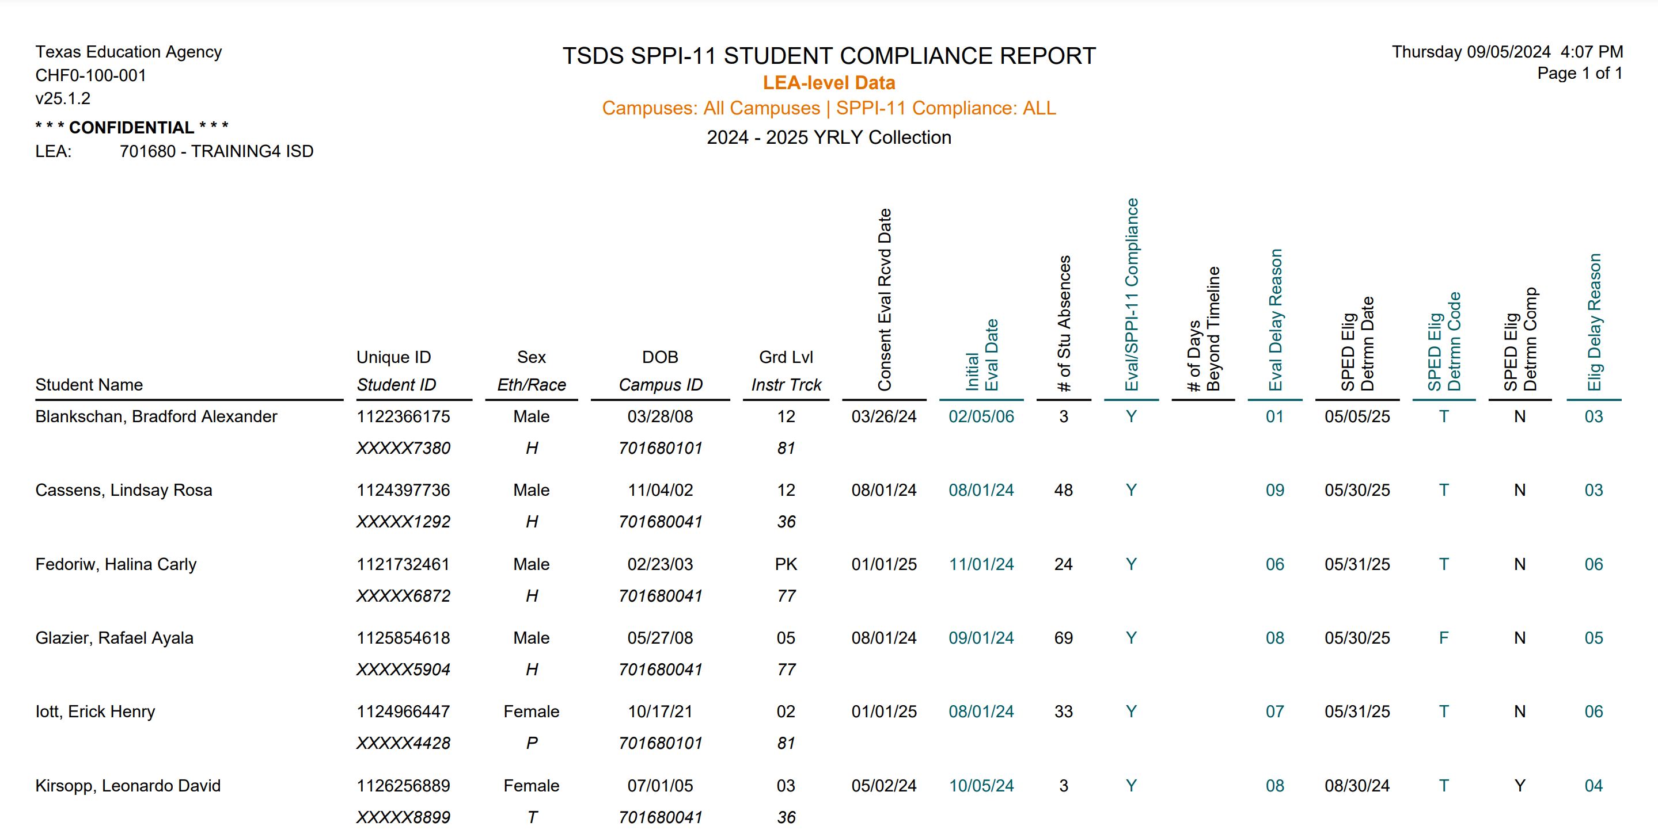

SPD0-111-001
SPPI-11
This report shows students ages 3-21 who have been identified to be in/out of compliance for initial evaluation and eligibility determination.

Slide 24
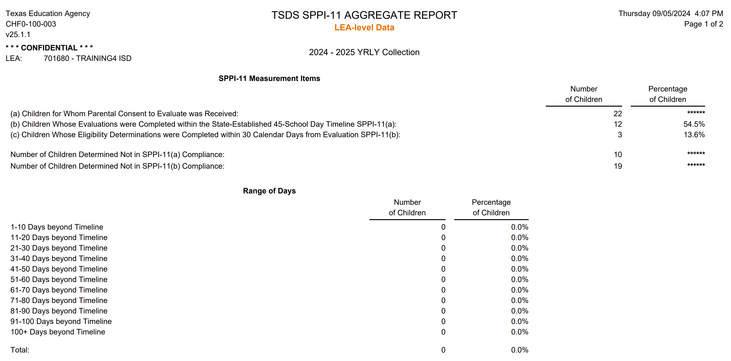
SPD0-111-002 (PAGE 1 of 2)
This report provides the 'Range of Days,' which includes aggregated counts for students whose Evaluation and Eligibility Determination surpassed the state-established timelines for SPPI-11a (45 school days) and SPPI-11b (30 calendar days).

Slide 25
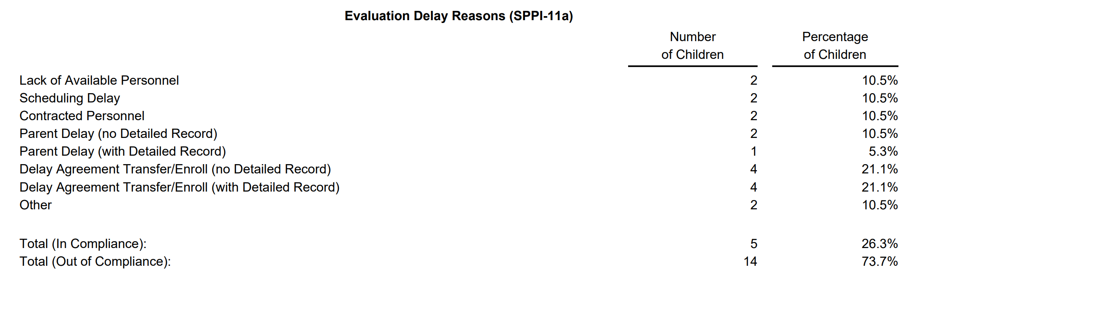
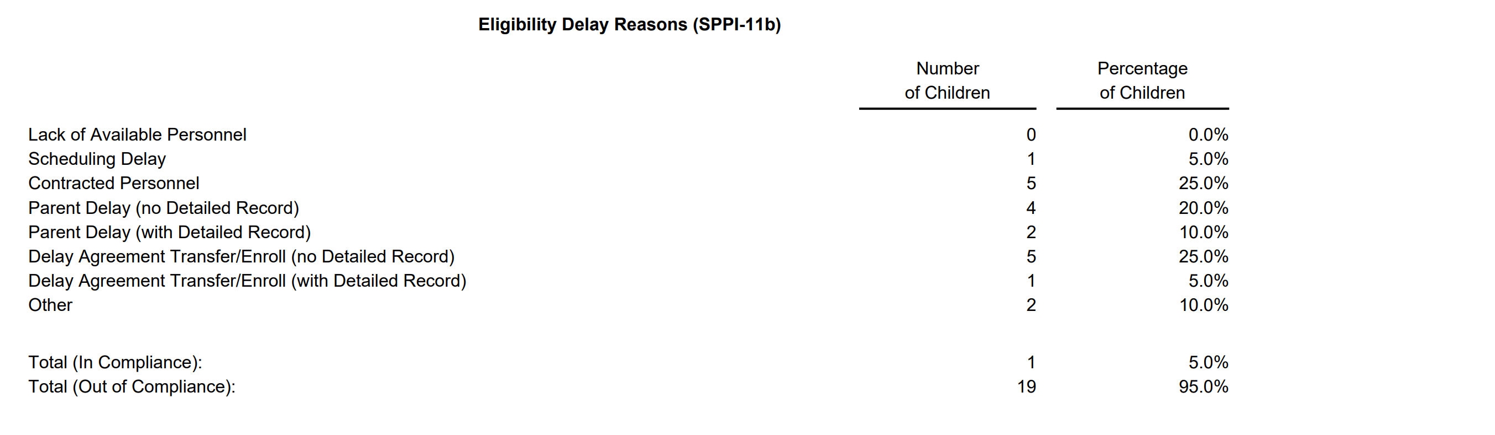
SPD0-111-002 (PAGE 2 of 2)
The ‘Evaluation Delay Reasons’ are aggregated counts for students for whom the evaluation was not completed within the state-established timeline for SPPI-11a.
The ‘Eligibility Delay Reasons’ are aggregated counts for students for whom the Eligibility Determination was not completed within the state-established timeline for SPPI-11b.

Slide 26
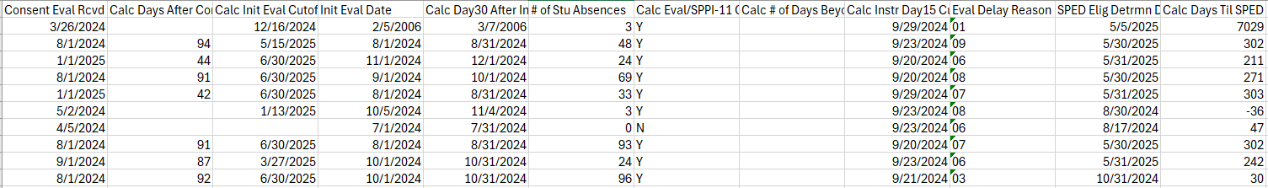
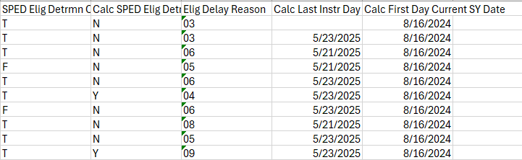
SPD0-111-003
This report includes calculations performed by the TSDS Core application to assist LEAs with troubleshooting compliance-related issues.
This report only available in CSV format.

Slide 27
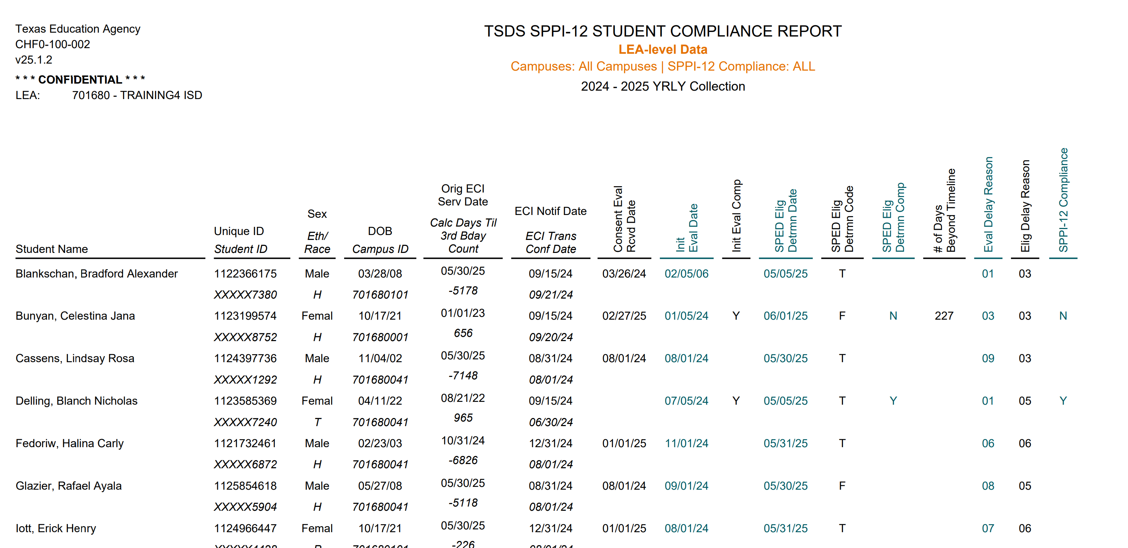
SPD0-112-001
This report shows children under the age of 3 who have been identified as being either in or out of compliance for initial evaluation and/or eligibility determination.

Slide 28
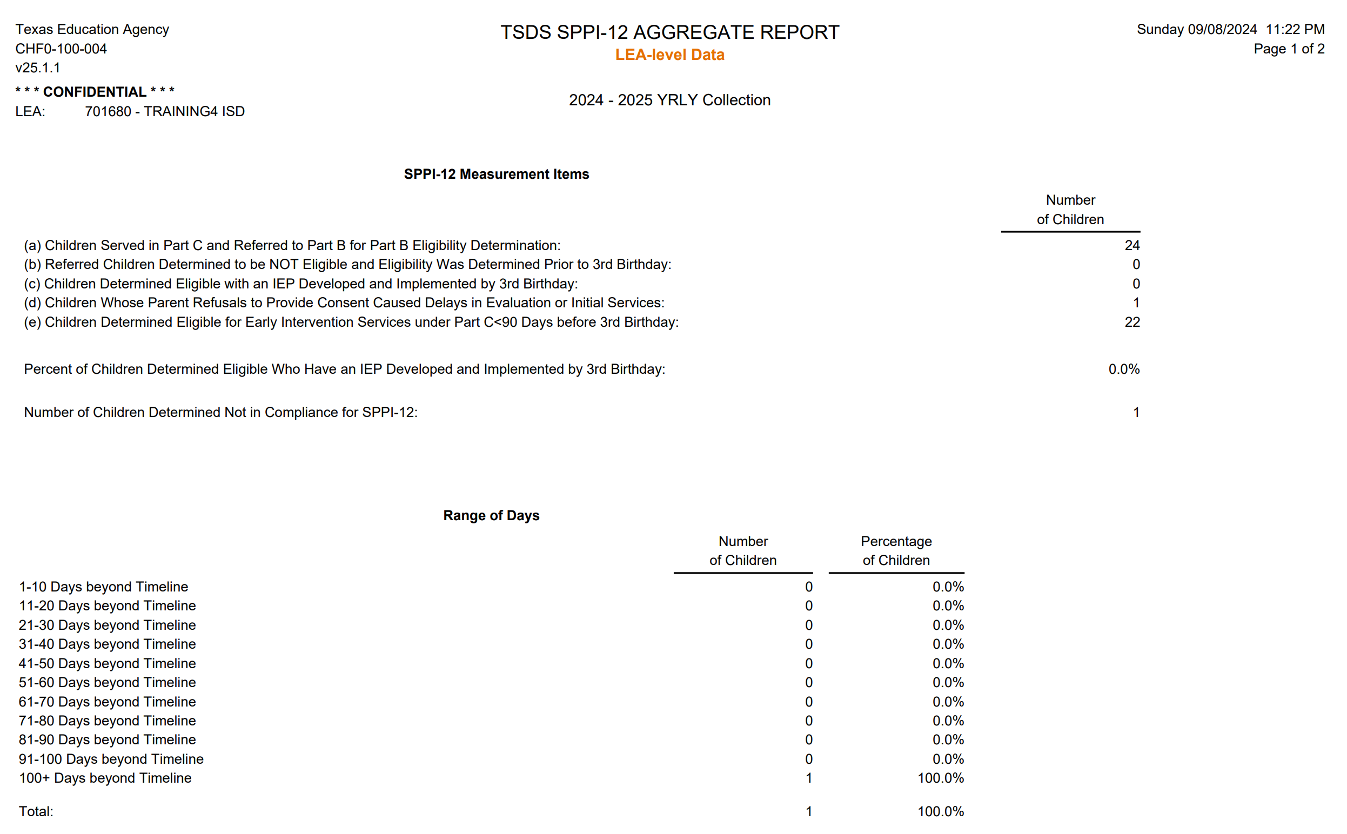
SPD0-112-002 (PAGE 1 of 2)
The ‘Range of Days’ are aggregated counts for students for whom the initial evaluation and/or eligibility determination was beyond the state-established timeline for SPPI-12.

Slide 29
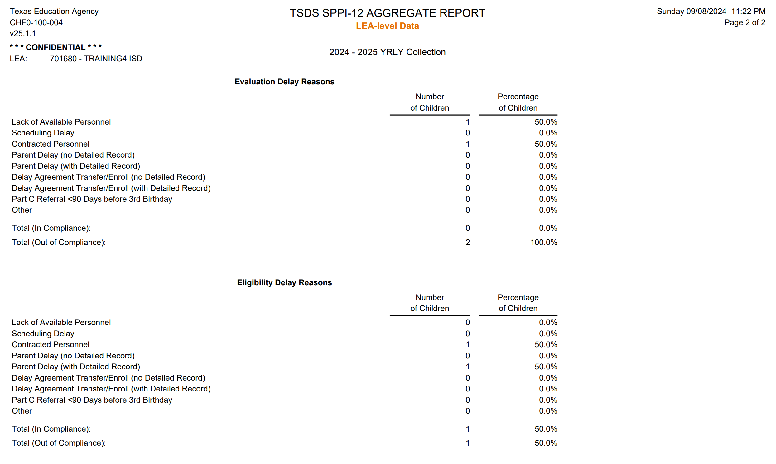
SPD0-112-002 (PAGE 2 of 2)
The ‘Evaluation Delay Reasons’ are aggregated counts for students for whom the evaluation was not completed within the state-established timeline for SPPI-12.
The ‘Eligibility Delay Reasons’ are aggregated counts for students for whom the eligibility determination was not completed within the state-established timeline for SPPI-12.

Slide 30

TRAINING ACTIVITY
Troubleshooting and Knowledge Checks

Slide 31
TROUBLESHOOTING 1
Resolution Steps:
Scenario 1: Which SPPI-11A: FIIE exception does this scenario fall under?
A student is referred for a FIIE in April. There are 40 instructional days left in the school year, and the student has 4 absences. What is the deadline for completing the FIIE?
This falls under Exception #3 because:
  There are less than 45 but more than or equal to 35 instructional days left,
  The student has 3 or more absences.
  Therefore, the FIIE must be completed within 45 instructional days + number of days absent.

Slide 32
TROUBLESHOOTING 2
Scenario 2: A student is referred from ECI less than 90 days prior to their 3rd birthday. What timeframe does the LEA have to complete the student’s evaluation and eligibility determination.
Resolution Steps:
The student would be considered a SPPI-11 student in this scenario since they were referred from ECI to the LEA less than 90 days prior to their third birthday and fall under the SPPI-11 timeframes.
The LEA has 45 instructional days to complete the student’s initial evaluation and 30 calendar days to finalize the eligibility determination.
SPPI-11 Student Compliance Report:
  Review the report to ensure it displays the student’s basic information along with their compliance/non-compliance results for the initial evaluation and eligibility determination.
SPPI-12 Student Compliance Report:
  Confirm that this report shows only the student’s basic information.
Cross-check both reports to ensure that all information for the student appears correctly and consistently on both reports.

Slide 33
KNOWLEDGE CHECK 1
What component(s) of SPPI-11 are used in calculating SPPI-11 compliance:
  FIIE and Eligibility Determination
  Eligibility Determination
  Full and Initial Individual Evaluation (FIIE)
  None of the above
Notes:
NOTE: To see the answer, you must be in presentation mode.

Slide 34
KNOWLEDGE CHECK 2
SPPI-11 refers to the timely evaluation of students, ages 3-21 for special education services under part B of IDEA (Individual Disabilities Education Act)
  True
  False
Notes:
NOTE: To see the answer, you must be in presentation mode.

Slide 35
KNOWLEDGE CHECK 3
For SPPI-11, generally what is the state established timeframe on the number of days an LEA has to complete a Full and Initial Individual Evaluation (FIIE) for a student starting the day after the LEA receives parental consent?
  30 Instructional Days
  15 Instructional Days
  45 Instructional Days
  45 Calendar Days
Notes:
NOTE: To see the answer, you must be in presentation mode.

Slide 36
KNOWLEDGE CHECK 4
For SPPI-11, generally what is the state established timeframe on the number of days an LEA has to complete eligibility determination for a student starting the day after the FIIE is completed.
  30 Instructional Days
  30 Calendar Days
  45 Instructional Days
  45 Calendar Days
Notes:
NOTE: To see the answer, you must be in presentation mode.

Slide 37
KNOWLEDGE CHECK 5
SPPI-12 refers to children who are referred from Early Childhood Intervention (ECI) prior to age 3 to the LEA who may be potentially eligible for special education services and need to have an IEP (Individualized Education Plan) developed and implemented by their third birthday to receive early childhood special education (ECSE) services at their LEA.
  True
  False
Notes:
NOTE: To see the answer, you must be in presentation mode.

Slide 38
KNOWLEDGE CHECK 6
For a SPPI-12 student who has been receiving ECI services for more than 90 days, generally what is the state established timeframe on the number of days an LEA has to complete an Evaluation and Eligibility Determination for a student?
  LEA has 45 Instructional Days prior to the child’s 3rd birthday to complete evaluation and eligibility determination.
  LEA has 30 Calendar Days prior to the child’s 3rd birthday to complete evaluation and eligibility determination.
  LEA must complete evaluation and eligibility determination prior to child’s 3rd birthday
Notes:
NOTE: To see the answer, you must be in presentation mode.

Slide 39
KNOWLEDGE CHECK 7
If a child is referred from ECI less than 90 days before their third birthday, which SPPI indicator applies?
  SPPI-12
  SPPI-11
  SPPI-13
  SPPI-7
Notes:
NOTE: To see the answer, you must be in presentation mode.

Slide 40

WRAP UP
Key Takeaways, Resources, and Next Steps

Slide 41

KEY TAKEAWAYS
SPPI-11 and 12 data is submitted in TSDS through the SPEDS Summer Submission.
For SPPI-11A, an LEA has 45 Instructional Days to complete FIIE starting the first instructional after the consent to evaluate is received.
SPPI-11B, an LEA has 30 Calendar Days to complete Eligibility Determination starting the date after the completed FIIE.
For SPPI-12, an LEA must complete initial evaluation and eligibility determination by child’s third birthday.
TRAINING RESOURCES
        Key Terms and Definitions
        SPEDS Summer Reference Guide
        Reference Guide for Unique ID Assignment

Slide 42
TECHNICAL RESOURCES 1
TEA Website and Communication Resources
    SPPI -11
    SPPI -12
SPEDS Program Area Support:
    spp@tea.texas.gov (SPP contact for Data, Measurement, Guidance)
Texas Education Data Standards Resources
    Texas Education Data Standards (TEDS)
Notes:
TSDS Web-Enabled Data Values (TWEDS)
Review the Texas Education Data Standards (TEDS) via the TSDS Web-Enabled Data Standards (TWEDS) for more information.

Slide 43
TECHNICAL RESOURCES 2
    Support Resources
    KB Articles
      TSDSKB-620 Child Find: SPPI-11 Compliance Flow Chart
      TSDSKB-621 Child Find: SPPI-12 Compliance Flow Chart
      TSDSKB-622 Child Find: Child Find Frequently Asked Questions
      TSDSKB-645 Child Find: SPPI-12 Frequently Asked Questions
      TSDSKB-646 Child Find: SPPI-11 Frequently Asked Questions
      TSDSKB-650 Child: Child Find Interactive Flowchart
Notes:
This slide provides a list of KB articles for SPPI-11 and SPPI-12, which were formerly known as Child Find. These KB articles will be updated to SPEDS Summer, and the field will be notified via the Field Coordination Network (FCN).

Slide 44
NEXT STEPS
  Complete a Teach Back Exercise
  Complete SPEDS Summer Certification Test
  Complete Core Collection Certification Test
Attend TSDS Continuing Education Trainings (CET)
Participate in TSDS Just-in-Time Trainings (JIT)
Attend Field Coordination Network (FCN) webinars for new updates and changes

Slide 45
WRAP UP
  In this training we talked about:
  The requirements for SPPI-11 & 12 in the SPEDS Summer Submission.
  The data elements required for SPPI-11 & 12 in the Summer Submission.
  The SPPI-11 & 12 reports in the SPEDS Summer Submission.

Slide 46

QUESTIONS

