Slide 1

Special Education Data System (SPEDS) Summer Introduction to SPEDS Summer
New User Certification Training
Notes:
This is an introductory course designed for ESCs and LEAs. It provides a basic overview of the TSDS SPEDS Summer Submission process.
Prerequisite Training
Before taking this course, participants should complete:
TSDS Overview and Key Concepts Provides foundational information about TSDS.
Common Steps for Core Collections Explains the process for preparing and finalizing the SPEDS Summer Submission in the Core application, including:
High-level overview of TWEDS and TIMS
Running and accessing Level 2 validations in the DMC
Next Steps After This Training: Introduction to SPEDS Summer Submission (This course)
Participants will explore the following topics:
SPPI-11 & 12
SPPI-7
SPPI-13

Slide 2




TRAINING MATERIALS
 | Introduction to TSDS SPEDS Summer | SPPI Indicators: 11 & 12 | SPPI Indicator: 7 | SPPI Indicator: 13
Getting Started | TSDS Architecture TEAL Roles Promotion Demo | Refer to Introduction to SPEDS Summer Training.
Key Concepts | TSDS SPEDS Summer Submission Overview | Includes indicator-specific requirements, validations, and reports.
Training Activity | Knowledge Checks | Includes troubleshooting guidance and knowledge checks.
Wrap-Up | Key Takeaways Resources Next Steps | Includes indicator-specific key takeaways, resources and next steps.
Click here to access training
Click here to access training
Click here to access training
Click here to access training
Notes:
This slide provides a high-level overview of training materials designed to help ESCs support and train their LEA staff.
These resources ensure LEA staff can meet federal and state requirements for SPPI indicators and transition smoothly from TSDS Child Find to TSDS SPEDS Summer submission.
Training Materials: We’ve created four decks:
Introduction to SPEDS Summer – Start here. This deck explains the shift from Child Find to SPEDS Summer and provides essential context before diving into indicators.
Three SPPI Indicator Decks – Each focuses on a specific indicator, allowing ESCs to customize training for LEA SPED staff based on their responsibilities.
(Some staff may handle one indicator, others multiple. Use these materials flexibly to meet your LEA’s needs.)

Slide 3
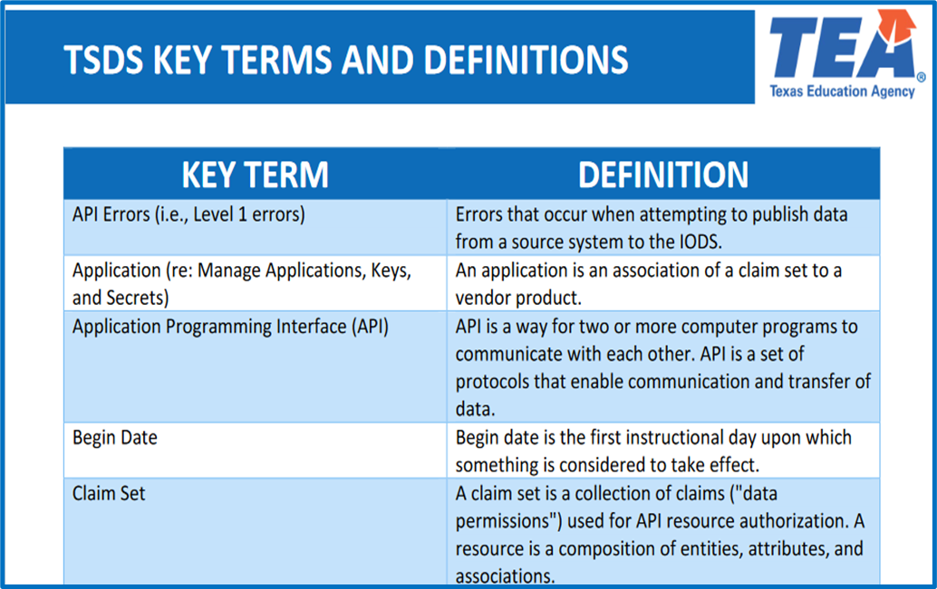
KEY TERMS
Please take a moment to familiarize yourself with common terminology by accessing the Key Terms and Definitions Document.
Access the Key Terms and Definitions Document.
3

Slide 4
LEARNING OBJECTIVES
By the end of this course, the users will be able to:
Use SPEDS Summer training materials effectively.
Explain the TSDS High-level Architecture.
Describe TEAL Roles for SPEDS Summer.
Understand the background and purpose of the SPEDS Summer Submission.
Explain LEA roles and responsibilities in the SPEDS Summer Submission.

Slide 5
WHY IS THIS COURSE IMPORTANT
To understand that all LEAs are required to submit SPEDS Summer data for State Performance Plan Indicators (SPPI) 7, 11, 12, and 13 as these are mandated by the United States Department of Education (USDE) under the Individuals with Disabilities Act (IDEA).

Slide 6

COURSE AGENDA
Getting Started
TSDS Architecture, TEAL Roles and Promotion Demo
Key Concepts
TSDS SPEDS Summer Submission Overview
Training Activity
Knowledge Checks
Wrap Up
Key Takeaways, Resources, and Next Steps

Slide 7


GETTING STARTED
TSDS Architecture, TEAL Roles and Promotion Demo

Slide 8
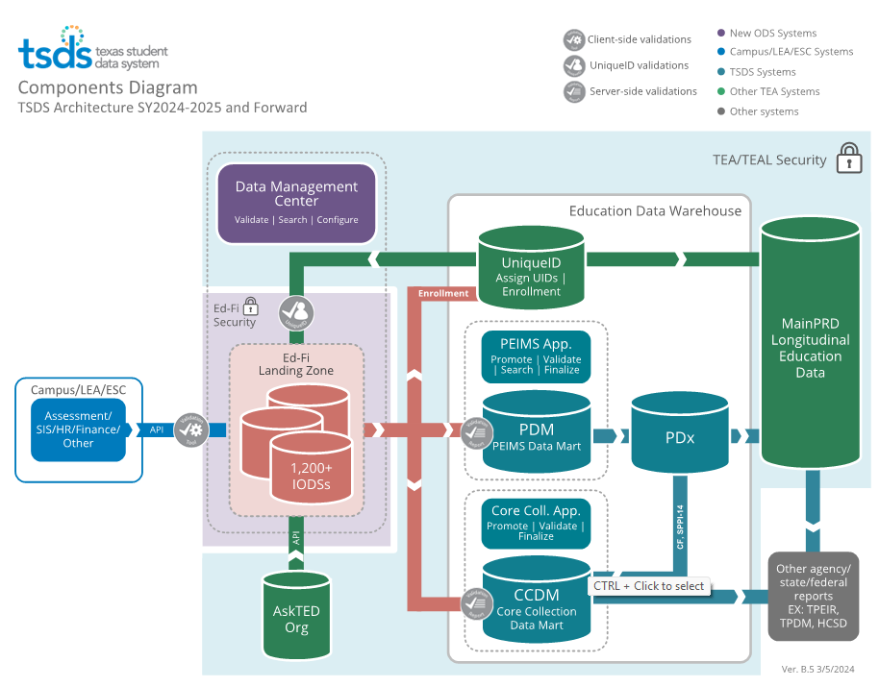
TSDS ARCHITECTURE

Slide 9
LEA TEAL ROLES - SPEDS SUMMER
Core LEA Data Viewer
This role monitors data promotions and data validations and generates reports.
Core LEA Data Promoter
This role schedules and monitors promotions, schedules and monitors validations, and generates reports.
Core LEA Data Completer
This role formally certifies the completeness and accuracy of the data and finalizes the submission. In addition, this role also schedules and monitors promotions, schedules and monitors validations, and generates reports.
Core LEA Data Approver
This role will be for the superintendent or his/her designee at the LEA. This role requests an extension if needed.
Notes:
Note:
The role the LEA staff would request will depend on the individual’s level of responsibility.
The existing TSDS Core roles will be used for the SPEDS Summer Submission.
No new TEAL roles will be added for the SPEDS Summer Submission.
Users who currently have the ‘Child Find Access’ privilege will not need to reapply for access to SPEDS Summer.

Slide 10
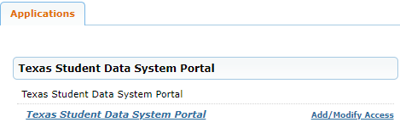
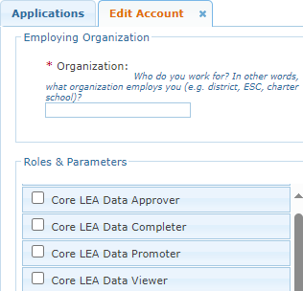
APPLY FOR SPEDS SUMMER ROLE
Login to your TEAL account; Click Add/Modify Access.
Enter your Employing Organization and select the appropriated Core LEA TEAL role.

Slide 11
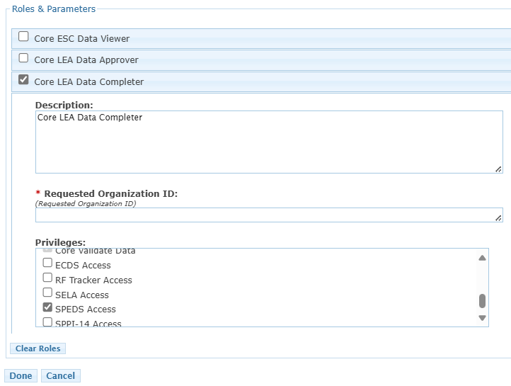
SPEDS SUMMER TEAL ROLE & PRIVILEGE
Users will check the appropriate role based on their level of responsibility at the LEA and in the Requested Organization ID enter their Organization ID.
Next, check the Privilege “SPEDS Access” and click Done.
The final step is to click Save Changes on the next screen.
Notes:
Check ‘SPEDS Access’ under the Privileges.

Slide 12
ESC ROLE FOR SPEDS
Core ESC Data Viewer
This role will be able to view and monitor SPEDS Summer activity in TSDS for the LEAs the ESC supports.
Notes:
Note:
The ESC Data Viewer role will allow the ESC to monitor the data promotions for SPEDS Summer for the LEAs in their region.

Slide 13
PROMOTION DEMO
Login to TEAL Account
Navigate to the Core Collections Application
Promote SPEDS Summer data
Monitor data promotion
NOTE: The Reference Guide (RG) is a resource that provides step-by-step instructions for Promoting, Validating, and Completing the SPEDS Summer Submission.
SPEDS Summer Reference Guide

Slide 14


KEY CONCEPTS
TSDS SPEDS Summer Submission Overview
Notes:
In this section we will cover the following:
IDEA/SPPI/Background
LEA Roles & Responsibilities
SPEDS Summer Training Materials/Resources
Timeline
Domain Definitions
Categories/Subcategories
Levels of Validations
Unique ID

Slide 15

BACKGROUND
IDEA
(Individuals with Disabilities Education Act)
IDEA Requirements: Annual federal reporting via State Performance Plan/ Annual Performance Report
State Performance Plan (SPP): Framework of indicators to measure performance and compliance
Applicable Indicators:
SPPI 7 Preschool Outcomes
SPPI 11A/B Initial Evaluation & Eligibility Determination
SPPI 12 Early Childhood Transition
SPPI 13 Secondary Transition
Notes:
Under IDEA, each state must submit a State Performance Plan (SPP) and an Annual Performance Report (APR) to the U.S. Department of Education. These reports include data on 17 indicators that measure outcomes for students with disabilities.
The State Performance Plan Indicators (SPPI) are part of the SPP/APR. This course focuses on:
SPPI-7: Early Childhood Outcomes
SPPI-11: Initial Evaluation Timelines (formerly Child Find)
SPPI-12: Early Childhood Transition (formerly Child Find)
SPPI-13: Secondary Transition

Slide 16




SPPI INDICATORS OVERVIEW
Indicator | Age Groups Served | What It Measures (Purpose) | What It Focuses On | Federal/State Reporting
SPPI-7 Preschool Outcomes | Ages 3–5 (not in kindergarten) | Measures how many children improve in key developmental areas after receiving Early Childhood Special Education (ECSE) services. | Social-emotional skills, learning and knowledge, and appropriate behavior to meet individual needs. | Federal Performance Indicator Target: varies by outcome measured
SPPI-11A Timely Initial Evaluation | Ages 3–21 | Measures if the Full and Individual Initial Evaluation (FIIE) is completed on time after parental consent is received. | FIIE completed within 45 school days (with some specified exceptions). | Federal Compliance Indicator Target: 100%
SPPI-11B Eligibility Determination | Ages 3–21 | Measures if the ARD committee determines eligibility for special education services on time after evaluation is completed. | Eligibility decision within 30 calendar days after FIIE (with some specified exceptions). | State Compliance Indicator Target: 100%
SPPI-12 Early Childhood Transition | Ages 0–3 | Measures if children referred from Part C are evaluated, found eligible, and have an IEP by age 3. | Evaluation, eligibility, and an IEP must be in place by age 3 as children transition from IDEA Part C (SPPI-12) to Part B (SPPI-11). | Federal Compliance Indicator Target: 100%
SPPI-13 Secondary Transition | Ages 16–21 | Measures if youth with IEPs age 16 or older have appropriate secondary transition planning documented in their IEPs. | IEPs contain secondary transition requirements. | Federal Compliance Indicator Target: 100%
Notes:
Performance Indicator (SPPI-7):
SPPI-7: Early Childhood Outcomes
Children aged 3–5 years (not in kindergarten) receiving ECSE services for 6+ months during the school year. Data collected at exit from ECSE.
Purpose:
Tracks improvement in developmental areas after ECSE services:
Social-emotional skills
Knowledge and skills acquisition
Appropriate behaviors
_________________________________________________________________________________________
Compliance Indicators (SPPI-11 & 12, 13):
Indicator under IDEA; states report annually for compliance and effectiveness.
LEA must maintain 100% for all indicators; otherwise, Corrective Action Plan is required.
____
SPPI-11A: Timely Initial Evaluation
Age: 3–21
Measure: FIIE completed within 45 school days after parental consent (exceptions apply)
SPPI-11B: Eligibility Determination
Age: 3–21
Measure: ARD committee determines eligibility within 30 calendar days after FIIE (exceptions apply)
____
SPPI-12: Early Childhood Transition
Age: 0–3
Measure: Children referred from Part C evaluated, found eligible, and have an IEP by age 3
____
SPPI-13: Secondary Transition
Age: 16–21
Measure: Youth with IEPs have coordinated, measurable goals and transition services
Requirement: IEPs include secondary transition components

Slide 17
WHY COMPLIANCE MATTERS
Any LEA that is not in compliance for the SPPI indicators 11, 12, and 13 (excluding SPPI-7) will be monitored by the Division of Special Education Monitoring at TEA.
For non-compliance, the LEA will submit the following in their Corrective Action Plan (CAP):
*Evidence of Self-Monitoring
*Evidence of Systemic Correction
*Evidence of Training
*Evidence of Revised Policies and
Procedures
*Evidence of Student Specific
Correction
Non-compliance for any of the SPPI indicators 11, 12, and 13 must be corrected no more than one year from identification.
Office of Special Education Programs - Questions and Answers (OSEP QA 23-01).
Notes:
LEAs will complete this process outside of TSDS, as they did for Child Find (SPPI-11 and SPPI-12).

Slide 18
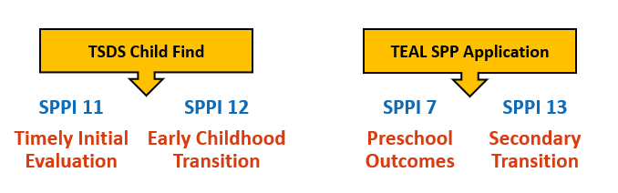
THEN VS. NOW
Different timelines and platforms for different indicators
(Historical)
TSDS SPEDS Summer Submission
(2025 - 2026)
Notes:
Challenge: Two platforms with different timelines caused confusion, duplicate work, and inconsistent data.
Indicators were split between two platforms, each with its own submission timelines and procedures.
This fragmentation led to confusion, duplicate data entry, and extra work to maintain consistency.
For example, the Child Find TSDS submission (Indicators 11 & 12) might have a different due date than the TEAL SPP submission (Indicators 7 & 13).
Solution: TEA is moving to a unified collection for all indicators.

Slide 19
KEY BENEFITS
One System for All Indicators: All four SPPI indicators are now reported through the TSDS system, eliminating the need for multiple systems.
Aligned Timeline: There is now a unified reporting period and submission deadline for all indicators. Submission schedule is the same for all four indicators.
Simplified Access: Only one TEAL role with ‘SPEDS Access’ privilege is required to access and submit data for all indicators.
Direct API Publishing: Data flows automatically from LEA source systems to TSDS via API, reducing manual steps.
Improved Data Quality: TSDS includes built-in business rules and validations to catch errors before the submission is completed and submitted to TEA.
Together, these benefits streamline SPPI reporting, improve data accuracy, and reduce the burden on LEAs.
Notes:
Key Benefits of the Unified System:
Unified Platform – All four SPPI indicators reported through TSDS.
Aligned Timeline – One reporting period and deadline for all indicators.
Improved Data Quality – Built-in business rules and validations catch errors early.
Direct API Publishing – LEAs can automatically send data from source systems to TSDS.
Simplified Access – Only one TEAL role (SPEDS Access privilege) needed for all indicators.

Slide 20
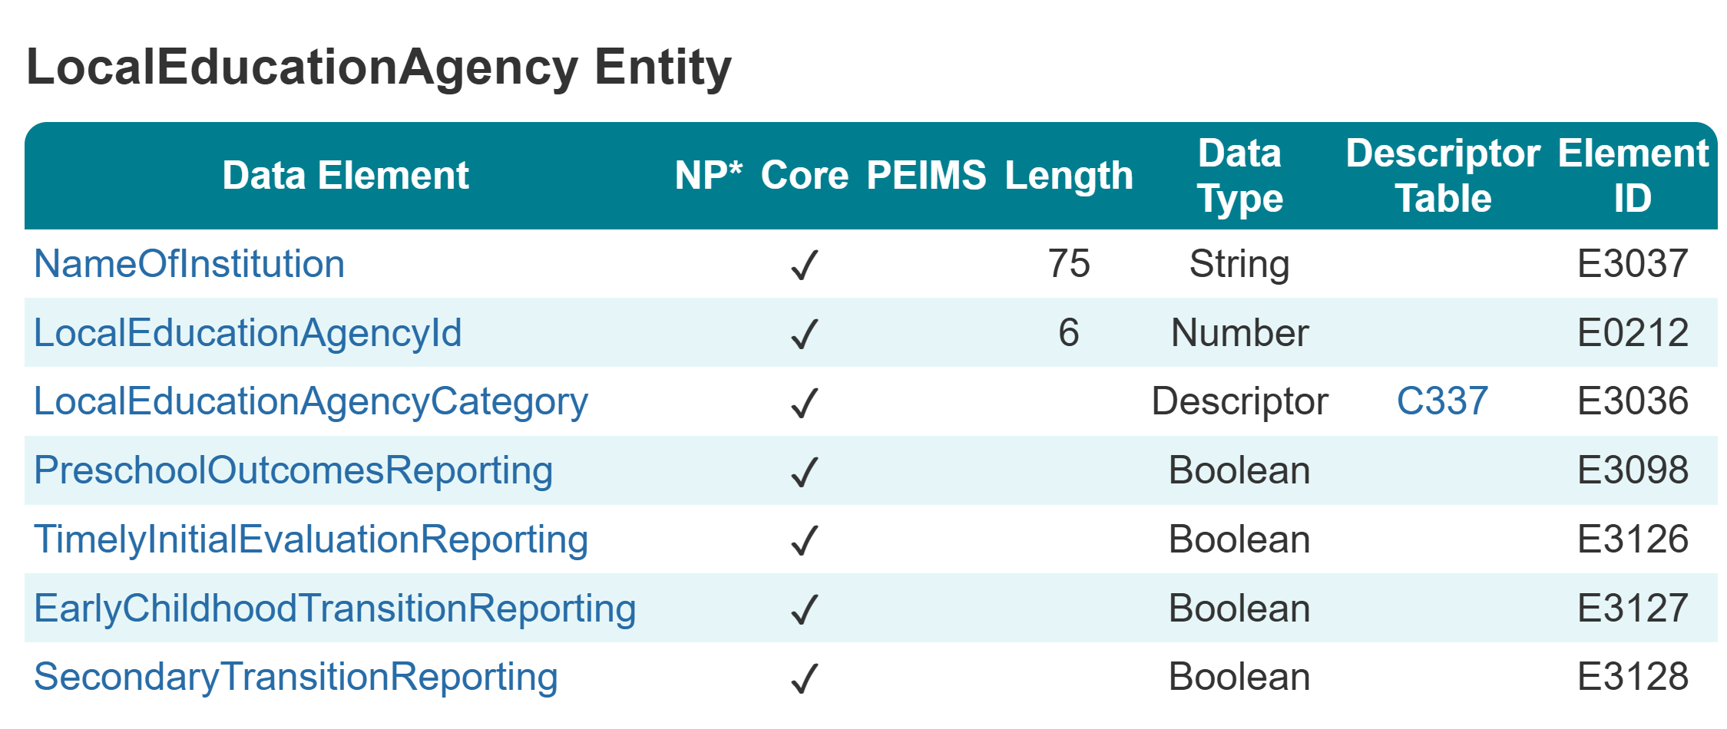
LEGACY VS. TSDS
Mandatory Submission for All LEAs
Even LEAs with no qualifying students must submit data
Ensures 100% statewide participation, data integrity, and compliance
Notes:
PreschoolOutcomesReporting can be found on the LocalEducationAgency entity
These four Boolean data elements will allow the LEA to verify when they do NOT have data for a particular collection.
TSDS Web-Enabled Data Standards (TWEDS)
Review the Texas Education Data Standards (TEDS) via the TSDS Web-Enabled Data Standards (TWEDS) for more information.

Slide 21
LEGACY VS. TSDS – SPPI-13
Previously: Only a sample of SPED students ages 16-21 with IEP transition plans was reported at the LEA level.
Now: With the SPEDS Summer Submission, all SPED students ages 16-21 with IEP transition plans must be reported by the LEA— not just a sample.
Notes:
IEP (Individualized Education Program)

Slide 22





LEA SHARED RESPONSIBILITES
LEA SPEDS Program Staff
Enters data in Source System
LEA Technical Data Steward
Verifies the data publishes to the IODS successfully
Resolves Level 1.5 filters
LEA SPEDS Program Staff
Promotes data
Validates data
Reviews reports to ensure data accuracy
Completes the submission
LEA Technical Data Steward/SPEDS Program Staff
Runs and views L2 Validations (optional step)
Source System
DMC Application
CORE Application
Notes:
Responsibilities by Role
1. LEA SPEDS Program Staff
Enter SPEDS data into the source system (e.g., SIS, SPED software, IEP software).
2. LEA Technical Data Steward
Verify data published to IODS using the DMC application.
Resolve Level 1.5 filters in the DMC application.
(Optional but recommended) Run and review Level 2 validations in the DMC application.
3. LEA SPEDS Program Staff
Promote data from IODS to the Core Application.
Validate data by correcting fatals, special warnings, and warnings.
Review reports for data accuracy.
Complete and certify the SPEDS Summer Submission.

Slide 23
SPEDS SUMMER TIMELINE
Special Education Data System (SPEDS) Summer Submission
SPEDS Summer ready for users to complete | End of May
SPEDS Summer submission due to TEA | End of July
Notes:
Reporting timeline for the 2025-2026 School Year.
LEAs can begin loading data early to begin the promotion and validation process.
The completion date is the 3rd Monday in May and the due date is the last Thursday in July.
TSDS Core Application will be available for running Level 2 Validations, Promotion, and Validation of data starting on September 15, 2025.
TSDS Web-Enabled Data Standards (TWEDS)
Review the Texas Education Data Standards (TEDS) via the TSDS Web-Enabled Data Standards (TWEDS) for more information.

Slide 24
DOMAIN DEFINITIONS 1
Alternative and Supplemental Services Domain – provides program information such as Title I, special education, and emergent bilingual.
Education Organization Domain – provides information about any public or charter school, education service center, organization or agency.
School Calendar Domain – provides the specific calendar information for a particular school.​
Student Identification and Demographics Domain – provides the characteristics and demographics of a student and the education organization associated with the student.
Notes:
The data on these domains will be published to the LEAs IODS and the data required for the SPEDS Summer submission will be promoted from data on these domains for the different SPPI indicators (7, 11, 12 & 13).

Slide 25
DOMAIN DEFINITIONS 2
Enrollment Domain – provides the enrollment and withdrawal information for a student and the relationship between a particular education organization.
Student Special Education Program Eligibility Association (TX) – represents the data needed to meet federal compliance reporting requirements related to special education Child Find (SPPI-11 and SPPI-12) activities.
Notes:
The data on these domains will be published to the LEAs IODS and the data required for the SPEDS Summer submission will be promoted from data on these domains for the different SPPI indicators (7, 11, 12 & 13).

Slide 26
CATEGORIES TO PROMOTE
Categories
Education Organization
Student
Sub-Categories
Campus
Local Education Agency
Calendar
Special Education Program
Student Basic
Enrollment(School Association)
TSDS Data Collection Documentation
Notes:
SPED Summer data will move from IODS to the Core application by categories and subcategories. These are the categories and subcategories included in the SPED Summer submission.

Slide 27
LEVELS OF VALIDATIONS
LEVEL 1
(Vendor Source System)
Includes basic data integrity checks that occur during the process of loading data via API transactions into the Individual Operational Data Store (IODS) in the Landing Zone. Data that fails Level 1 validations does not enter the IODS.
LEVEL 1.5
(DMC: DMC Data Monitor)
Includes filters that prevent invalid or non-TSDS data from being loaded into TSDS. These filters include Unique ID checks, descriptor value checks, Do Not Report flag checks, and Course ID checks.
LEVEL 3
(PEIMS/Core: Existing TEAL Roles)
Business rules that are executed in TSDS. Level 3 validations contain all Level 2 validations, plus any additional validations required for the TSDS submissions. Fatal errors prevent TSDS submissions from being completed or finalized.
LEVEL 2
(DMC: DMC L2 Validations)
Business rules that are executed on the data destined for TSDS. Fatal, Special Warning, and Warning validation errors do not prevent data from being loaded to TSDS.
Prevents data from loading to IODS
Prevents data from loading to TSDS
Does not prevent loading to TSDS.
Fatals prevent from completing submission
Notes:
Level 1.5 Filters
Data filtered out by Level 1.5 does not indicate whether the data is correct or incorrect.
LEAs must review all results generated by Level 1.5 filters and take one of the following actions:
Confirm that the data should not move to TSDS, or
Correct the data so that it can move to TSDS.

Slide 28
SPEDS SUMMER VALIDATIONS
As part of checking your data validations, check with your DMC Technical Steward to make sure that none of your SPEDS Summer data is appearing in L1.5 filters.
Additionally, check your student Unaffiliated Reports.
Notes:
Note:
There are no validations that define a duplicated Unique ID.
Review the business validations in TEDS for CSW.
All Fatal warnings must be cleared up to complete the submissions.
Special Warnings and Warnings should be reviewed carefully, and corrections made as needed to ensure accurate and complete data is reported.

Slide 29
UNIQUE IDs FOR STUDENT
All students will require a Unique ID.
These students may need a Unique ID created:
Early Childhood Interventions (ECI),
Homeschooled students, and
Private school students.
Students must have an SSN or an S-number to obtain a Unique ID.
LEAs needing additional S-numbers should submit a TIMS ticket to obtain an additional block of numbers.
Search in the Unique ID system to ensure students who already have a Unique ID are not assigned a new Unique ID.
Notes:
Students must have a UID # to be included in the SPEDS Summer submission. Students who do not have a UID # at the time the SPEDS Summer submission is finalized to TEA will not be reported.
The UID system requires an SSN or S# to assign UID to students. If the parents do not provide an SSN, the LEA could assign a S# to the student.

Slide 30
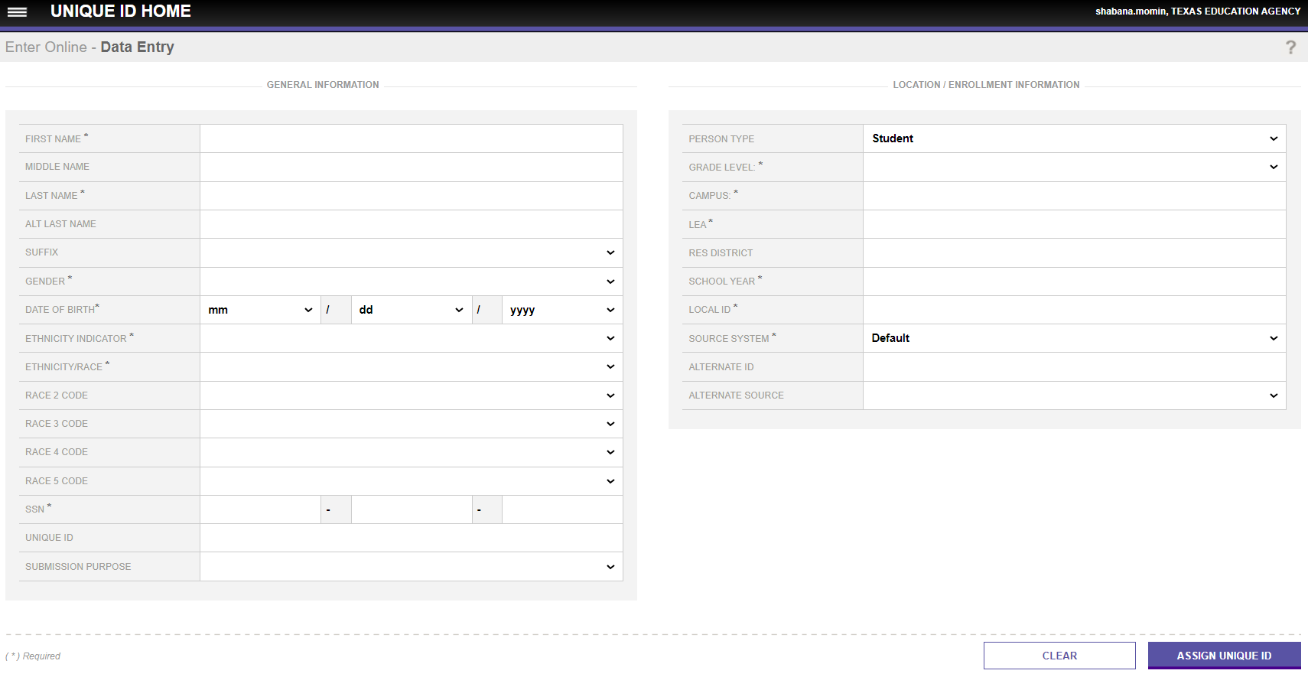
UID DATA ENTRY SCREEN
Notes:
Here’s a screenshot of the Data Entry screen in the UID application. The required fields are marked with an asterisk. Search in the UID system before assigning a new UID.
The following fields are required to create a UID:
First Name
Last Name
Gender
Date of Birth
Ethnicity Indicator
Ethnicity/Race
SSN (alternate s-number can be used)
Grade Level
Campus
LEA
School Year
Local ID
Source System

Slide 31

TRAINING ACTIVITIES
Knowledge Checks

Slide 32
KNOWLEDGE CHECK 1
What federal law mandates the collection and reporting of SPPI indicators?
FERPA
ESSA
IDEA
ADA
Note: IDEA is the federal law that mandates the collection and reporting of State Performance Plan Indicators (SPPIs), which include data on how well states are meeting the requirements of special education services for children with disabilities.
Notes:
NOTE:
To see the answer, you must be in presentation mode.

Slide 33
KNOWLEDGE CHECK 2
Which TEAL role allows you to certify the completeness and accuracy of the SPEDS Summer Submission?
Core LEA Data Approver
Core LEA Data Completer
Core LEA Data Promoter
Core LEA Data Viewer
Note: To complete the SPEDS Summer Submission, when applying for the Core LEA Data Completer role in TEAL, remember to select the “SPEDS Access” privilege.
Notes:
NOTE:
To see the answer, you must be in presentation mode.

Slide 34
KNOWLEDGE CHECK 3
What is the role of the SPEDS LEA staff in the SPEDS Summer Submission process?
Entering the SPEDS data into the source system (e.g., SIS, IEP software)
Resolve Level 1.5 filters in the DMC Application
Promoting data to the Core Application
Viewing the Level 2 validations in the DMC Application
Reviewing reports for accuracy
All except B
All of the above
Note: The SPEDS Summer Submission should work closely with their Technical Data Steward to ensure Level 1.5 filters are resolved.
Notes:
NOTE:
To see the answer, you must be in presentation mode.

Slide 35

WRAP UP
Key Takeaways, Resources, and Next Steps

Slide 36

KEY TAKEAWAYS
LEAs are required to complete a submission for SPPI-7, 11, 12 and 13 regardless of whether they have students that meet the criteria or not.
SPEDS Summer Submission is a shared responsibility between the LEA SPED program and TSDS technical staff.
LEAs are expected to be in 100% compliance for SPPI-11, 12, and 13.
SPPI-11 and 12 (formerly Child Find) will be reported in the SPEDS Summer Submission along with SPPI-7 & 13.
TRAINING MATERIALS
Requesting Access to TSDS Parallel Portal in TEAL
Click Sheet 1
Step-by-Step Video
Requesting TEAL Roles and Privileges for Promoting from TSDS Parallel Portal
Click Sheet 3
Step-by-Step Video
TRAINING RESOURCES
Key Terms and Definitions
Reference Guide for SPEDS Summer Submission
Reference Guide for Unique ID Assignment

Slide 37
TECHNICAL RESOURCES
Texas Education Data Standards Resources
TSDS Web-Enabled Data Standards (TWEDS)
Support Resources
Knowledge Based Articles in TIMS
TSDSKB-613 - FAQs
TSDSKB-606 - TEAL Roles for Core Collections
TSDS SPEDS SUMMER Submission:
SPPI Indicators 7, 11, 12 & 13 Overview
Notes:
TSDS Web-Enabled Data Values (TWEDS)
Review the Texas Education Data Standards (TEDS) via the TSDS Web-Enabled Data Standards (TWEDS) for more information.
Navigate to TWEDS
Go to the TSDS website at https://www.texasstudentdatasystem.org
Hover over the TEDS Data Standards tab.
Next, click on ‘TWEDS Upgrade’
Finally, click on the “XXXX-XXXX Texas Education Data Standards via TWEDS” hyperlink.

Slide 38
NEXT STEPS
Attend SPPI-7, 11&12, and 13 Training
Attend Common Steps for Core Collection Training
Complete a Teach Back Exercise
Complete SPEDS Summer Certification Test – Part 1
Complete Core Collection Certification Test – Part 2
Attend TSDS Continuing Education Trainings (CET)
Participate in TSDS Just-in-Time Trainings (JIT)
Attend Field Coordination Network (FCN) webinars for updates and changes
Notes:
The “Common Steps for Core Collection” training is offered prior to this session. If you missed that training, please plan to attend it the next time it is offered. It is a required to become a SPEDS Summer Champions.

Slide 39
WRAP UP
In this training we talked about:
How to use SPEDS Summer training materials effectively.
The TSDS High-level Architecture.
The TEAL Roles for SPEDS Summer.
The background and purpose of the SPEDS Summer Submission.
The LEA roles and responsibilities in the SPEDS Summer Submission.

Slide 40

QUESTIONS

