Slide 1

Public Education Information Management System (PEIMS) PEIMS Summer
New User Certification Training
TITLE SLIDE: TSDS ODS 3.x Project
Updates

Slide 2
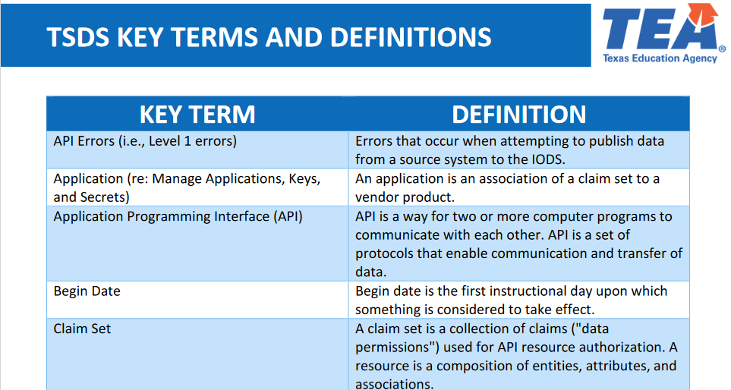
KEY TERMS
Please take a moment to familiarize yourself with common terminology by accessing the Key Terms and Definitions Document.
Access the Key Terms and Definitions Document

Slide 3
LEARNING OBJECTIVES
By the end of this course, the users will be able to explain:
The PEIMS Summer Domains and Data Elements
How to promote and validate the PEIMS Summer Submission
How to review PEIMS Summer validations
How to run and view TSDS Reports for the PEIMS Summer Submission
How to verify and complete the PEIMS Summer Submission

Slide 4
WHY IS THIS IMPORTANT
To understand that an LEA’s funding and accountability are impacted by accurately reporting PEIMS data
To better understand the data that is submitted for the PEIMS Summer Submission and the steps the LEA will take to validate and finalize the submission
4

Slide 5

COURSE AGENDA
Getting Started
PEIMS Summer Demo
Key Concepts
Timeline, PEIMS Summer Data, Validations, and Reports
Training Activity
Practice, Troubleshooting, and Knowledge Checks
Wrap Up
Key Takeaways, Resources, and Next Steps

Slide 6


GETTING STARTED
PEIMS Summer Demo

Slide 7
PEIMS SUMMER DEMO
Login to your TEAL account.
Navigate to the PEIMS Application.
Promote PEIMS Summer data.
Validate PEIMS Summer data.
Generate PEIMS Summer reports and verify the data on each report.
Prepare/Finalize the PEIMS Summer Submission
Note: The Reference Guide (RG) is a resource that provides step-by-step instructions for Promoting, Validating, and Completing the PEIMS Submission.
PEIMS Reference Guide
Notes:
This will be a high-level overview demonstration of the processes within the Texas Student Data System where LEAs will submit your PEIMS data submission. We will then take a deep look into the requirements and data that will be submitted for the PEIMS submission.

Slide 8


KEY CONCEPTS
PEIMS Summer Data, Validations, and Reports

Slide 9
PEIMS SUBMISSION TIMELINES
Submission | Date Due to TEA*
PEIMS Fall Snapshot | Late October
PEIMS Attendance 1 | Late October**
PEIMS Attendance 2 | Early December**
PEIMS Fall Submission | Early December
PEIMS Fall Resubmission | Mid-January
PEIMS Attendance 3 | Late January**
PEIMS Mid-Year Submission | Late January
PEIMS Mid-Year Resubmission | Mid-February
PEIMS Attendance 4 | Mid-March**
PEIMS Attendance 5 | Early-May**
PEIMS Summer Submission | Mid-June
PEIMS Summer Resubmission | Mid-July
PEIMS Extended Year Submission | Late August
PEIMS Extended Year Resubmission | Mid-September
*These are reference dates, please see the actual due dates in TWEDS.
**Beginning this year (2025-2026) a new PEIMS Attendance Submission is being added where LEAs will report the first 5 six-weeks reporting periods. Reporting period six and the initial five will be submitted in the PEIMS Summer Submission. (For 2025-2026 the 1st - 3rd six weeks attendance will be due to TEA in late January, the 4th six weeks will be due in mid-March, and the 5th six weeks will be due in early May.)

Slide 10
PEIMS SUMMER DOMAINS 1
Alternative & Supplemental Services Domain:
This domain provides program information such as Title I, Special Education, and Emergent Bilingual.
Discipline Domain:
This domain provides the discipline incidents, the students associated with the incident, and any actions that were taken against the student.
Education Organization Domain:
This domain provides information about any public, charter, education service center, organization or agency.

Slide 11
PEIMS SUMMER DOMAINS 2
Enrollment Domain:
This domain provides the enrollment and withdrawal information for a student and the relationship between a particular education organization.
Restraint Event Domain:
This domain provides the restraint information and the student associated to the restraint.
School Calendar Domain:
This domain provides the specific calendar information for a particular school.

Slide 12
PEIMS SUMMER DOMAINS 3
Student Academic Record Domain:
This domain provides the cumulative record of academic achievement for a student and the final record of a student's performance in their course at the end of a semester or school year.
Student Attendance:
This domain provides the daily attendance information for students.

Slide 13
PEIMS SUMMER DOMAINS 4
Student Identification and Demographics Domain:
This domain provides the characteristics and demographics of a student, and the education organization associated with the student.
Teaching and Learning:
This domain provides course information, including the students assigned to a course offered on a particular campus and the staff member who provides instruction for the course.

Slide 14
PROMOTION LOGIC RESOURCES
Promotion logic documentation provides details that explain how the data is promoted for each of the annual PEIMS submissions.
These resources are available through the Texas Student Data System (TSDS) website on the PEIMS Data Collection Documentation page.

Slide 15
SUMMER PROMOTION 1
Categories
Campus Course Section
Education Organization
Student (Con’t)
Sub-Categories
Course Section
Calendar,
Campus,
Local Education Agency
Basic Attendance,
Career and Technical Education(C/T) Attendance,
C/T Flexible Attendance,
C/T Program,
Course Completion,
Disciplinary Action,
PEIMS Data Collection Documentation
Notes:
Speaker Note:​
Categories and Sub-Categories that will be promoted for PEIMS Summer

Slide 16
SUMMER PROMOTION 2
Categories
Student (Con’t)
Sub-Categories
Enrollment (Program),
Enrollment (School Association),
Flexible Attendance,
Granular Attendance,
School Leaver,
Special Education (SPED) Attendance,
SPED Flexible Attendance,
SPED Program,
Student Basic Information,
Student Graduation Program,
Student Restraint,
Student Truancy,
Title 1, Part A Program.
PEIMS Data Collection Documentation
Notes:
Speaker Note:​
Categories and Sub-Categories that will be promoted for PEIMS Summer

Slide 17
SCHOOL LEAVER REPORTING
2025-2026 will be a Transition Year for reporting Leavers and Graduates
2024-2025 (prior year) school year Leavers and Graduates were reported in the 2025-2026 PEIMS Fall Submission.
2025-2026 (current year) school year Leavers and Graduates will be reported in the 2025-2026 PEIMS Summer and Extended Year Submissions.

Slide 18
2025-2026 SCHOOL LEAVERS
2025-2026 PEIMS Summer Submission and Resubmission leavers and graduates:
Students in grades 7 through 12:
Who were enrolled at some time during the year but not on the final day of the school year (AsOfStatusLastDayEnrollment (C323) “I”).
Who were enrolled on the final day of the school year (AsOfStatusLastDayEnrollment (C323) “H”), and the LEA has documentation that the student has since entered a new educational setting. (Atypical situation).
Who graduated between the first and last day of school.
Between the PEIMS Summer First Submission and Resubmission, TEA will reconcile any school-year movers and provide a preliminary list of underreported students.
LEAs will have an opportunity to update any documented exit withdraw type information during Resubmission.

Slide 19
NEW TO PEIMS SUMMER
The following data elements are being added for PEIMS Summer Submission to accommodate the school-year leaver/graduate reporting:
StudentSchoolAssociationEntity
EntryType (NP006)
ADAEligibility (E0787)
ExitWithdrawDate (E3028)
ExitWithdrawType (E1001)
StudentAcademicRecordEntity (Diploma Common Type)
DiplomaAwardData (E0791)
DiplomaType (E0806)
AchievementCategory (NP008)
IndividualGraduationCommitteeGraduateIndicator (E1562)
FinancialAidApplication (E1724)
TexasFirstEarlyHSCompletionProgram (E1736)
DistingLevelAchievementGraduate (E3089)

Slide 20
PEIMS VALIDATIONS

Slide 21
LEVELS OF VALIDATIONS
LEVEL 1
(Vendor Source System)
Includes basic data integrity checks that occur during the process of loading data via API transactions into the Individual Operational Data Store (IODS) in the Landing Zone. Data that fails Level 1 validations does not enter the IODS.
LEVEL 1.5
(DMC: DMC Data Monitor)
Includes filters that prevent invalid or non-TSDS data from being loaded into TSDS. These filters include Unique ID checks, descriptor value checks, Do Not Report flag checks, and Course ID checks.
LEVEL 3
(PEIMS/Core: Existing TEAL Roles)
Business rules that are executed in TSDS. Level 3 validations contain all Level 2 validations, plus any additional validations required for the TSDS submissions. Fatal errors prevent TSDS submissions from being completed or finalized.
LEVEL 2
(DMC: DMC L2 Validations)
Business rules that are executed on the data destined for TSDS. Fatal, Special Warning, and Warning validation errors do not prevent data from being loaded to TSDS.
Prevents data from loading to IODS
Prevents data from loading to TSDS.
Does not prevent data from loading to TSDS.
Fatals prevent from completing submission
Notes:
L 1.5
The data being filtered out does not indicate that the data is right or wrong.
The LEA can move local data into their IODS that is not appropriate to move to TSDS.
The IODS is the LEA’s own separate operational data store that houses all the data it loads to the IODS in the Landing Zone for TSDS data and/or local use data.
The LEA will need to check all of their results that are generated by Level 1.5 filters and either verify the data should not move to TSDS or correct the data so that it can move to TSDS.

Slide 22
PEIMS VALIDATIONS
As part of checking your data validations, check with your DMC Technical Steward to make sure that none of your PEIMS data is appearing in L1.5 filters.
Additionally, check your student Unaffiliated Report.

Slide 23
PEIMS SUMMER VALIDATIONS
Tools to assist with resolving PEIMS Summer Validations:
Use Search Data in the DMC to verify what data was published to the IODS and view the JSON.
Use Data Search in the PDM to verify the PEIMS Summer data that was promoted to TSDS.
Promotion Logic
PEIMS Summer Promotion Logic
TWEDS
Domain Dependencies
PEIMS Summer Domain Dependency (TSDSKB-660)

Slide 24
PEIMS SUMMER VALIDATIONS
PEIMS Summer includes business validations such as:
10200-0015 CalendarEvent must be Waiver Day (“02”) when CalendarWaiverEventType is Missed School Waiver Day (“02”)
41169-0003 A career and technical education student receiving Transportation CTE Support Services (“9”) must be economically disadvantaged.
42400-0011 For a student reported with attendance in PEIMS Summer Submission, the ReportingPeriod must be “1”-”6”.
Note: Most PEIMS Summer Validations will fire at Level 2 and again at Level 3.
Review the Texas Education Data Standards (TEDS) via the TSDS Web-Enabled Data Standards (TWEDS) for all business validations for PEIMS.
Notes:
TWEDS
Go to the TSDS website at https://www.texasstudentdatasystem.org
Hover over the TEDS Data Standards tab.
Next, click on ‘TWEDS Upgrade’
Finally, click on the “XXXX-XXXX Texas Education Data Standards via TWEDS” hyperlink.

Slide 25
SCHOOL LEAVER VALIDATIONS
New for the PEIMS Summer Submission:
40203-0048 For a graduate leaver reported in the PEIMS Summer or Extended Year Submission, the DiplomaAwardDate must be after the month of July preceding the current school year and before the month of September following the current school year.
40203-0050 If a leaver reported in the PEIMS Summer or Extended Year Submission has not graduated, then graduate data must not be reported.
40203-0051 If DiplomaType is “07” or “57”, then the graduate leaver should be at least 21 years of age as of September 1 of the current school year.
Review the Texas Education Data Standards (TEDS) via the TSDS Web-Enabled Data Standards (TWEDS) for all business validations for PEIMS.

Slide 26
TSDS PEIMS SUMMER REPORTS

Slide 27
VERIFYING PEIMS REPORTS
LEAs must verify the data on all reports. Report verification should be a team effort.
All Special Program staff should review the reports for their program.
Note: Special Education staff should review the Leaver and Graduate data as this will be reflected in the SPPI-14 data collection for the next school year.
Campus Principals/Assistant Principals should review all campus level reports.
Attendance, Enrollment, Special Programs, Calendar, Discipline, Restraint Events, Course Offering, Leavers and Graduates, etc.
Campus Counselors should verify appropriate reports.
Pregnancy Related Services reports, Discipline, Course Completion & Dual Credit, Graduate data, Dropout and Leaver reports, etc.
Begin verification early to allow time for each team member to review and approve the data on the reports.
Review all reports for accuracy and completeness.
Failure to review the reports carefully could affect the LEA’s funding and/or accountability rating!
Notes:
Verification – Team effort. Funding and accountability ratings.

Slide 28
PEIMS SUMMER REPORTS
The TSDS PEIMS Summer Reports are divided into the following categories:
Summer Standard Reports
Summer Special Reports
Summer Student Leaver Reports
Summer Statewide Reports
Summer Region-Wide Detail Reports (ESC Only)
Summer Region-Wide Aggregate Reports (ESC Only)
Summer UID Discrepancy Reports
Notes:
TEA envisions this submission as a 2-part process with responsibilities shared between the DMC Technical Steward and the LEA Special Program Staff.

Slide 29
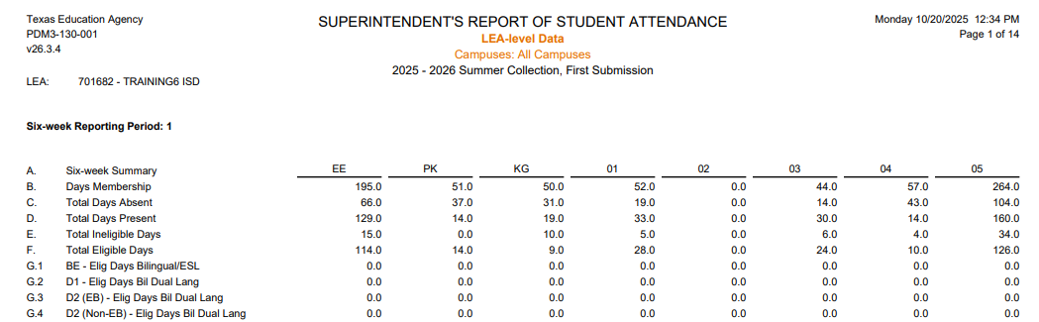
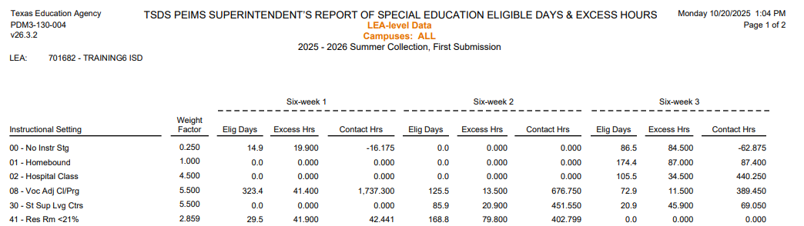
PEIMS SUMMER REPORTS 1
Standard Attendance Report – PDM3-130-001
Standard Attendance Report – PDM3-130-004
Notes:
PDM3-130-001 – Superintendent’s Report of Student Attendance summarizes student attendance for each six-week period. Some refined ADA and special program FTEs are accumulated from other reports. This report can be generated at the district or campus level. This report does not include flex attendance. The following reports should be reviewed concurrently to verify attendance data: PDM3-130-001, PDM3-130-002, and PDM3-130-004.
The roster reports provide a list of students in many of the special programs for a more detailed verification of the data.
PDM3-130-004 – Superintendent’s Report of Special Education Eligible Days and Excess Hours summarizes Special Education eligible days present, excess hours, and contact hours for each six-weeks period. This report can be generated at the district or the campus level. The report includes ONLY Special education in a specific instructional setting.

Slide 30
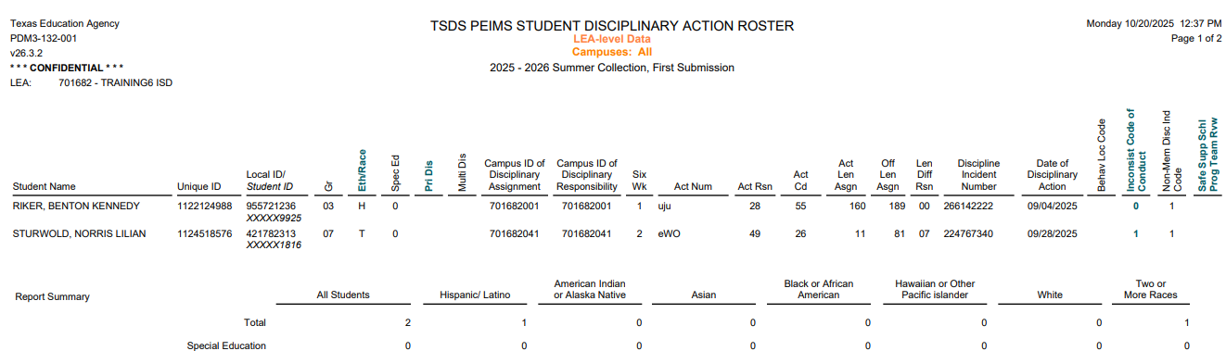
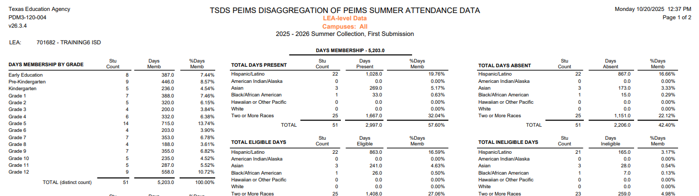
PEIMS SUMMER REPORTS 2
Standard Discipline Report - PDM3-132-001
Standard Student Report – PDM3-120-004
Notes:
PDM3-132-001 – Student Disciplinary Action Roster – This report students who have a reported disciplinary action along with the details of that action. Students with multiple disciplinary actions is counted only once in the summary counts.
PDM3-120-004 – Disaggregation of PEIMS Summer Attendance Data – This report provides student enrollment counts and percentages from the summer submission. The information is based on days membership and is organized into categories by grade, sex, ethnicity, and special populations. (Days Membership = Total Days Absent + Total Eligible Days Present + Total Ineligible Days Present) (% Days Membership = (Days Membership/Total Days Membership) * 100)

Slide 31
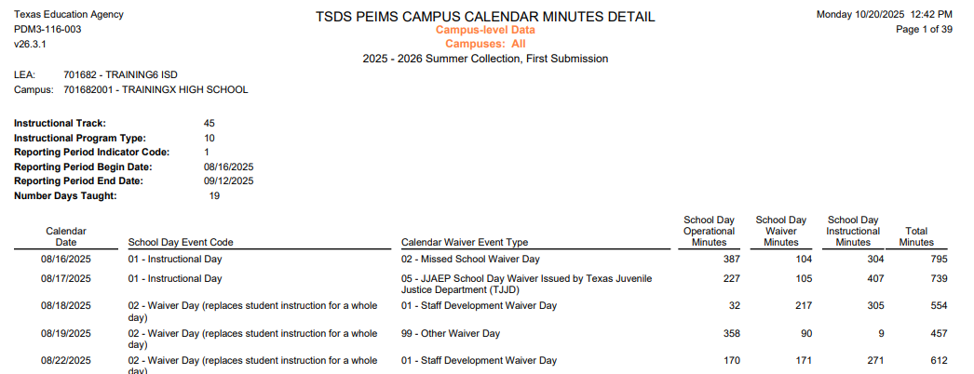
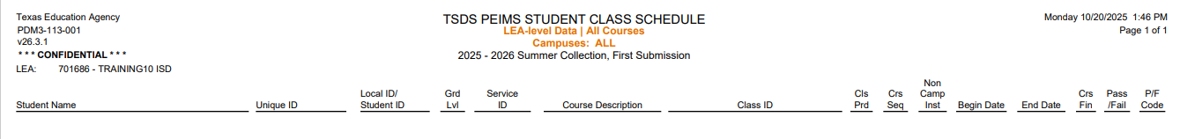
PEIMS SUMMER REPORTS 3
Standard Organization Report – PDM3-116-003
Standard Class Report – PDM3-113-001
Notes:
PDM3-116-003 – Campus Calendar Minutes Detail – This report lists the campuses school day events and their calendar minute detail to verify the calendar information reported to PEIMS. This report can only be generated at the campus level.
PDM3-113-001 – Student Class Schedule – This report provides a listing of students with their class assignments and attributes. The report will show pass/fail indicators. The report can be generated to show failed courses only or all courses.

Slide 32
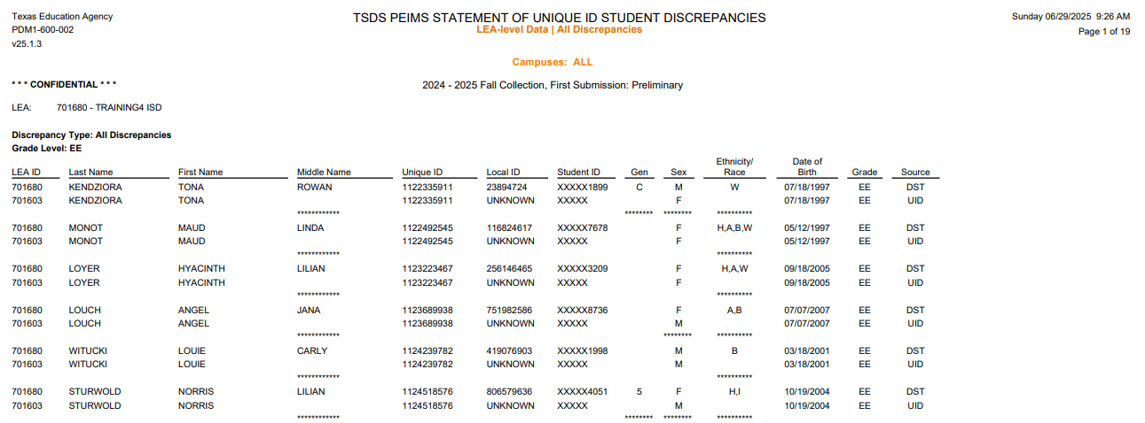
UID DISCREPANCIES REPORTS
UID Student Discrepancies – PDM3-600-002
Notes:
PDM3-600-002 – Statement of Unique ID Student Discrepancies – This report identifies discrepancies between the TSDS Unique ID demographic data and student demographic information reported through PEIMS. There are several parameter selections users can choose when generating this report. The report can be run for enrolled students, for dropout/leaver students, graduates, major or minor discrepancies, etc. Or the report can run for all discrepancies. At the bottom of the report it will show total discrepancies by grade, by campus, and for the LEA. The report can be run by campus or for the entire LEA.

Slide 33
FALL REPORTS MOVED TO SUMMER
PDM3-120-005 – Student Data Review
PDM3-120-007 – Underreported Students Presumed At Risk
PDM3-120-018 – Student Foundation High School Program Graduate Roster
PDM3-124-001 – Dropout Students by Gender, Ethnicity & Grade
PDM3-124-002 – Dropout Roster
PDM3-124-003 – Graduates by Gender, Ethnicity, and Graduation Type
PDM3-124-004 – School Leaver Roster
PDM3-124-006 – Non-Dropout Non-Graduates Leaver Roster
PDM3-124-007 – Graduate Roster by Graduation Type
PDM3-124-008 – School Leaver Data Report
PDM3-220-001 – Graduates Already Reported in Previous Year
PDM3-320-001 – Interim List to Assist LEAs in Leaver Record Submission
PDM3-321-001 – Presumed Underreported Students Lists
PDM3-404-001 – Duplicate Students by Attendance
PDM3-404-002 – Duplicate Student Report for Graduates

Slide 34
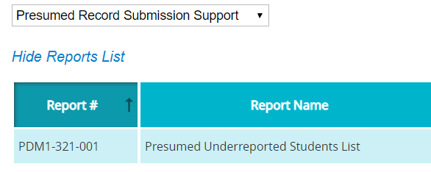
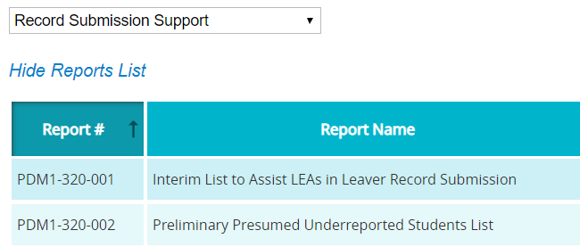
STUDENT LEAVER REPORTS
Presumed Record Submission Support Group
The Presumed Underreported Student List report is only available after the PEIMS Summer First Submission is closed and TEA has performed the leaver calculations. The report only displays finalized submission data.
Record Submission Support Group
The Interim List to Assist LEAs in Leaver Record Submission report can be run at any time.
The Preliminary Presumed Underreported Students List report can be run at any time.
2
PDM3-321-001
1
PDM3-320-001
PDM3-320-002
Hint: PDM3-320-001 & 002 reports will be generated BEFORE the PDM3-321-001
Notes:
The Summer Student Leaver report groups are individual LEA reports that help LEAs identify students for whom a school leaver record may need to be submitted.
1. The Presumed Underreported Students List report is only available after the submission is closed and TEA has performed the leaver calculations. This report only displays finalized submission data. This report lists students who attended or were enrolled in grades 7-12 during the previous school year. Individual LEA reports help identify students for whom a leaver record may be needed. This report is very similar to the PDM3-320-002 report, but this report is a state-wide report. If at least one of the indicators is not listed, the student is not presumed underreported at the time the report is generated. An asterisk to the left of the Student ID indicates that the student is presumed underreported.
2. The Record Submission Support group of Summer Leaver Reports has two reports.
a. The Interim List to Assist LEAs in Leaver Record Submission report can be run at any time to help LEAs identify students who attended or were enrolled in grades 7-12 during the previous school year and for whom a leaver record may be needed. This report lists students who attended or were enrolled in grades 7012 during the prior school year. The report flags students as School Year Mover, prior Texas Graduate, or a Texas GED Recipient. Students with these flags do not need a leaver record.
b. The Preliminary Presumed Underreported Student List report lists students who attended or were enrolled in grades 7-12 during the previous school year. This report can also be run at anytime. This report lists students who attended or were enrolled in grades 7-12 during the prior school year. Students on this list can be flagged as Presumed Summertime Mover, Presumed Returned Student, a Presumed Leaver, a School year Mover, a Prior Texas Graduate, or a Texas GED Recipient. (The three underlined indicators are also on the PDM3-320-001 report.) If at least one of these indicators is not listed, the student is not presumed underreported at the time the report is generated. An asterisk to the left of the Student ID indicates that the student is presumed underreported.

Slide 35
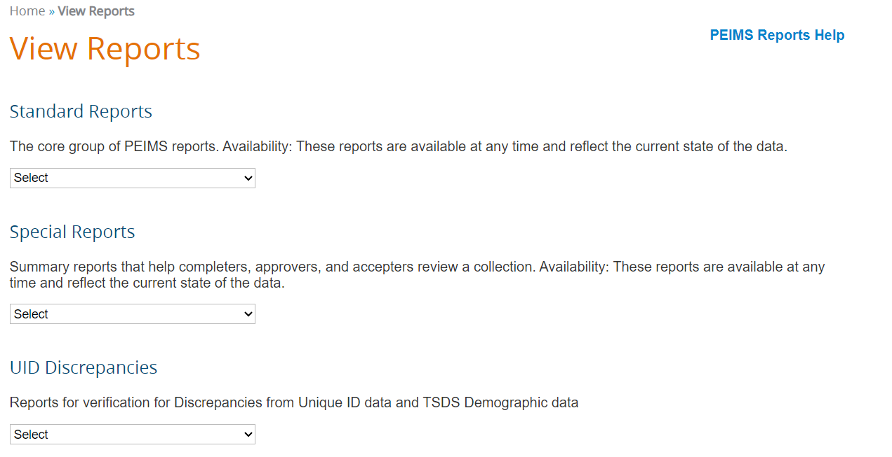
PEIMS REPORTS HELP
PEIMS Reports Help is available on the View Reports landing page and contains detailed information concerning the content of the report.
The help documentation is PEIMS submission specific. For example, if you click on the PEIMS Reports Help on the PEIMS Summer reports page you will only see the PEIMS Summer Reports listed.

Slide 36
PEIMS SUMMER APPROVER
TEA requires the PEIMS Data Approver to review the ‘PDM3-231-002 Percentage of Change from Prior Year’ report before approving the PEIMS Summer Submission.
PDM3-231-002
Includes 5 Sections:
Student Attendance
College Prep
Dual Credit
Student Demographics, Characteristics, and Programs
Leavers and Graduates
When the PEIMS Completer clicks ‘Complete’, the email on the next slide will be sent to the PEIMS Data Approver.
This report is available for the PEIMS Coordinator to use outside the Approval process.

Slide 37
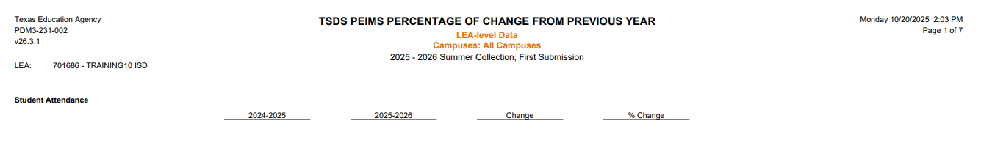
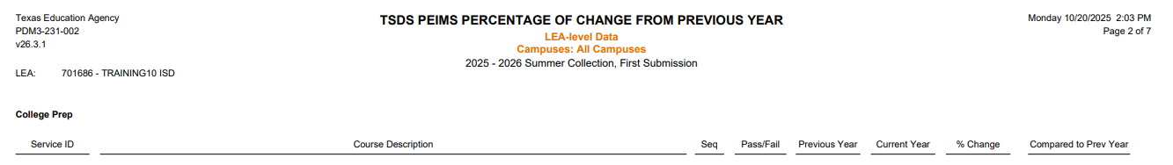
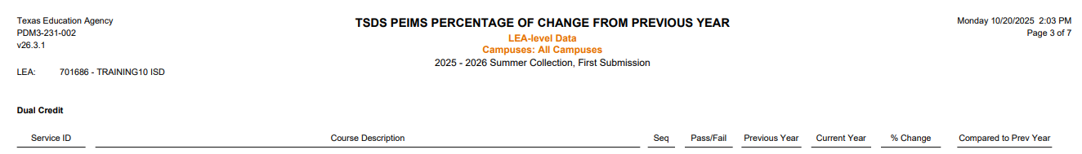
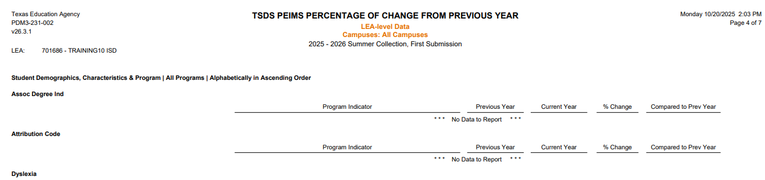
PDM3-231-002
1
2
3
4
5
Notes:
PDM3-231-002 – This report compares the percentage change of student counts in various programs and statuses from previous year to the current year. The report can be generated by district or by campus and can be generated for all programs or just selected programs. This report can be grouped by Campus or by Selected Programs.

Slide 38
PEIMS SUMMER NOTIFICATION
The PEIMS Data Approver can download report ‘PDM3-231-002’ by clicking on the link in the email.
Email Notification Text
SUBJECT: Learning ISD; PEIMS Summer Submission Data: COMPLETE
ATTACHMENTS:
PDM3-231-002: Percentage of Change from Previous Year
BODY:
Dear Dr. Superintendent
The District PEIMS Coordinator has marked the Learning ISD PEIMS Summer Submission as "COMPLETE."
The submission will now go to the Superintendent for approval and the ESC for acceptance. The submission is now locked and cannot be changed, unless the ESC rejects the collection.
The following report(s) have been automatically generated for your organization and attached to this email. The Superintendent is required to review the attached report and verify its contents before approving the PEIMS Summer Submission as “COMPLETE”:
PDM3-231-002: Percentage of Change from Previous Year
This notification was sent to the following roles: Data Approver
Regards,
The TSDS PEIMS System
REMINDER: If you need TSDS PEIMS customer support, create an incident in the TIMS system using the Support link in the PEIMS header.

Slide 39
PEIMS DATA APPROVER PROCESS
The PEIMS Data Approver should review report PDM3-231-002.
Click on the link in the email received after the submission is completed, or
Log into the PEIMS Application, go to the ‘Prepare/Finalize’ tab, click ‘Approve’, and download and review the report.
After the report has been downloaded and reviewed, the PEIMS Data Approver will click ‘Confirm’ to confirm that he/she has reviewed the report or ‘Cancel’ to go back and make corrections.
After clicking ‘Confirm’ the PEIMS Summer Submission is ready for the ESC to Accept, and the Statement of Approval (SOA) can be viewed.

Slide 40

TRAINING ACTIVITY
Practice, Troubleshooting, and Knowledge Checks

Slide 41
PRACTICE EXERCISE
Task 1: Promote and Validate PEIMS Summer data.
Task 2: Verify data on Reports.
Ready
Set
Go

Slide 42
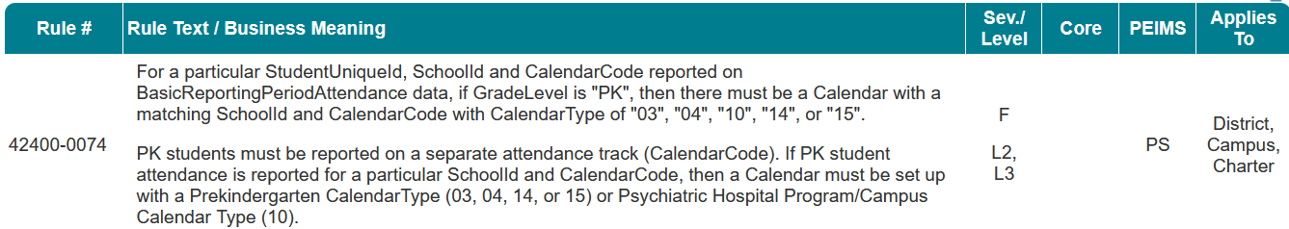
TROUBLESHOOTING 1
Scenario 1: Why am I getting this fatal error: 42400-0074?
Resolution Steps:
The error occurs when the LEA did not set up a separate calendar for their PK program.
A calendar should be set up for the PK program with CalendarType:
03 – Charter operating before 1/1/2-15,
04 – PK Program – half-day program for 3-year-old students and half-day, ineligible 3- and 4-year-old students
14 – Full-day PK program following 75,600 operational minutes. or
15 – Half-day PK program with waiver following 32,400 instructional minutes.
Does the LEA have a PK program? Was a separate attendance track calendar created for the PK program?
The LEA should build a calendar with CalendarType 03, 04, 15, or 15 and all PK students should be reported on this separate attendance track calendar.
Make the calendar correction in the SIS; publish the corrected calendar information to the IODS; run L2 validations in the DMC; verify that the error is no longer triggering; promote and validate; continue data validation in TSDS.

Slide 43
TROUBLESHOOTING 2
Scenario 1: Why am I getting this fatal error: 40203-0049?
Resolution Steps:
Johnny was not on track to graduate in May of the current school year.
Counselors entered all graduation data for the upcoming graduates in early spring in their SIS.
Johnny was able to complete all graduation requirements and graduate in May of the current school year.
Verify that Johnny’s ExitWithdrawType is 01 in the SIS.
Enter the graduate data for DiplomaAwardDate, the DiplomaType, and IGC indicator in the SIS.
Ensure that the updated data is published to the IODS.
Run L2 validations in the DMC; verify that the error is no longer triggering; promote and validate; continue data validation in TSDS.

Slide 44
KNOWLEDGE CHECK 1
1. Beginning in the 2025-2026 school year, leavers and graduates will be reported in the PEIMS Summer and Extended Year Submissions.
True
False
Notes:
NOTE
To see the answer, you must be in presentation mode.

Slide 45
KNOWLEDGE CHECK 2
2. Regarding attendance data, only Basic Attendance data is reported in the PEIMS Summer Submission.
True
False
Note: Basic attendance and all special program attendance data is reported in the PEIMS Summer Submission.
Notes:
NOTE
To see the answer, you must be in presentation mode.

Slide 46
KNOWLEDGE CHECK 3
3. Which of the following is NOT reported on the PEIMS Summer Submission?
Student Attendance
Truancy
Discipline
Staff Payroll
Notes:
NOTE
To see the answer, you must be in presentation mode.

Slide 47
KNOWLEDGE CHECK 4
4. The LEA’s PEIMS Coordinator is the only one who should review and verify the data on the TSDS PEIMS Summer reports.
True
False
Note: Reviewing the reports should be a shared responsibility between the PEIMS Coordinator, Campus Principals, Assistant Principals, Campus Counselors, Special Education staff and other special program staff, along with the Superintendent at the LEA.
Notes:
NOTE
To see the answer, you must be in presentation mode.

Slide 48
KNOWLEDGE CHECK 5
5. PEIMS Summer Submission data for attendance will only reflect the data that was previously submitted on each of the PEIMS Attendance Submission Instances.
True
False
Note: The attendance data promoted for the PEIMS Summer Submission reflects the most current attendance information in the SIS that was published to IODS at the time of promotion.
This means any corrections or updates made after earlier PEIMS Attendance Submission Instances will be included in the PEIMS Summer Submission promoted data.
Example: If a parent provides a doctor’s note in December for an absence originally reported in the first six weeks PEIMS Attendance Submission Instance, and the LEA updates the SIS accordingly, the corrected attendance will be promoted for the PEIMS Summer Submission.
Notes:
NOTE
To see the answer, you must be in presentation mode.

Slide 49

WRAP UP
Key Takeaways, Resources, and Next Steps

Slide 50

KEY TAKEAWAYS
PEIMS data is submitted through TSDS.
PEIMS Summer Submission attendance data consists of all reconciled attendance events for the entire school year.
PEIMS Summer Submission data will include current-year leaver and graduate data.
Viewing Level 2 Validations in the DMC will allow users to begin correcting errors prior to promoting their data in the PEIMS application.
The PEIMS Data Approver must review PDM3-231-002 prior to approving the PEIMS Summer Submission.
TRAINING RESOURCES
Key Terms and Definitions
Introduction to PEIMS
PEIMS Reference Guide
SOA Reference Guide

Slide 51
TECHNICAL RESOURCES
Training Resources
PEIMS Reference Guide
SOA Resource Document
TEA Website and Communication Resources
Student Attendance Accounting Handbook(SAAH)
Link to Key Terms Document
Texas Education Data Standards Resources
TSDS Web-Enabled Data Standards (TWEDS)
To the Administrator Addressed
TAA September 5, 2024 – Moving Leavers & Graduate Reporting from PEIMS Fall to the PEIMS Summer and Extended Year Submission
Support Resources
KB Articles
TSDSKB-375 - PEIMS- Submission Process Chart
TSDSKB-600 – TSDS Known Issues List
TSDSKB 606 - TEAL Roles for TSDS Collections

Slide 52
NEXT STEPS
Ensure that you attend Overview and Key Concepts, TEDS Overview, DMC Level 1.5, DMC Level 2 Validations, DMC Descriptor Mapping, and TEAL Roles trainings.
Complete a Teach Back Exercise.
Complete PEIMS Summer Certification Test.
Attend PEIMS Fall, PEIMS Mid-Year, and PEIMS Extended Year trainings.
Attend TSDS Continuing Education Trainings (CET).
Participate in TSDS Just-in-Time Trainings (JIT).
Attend Field Coordination Network (FCN) webinars for updates and changes.

Slide 53
WRAP UP
In this training we talked about:
The PEIMS Summer Domains and Data Elements
How to promote and validate the PEIMS Summer Submission
How to review PEIMS Summer validations
How to run and view TSDS Reports for the PEIMS Summer Submission
How to verify and complete the PEIMS Summer Submission

Slide 54

QUESTIONS

