Slide 1

Public Education Information Management System (PEIMS)
PEIMS Mid-Year
New User Certification Training
TITLE SLIDE: TSDS ODS 3.x Project
Updates

Slide 2
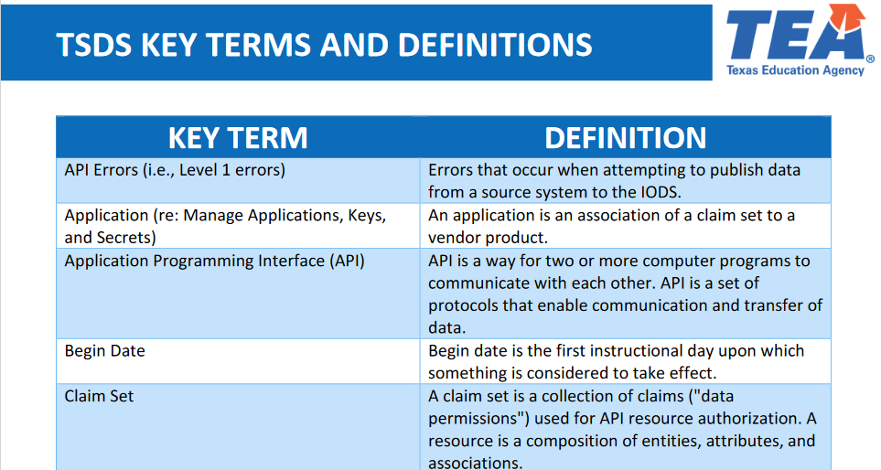
KEY TERMS
Please take a moment to familiarize yourself with common terminology by accessing the Key Terms and Definitions Document.
Access the Key Terms and Definitions Document.

Slide 3
LEARNING OBJECTIVES
  By the end of this course, the users will be able to explain:
The PEIMS Mid-Year Domains and Data Elements.
How to promote and validate the PEIMS Mid-Year Submission.
How to review PEIMS Mid-Year validations.
How to run and view TSDS Reports for the PEIMS Mid-Year Submission.
How to verify and complete the PEIMS Mid-Year Submission.

Slide 4
WHY IS THIS IMPORTANT
To understand that the PEIMS Mid-Year Submission includes actual financial data for the prior school year and that both LEAs and ESCs are required to submit this data.
To better understand the process for validating and finalizing the PEIMS Mid-Year Submission.
4

Slide 5

COURSE AGENDA
Getting Started
PEIMS Mid-Year Demo
Key Concepts
PEIMS Mid-Year Data, Validations, and Reports
Training Activity
Practice, Troubleshooting, and Knowledge Checks
Wrap Up
Key Takeaways, Resources, and Next Steps

Slide 6


GETTING STARTED
PEIMS Mid-Year Demo

Slide 7
PEIMS MID-YEAR DEMO
Login to your TEAL account.
Navigate to the PEIMS Application.
Promote PEIMS data.
Validate PEIMS data.
Generate PEIMS reports and verify the data on each report.
Prepare/Finalize the PEIMS Submission
Note: The Reference Guide (RG) is a resource that provides step-by-step instructions for Promoting, Validating, and Completing the PEIMS Submission.
PEIMS Reference Guide
Notes:
This will be a high-level overview demonstration of the processes within the Texas Student Data System where LEAs will submit your PEIMS data submission. We will then take a deep look into the requirements and data that will be submitted for the PEIMS submission.

Slide 8


KEY CONCEPTS
PEIMS Mid-Year Data, Validations, and Reports

Slide 9
PEIMS SUBMISSION TIMELINES
Submission | Date Due to TEA*
PEIMS Fall Snapshot | Late October
PEIMS Attendance 1 | Late October**
PEIMS Attendance 2 | Early December**
PEIMS Fall Submission | Early December
PEIMS Fall Resubmission | Mid-January
PEIMS Attendance 3 | Late January**
PEIMS Mid-Year Submission | Late January
PEIMS Mid-Year Resubmission | Mid-February
PEIMS Attendance 4 | Mid-March**
PEIMS Attendance 5 | Early-May**
PEIMS Summer Submission | Mid-June
PEIMS Summer Resubmission | Mid-July
PEIMS Extended Year Submission | Late August
PEIMS Extended Year Resubmission | Mid-September
*These are reference dates, please see the actual due dates in TWEDS.
**Beginning this year (2025-2026) a new PEIMS Attendance Submission is being added where LEAs will report the first 5 six-weeks reporting periods. Reporting period six and the initial five will be submitted in the PEIMS Summer Submission. (For 2025-2026 the 1st-3rd six weeks attendance will be due to TEA in late January, the 4th six weeks will be due in mid-March, and the 5th six weeks will be due in early May.)

Slide 10
PEIMS MID-YEAR DOMAINS
Education Organization Domain:
The Education Organization domain provides information about any public, charter, education service center, organization or agency.
Finance Domain:
The Finance domain provides prior year actual financial data and shared services actual data based on the mandated minimum accounting structure of the Financial Accountability System Resource Guide (FASRG). This PEIMS collection consists of actual audited financial data.

Slide 11
PROMOTION LOGIC RESOURCES
Promotion logic documentation provides details that explain how the data is promoted for each of the annual PEIMS submissions.
These resources are available through the Texas Student Data System (TSDS) website on the PEIMS Data Collection Documentation page.

Slide 12
MID-YEAR PROMOTION
Categories
Education Organization
Finance
Sub-Categories
Education Service Center,
Local Education Agency,
Campus,
SSA Org Association
Actual
Shared Services Arrangement Actual
PEIMS Data Collection Documentation
Notes:
Speaker Note:​

Slide 13
PEIMS VALIDATIONS

Slide 14
LEVELS OF VALIDATIONS
LEVEL 1
(Vendor Source System)
Includes basic data integrity checks that occur during the process of loading data via API transactions into the Individual Operational Data Store (IODS) in the Landing Zone. Data that fails Level 1 validations does not enter the IODS.
LEVEL 1.5
(DMC: DMC Data Monitor)
Includes filters that prevent invalid or non-TSDS data from being loaded into TSDS. These filters include Unique ID checks, descriptor value checks, Do Not Report flag checks, and Course ID checks.
LEVEL 3
(PEIMS/Core: Existing TEAL Roles)
Business rules that are executed in TSDS. Level 3 validations contain all Level 2 validations, plus any additional validations required for the TSDS submissions. Fatal errors prevent TSDS submissions from being completed or finalized.
LEVEL 2
(DMC: DMC L2 Validations)
Business rules that are executed on the data destined for TSDS. Fatal, Special Warning, and Warning validation errors do not prevent data from being loaded to TSDS.
Prevents data from loading to IODS
Prevents data from loading to TSDS.
Does not prevent data from loading to TSDS.
Fatals prevent from completing submission
Notes:
L1.5
The data being filtered out does not indicate that the data is right or wrong.
The LEA can move local data into their IODS that is not appropriate to move to TSDS.
The IODS is the LEA’s own separate operational data store that houses all the data it loads to the IODS in the Landing Zone for TSDS data and/or local use data.
The LEA will need to check all of their results that are generated by Level 1.5 filters and either verify the data should not move to TSDS or correct the data so that it can move to TSDS.

Slide 15
PEIMS MID-YEAR VALIDATIONS
Tools to assist with resolving PEIMS Mid-Year Validations
    Use Search Data in the DMC to verify what data was published to the IODS and view the JSON.
    Use Data Search in the PDM to verify the PEIMS Mid-Year data that was promoted to TSDS.
      Promotion Logic
        PEIMS Mid-Year Promotion Logic
      TWEDS
      Domain Dependencies
        PEIMS Mid-Year Domain Dependency (TSDSKB-660)

Slide 16
PEIMS MID-YEAR VALIDATIONS
  PEIMS includes business validations such as:
    Level 2 Example:
      20032-0029 ActualFund must not be “102”, “400”, “403”, or “405”-”406”. (Only ESCs can use these fund codes.)
    Level 2 Example:
      20032-0105 If Actual ProgramIntent is “91” (Athletics and Related Activities), then ActualFunction must be “41”, “53”, “71”, or “99”.
      Note: All PEIMS Mid-Year Validations will fire at Level 2 and again at Level 3.
      Review the Texas Education Data Standards (TEDS) via the TSDS Web-Enabled Data Standards (TWEDS) for all business validations for PEIMS.
Notes:
PEIMS provides data validations to ensure data quality and accuracy.
Review the business validations in TWEDS for PEIMS.

Slide 17
TSDS PEIMS MID-YEAR REPORTS

Slide 18
VERIFYING PEIMS REPORTS
LEAs must verify the data on all reports. Report verification should be a team effort.
    Business Office staff should verify all Mid-Year reports.
Begin verification early to allow time for each team member to review and approve the data on the reports.
Review all reports for accuracy and completeness and for adjustments based on the outside auditor's findings.

Slide 19
PEIMS MID-YEAR REPORTS
The TSDS PEIMS Mid-Year Reports are divided into the following categories:
  Mid-Year Standard Reports
    Actual
    Actual Allocation
    Audit
  Mid-Year Special Reports
    District Level QA
    Summary
    Mid-Year Across-State Reports
      Fiscal Agent SSA Cross Reference Report
    Mid-Year Region-Wide Detail Reports (ESC Only)
      Error Reports
      Finance Reports

Slide 20
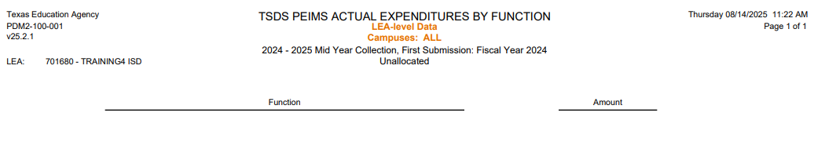
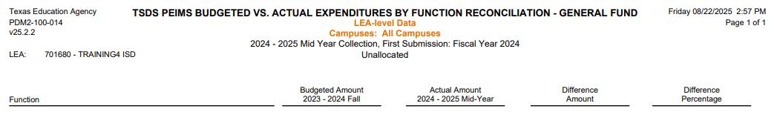
PEIMS MID-YEAR ACTUAL REPORTS
Actual Expenditures by Function – PDM2-100-001
This report summaries expenditures by function. Expenditures within each function are for object codes 6XXX. Data only appears for functions that contain values.
Budged vs. Actual Expenditures – PDM2-100-014
This report provides a summary analysis by General Fund of the budgeted expenditures by function (submitted in prior-year Fall Submission) vs. the actual expenditures by function.
Notes:
PDM2-100-001 can be generated by Campus or for the entire LEA.
PDM2-100-014 can be generated by Campus or for the entire LEA. The report shows the difference between the budgeted amount and the actual amount as well as the percentage difference between budgeted and actual amounts.

Slide 21
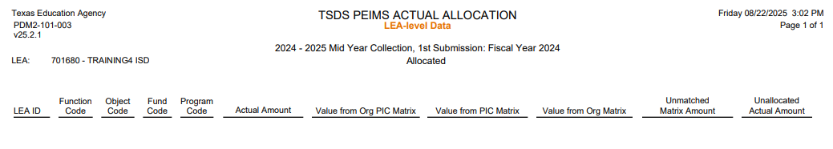
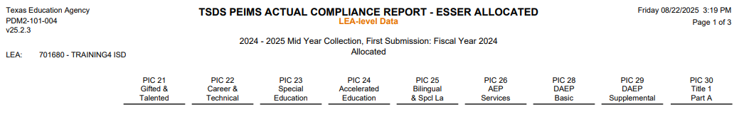
PEIMS ACTUAL ALLOCATION REPORTS
Actual Allocation – PDM2-101-003
This report summarizes actual expenditures for the General Fund. The purpose of this report is to assist LEAs in detecting potential compliance problems with the Texas Administrative Code.
Actual Compliance ESSER Report – PDM2-101-004
This report summarizes the allocated actual expenditures from the Elementary and Secondary Emergency Relief Fund (ESSER)
Notes:
PDM2-101-003 - The Texas Administrative Code states that no more the 15% of each district’s FSP allotments may be expended for indirect costs relating to Comp Ed, GT, Bilingual, and SPED programs and no more than 10% of the district’s LEA allotments may be expended for indirect costs related to Career and Technical Education programs. The report is divided into two sections, the first reporting direct costs and the second reporting indirect costs for each included PIC.
PDM2-101-004 – This report summarized allocated actual expenditures from the ESSER Fund Code 266, 281, 282, and 283; Fund Codes 100-199; and Fund Code 420, broken out by PIC and Function Code. The report assists LEAs with detecting potential compliance problems, and it is divided into two sections: the first section reports direct costs, and the second section reports indirect costs.

Slide 22
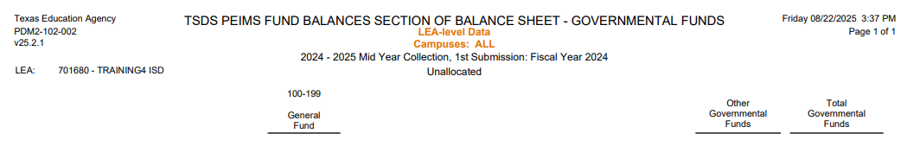
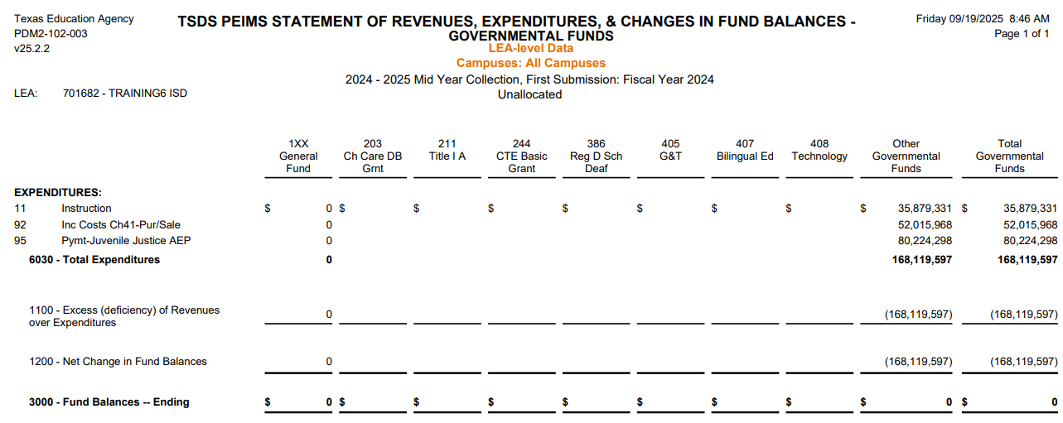
PEIMS MID-YEAR AUDIT REPORTS
Fund Balances Section of Balance Sheet – PDM2-102-002
Fund Balance for District Designated Majoy Funds
This report corresponds to Exhibit C-1 of the FASRG. The LEA can select up to four of the district’s major funds. Funds not selected as major are aggregated under Other Governmental Funds.
Statement of Revenues, Expenditures & Changes – PDM2-102-003
This report is much like Exhibit C-2 of the FASRG. This report is used by the LEA and its auditors to compare financial reporting data to the PEIMS Data.
Notes:
PDM2-102-002 – This report is used by the LEA auditors to compare financial reporting data to the PEIMS data. It is also used by TEA auditors to compare data across LEAs. The Other Governmental Funds is the sum of all special revenue funds (201-499) + the sum of all Debt Service funds (501-599) + the sum all Capital Projects funds (601-699) less any funds designated as major.
PDM2-102-003 – This report is used by the LEA and its auditors to compare financial reporting data to the TSDS PEIMS data. The report is also used by TEA auditors to compare data across LEAs. The LEA will select up to 7 major funds and all others are aggregated under the Other Governmental Funds.

Slide 23
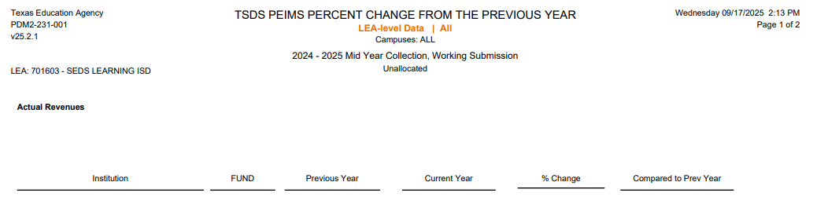
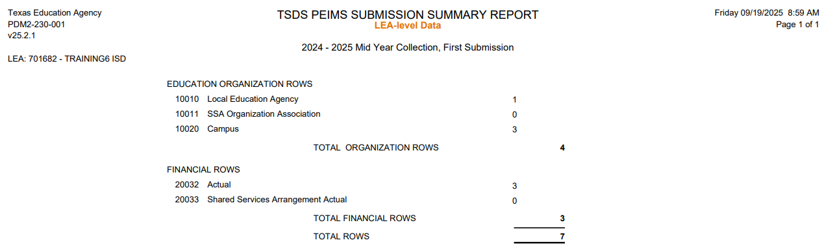
PEIMS MID-YEAR SPECIAL REPORTS
Percent Change from Previous Year – PDM2-231-001
PEIMS Mid-Year Submission Summary – PDM2-230-001
Notes:
PDM2-231-001 – This report shows all percent changes of total actual expenditures or revenues by campus and fund from last year to this year. This report may alert LEA staff about reported expenditures or revenue amounts for a campus that differ from last year. This is the report that the PEIMS Data Approver is required to review prior to approving the PEIMS Mid-Year Submission. The first page shows differences in actual revenues, and the second page shows differences in actual expenditures.
PDM2-230-001 – This report provides a summary of the records that were promoted for the LEAs Mid-Year Submission.

Slide 24
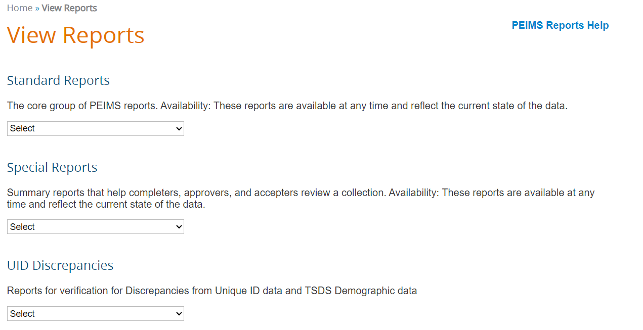
PEIMS REPORTS HELP
PEIMS Reports Help is available on the View Reports landing page and contains detailed information concerning the content of the report.
The help documentation is PEIMS submission specific. For example, if you enter the PEIMS Reports Help on the PEIMS Mid-Year reports page you will see the PEIMS Mid-Year Reports listed.

Slide 25
PEIMS MID-YEAR APPROVER
TEA requires the PEIMS Data Approver to review the ‘PDM2-231-001 Percentage of Change from Previous Year’ report before approving the PEIMS Mid-Year Submission.
PDM2-231-001
  Includes 2 Sections:
    The first page shows the percentage of change for Actual revenues.
    The second pages shows the percent of change for Actual expenditures.
When the PEIMS Completer clicks ‘Complete’, the email on the next slide will be sent to the PEIMS Data Approver.
This report is available for the Business Office staff to use outside the Approval process.

Slide 26
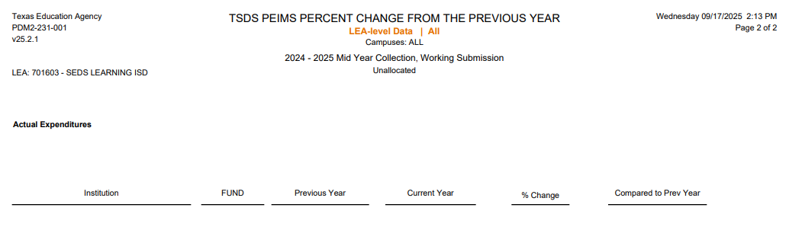
PDM2-231-001
Actual Revenues
44444444444444444444444444444444444444444444444444
Actual Expenditures
Notes:
Previous year and current year data includes Object codes 5XXX for revenues; Object codes 61XX-64XX for expenditures; Function codes 11-13, 21, 23, 31-33, 35, 36, 51-53, or 95; Org codes 001-649 and 651-698.
% of change from previous year to the current year expenditure or revenue is calculated as follows: (Current year-Previous year/Previous year) * 100. If there is a negative change, a negative sign is displayed.
Compared to Previous Year column will indicate if this is an increase or decrease in the amount.

Slide 27
PEIMS MID-YEAR NOTIFICATION
  The PEIMS Data Approver can download report ‘PDM2-231-001’ by clicking on the link in the email.
Email Notification Text
SUBJECT: Learning ISD; PEIMS Fall Submission Data: COMPLETE
ATTACHMENTS:
PDM2-231-001: Percentage of Change from Previous Year
BODY:
Dear Dr. Superintendent
The District PEIMS Coordinator has marked the Learning ISD PEIMS Mid-Year Submission as "COMPLETE."
The submission will now go to the Superintendent for approval and the ESC for acceptance. The submission is now locked and cannot be changed, unless the ESC rejects the collection.
The following report(s) have been automatically generated for your organization and attached to this email. The Superintendent is required to review the attached report and verify its contents before approving the PEIMS Summer Submission as “COMPLETE”:
PDM2-230-001: Percentage of Change from Previous Year
This notification was sent to the following roles: Data Approver
Regards,
The TSDS PEIMS System
REMINDER: If you need TSDS PEIMS customer support, create an incident in the TIMS system using the Support link in the PEIMS header.
Learning ISD; PEIMS Mid-Year Submission Data: COMPLETE

Slide 28
PEIMS DATA APPROVER PROCESS
  The PEIMS Data Approver should review PDM2-231-001.
  Click on the link in the email received after the submission is completed, or
  Log into the PEIMS Application, go to the ‘Prepare/Finalize’ tab, click ‘Approve’, and download and review the report.
  After the report has been downloaded and reviewed, the PEIMS Data Approver will click ‘Confirm’ to confirm that he/she has reviewed the report or ‘Cancel’ to go back and make corrections.
  After clicking ‘Confirm’ the PEIMS Mid-Year Submission is ready for the ESC to Accept, and the Statement of Approval (SOA) can be viewed.
28

Slide 29

TRAINING ACTIVITY
Practice and Knowledge Checks

Slide 30
PRACTICE EXERCISE
Task 1: Promote and Validate PEIMS Mid-Year data.
Task 2: Verify data on Reports.
Ready
Set
Go

Slide 31
KNOWLEDGE CHECK 1
1. Which of the following TEAL roles can mark the PEIMS submission complete?
  PEIMS Data Promoter
  PEIMS Data Submitter
  PEIMS Data Completer
  All of the above
  Note: ONLY the PEIMS Data Completer can mark the submission complete.
Notes:
NOTE
To see the answer, you must be in presentation mode.

Slide 32
KNOWLEDGE CHECK 2
2. Who should review the TSDS PEIMS Mid-Year reports?
  The LEA’s PEIMS Coordinator
  The Business Office/Finance staff
  The LEA’s Superintendent
  All of the above.
Notes:
NOTE
To see the answer, you must be in presentation mode.

Slide 33
KNOWLEDGE CHECK 3
3. Actual financial data from the current school year is submitted on the PEIMS Mid-Year Submission.
  True
  False
Note: On the PEIMS Mid-Year Submission the actual expenditure and revenue data from the prior school year is submitted.
Notes:
NOTE
To see the answer, you must be in presentation mode.

Slide 34
KNOWLEDGE CHECK 4
4. Promoting data to the PEIMS Data Mart (PDM) is a manual process.
  True
  False
Notes:
NOTE
To see the answer, you must be in presentation mode.

Slide 35

WRAP UP
Key Takeaways, Resources, and Next Steps

Slide 36

KEY TAKEAWAYS
PEIMS Mid-Year data reflects the actual financial data from the prior school year.
Business Office staff should verify the data on the PEIMS reports prior to finalizing the PEIMS Mid-Year Submission/Resubmission.
If an LEA is no longer open in the current school year, they are still required to submit the PEIMS Mid-Year Submission to report actual financial data from the prior school year.
Viewing Level 2 Validations in the DMC will allow users to begin correcting errors prior to promoting their data in the PEIMS application.
The PEIMS Data Approver must review PDM2-231-001 prior to approving the PEIMS Mid-Year Submission.
TRAINING RESOURCES
        Key Terms and Definitions
        PEIMS Reference Guide
        SOA Resource Document
        Financial Accountability System Resource Guide

Slide 37
TECHNICAL RESOURCES
Training Resources
    PEIMS Reference Guide
    SOA Resource Document
TEA Website and Communication Resources
    Link to Key Terms Document
  Texas Education Data Standards Resources
    TSDS Web-Enabled Data Standards (TWEDS)
    Support Resources
    KB Articles
      TSDSKB-375 - PEIMS- Submission Process Chart
      TSDSKB-600 – TSDS Known Issues List
      TSDSKB 606 - TEAL Roles for TSDS Collections

Slide 38
NEXT STEPS
Ensure that you attend Overview and Key Concepts, TEDS Overview, DMC Level 1.5, DMC Level 2 Validations, DMC Descriptor Mapping, and TEAL Roles trainings.
  Complete a Teach Back Exercise.
  Complete PEIMS Mid-Year Certification Test.
  Attend PEIMS Fall, PEIMS Summer, and PEIMS Extended Year trainings.
Attend TSDS Continuing Education Trainings (CET).
Participate in TSDS Just-in-Time Trainings (JIT).
Attend Field Coordination Network (FCN) webinars for updates and changes.

Slide 39
WRAP UP
  In this training we talked about:
The PEIMS Mid-Year Domains and Data Elements
How to promote and validate the PEIMS Mid-Year Submission
How to review PEIMS Mid-Year validations
How to run and view TSDS Reports for the PEIMS Mid-Year Submission.
How to verify and complete the PEIMS Mid-Year Submission

Slide 40

QUESTIONS

