Slide 1

TITLE SLIDE: TSDS ODS 3.x Project
Updates
Early Childhood Data System (ECDS) Prekindergarten (Pre-K)
New User Certification Training
Notes:
This course provides an overview of the "why" for Early Childhood Data System (ECDS) PK Submission and is provided in conjunction with the Common Steps for Core Collections training where the actual "how" for ECDS submission process will be discussed in detail.

Slide 2
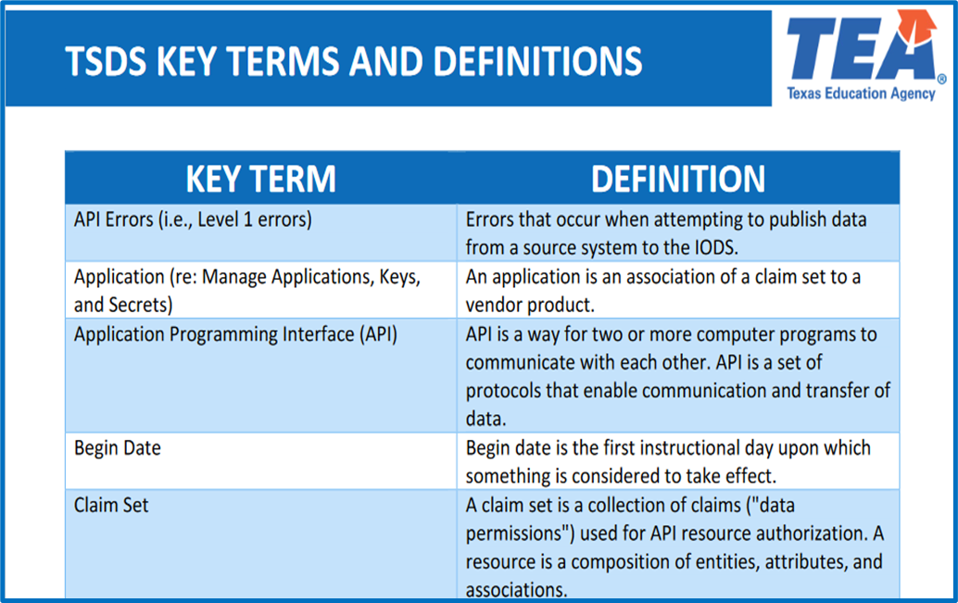
KEY TERMS
Please take a moment to familiarize yourself with common terminology by accessing the Key Terms and Definitions Document.
Access the Key Terms and Definitions Document.

Slide 3
LEARNING OBJECTIVES
  By the end of this course, users will be able to explain:
  The requirements for the Early Childhood Data System (ECDS) Prekindergarten (Pre-K) Submission.
  The data that comprises the ECDS Pre-K data submission.
  The TSDS reports for ECDS Pre-K.
Notes:
See slide.

Slide 4
WHY THIS COURSE IS IMPORTANT
To understand that accurate and timely ECDS reporting is critical to provide the Texas Education Agency (TEA) and other stakeholders with comprehensive data on early childhood programs across the state.​
​
To recognize that diligently reporting high-quality ECDS data contributes to statewide efforts to evaluate and enhance early childhood education while supporting LEAs in their early childhood programs with actionable data.
Notes:
See slide.

Slide 5

COURSE AGENDA
Getting Started
TSDS Architecture and TEAL Roles
Key Concepts
ECDS Pre-K and Reports
Training Activity
Activity and Knowledge Checks
Wrap Up
Key Takeaways, Resources, and Next Steps

Slide 6


GETTING STARTED
TSDS Architecture and TEAL Roles

Slide 7
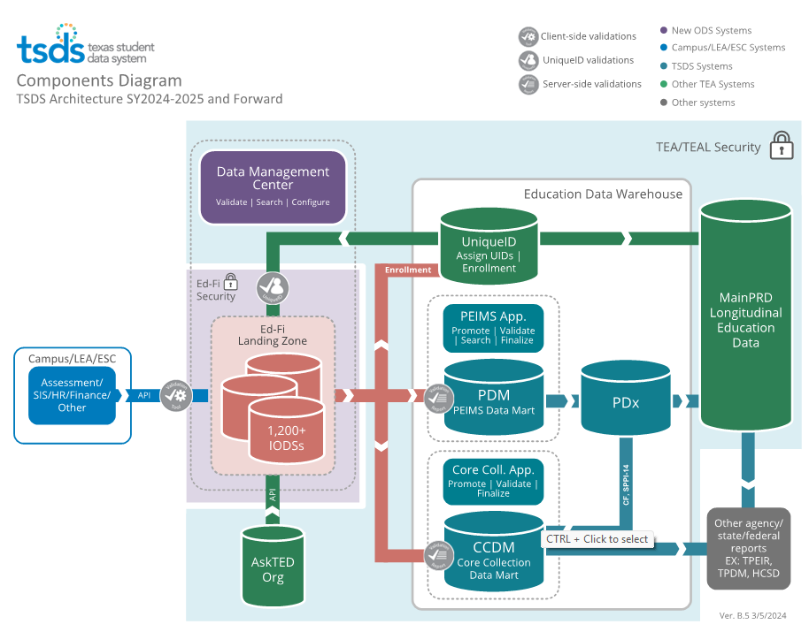
TSDS ARCHITECTURE

Slide 8
TEAL ROLES – ECDS
Core LEA Data Viewer
This role monitors data promotions and data validations and generates reports.
Core LEA Data Promoter
  This role schedules and monitors promotions, schedules and monitors validations, and generates reports.
Core LEA Data Completer
  This role formally certifies the completeness and accuracy of the data and finalizes the submission. In addition, this role also schedules and monitors promotions, schedules and monitors validations, and generates reports.
Core LEA Data Approver
This role will be for the superintendent or his/her designee at the LEA. This role requests an extension if needed.
Notes:
The role the LEA staff would request will depend on the individual’s level of responsibility.

Slide 9
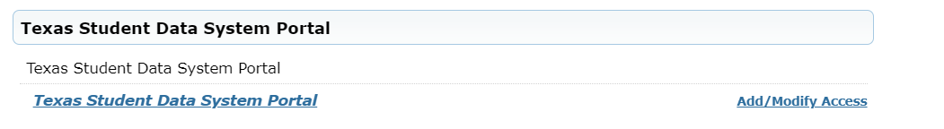
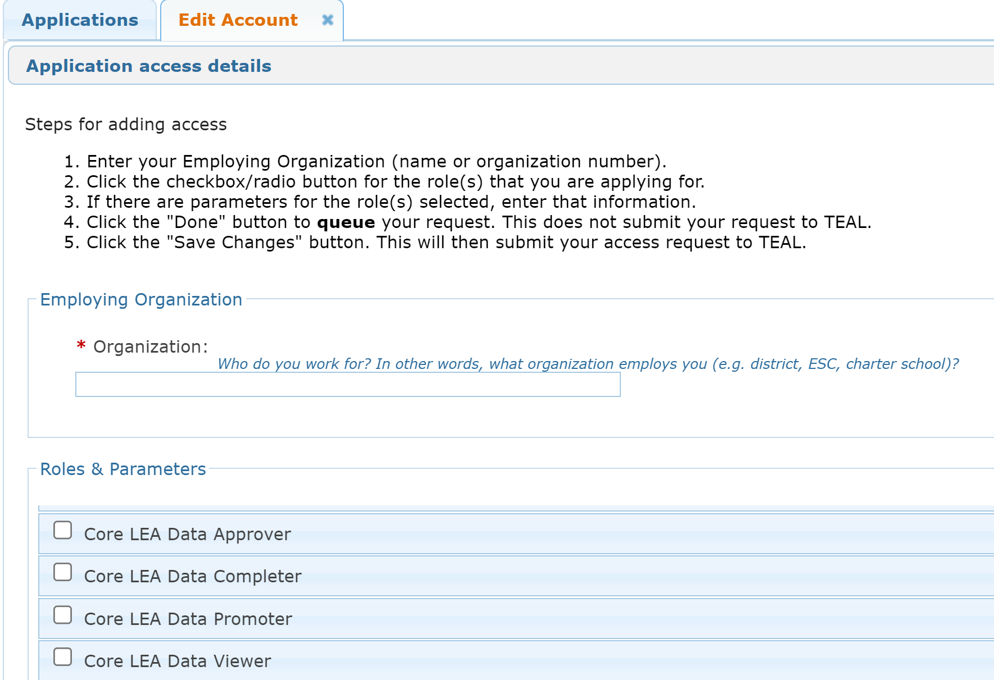

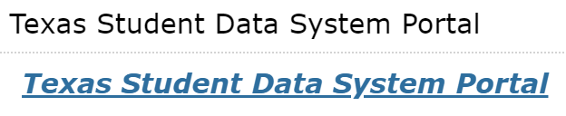

APPLY FOR ECDS ROLE
Login to your TEAL account; Click Add/Modify Access.
Enter your Employing Organization and select the appropriated Core LEA TEAL role.

Slide 10
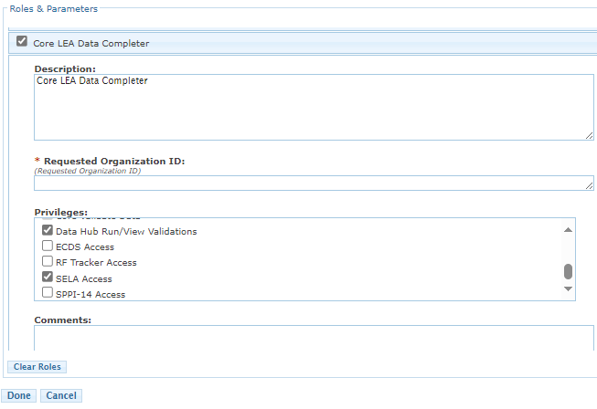
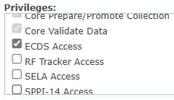
ECDS TEAL ROLE & PRIVILEGE
Users will check the appropriate role based on their level of responsibility at the LEA and in the Requested Organization ID enter their Organization ID.
Next, check the Privilege “ECDS Access” and click Done.
The final step is to click Save Changes on the next screen.
Notes:
Check ‘Class Roster Access’ under the Privileges.

Slide 11
ESC ROLE FOR ECDS
Core ESC Data Viewer
  This role will be able to view and monitor ECDS activity in TSDS for the LEAs the ESC supports.
Notes:
The ESC Data Viewer role will allow the ESC to monitor the data promotions for ECDS for the LEAs in their region.

Slide 12


KEY CONCEPTS
ECDS Pre-K

Slide 13
ECDS
The Early Childhood Data System (ECDS) is a state-wide reporting feature of the Texas Student Data System (TSDS). The system includes the collection of both KG and Pre-K student data.
ECDS allows schools and parents to gauge how well KG and Pre-K programs are preparing students for school, and especially for reading.
The system also empowers regional Education Service Centers (ESC) to compare results within their region to determine which programs are best serving students, and to encourage the sharing of successful strategies among districts.

Slide 14
TEA PROGRAM AREA INFORMATION
All Public pre-K programs will be required to submit demographic, classroom link information, special program information, and funding source information in the TSDS collection.
E1440 Homeroom Indicator designates the pre-K course/section that is connected to the Student and Teacher where the Commissioner approved assessment was administered.
All Public pre-K programs for 4-year-olds must administer an assessment from the Commissioner’s List of Approved Prekindergarten Assessment Instruments and will submit Beginning of Year (BOY) and End of Year (EOY) assessment data through the TSDS collection. ECDS Assessment Specifications
Notes:
Districts providing full-day prekindergarten for 4-year-olds must collect data on student progress in health and wellness, language and communication, emergent literacy reading, emergent literacy writing, and mathematics. Data is collected at the beginning and end of the year using approved tools from the Commissioner’s List. Districts and open-enrollment charters submit this data annually to TEA's Early Childhood Data System (ECDS).
Student progress monitoring is a very important part of the teaching cycle and is considered a best practice with all age groups. Progress monitoring enables a teacher to effectively adapt the daily classroom instruction to meet the needs of their students.

Slide 15
ECDS TIMELINE
ECDS Collection
ECDS Prekindergarten ready for users to complete | Beginning of May
ECDS Prekindergarten submission due date for LEAs | End of June

Slide 16
DOMAIN DEFINITIONS 1
Education Organization Domain – provides information about any public or charter school, education service center, organization or agency.
Student Identification and Demographics Domain – provides the characteristics and demographics of a student and the education organization associated with the student.
Enrollment Domain – provides the enrollment and withdrawal information for a student and the relationship between a particular education organization.

Slide 17
DOMAIN DEFINITIONS 2
Alternative and Supplemental Services Domain – provides program information such as Title I, Special Education, and Emergent Bilingual.
Teaching and Learning Domain – provides the course information, the students assigned to a course offered on a particular campus and the staff member that provides instruction for the course.​
Staff Domain – provides the general staff information for a local education agency.​
Assessment Domain – provides the assessments given to students and the results.​

Slide 18
ECDS SPECIFIC DATA ELEMENTS
    Data Elements
      E1440 HomeroomIndicator
      E3010 BeginDate
      E3020 EndDate
      E1579 PKCurricula
      E1078 PKProgramType
      E1583 FamilyEngagementPlanLink
      E3044 PKFundingSource
      E1573 ReportAssessmentType
      E1154 AssessmentReportingMethod
      E1097 AcademicSubject
      E1726 ChildCareOperationNumber
      E0790 EmergenctBilingualIndicator
Note: More information about the data can be found in the TSDS Web-Enabled Data Standards (TWEDS).
Notes:
TWEDS
Go to the TSDS website at https://www.texasstudentdatasystem.org
Hover over the TEDS Data Standards tab.
Next, click on ‘TWEDS Upgrade’
Finally, click on the “XXXX-XXXX Texas Education Data Standards via TWEDS” hyperlink.

Slide 19
CATEGORIES TO PROMOTE
Categories
  Education Organization
  Campus Course Section
  Staff
  Student
  Assessment
Sub-Categories
  Local Education Agency, Campus
  Course Section
  Staff Basic Info., Teacher Class Assignment
  Student Basic Info., Enrollment (School Association), Enrollment (Programs), Student Assessment, Student Section
  Assessment Metadata
TSDS Data Collection Documentation
Notes:
Trainer:
Navigate to this link https://www.texasstudentdatasystem.org/tsds/about/resources and go to the ‘Data Collection Documentation’ tab to see the ECDS Promotion Logic and Test Case documents.

Slide 20
LEVELS OF VALIDATIONS
LEVEL 1
(Vendor Source System)
Includes basic data integrity checks that occur during the process of loading data via API transactions into the Individual Operational Data Store (IODS) in the Landing Zone. Data that fails Level 1 validations does not enter the IODS.
LEVEL 1.5
(DMC: DMC Data Monitor)
Includes filters that prevent invalid or non-TSDS data from being loaded into TSDS. These filters include Unique ID checks, descriptor value checks, Do Not Report flag checks, and Course ID checks.
LEVEL 3
(PEIMS/Core: Existing TEAL Roles)
Business rules that are executed in TSDS. Level 3 validations contain all Level 2 validations, plus any additional validations required for the TSDS submissions. Fatal errors prevent TSDS submissions from being completed or finalized.
LEVEL 2
(DMC: DMC L2 Validations)
Business rules that are executed on the data destined for TSDS. Fatal, Special Warning, and Warning validation errors do not prevent data from being loaded to TSDS.
Prevents data from loading to IODS
Prevents data from loading to TSDS
Does not prevent loading to TSDS.
Fatals prevent from completing submission

Slide 21
ECDS VALIDATIONS 1
  As part of checking your data validations, check with your DMC Technical Steward to make sure that none of your ECDS pre-K data is appearing in L1.5 filters.
  Additionally, check your staff and student Unaffiliated Reports.

Slide 22
ECDS VALIDATIONS 2
  ECDS includes business validations such as:
  60010-0006 - If ReportAssessmentType is "02" (ECDS - PK), then AssessedGradeLevel must be "PK" (PreKindergarten).
  40110-0034 - If PKFundingSource with OrderOfPKFundingSource of 2 (Secondary PK Funding Source) is reported, then PKFundingSource with OrderOfPKFundingSource of 1 (Primary PK Funding Source) must also be reported, and the two PKFundingSource values must not be the same.
  Review TWEDS for all business validations for CSW.
Notes:
ECDS PK Submission provides data validations to ensure data quality and compliance.
LEAs can run validations against specific data subcategories or validate an entire submission at once. Error reporting allows the LEAs to identify data issues with their ECDS collection.
60010-0006
If ReportAssessmentType is "02" (ECDS - PK), then AssessedGradeLevel must be "PK" (PreKindergarten).
Pre-K Assessments collected for the Early Childhood Data System (ECDS) must have a AssessedGradeLevel of PreKindergarten ("PK").
40110-0034
If PKFundingSource with OrderOfPKFundingSource of 2 (Secondary PK Funding Source) is reported, then PKFundingSource with OrderOfPKFundingSource of 1 (Primary PK Funding Source) must also be reported, and the two PKFundingSource values must not be the same.
Any student reported with a Secondary PKFundingSource must be reported with a Primary PKFundingSource and those values must be different.
TWEDS
Go to the TSDS website at https://www.texasstudentdatasystem.org
Hover over the TEDS Data Standards tab.
Next, click on ‘TWEDS Upgrade’
Finally, click on the “XXXX-XXXX Texas Education Data Standards via TWEDS” hyperlink.

Slide 23
ECDS PRE-K REPORTS

Slide 24
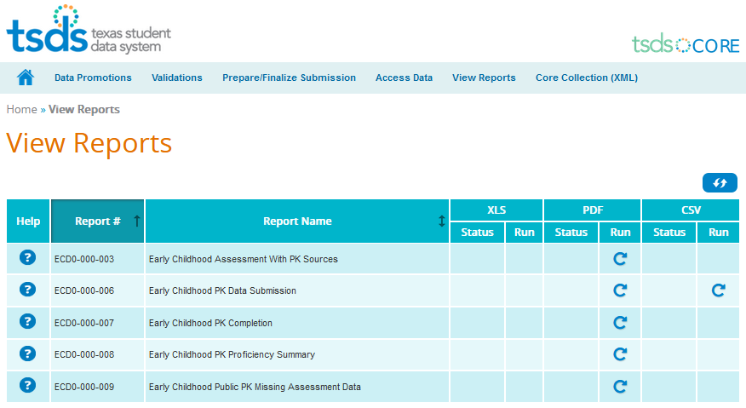
ECDS PRE-K REPORTS
Notes:
The report will generate a PDF or CSV document, depending on the report. The Help document provides more details about the report layout and report fields. It is vital that the report be run and all data on the report verified. Sometimes data on the report will reveal incorrect information that did not trigger an error message. Go back to SIS, make corrections, and go through the process again.

Slide 25
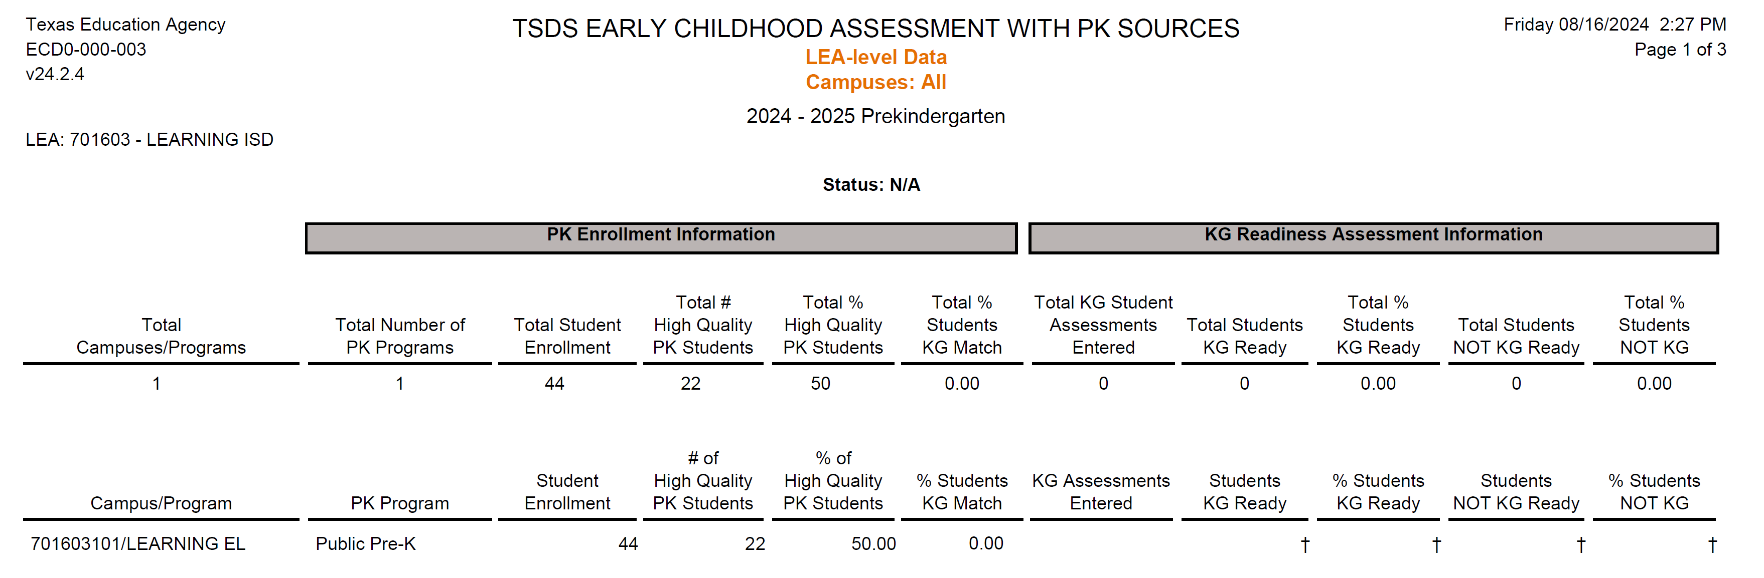

ECD0-000-003
Verify correct pre-K Program and Student Enrollment.
% of pre-K Students who have been matched to the current KG students.
Notes:
This report will show the students who are currently in KG and for whom EDCS data was submitted last year in preK. The main purpose of this report is to identify the association Early Childhood (preK) Programs associated with KG students and their “Ready/Not Ready” status.
The data within the report shall be calculated by:
Match the preK students for the school year being reported to the KG students in the NEXT school year. For example, the preK students reported for 2024-25 would be matched to 2026-26 KG students.
For those students that are matched, identify the name of the preK program associated with the student.
For each preK program, accumulate the number of students that are identified as part of the match.
Total students will be accumulated for each preK program identified in the match and aggregated based on the criteria of the report (i.e., Classroom, Campus, LEA/District, etc).
Note: There must be 2 years of data.

Slide 26
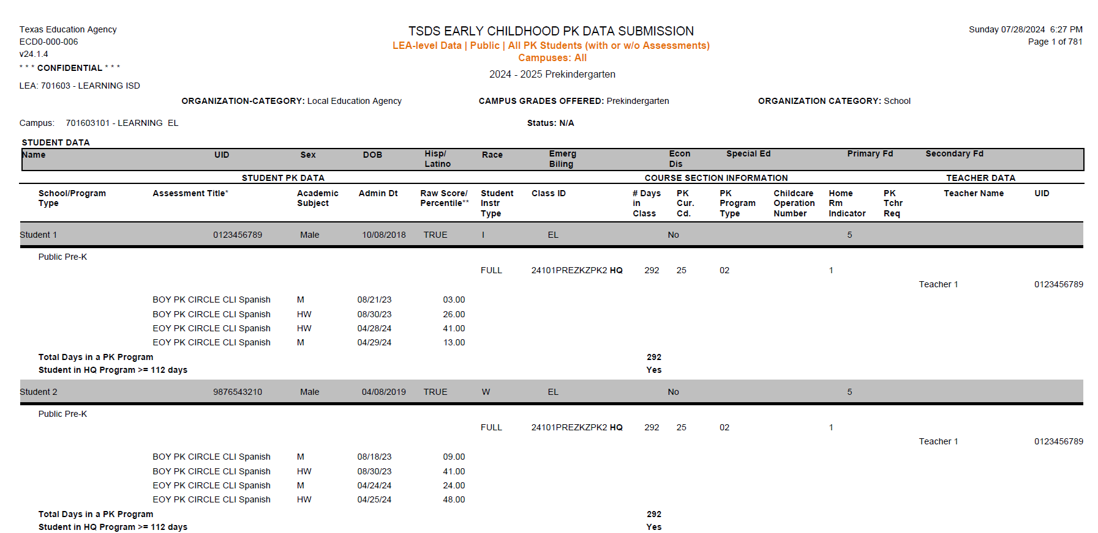
ECD0-000-006
Verify # of days in pre-K Program and # of days in HQ program.
Notes:
This report provides a detailed breakdown of the data submissions for the preK submission. The purpose of the report is to allow LEAs and campuses to review data to evaluate whether their preK submission is complete.

Slide 27
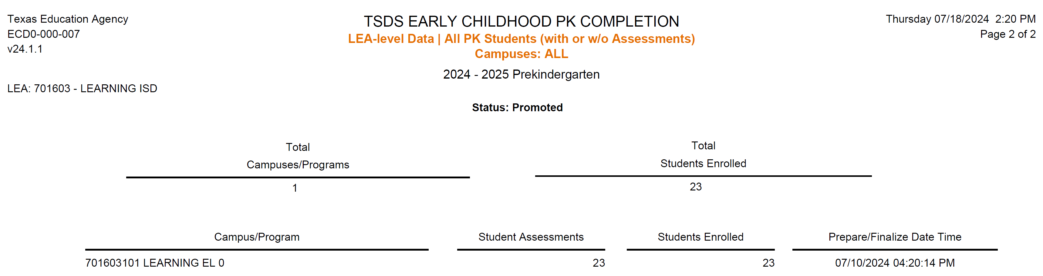
ECD0-000-007
Total number of students with valid assessment scores from the campus or program.
Verify the Family Engagement URL information.
Notes:
This report provides users with an overall status of the current ECDS preK submission for all preK programs. The reports may be run any time from when the submission is open until it is closed or complete.
Note: The FamilyEngagementPlan URL data element has a 200-character data limit.

Slide 28
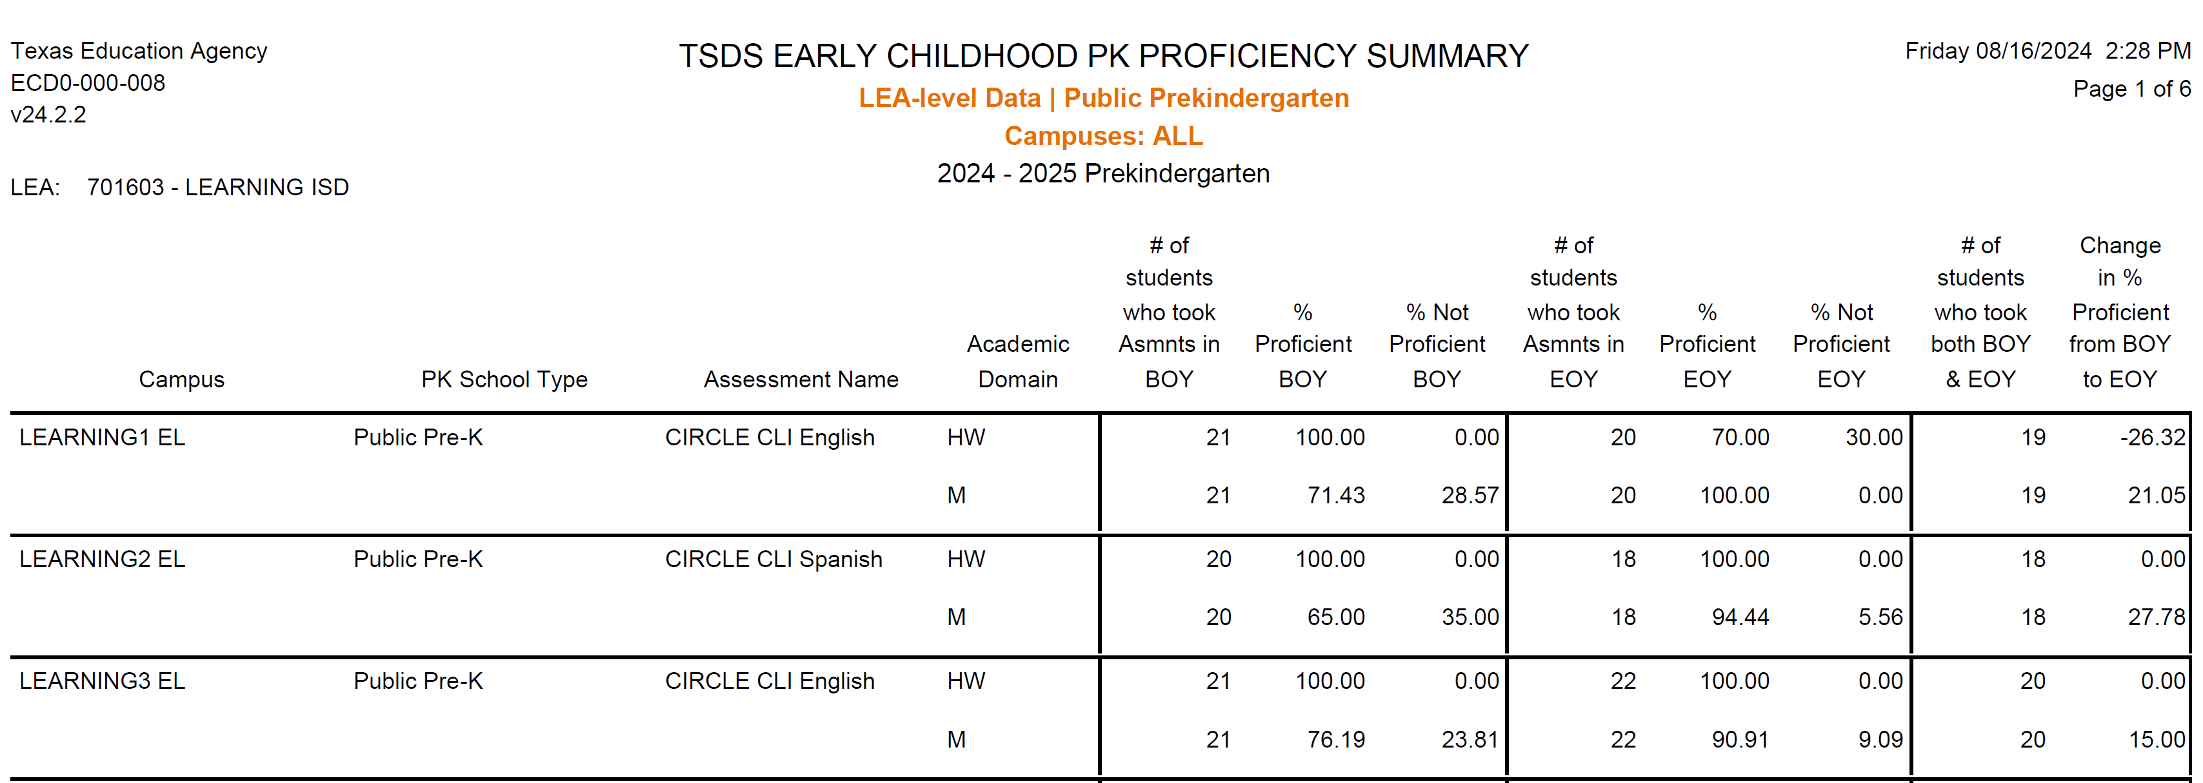
ECD0-000-008
Notes:
This report provides the compiled results by preK program for beginning-of-year and end-of-year assessments, and a comparison of the two.
Authorized users will be able to generate a report that provides the compiled results by preK program for BOY and EOY assessments, and a comparison of the two.
The report will be available at the ESC, LEA, and Campus levels.

Slide 29
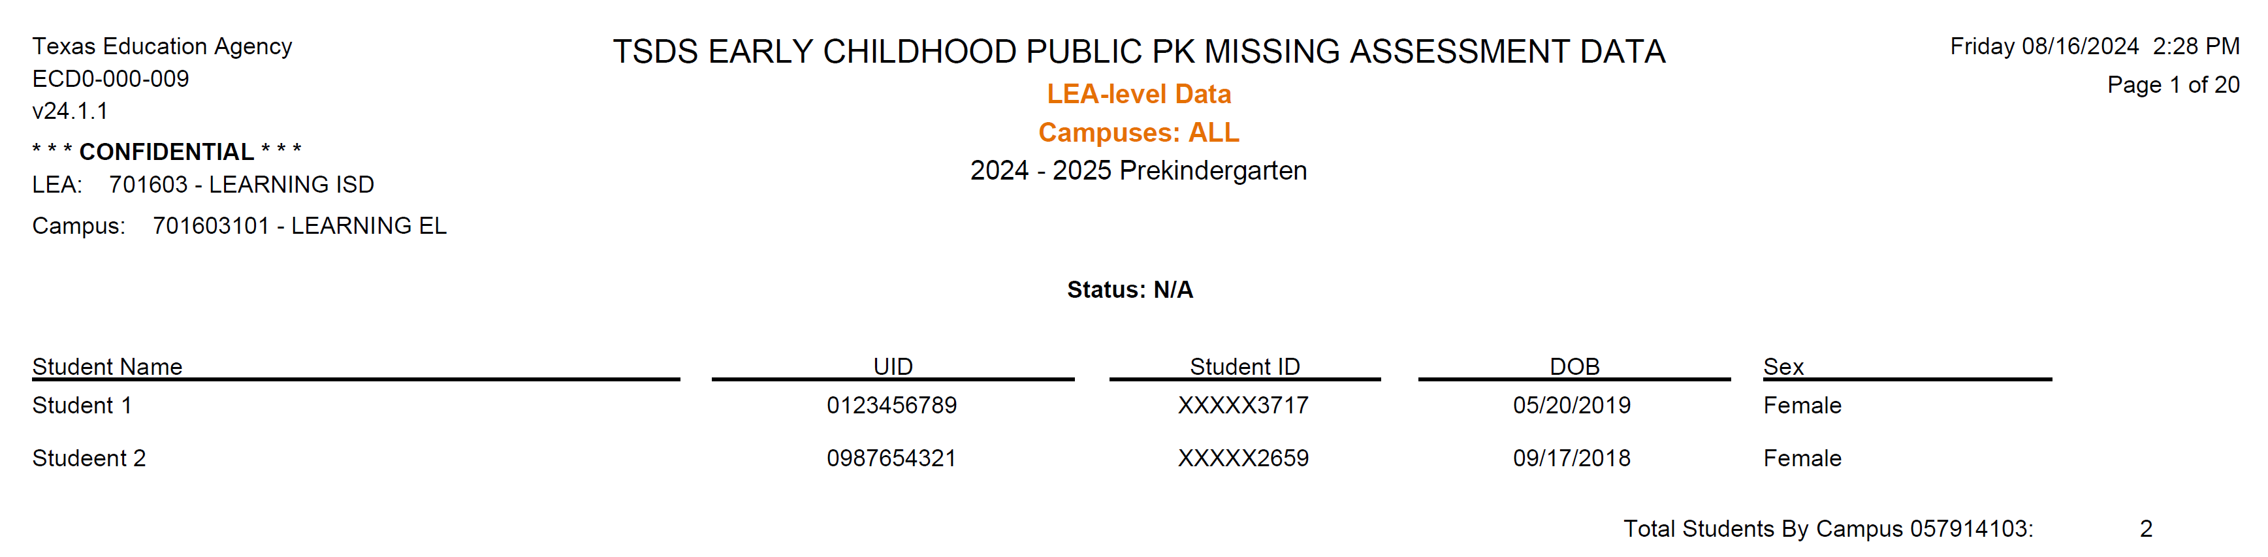
ECD0-000-009
Review all students on report to verify if there is potential missing assessment data.
Notes:
This report shows the total count of distinct students who have missing assessment data attributed to the campus in the preK submission. The student could be reflected on multiple campus reports. LEAs should use this report to identify missing ECDS Assessment data prior to making their data submissions “Complete.”
This report lists "Potential students missing a PK assessment." As not all Pre-K students might have been assessed for various reasons documented in the last page of the Assessment Specifications - ECDS Not Assessed guidance chart.

Slide 30
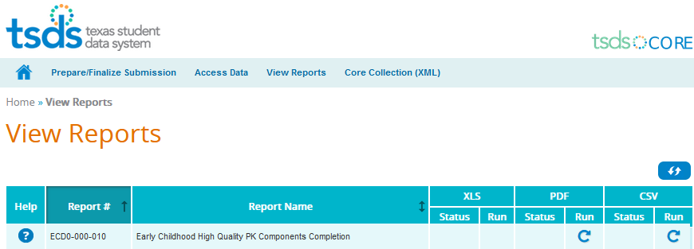
ECDS REPORT – ESC ONLY

Slide 31
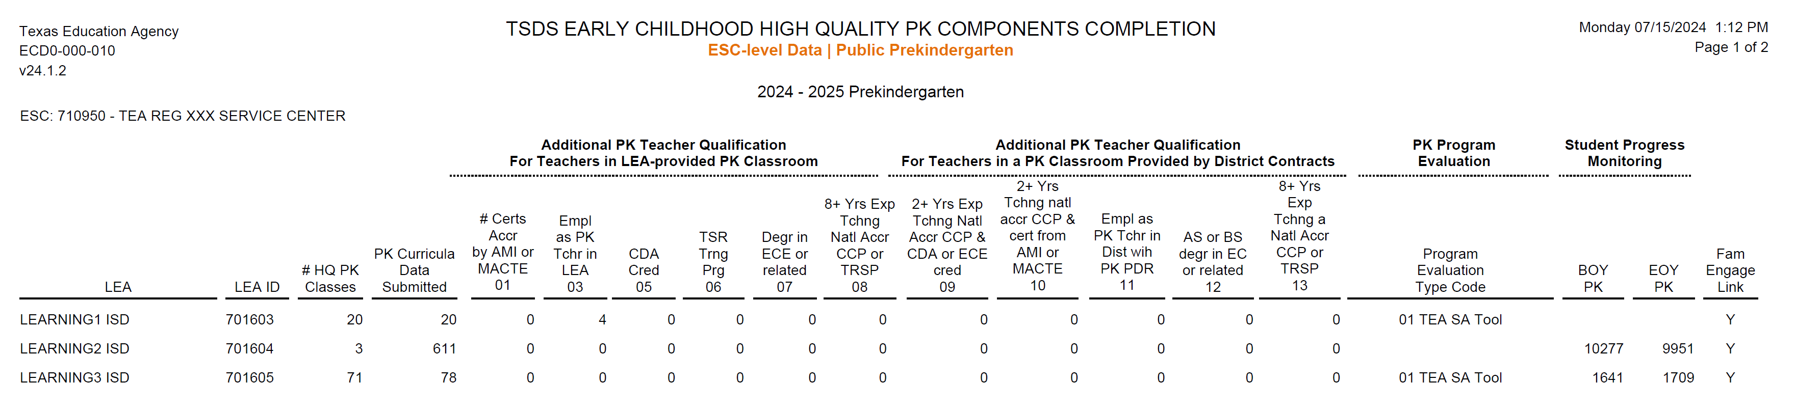
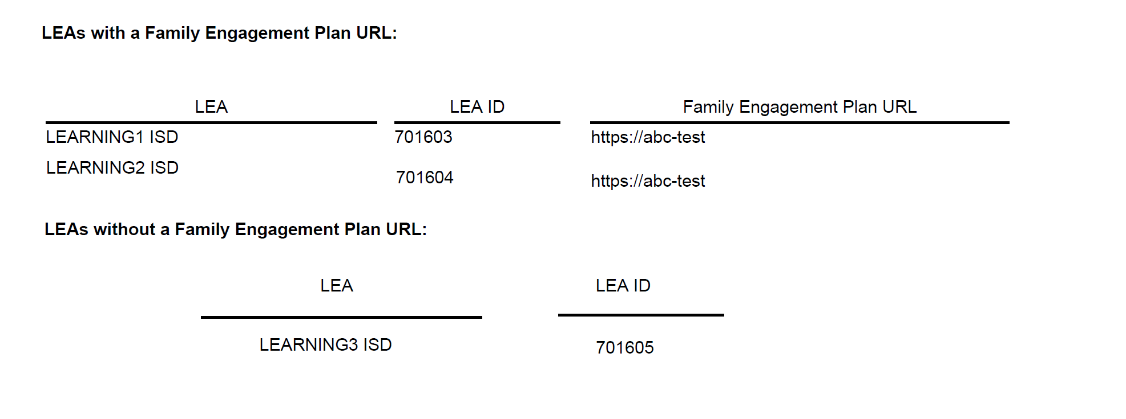
ECD0-000-010 – ESC ONLY
Verify the HQPK component data for each of the LEAs in your region.
Notes:
The report is available to ESCs to ensure LEAs are submitting data for the following:
Additional Pre-K Teacher Qualifications
# HQPK Classes
Pre-K Program Evaluation
Student Monitoring Progress Completion
Family Engagement Plan URL link information

Slide 32

TRAINING ACTIVITY
Activity and Knowledge Checks

Slide 33
TROUBLESHOOTING 1
Scenario 1: I am getting validation errors because the BeginDate(E3010) and EndDate(E3010) for certain data elements are missing or not correctly reported
Resolution Steps:
Business validation logic requires that a BeginDate(E3010) and EndDate(E3010) must be reported for certain data elements.
Visit TWEDS to review TEDS to find more information on which data elements require the BeginDate and EndDate to be reported with their respective definitions.
E.g., StudentSectionAssociation Entity:
  BeginDate (E3010) is the first instructional day in the current school year the student is assigned to the section.
  EndDate (E3020) is the first day after the last instructional day the student is no longer assigned to the section.
Notes:
TWEDS
Go to the TSDS website at https://www.texasstudentdatasystem.org
Hover over the TEDS Data Standards tab.
Next, click on ‘TWEDS Upgrade’
Finally, click on the “XXXX-XXXX Texas Education Data Standards via TWEDS” hyperlink.

Slide 34
TROUBLESHOOTING 2
Scenario 1: Why am I getting this fatal error: 40110-0173?
Resolution Steps:
For each StudentAssessment for an Assessment with ReportAssessmentType of "01" (ECDS - KG) or "02" (ECDS - PK), the HomeroomIndicator must not be blank on any StudentSectionAssociations with a matching StudentUniqueId.
HomeroomIndicator (E1440) indicates the homeroom section assigned to the student.
HomeroomIndicator must be reported for all Public preKindergarten and Kindergarten students reported with an ECDS assessment.
Ensure that the values in the HomeroomIndicator field correctly indicate the homeroom status (e.g., true or false)

Slide 35
KNOWLEDGE CHECK 1
What is the primary purpose of ECDS preK reporting?
  To track teacher certifications
  To collect data on prekindergarten programs and student outcomes
  To monitor district financial compliance
  To report STAAR results
Notes:
NOTE:
To see the answer, you must be in presentation mode.

Slide 36
KNOWLEDGE CHECK 2
What students are included in ECDS PK Submission?
  PK only
  Both PK and KG
  KG only
Notes:
NOTE
To see the answer, you must be in presentation mode.

Slide 37
KNOWLEDGE CHECK 3
What data must districts report for the PK Submission?
  Student demographics, program type, and assessment results.
  Teach salary information
  Campus ratings
  Parent income verification
Notes:
NOTE
To see the answer, you must be in presentation mode.

Slide 38
KNOWLEDGE CHECK 4
ECDS PK Submission include both enrollment and assessment data for PK students?
  True
  False
Notes:
NOTE
To see the answer, you must be in presentation mode.

Slide 39
KNOWLEDGE CHECK 5
Why is it important to use an assessment from the Texas Commissioner’s List of Approved Prekindergarten Assessment Instruments Commissioner’s List?
  To ensure compliance with state requirements
  To allow districts to choose any assessment
  To reduce reporting requirements
Notes:
NOTE
To see the answer, you must be in presentation mode.

Slide 40

WRAP UP
Key Takeaways, Resources, and Next Steps

Slide 41

KEY TAKEAWAYS
ECDS data is submitted through TSDS.
All Public pre-K programs that administer an assessment from the Commissioner’s List of Approved Prekindergarten Assessment Instruments, will submit Beginning of Year (BOY) and End of Year (EOY) assessment data through the TSDS collection.
TRAINING RESOURCES
        Key Terms and Definitions
        ECDS Reference Guide

Slide 42
TECHNICAL RESOURCES
TEA Website and Communication Resources
    Early Childhood Education Website
ECDS Program Area Support:
    Early Childhood Education Support Portal
  Texas Education Data Standards Resources
    TSDS Web-Enabled Data Standards
Notes:
TWEDS
Go to the TSDS website at https://www.texasstudentdatasystem.org
Hover over the TEDS Data Standards tab.
Next, click on ‘TWEDS Upgrade’
Finally, click on the “XXXX-XXXX Texas Education Data Standards via TWEDS” hyperlink.

Slide 43
NEXT STEPS
Attend Common Steps for Core Collection Training
Complete a Teach Back Exercise
Complete ECDS Pre-K Certification Test
  Attend TSDS Continuing Education Trainings (CET)
  Participate in TSDS Just-in-Time Trainings (JIT)
  Attend Field Coordination Network (FCN) webinars for
  new updates and changes

Slide 44
WRAP UP
  In this training we talked about:
  The requirements for the Early Childhood Data System (ECDS) Submission.
  The data that comprises the ECDS Pre-K data submission.
  How to promote ECDS Pre-K data.
  The Texas Student Data System (TSD) reports for ECDS Pre-K.

Slide 45

QUESTIONS

