Slide 1

TITLE SLIDE: TSDS ODS 3.x Project
Updates
Early Childhood Data System (ECDS) Kindergarten (KG) New User Certification Training
Notes:
This course provides an overview of the "why" for Early Childhood Data System (ECDS) KG Submission and is provided in conjunction with the Common Steps for Core Collections training where the actual "how" for ECDS KG submission process will be discussed in detail.

Slide 2
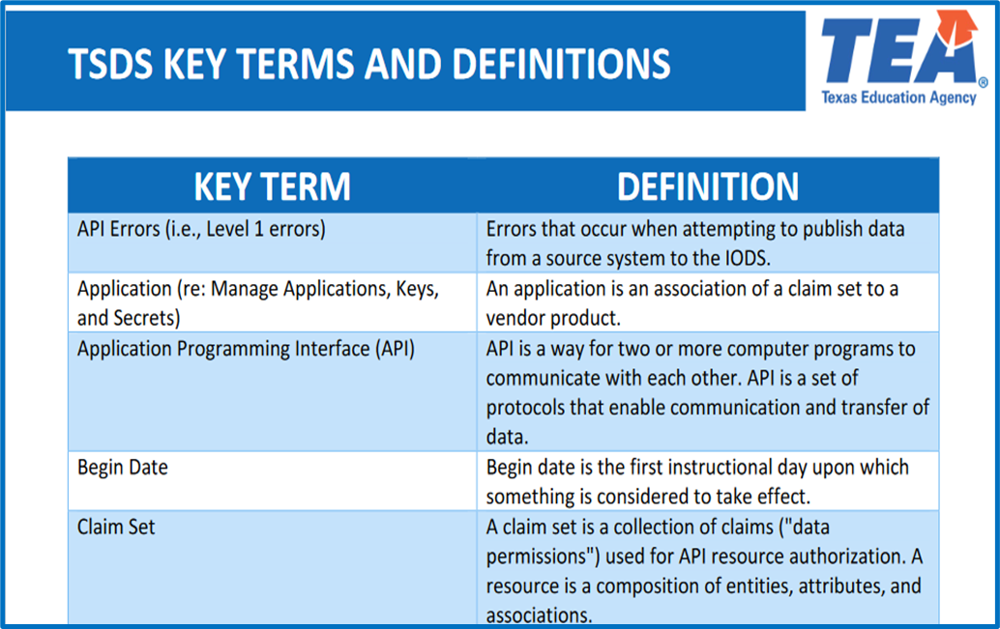
KEY TERMS
Please take a moment to familiarize yourself with common terminology by accessing the Key Terms and Definitions Document.
Access the Key Terms and Definitions Document.

Slide 3
LEARNING OBJECTIVES
By the end of this course, users will be able to explain:
The requirements for the Early Childhood Data System (ECDS) KG Submission.
The data that comprises the ECDS KG data submission.
How to promote ECDS KG data.
The TSDS reports for ECDS KG.
Notes:
See slide.

Slide 4
WHY THIS COURSE IS IMPORTANT
To understand that accurate and timely ECDS reporting is critical to provide the Texas Education Agency (TEA) and other stakeholders with comprehensive data on early childhood programs across the state.
To recognize that diligently reporting high-quality ECDS data contributes to statewide efforts to evaluate and enhance early childhood education while supporting LEAs in their early childhood programs with actionable data.
Notes:
See slide.

Slide 5

COURSE AGENDA
Getting Started
TSDS Architecture, TEAL Roles, Promotion Demo
Key Concepts
ECDS KG and Reports
Training Activity
Practice, Troubleshooting, and Knowledge Checks
Wrap Up
Key Takeaways, Resources, and Next Steps

Slide 6


GETTING STARTED
TSDS Architecture, TEAL Roles, Promotion Demo

Slide 7
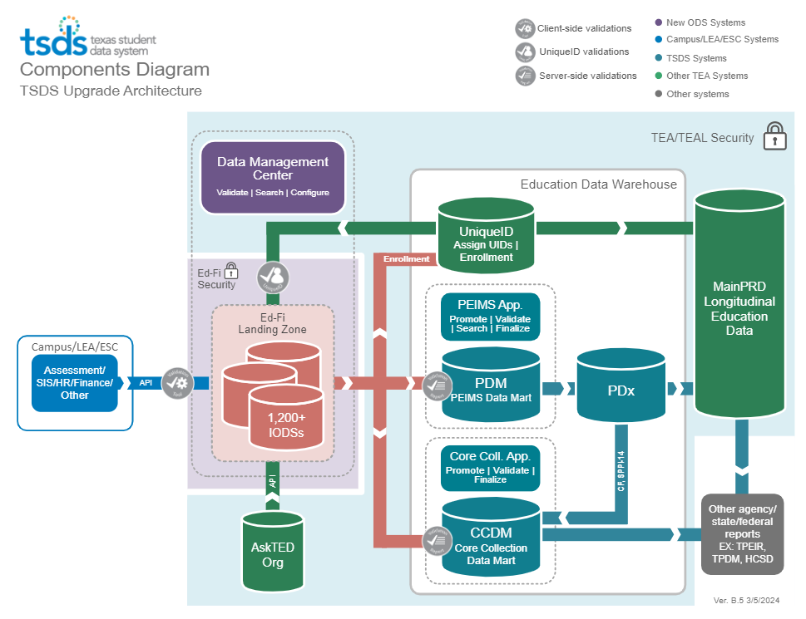
HIGH-LEVEL ARCHITECTURE

Slide 8
TEAL ROLES – ECDS
Core LEA Data Viewer
This role monitors data promotions and data validations and generates reports.
Core LEA Data Promoter
This role schedules and monitors promotions, schedules and monitors validations, and generates reports.
Core LEA Data Completer
This role formally certifies the completeness and accuracy of the data and finalizes the submission. In addition, this role also schedules and monitors promotions, schedules and monitors validations, and generates reports.
Core LEA Data Approver
This role will be for the superintendent or his/her designee at the LEA. This role requests an extension if needed.
Notes:
The role the LEA staff would request will depend on the individual’s level of responsibility.

Slide 9
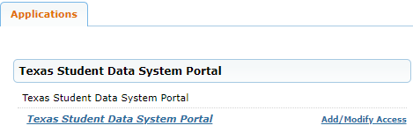
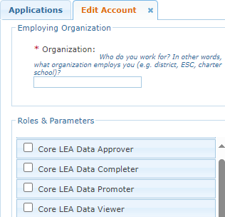
APPLY FOR ECDS ROLE
Login to your TEAL account; Click Add/Modify Access.
Enter your Employing Organization and select the appropriated Core LEA TEAL role.

Slide 10
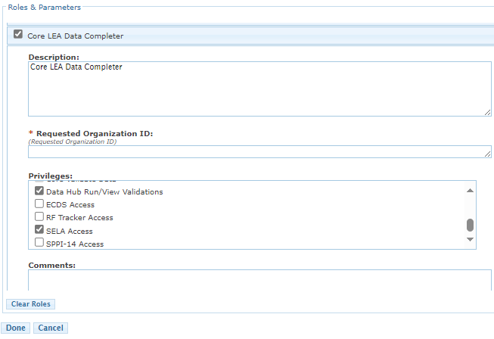
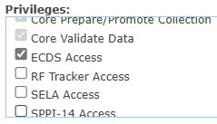
ECDS TEAL ROLE & PRIVILEGE
Users will check the appropriate role based on their level of responsibility at the LEA and in the Requested Organization ID enter their Organization ID.
Next, check the Privilege “ECDS Access” and click Done.
The final step is to click Save Changes on the next screen.
Notes:
Check ‘ECDS Access’ under the Privileges.

Slide 11
ESC ROLE FOR ECDS
Core ESC Data Viewer
This role will be able to view and monitor ECDS activity in TSDS for the LEAs the ESC supports.
Notes:
The ESC Data Viewer role will allow the ESC to monitor the data promotions for ECDS for the LEAs in their region.

Slide 12
PROMOTION DEMO
Login to TEAL Account
Navigate to Core Collection Application
Promote ECDS KG data
Monitor data promotion
NOTE: The Reference Guide (RG) is a resource that provides step-by-step instructions for Promoting, Validating, and Completing the ECDS Submissions.​
ECDS Reference Guide

Slide 13


KEY CONCEPTS
ECDS KG

Slide 14
ECDS
The Early Childhood Data System (ECDS) is a state-wide reporting feature of the Texas Student Data System (TSDS). The system includes the collection of both KG and pre-K student data.
ECDS allows schools and parents to gauge how well KG and pre-K programs are preparing students for school, and especially for reading.
The system also empowers regional Education Service Centers (ESC) to compare results within their region to determine which programs are best serving students, and to encourage the sharing of successful strategies among districts.

Slide 15
TEA PROGRAM AREA INFORMATION
All LEAs that serve students enrolled in KG will submit demographic, classroom link information, and special program information in the TSDS collection.
All participating KG programs will submit Beginning of Year (BOY) assessment data through the TSDS collection.
E1440 Homeroom Indicator designates the KG course/section that is connected to the Student and Teacher where the Commissioner approved assessment was administered.
LEAs with a KG program must administer either a TX-KEA or mClass assessment - ECDS Assessment Specifications
Notes:
As defined in TEC 28.006 districts and open-enrollment charter schools must conduct a beginning of year (BOY) reading screener using either TX-KEA or mCLASS Texas (both free of charge). This raw data is submitted to the Early Childhood Data System (ECDS) yearly. Diagnosing reading development and comprehension of kindergarten students is vital, in whatever form it may take.

Slide 16
ECDS TIMELINE
ECDS Collection
ECDS KG ready for users to complete | Beginning of November
ECDS KG submission due date for LEAs | End of January

Slide 17
DOMAIN DEFINITIONS 1
Education Organization Domain – provides information about any public or charter school, education service center, organization or agency.
Student Identification and Demographics Domain – provides the characteristics and demographics of a student and the education organization associated with the student.
Enrollment Domain – provides the enrollment and withdrawal information for a student and the relationship between a particular education organization.

Slide 18
DOMAIN DEFINITIONS 2
Teaching and Learning Domain – provides the course information, the students assigned to a course offered on a particular campus and the staff member that provides instruction for the course.​
Staff Domain – provides the general staff information for a local education agency.​
Assessment Domain – provides the assessments given to students and the results.​

Slide 19
ECDS SPECIFIC DATA ELEMENTS
Data Elements
E1440 HomeroomIndicator
E3010 BeginDate
E3020 EndDate
E1127 TitleofAssessment
E1573 ReportAssessmentType
E1097 AcademicSubject
E1129 AssessmentGradeLevel
E1396 AdministrationDate
E1154 AssessmentReportingMethod
E1359 Result
Note: More information about the data can be found in the TSDS Web-Enabled Data Standards (TWEDS).
Notes:
TWEDS
Go to the TSDS website at https://www.texasstudentdatasystem.org
Hover over the TEDS Data Standards tab.
Next, click on ‘TWEDS Upgrade’
Finally, click on the “XXXX-XXXX Texas Education Data Standards via TWEDS” hyperlink.
ECDS AssesssmentMetadata is now pre-coded in the IODS by TEA.
E1127 TitleofAssessment
E1573 ReportAssessmentType
E1097 AcademicSubject
E1129 AssessmentGradeLevel
E1396 AdministrationDate
E1154 AssessmentReportingMethod
E1359 Result
ECDS KG assessment vendors will only need to send the data elements from the StudentAssessment entity shown on the slide.

Slide 20
CATEGORIES TO PROMOTE
Categories
Education Organization
Campus Course Section
Staff
Student
Assessment
Sub-Categories
Local Education Agency, Campus
Course Section
Staff Basic Info., Teacher Class Assignment
Student Basic Info., Enrollment (School Association), Student Assessment, Student Section
Assessment Metadata
TSDS Data Collection Documentation
Notes:
Trainer:
Navigate to this link https://www.texasstudentdatasystem.org/tsds/about/resources and go to the ‘Data Collection Documentation’ tab to see the ECDS Promotion Logic and Test Case documents.

Slide 21
LEVELS OF VALIDATIONS
LEVEL 1
(Vendor Source System)
Includes basic data integrity checks that occur during the process of loading data via API transactions into the Individual Operational Data Store (IODS) in the Landing Zone. Data that fails Level 1 validations does not enter the IODS.
LEVEL 1.5
(DMC: DMC Data Monitor)
Includes filters that prevent invalid or non-TSDS data from being loaded into TSDS. These filters include Unique ID checks, descriptor value checks, Do Not Report flag checks, and Course ID checks.
LEVEL 3
(PEIMS/Core: Existing TEAL Roles)
Business rules that are executed in TSDS. Level 3 validations contain all Level 2 validations, plus any additional validations required for the TSDS submissions. Fatal errors prevent TSDS submissions from being completed or finalized.
LEVEL 2
(DMC: DMC L2 Validations)
Business rules that are executed on the data destined for TSDS. Fatal, Special Warning, and Warning validation errors do not prevent data from being loaded to TSDS.
Prevents data from loading to IODS
Prevents data from loading to TSDS
Does not prevent loading to TSDS.
Fatals prevent from completing submission

Slide 22
ECDS VALIDATIONS 1
As part of checking your data validations, check with your DMC Technical Steward to make sure that none of your ECDS KG data is appearing in L1.5 filters.
Additionally, check your staff and student Unaffiliated Reports.

Slide 23
ECDS VALIDATIONS 2
ECDS includes business validations such as:
10010-0016 - For each Local Education Agency’s data submission, if at least one KG student is reported (StudentSchoolAssociation data with EntryGradeLevel "KG"), then there must be Kindergarten Assessment data reported where ReportAssessmentType is "01" (ECDS - KG).
60010-0005 - If ReportAssessmentType is "01" (ECDS - KG), then AssessedGradeLevel must be "KG" (Kindergarten).
46010-0007 - For each StudentAssessment for an Assessment with ReportAssessmentType of "01" (ECDS - KG), the AssessmentReportingMethod must be "27" (Raw Score).
Review the Texas Education Data Standards (TEDS) via the TSDS Web-Enabled Data Standards (TWEDS) for all business validations for PEIMS.
Notes:
ECDS provides data validations to ensure data quality and compliance.
LEAs can run validations against specific data subcategories or validate an entire submission at once. Error reporting allows the LEAs to identify data issues with their ECDS collection.
KG:
10010-0016 - For reporting KG data for ECDS, each LEA that reports at least one KG student also must report assessment data.
0010-0005 - KG Assessments collected for the Early Childhood Data System (ECDS) must have a AssessedGradeLevel of Kindergarten ("KG").
46010-0007 - KG Assessments collected for the Early Childhood Data System (ECDS) must have a AssessmentReportingMethod of Raw Score ("27").

Slide 24
ECDS KG REPORTS

Slide 25
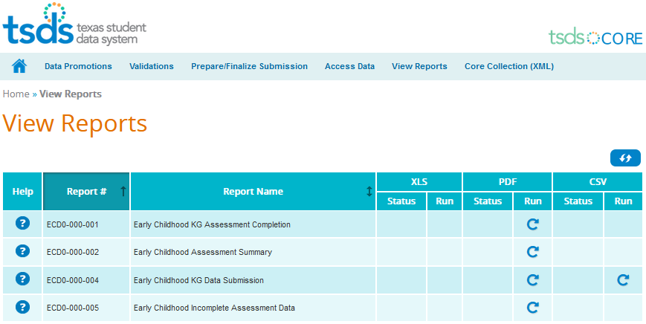
ECDS REPORTS
Notes:
The report will generate a PDF or CSV document, depending on the report. The Help document provides more details about the report layout and report fields. It is vital that the report be run and all data on the report verified. Sometimes data on the report will reveal incorrect information that did not trigger an error message. Go back to SIS, make corrections, and go through the process again.

Slide 26
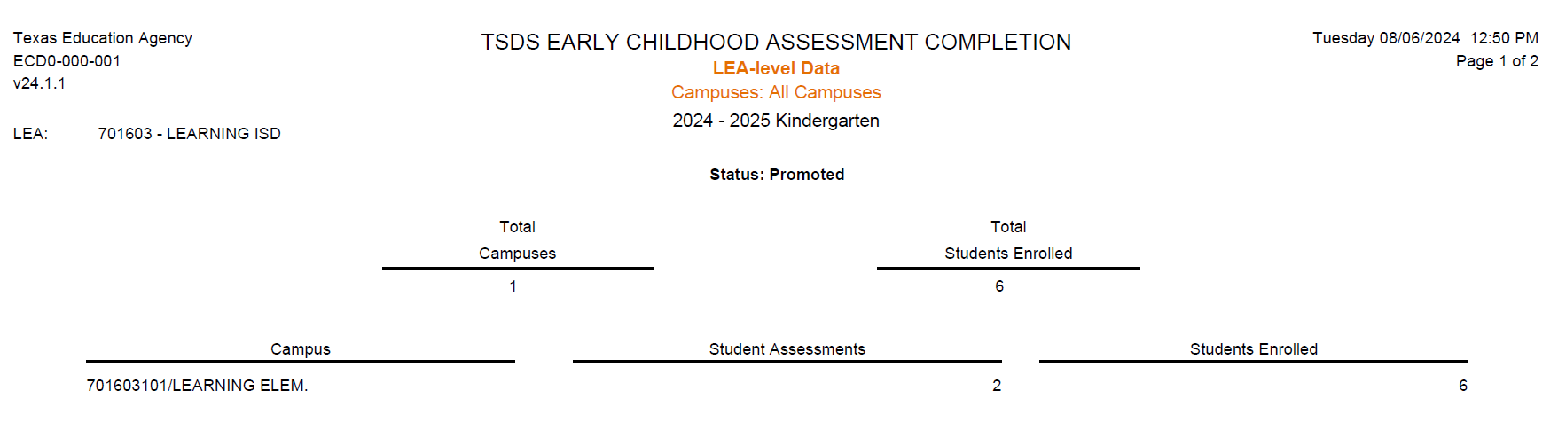
ECD0-000-001
Verify Status
Verify correct number of Student Assessments and Students Entered.
Notes:
This report displays all submitted assessment completion data to help LEAs evaluate if their submission is complete.
Total Campuses/Programs - Total number of campuses or programs with assessment data
Total Students Entered - Total number of students with valid assessment scores within all classes. Although multiple assessment instruments scores may be submitted for a student, each student is only counted once.

Slide 27
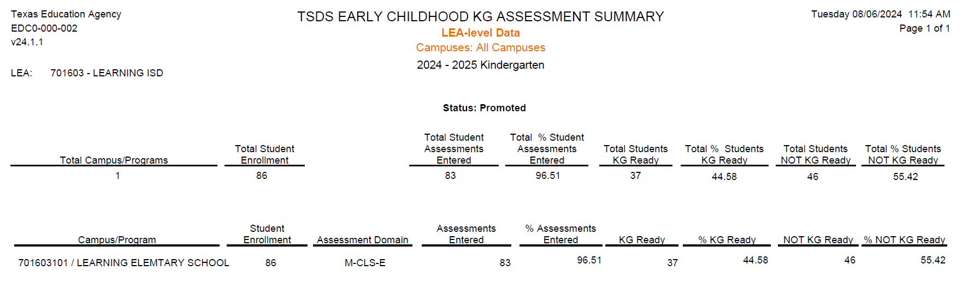
ECD0-000-002
701603101 LEARNING ELEMENTARY SCHOOL
Verify correct number of Students Enrolled and Assessments Entered.
Verify Kindergarten Ready/Not Ready counts and percentages.
Notes:
This report summarizes the results of KG assessments, showing the number and percentage of students who are KG ready or who are not KG ready.

Slide 28
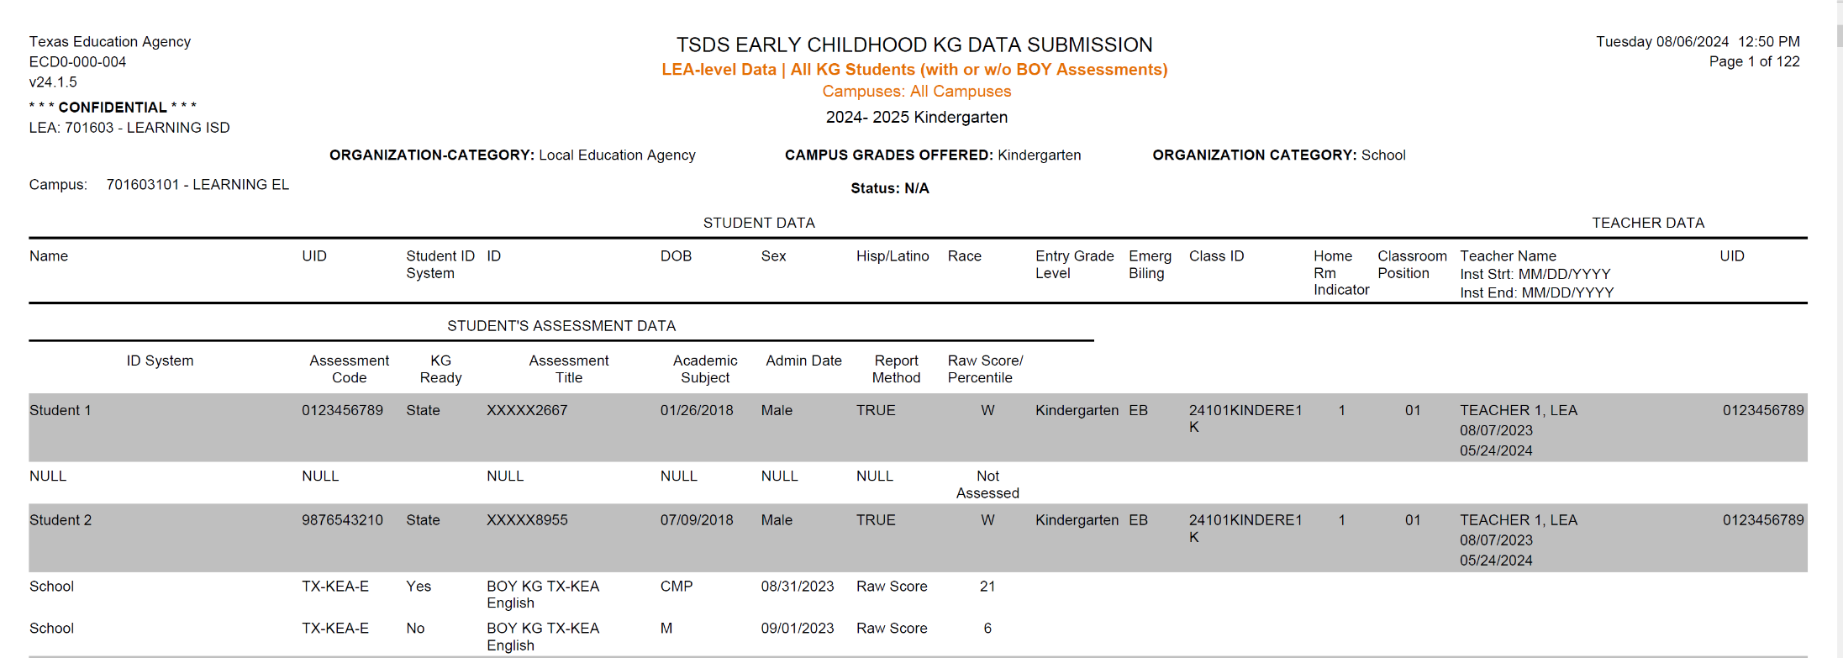
ECD0-000-004
Assessment Data Promoted - Verify correct KG Assessment Code, Assessment Title, Admin Date, and Score.
Verify correct KG Homeroom Teacher and UID information.
Verify KG Ready column is correct for each student. The results of ‘Yes’ and ‘No’ are based on the Lowest Ready score ranges in the ECDS Assessment Specifications document in TWEDS.
Verify correct student KG demographic information: Name, Unique ID, Student ID, DOB, Sex, Hisp/Latino, Race, LEP info.
Notes:
This report provides a detailed breakdown of the data submissions for the KG submission. The purpose of the report is to allow LEAs and campuses to review data to evaluate whether their KG submission is complete.

Slide 29
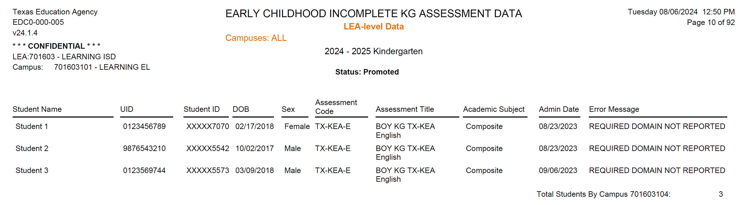
ECD0-000-005
Resolve all incomplete assessment data listed on the report.
Notes:
This report lists students with incomplete assessment data to assist LEAs and campuses in reviewing their data submissions.
Q. Explain why you may get the following error messages on the Incomplete Assessment Data report ‘Required domain not reported’ or ‘All domains not reported’?
A. This occurs if a district does not submit all parts of an assessment used in determination for KG readiness.

Slide 30

TRAINING ACTIVITY
Practice, Troubleshooting, and Knowledge Checks

Slide 31
PRACTICE EXERCISE
Task 1: Promote ECDS KG data.
Task 2: Monitor the promotion.
Ready
Set
Go

Slide 32
TROUBLESHOOTING 1
Scenario 1: I am getting validation error because the BeginDate(E3010) and EndDate(E3010) for certain data elements are missing or not correctly reported.
Resolution Steps:
Business validation logic requires that a BeginDate(E3010) and EndDate(E3010) must be reported for certain data elements.
Visit TWEDS to review TEDS to find more information on which data elements require the BeginDate and EndDate to be reported with their respective definitions.
E.g., StudentSectionAssociation Entity:
BeginDate (E3010) is the first instructional day in the current school year the student is assigned to the section.
EndDate (E3020) is the first day after the last instructional day the student is no longer assigned to the section.

Slide 33
TROUBLESHOOTING 2
Scenario 1: Why am I getting this fatal error: 40110-0173?
Resolution Steps:
For each StudentAssessment for an Assessment with ReportAssessmentType of "01" (ECDS - KG) or "02" (ECDS - PK), the HomeroomIndicator must not be blank on any StudentSectionAssociations with a matching StudentUniqueId.
HomeroomIndicator (E1440) indicates the homeroom section assigned to the student.
HomeroomIndicator must be reported for all Public pre-K and Kindergarten students reported with an ECDS assessment.
Ensure that the values in the HomeroomIndicator field correctly indicate the homeroom status (e.g., true or false)

Slide 34
KNOWLEDGE CHECK 1
ECDS allows schools and parents to gauge how well KG and pre-K programs are preparing students for school, and especially for reading
True
False
Notes:
NOTE:
To see the answer, you must be in presentation mode.

Slide 35
KNOWLEDGE CHECK 2
The purpose of the data element "Homeroom Indicator" is to show the teacher who administered the test?
True
False
Notes:
NOTE
To see the answer, you must be in presentation mode.

Slide 36
KNOWLEDGE CHECK 3
All participating KG programs will submit Beginning of Year (BOY) assessment data through the TSDS collection
True
False
Notes:
NOTE
To see the answer, you must be in presentation mode.

Slide 37
KNOWLEDGE CHECK 4
Under View Reports, the following ECDS reports are available EXCEPT:
Assessment Completion
Data Submission Kindergarten
Incomplete Assessment Data
State Accountability Report
Notes:
NOTE
To see the answer, you must be in presentation mode.

Slide 38

WRAP UP
Key Takeaways, Resources, and Next Steps

Slide 39

KEY TAKEAWAYS
ECDS data is submitted through TSDS.
All participating KG programs that administer an assessment from the Commissioner’s List of Approved Assessment Instruments, will submit Beginning of Year (BOY) assessment data through the TSDS collection.
TRAINING RESOURCES
Key Terms and Definitions
ECDS Reference Guide

Slide 40
TECHNICAL RESOURCES
TEA Website and Communication Resources
Early Childhood Education Website
ECDS Program Area Support
Early Childhood Education Support Portal
Texas Education Data Standards Resources
TSDS Web-Enabled Data Standards
Notes:
TWEDS
Go to the TSDS website at https://www.texasstudentdatasystem.org
Hover over the TEDS Data Standards tab.
Next, click on ‘TWEDS Upgrade’
Finally, click on the “XXXX-XXXX Texas Education Data Standards via TWEDS” hyperlink.

Slide 41
NEXT STEPS
Attend Common Steps for Core Collection Training
Complete a Teach Back Exercise
Complete ECDS Certification Test – Part 1
Complete Core Collection Certification Test – Part 2
Attend TSDS Continuing Education Trainings (CET)
Participate in TSDS Just-in-Time Trainings (JIT)
Attend Field Coordination Network (FCN) webinars for new updates and changes

Slide 42
WRAP UP
In this training we talked about:
The requirements for the Early Childhood Data System (ECDS) KG Submission.
The data that comprises the ECDS KG data submission.
How to promote ECDS KG data.
The TSDS reports for ECDS KG.

Slide 43

QUESTIONS

