Slide 1

TITLE SLIDE: TSDS ODS 3.x Project
Updates
Class Roster (CR)
New User Certification Training

Slide 2
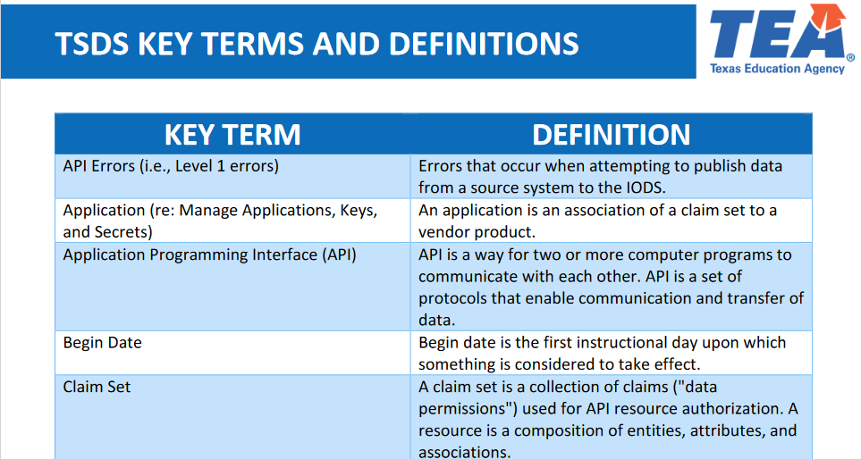
KEY TERMS
Please take a moment to familiarize yourself with common terminology by accessing the Key Terms and Definitions Document.

Slide 3
LEARNING OBJECTIVES
By the end of this course, the users will be able to explain:
The requirements for the Class Roster data submission.
The data that compromises the Class Roster data submission.
How to promote Class Roster data.
TSDS reports for Class Roster.

Slide 4
WHY IS THIS COURSE IMPORTANT
The Class Roster Submission is used to gather data relevant to accountability requirements for state-mandated teacher preparation programs.
The data also supports accurate identification of all local education agencies with teachers who qualify for funding through the Teacher Incentive Allotment (TIA).

Slide 5

COURSE AGENDA
Getting Started
TSDS Architecture, TEAL Roles, Promotion Demo
Key Concepts
Class Roster Overview, Validations, and Reports
Training Activity
Practice, Troubleshooting, and Knowledge Checks
Wrap Up
Key Takeaways, Resources, and Next Steps

Slide 6


GETTING STARTED
TSDS Architecture, TEAL Roles, Promotion Demo

Slide 7
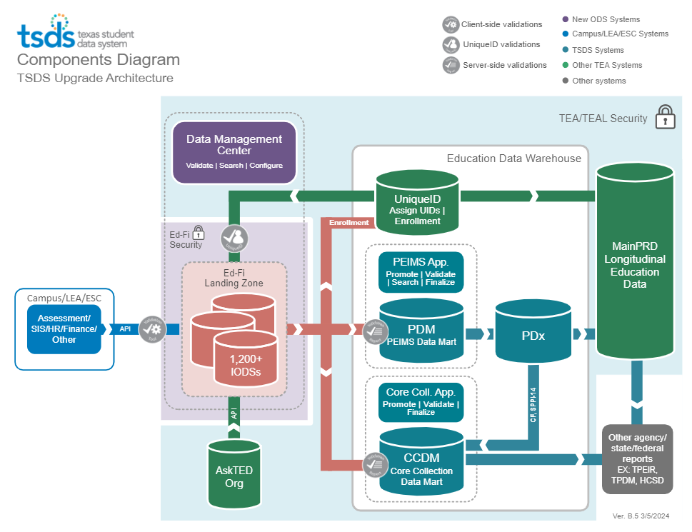
TSDS ARCHITECTURE

Slide 8
LEA TEAL ROLES – CLASS ROSTER
Core LEA Data Viewer
This role monitors data promotions and data validations and generates reports.
Core LEA Data Promoter
This role schedules and monitors promotions, schedules and monitors validations, and generates reports.
Core LEA Data Completer
This role formally certifies the completeness and accuracy of the data and finalizes the submission. In addition, this role also schedules and monitors promotions, schedules and monitors validations, and generates reports.
Core LEA Data Approver
This role will be for the superintendent or his/her designee at the LEA. This role requests an extension if needed.
Notes:
The role the LEA staff would request will depend on the individual’s level of responsibility.

Slide 9
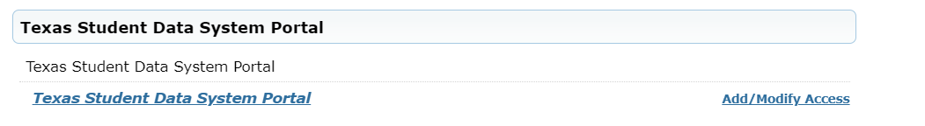
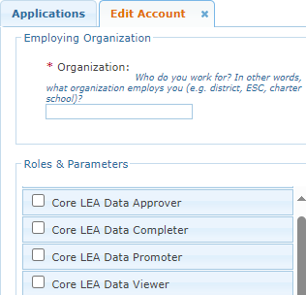

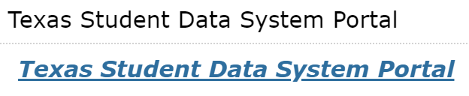

APPLY FOR CLASS ROSTER ROLE
Login to your TEAL account; Click Add/Modify Access.
Enter your Employing Organization and select the appropriated Core LEA TEAL role.

Slide 10
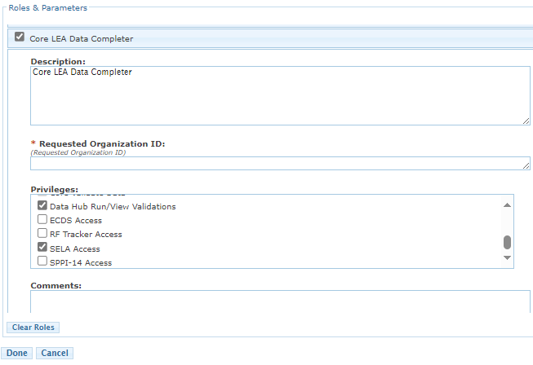
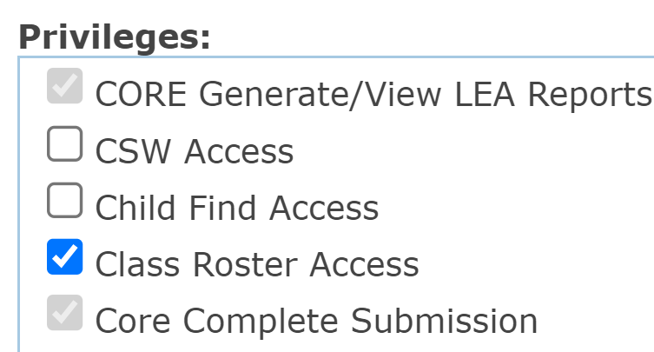
CLASS ROSTER TEAL ROLE & PRIVILEGE
Users will check the appropriate role based on their level of responsibility at the LEA and in the Requested Organization ID enter their Organization ID.
Next, check the Privilege “Class Roster Access” and click Done.
The final step is to click Save Changes on the next screen.
Notes:
Check ‘Class Roster Access’ under the Privileges.

Slide 11
ESC ROLE FOR CLASS ROSTER
Core ESC Data Viewer
This role will be able to view and monitor Class Roster activity in TSDS for the LEAs the ESC supports.
Notes:
The ESC Data Viewer role will allow the ESC to monitor the data promotions for Class Roster for the LEAs in their region.

Slide 12
PROMOTION DEMO
Login to TEAL Account
Navigate to Core Collection Application
Promote Class Roster data
Monitor data promotion
NOTE: The Reference Guide (RG) is a resource that provides a step-by-step instructions for Promoting, Validating, and Completing the Class Roster Winter Submission.​
Class Roster Reference Guide

Slide 13


KEY CONCEPTS
Class Roster Overview, Validations, and Reports

Slide 14
CLASS ROSTER
The Class Roster data is used in relation to the accountability for state-mandated teacher preparation programs. Additionally, the data is used to accurately identify all the local education agencies with teachers eligible for funds under the Teacher Incentive Allotment (TIA).
HB 4545 (87th Regular Legislative Session) mandates that class roster data will be used to ensure that a student who did not pass the STAAR test has a TIA teacher assigned the following school year.

Slide 15
TEACHER INCENTIVE ALLOTMENT (TIA)
Under HB 3, which was passed by the 86th Texas Legislature in 2019, a Teacher Incentive Allotment was established to provide additional funding for high needs and rural LEAs to provide additional compensation to master, exemplary and recognized teachers serving in these LEAs.
The data collected for the Class Roster Submission accurately identifies all LEAs with teachers who are eligible for funds under the Teacher Incentive Allotment.
The TSDS Class Roster Submission will collect class roster information for all grade levels (EE-12).

Slide 16
TIA ELIGIBILITY
Class Roster Submission data is used to annually determine teacher eligibility for Teacher Incentive Allotment (TIA) designations and funding.
Texas Administrative Code defines TIA eligibility as employed under StaffClassification 087 for a creditable year of service who has been designated as a high performing teacher or who is a National Board Certified teacher.
Once a teacher earns a designation, the designation stays with them if they change LEAs. If they are reported in the next year’s PEIMS Fall Submission and meet eligibility criteria, they will generate an allotment for their new LEA.
The TIA program team will review the PEIMS Fall Submission and notify LEAs that have hired a teacher with an existing designation and/or National Board certification.
For Ls that do not yet employ designated teachers the Class Roster Submission will not include any TIA data elements.

Slide 17
CLASS ROSTER TIMELINE
Class Roster Submission
Class Roster Winter Snapshot Date | Late February
Class Roster Winter ready for users to complete | Late February
Class Roster Winter Submission due date for LEAs | Late March
*These are reference dates, please see the actual due dates in TWEDS.

Slide 18
DOMAINS DEFINITIONS
Education Organization Domain – provides information about any public or charter school, education service center, organization or agency.
Teaching and Learning Domain – provides the course information, the students assigned to a course offered on a particular campus, and the staff member that provides instruction for the course.
Student Identification and Demographics Domain – provides the characteristics and demographics of a student and the education organization associated with the student.
Enrollment Domain – provides the enrollment and withdrawal information for a student and the relationship between a particular education organization.
Staff Domain – provides the general staff information for a local education agency.

Slide 19
CLASS ROSTER SPECIFIC DATA ELEMENTS
Data Elements
E1064 – HighestCompletedLevelOfEducation
E1064 – HispanicLatinoEthnicity
E1377 – TotalYearasPriorTeachingExperience
E1721 – CreditableYearOfService
E0505 – StaffId
E1722 – TeacherIncentiveAllotmentDesignation
E1073 – StaffType
E3010 – BeginDate
E3020 – EndDate
E3045 – ProgramAssignment
E1454 – ClassroomPosition
E1517 – EntryGradeLevel
Note: More information about the data can be found in the TSDS Web-Enabled Data Standards (TWEDS).

Slide 20
CLASS ROSTER - CATEGORIES
Categories
Campus Course Section
Education Organization
Staff
Student
Sub-Categories
Course Section
Campus, Local Education Agency
Staff Basic, Staff Association, Teacher Class Assignment
Enrollment (School Association), Student Basic, Student Section
TSDS Data Collection Documentation
Notes:
Categories and Sub-Categories that will be promoted for Class Roster Winter submission.

Slide 21
LEVELS OF VALIDATIONS
LEVEL 1
(Vendor Source System)
Includes basic data integrity checks that occur during the process of loading data via API transactions into the Individual Operational Data Store (IODS) in the Landing Zone. Data that fails Level 1 validations does not enter the IODS.
LEVEL 1.5
(DMC: DMC Data Monitor)
Includes filters that prevent invalid or non-TSDS data from being loaded into TSDS. These filters include Unique ID checks, descriptor value checks, Do Not Report flag checks, and Course ID checks.
LEVEL 3
(PEIMS/Core: Existing TEAL Roles)
Business rules that are executed in TSDS. Level 3 validations contain all Level 2 validations, plus any additional validations required for the TSDS submissions. Fatal errors prevent TSDS submissions from being completed or finalized.
LEVEL 2
(DMC: DMC L2 Validations)
Business rules that are executed on the data destined for TSDS. Fatal, Special Warning, and Warning validation errors do not prevent data from being loaded to TSDS.
Prevents data from loading to IODS
Prevents data from loading to TSDS
Does not prevent loading to TSDS.
Fatals prevent from completing submission

Slide 22
CLASS ROSTER VALIDATIONS 1
As part of completing your data validation rules, check with your DMC Technical Steward to make sure that none of your Class Roster staff and courses are appearing in L1.5 filters.
Additionally, check your staff and student Unaffiliated Reports.

Slide 23
CLASS ROSTER VALIDATIONS 2
Class Roster includes business validations such as:
30305-0027 – If ClassroomPosition is “04”, then TeacherIncentiveAllotmentDesignation must not be reported and CreditableYearOfService must be FALSE or not reported.
30040-0055 – If TeacherIncentiveAllotmentDesignation is reported, then there must be a StaffSchoolAssociation or a StaffSectionAssociation with a matching StaffUniqueId.
30040-0058 - If at least one TeacherIncentiveAllotmentDesignation is reported for a staff person, then CreditableYearOfService must not be blank.
Review TEDS via TWEDS for all business validations for Class Roster
Notes:
Classroom position 04 (sub) goes along with Staff Classification 047 (long term sub)

Slide 24
CLASS ROSTER REPORTS

Slide 25
CLASS ROSTER REPORTS
TSDS Class Roster Report # | TSDS Class Roster Report Name
CLS2-100-001 | Student Class Roster
CLS2-100-002 | Student Class Schedule
CLS2-100-003 | Staff Class Assignment
CLS2-100-004 | Teacher Class Summary
CLS2-100-005 | Staff Roster
CLS2-100-006 | Submission Summary
CLS2-100-007 | Teacher Incentive Allotment Designated Staff
ESC Level Report CLS2-100-008 | Class Roster Totals By Grade Report

Slide 26
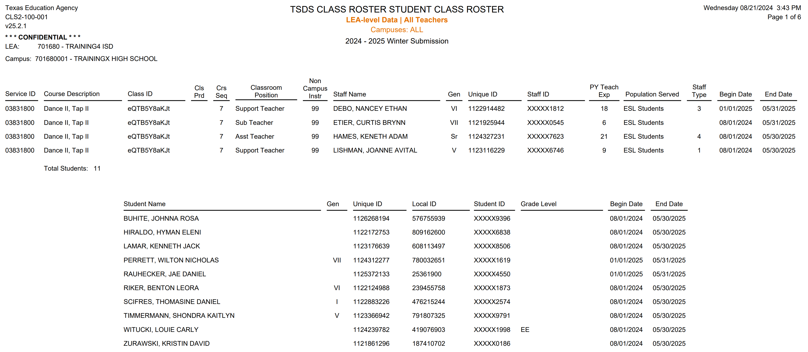
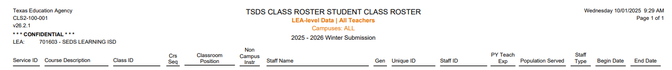
CLS2-100-001
7
7
7
7
7
99
99
99
99
9
9
9
9
9
9
9
9
9
9
This report lists class and teacher information, including a list of students enrolled in each class.
LEAs should verify the data they have submitted for each teacher’s Class IDs.

Slide 27
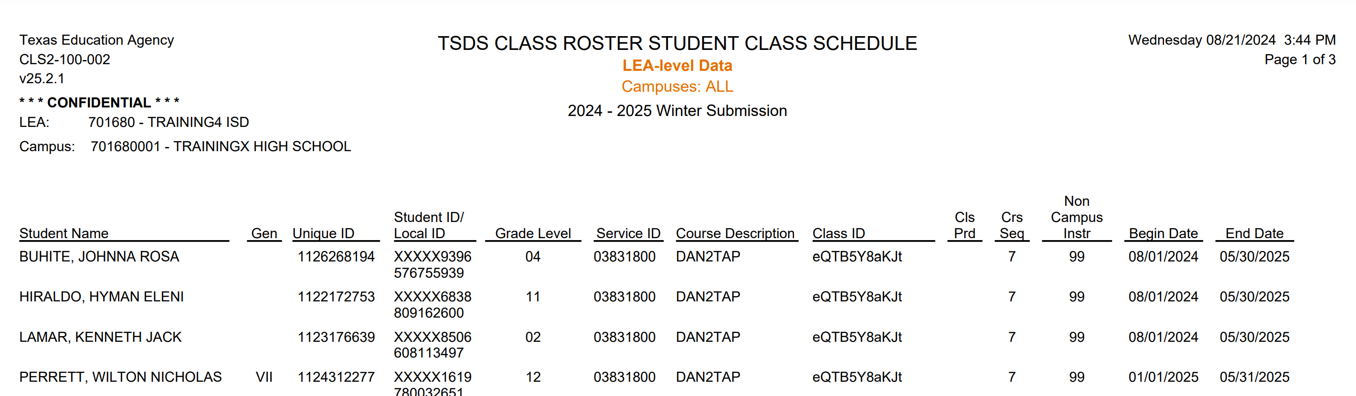
CLS2-100-002
This report will provide a listing of students with their class assignment schedules and class attributes.
LEAs should verify the data they have submitted for each student’s class schedule.
26

Slide 28
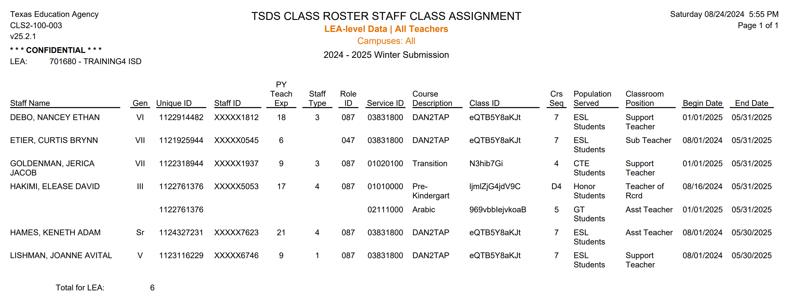
CLS2-100-003
This report lists the staff alphabetically, along with their classroom attributes.
Report can be generated for all teachers or only beginning teachers.
This report provides the total number of staff members for the LEA.
27

Slide 29
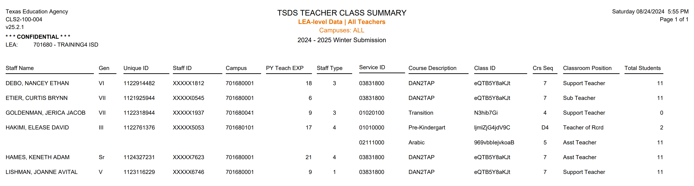
CLS2-100-004
This report summarizes teacher and class information for all grade levels including student counts.
28

Slide 30
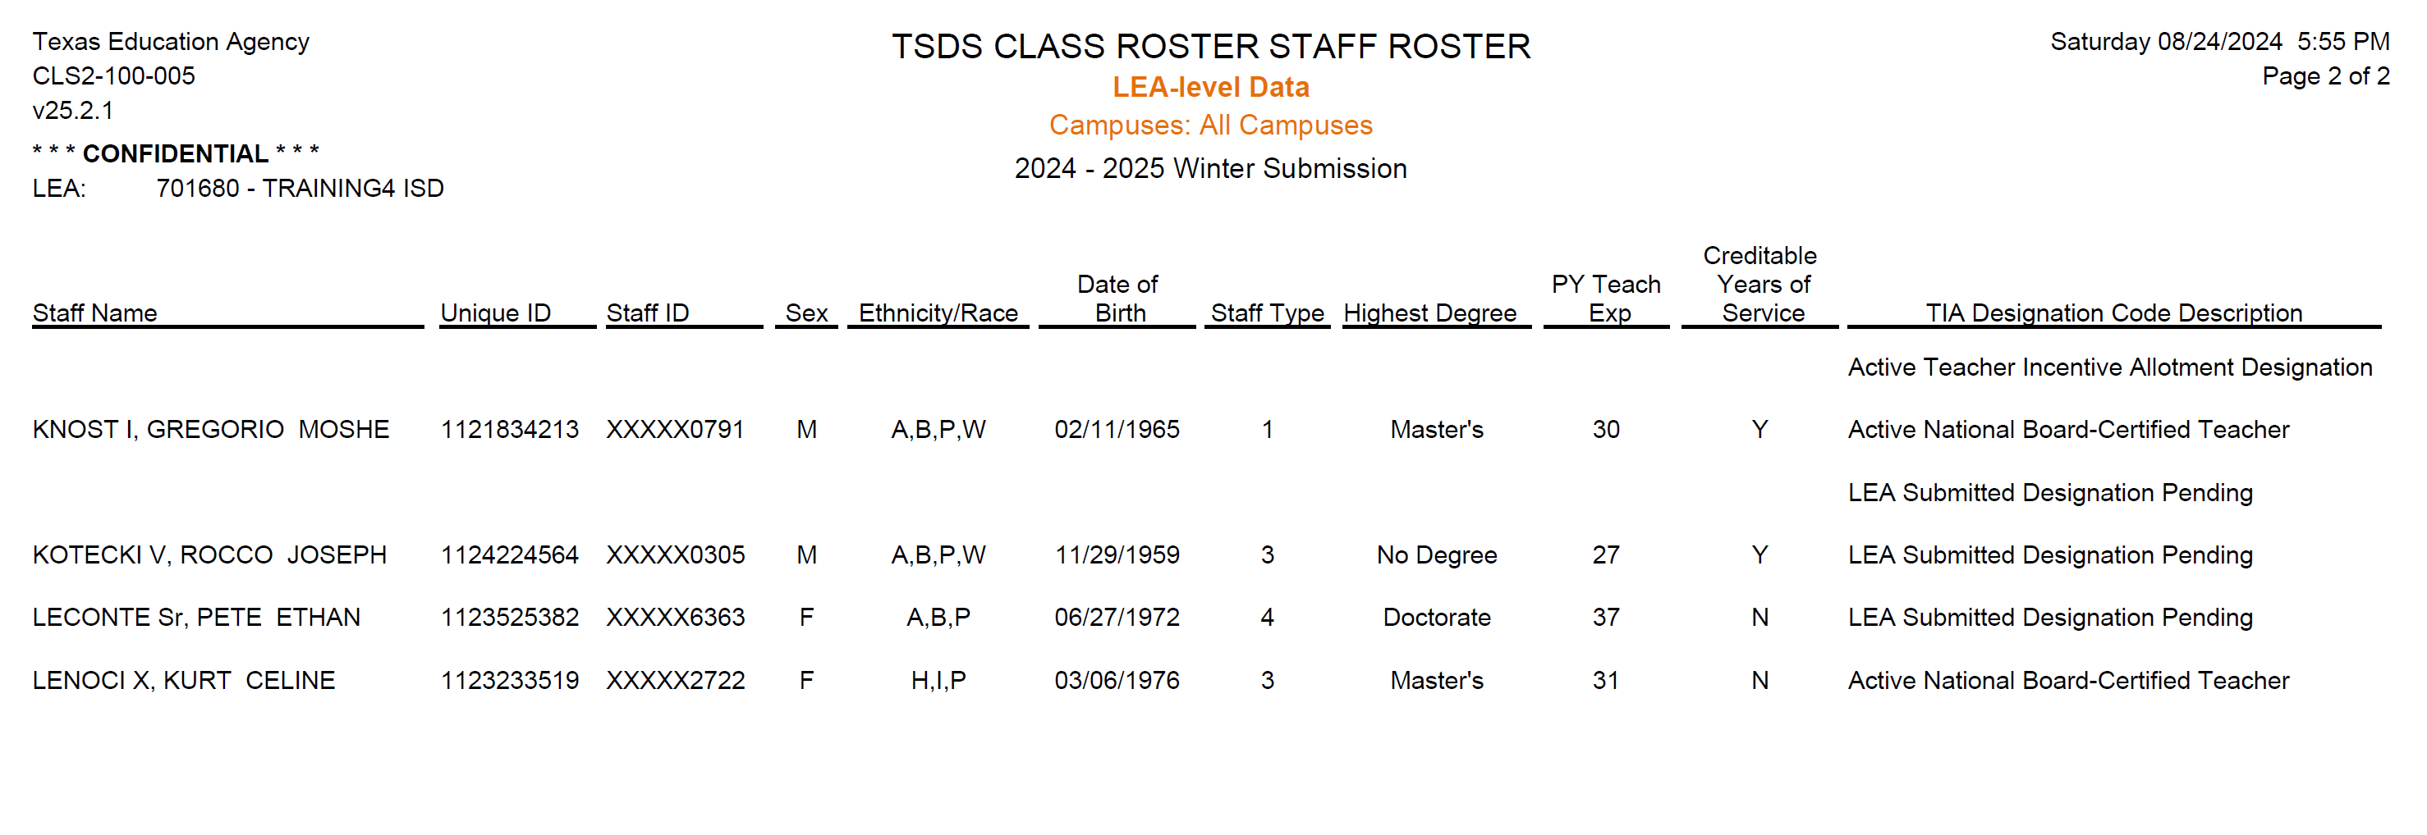
CLS2-100-005
4
This report provides a staff roster listing and summarizes individual staff profiles in alphabetical order by last name.
LEAs should verify the data they are submitting for each staff member:
E1721 – CreditableYearOfService.
E1722 – TeacherIncentiveAllotmentDesignation
29
Notes:
Creditable Years of Service indicates a teacher who currently qualifies for the TIA allotment and has been submitted by the LEA for a new or change of designation and has been employed by the LEA and compensated or will be compensated for a creditable year of service..

Slide 31
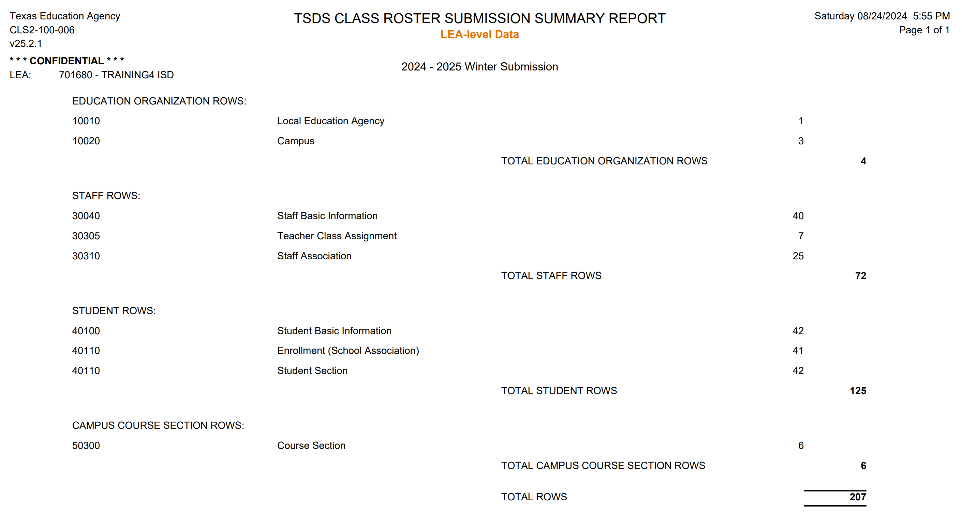
CLS2-100-006
This report displays the promotion record counts for the LEA:
Staff Basic: Count of total staff promoted.
Teacher Class Assignment: Count of Staff assigned to a course/section.
Staff Association: Count of Staff without course/section information who have a TIA designation (Ex: Centrally assigned SPED teacher who is not assigned to a specific course/section and instructs at multiple campuses).
30
Notes:
TSDS Class Roster Report:
The TSDS Submission Summary Report in the TSDS Class Roster collection will display row counts by category and subcategory, including those with no data.

Slide 32
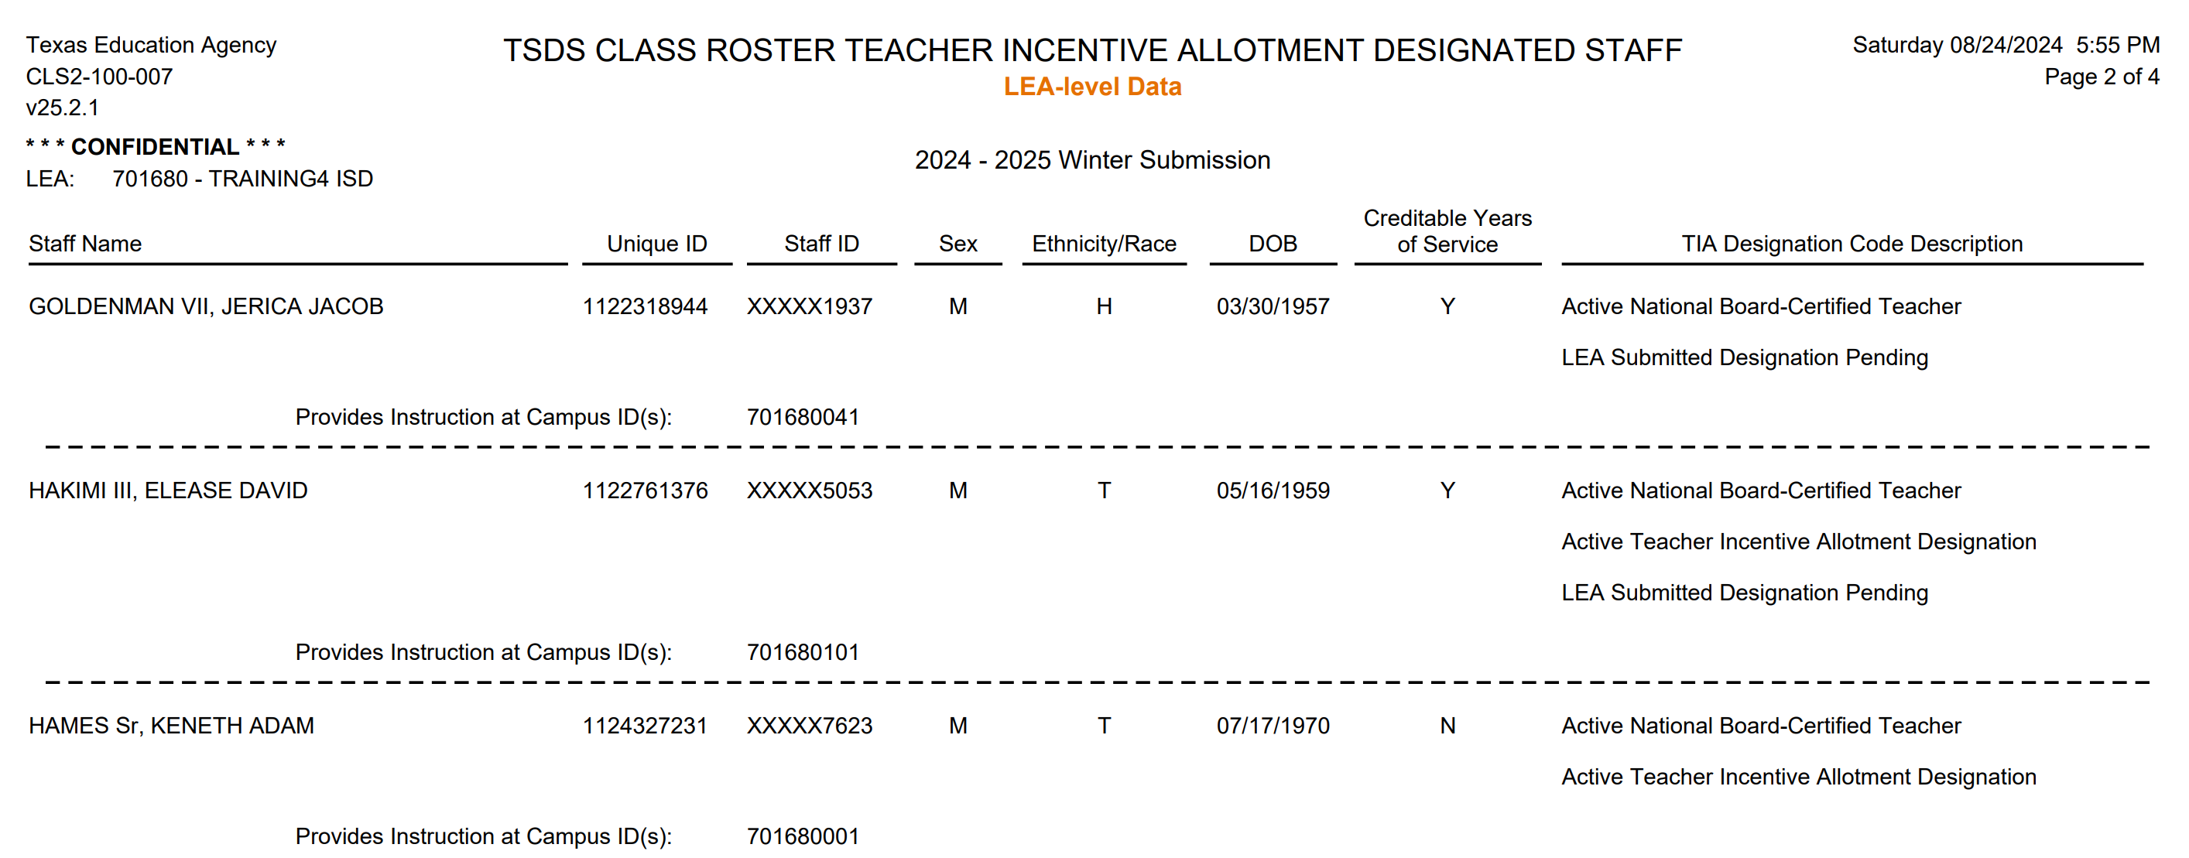

CLS2-100-007
This report will only display teachers with a descriptor value from the TeacherIncentiveAllotmentDesignation - C322 Descriptor table.
It includes data for all teachers with a TIA designation code(s).
The report also lists the campuses where these teachers provide instruction, allowing LEAs to verify the designated campuses for funding.
31
Notes:
NOTE: N under Creditable Years of Service means they will NOT be compensated for Creditable Years of Service.

Slide 33
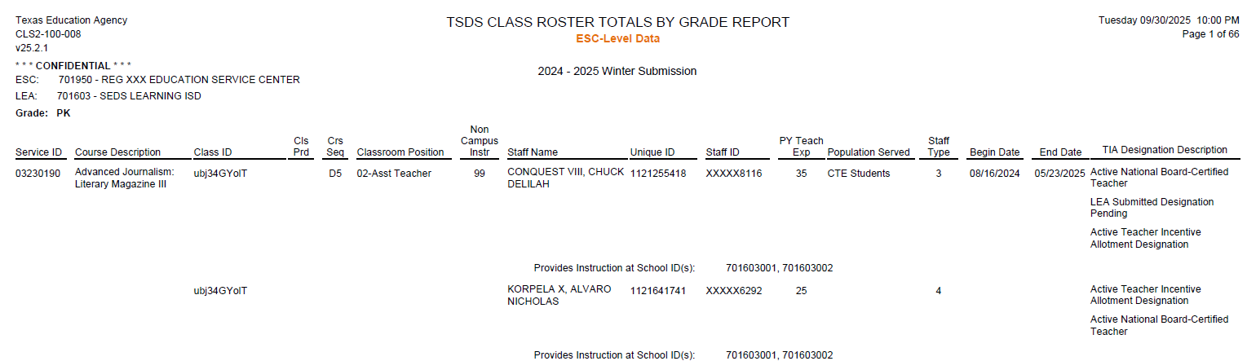
CLS2-100-008
This ESC-level report shall provide a Class Roster Submission listing by LEA showing each CourseCode, including basic information about each class and teacher with the TIA Designation Description. The report can be generated for all LEAs, or the ESC can choose specific LEAs and can run as a CSV for easier sorting.
The purpose of the report is to allow the ESC users to verify the data the LEAs will be submitting for each teacher.
32

Slide 34

TRAINING ACTIVITY
Practice, Troubleshooting, and Knowledge Checks

Slide 35
PRACTICE EXERCISE
Task 1: Promote Class Roster data.
Task 2: Monitor data promotions.
Ready
Set
Go

Slide 36
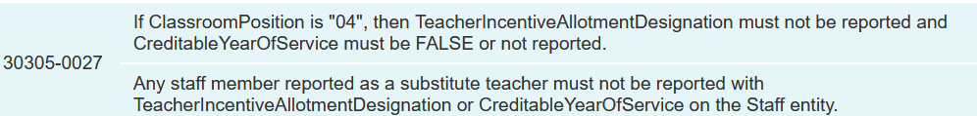
TROUBLESHOOTING 1
Scenario 1: Why am I getting this fatal error: 30305-0027?
Resolution Steps:
The error occurs when you report the data element the ClassroomPosition of “04” (substitute), and you reported a TeacherIncentiveAllotmentDesignation (E1722) and/or CreditableYearsOfService (E1721) for this staff person who is a substitute in the class.
Ensure that this staff person should be reported with the ClassroomPosition of “04”.
Remove the TIA Designation and/or CreditableYearsOfService on this record.
For detailed information visit TWEDS.

Slide 37
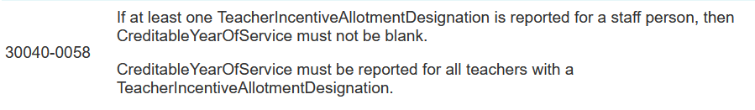
TROUBLESHOOTING 2
Scenario 2: Why am I getting this fatal error: 30040-0058?
Resolution Steps:
The error occurs when you report the data element TeacherIncentiveAllotmentDesignation (E1722) for a teacher (identified with StaffClassification 087), but you have not reported the CreditableYearsOfService (E1721).
Ensure CreditableYearsOfService (E1721) is reported for all teachers who have a TeacherIncentiveAllotmentDesignation (E1722).
For detailed information about the TeacherIncentiveAllotmentDesignation (E1722) and CreditableYearsOfService (E1721), visit TWEDS.

Slide 38
KNOWLEDGE CHECK 1
The data submitted through the Class Roster Submission is used annually to determine teacher eligibility for Teacher Incentive Allotment designations and funding.
True
False
Notes:
NOTE
To see the answer, you must be in presentation mode.

Slide 39
KNOWLEDGE CHECK 2
Only staff who are teachers (StaffClassification 087) or substitute teachers (StaffClassification 047) are reported in the StaffSectionAssociation Entity for the Class Roster Submission.
True
False
Note:
ClassroomPosition 01 (Teacher of Record) correlates with StaffClassification 087.
ClassroomPosition 02 (Assistant Teacher) correlates with StaffClassification 087.
ClassroomPosition 06 (Teacher Resident) correlates with StaffClassification 087.
ClassroomPosition 04 (Substitute Teacher) correlates with StaffClassification 047.
*ClassroomPosition 03 (Support Teacher) correlates with StaffClassification 087 but will be reported on the StaffSchoolAssociation not the StaffSectionAssociation.
Notes:
NOTE
To see the answer, you must be in presentation mode.
Class Roster Winter Submission:
The StaffSectionAssociation Entity is reported for all LEA-employed or contracted teachers of courses offered in grades EE-12 as of the last Friday in February. CourseCodes that begin with "SA," "SE," "SR," "SS," or "8" are not promoted.

Slide 40
KNOWLEDGE CHECK 3
The Class Roster Submission will be completed using the following Data Mart:
PEIMS Data Mart
Core Collection Data Mart
Notes:
NOTE
To see the answer, you must be in presentation mode.

Slide 41
KNOWLEDGE CHECK 4
Staff who are teachers (StaffClassification 087) and who are support teachers (ClassroomPosition 03) are reported in the StaffSchoolAssociation Entity for the Class Roster Submission only if the teacher has a TIA designation.
True
False
Note:
Teachers reported on the StaffSchoolAssociation Entity are those teachers who provide instructional services but are not reported on the StaffSectionAssociation Entity because they are not assigned a class section on the master schedule.
Notes:
NOTE
To see the answer, you must be in presentation mode.
Class Roster Winter Submission:
The StaffSectionAssociation Entity is reported for all district-employed or contracted teachers of courses offered in grades EE-12 as of the last Friday in February. CourseCodes that begin with "SA," "SE," "SR," "SS," or "8" are not promoted.

Slide 42
KNOWLEDGE CHECK 5
Which of the following is true about data element ClassroomPosition (E1454)?
It indicates the type of position the staff member holds in a specific class.
Classroom positions such as Teacher of Record, Assistant Teacher, Support Teacher, and Substitute Teacher will be promoted to the Class Roster submission.
Both of the above.
None of the above.
Notes:
NOTE
To see the answer, you must be in presentation mode.

Slide 43

WRAP UP
Key Takeaways, Resources, and Next Steps

Slide 44

KEY TAKEAWAYS
The Class Roster Submission will collect class roster information for all grade levels (EE-12). The data is used annually to determine teacher eligibility for Teacher Incentive Allotment designations and funding.
Only staff with a StaffClassification of 087 (teacher) should be reported with a TIA Designation and CreditableYearsOfService.
Class Roster data is submitted through TSDS.
TRAINING RESOURCES
Key Terms and Definitions
Class Roster Reference Guide

Slide 45
TECHNICAL RESOURCES
TIA Program Area
tia@tea.texas.gov
Texas Education Data Standards Resources
TSDS Web-Enabled Data Standards

Slide 46
NEXT STEPS
Attend Common Steps for Core Collection Training
Complete a Teach Back Exercise
Complete Class Roster Certification Test – Part 1
Complete Core Collection Certification Test – Part 2
Attend TSDS Continuing Education Trainings (CET)
Participate in TSDS Just-in-Time Trainings (JIT)
Attend Field Coordination Network (FCN) webinars for updates and changes

Slide 47
WRAP UP
In this training we talked about:
The requirements for the Class Roster data submission.
The data that comprises the Class Roster data submission. ​
How to promote Class Roster data.
The TSDS reports for Class Roster.

Slide 48

QUESTIONS

