Slide 1

TEXAS STUDENT DATA SYSTEM (TSDS)
Overview, Key Concepts, and TEAL

Slide 2
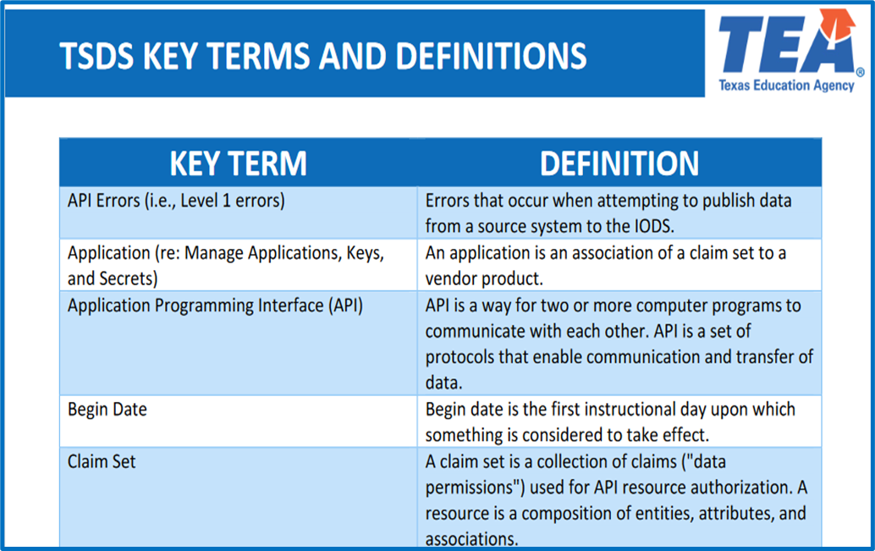
KEY TERMS
Please take a moment to familiarize yourself with common terminology by accessing the Key Terms and Definitions Document.
Access the Key Terms and Definitions Document.

Slide 3
LEARNING OBJECTIVES
  By the end of this course, the learner will be able to explain:
The components of the TSDS.
How data is loaded and promoted.
Where the validations and filters will be executed and viewed.

Slide 4
WHY IS THIS COURSE IMPORTANT
To provide a foundation of knowledge and understanding for TSDS.
To ensure that you can effectively teach these key concepts to the LEAs.

Slide 5

COURSE AGENDA
GETTING STARTED
High Level Architecture
Key Concepts
Data Loading, Promotion, Validation, Load Summary
Training Activity
Demo and Knowledge Checks
WRAP-UP
Key Takeaways, Resources, and Next Steps

Slide 6


GETTING STARTED
High Level Architecture

Slide 7
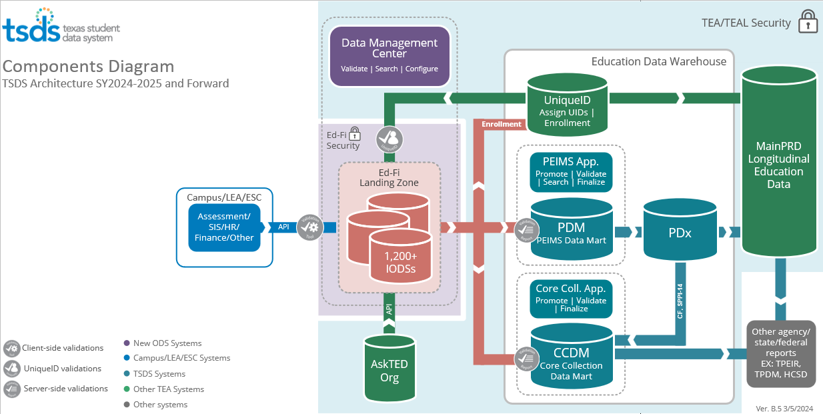
HIGH-LEVEL ARCHITECTURE 1

Slide 8
HIGH-LEVEL ARCHITECTURE 2
Data
Landing Zone
Each LEA will be provided a local Individual Operational Data Store (IODS).
Source system vendors will publish data via API transactions at near real-time.

Slide 9
HIGH-LEVEL ARCHITECTURE 3
Data
Application
LEAs will be able to view data loads and run validations on local IODS data.

Slide 10
HIGH-LEVEL ARCHITECTURE 4
Data
Data
Unique-ID
The Unique ID application is used to search and assign Unique IDs for students and staff.
Data
TSDS Applications
The PEIMS and Core Collections applications are used to promote and finalize the TSDS data submissions.
The PEIMS and Core Collections Data Marts store the data that is promoted from the Transition Zone.
These applications are not expected to change.
Data

Slide 11

KEY CONCEPTS
Data Loading, Promotion, and Validation

Slide 12
TSDS DMC AND VALIDATIONS
Data Management Center (DMC)
Data loaded via Application Programming Interface (API)
Deletes and updates processed through API transactions
More validations at local level
  Level 1 Validations, Level 1.5 Filters, and Level 2 Validations
Fewer downstream-only* validations
  Level 2 Validations (95%) and
  Level 3 Validations (5%)*
Notes:
Note: Incentive for running Level 2 Validations in the DMC
Previously in TSDS LEAs had to promote their data downstream to get the business validations to run. Going forward some of those validations will be able to be run locally in the DMC. Therefore, there will be fewer validations (i.e., Level 3) that will not be able to be run locally and can only be run “downstream-only”.
Conversely, in addition to running the Level 2 validations downstream as part of Level 3 validations, LEAs will have the option of running them Locally as well and viewing them in the DMC.
*For example, you can run 95% (i.e., 1275) of your validations and fix those errors at Level 2 before running your validations at Level 3 (i.e.,1275 + 64) when you promote your data.

Slide 13



DATA LOADING PROCESS
Data is automatically loaded via API transactions.
There is one stream of singular transactional data published from the local source systems into the IODS at near-real time via API transactions.
Data is seamlessly updated in the IODS to reflect updates and corrections the LEA makes in their local source systems.
IODS (Landing Zone)
Source System
The vendors publish the singular transactional data from the local source systems to the LEA’s IODS via API transactions.

Slide 14
HOW DATA IS LOADED
Data
LEA Promotes 4 Submissions
Singular Transactional
Singular transactional data via API transactions
LEA Promotes 7 Submissions
NOTE: Data promotions a manual process.
Notes:
Notes
The left arrow changed.
The left arrow indicates that there is one stream of data for all 11 collections into which LEAs may publish TSDS data to their IODS (Landing Zone).
These next two bullets remains the same.
The top right arrow (4) indicates that there are four PEIMS collections into which LEAs may promote PEIMS data into the PEIMS application.
The bottom right arrow (7) indicates that there are seven Core Collections into which LEAs may promote Core Collection data into the Core application.

Slide 15
GENERAL PROMOTION LOGIC
  Promotion logic and data field effective dates (i.e., begin/end
  dates) will be used to determine which data should be
  promoted for each collection and submission.
  For PEIMS Summer, we collect attendance data for all students, and the general promotion logic is to promote all students who are enrolled and in membership at any time during the school year.
  For Residential Facility Tracker, the general promotion logic is to promote the data for students who are enrolled AND are receiving special education services AND reside in a residential facility at any time during the school year.
A 9th grade student is economically disadvantaged and eligible for free and reduced lunch. A start date and an end date must be entered for these services. In addition, these dates will need to be updated each year.

Slide 16
BEGIN AND END DATES
In order to “effective date” some data elements, TEA will collect Begin Dates and End Dates. The TSDS system will determine for which collections and submissions date-sensitive data will be promoted based on the begin and end dates.
Begin date is the first instructional day upon which something is considered to take effect.
End date is the day after the last instructional day when something is considered to no longer be in effect.
Some data fields will require that the begin/end dates be updated yearly. i.e., Homeless Status
Other data fields do not require an end date unless the status changes. i.e., Emergent Bilingual Indicator

Slide 17
BEGIN/END DATE EXAMPLE 1
How the begin and end dates can affect the data that is reported for different data collections.
  Mr. Smith is hired as an Educational Aide beginning on August 30. His StaffClassification is 033 with a BeginDate of YYYY-08-30.
      On November 10, Mr. Smith is promoted to teacher (087) with a BeginDate of YYYY-11-10.
      Mr. Smith's StaffClassification record will have these entries:
        033 BeginDate YYYY-08-30
        033 EndDate YYYY-11-10
        087 BeginDate YYYY-11-10
A 9th grade student is economically disadvantaged and eligible for free and reduced lunch. A start date and an end date must be entered for these services. In addition, these dates will need to be updated each year.

Slide 18
BEGIN/END DATE EXAMPLE 2
How the begin and end dates will affect the data that is reported for Mr. Smith on PEIMS Fall and on Class Roster.
  Mr. Smith is reported on the PEIMS Fall Submission as an 033 (Educational Aide) since that was his StaffClassification on the PEIMS Fall snapshot which is the last Friday in October.
      033 BeginDate YYYY-08-30
      033 EndDate YYYY-11-10
      Mr. Smith was promoted to a teacher (087) effective November 10. He would be reported on the Class Roster (CR) Submission as an 087. The Class Roster snapshot date is the last Friday in February.
          087 BeginDate YYYY-11-10

Slide 19
DEMONSTRATION
Log in to the TSDS Portal.
Navigate to DMC.
Hover over View Reports. Click Load Summary.
Select the filter type in the Type dropdown to execute your search.
Review the number of Domains that have been loaded.
Under each Domain, click on the dropdown arrow to see the record count by entity.

Slide 20
LEVELS OF VALIDATIONS
LEVEL 1
(Vendor Source System)
Includes basic data integrity checks that occur during the process of loading data via API transactions into the Individual Operational Data Store (IODS) in the Landing Zone. Data that fails Level 1 validations does not enter the IODS.
LEVEL 1.5
(DMC: DMC Data Monitor)
Includes filters that prevent invalid or non-TSDS data from being loaded into TSDS. These filters include Unique ID checks, descriptor value checks, Do Not Report flag checks, and Course ID checks.
LEVEL 3
(PEIMS/Core: Existing TEAL Roles)
Business rules that are executed in TSDS. Level 3 validations contain all Level 2 validations, plus any additional validations required for the TSDS submissions. Fatal errors prevent TSDS submissions from being completed or finalized.
LEVEL 2
(DMC: DMC L2 Validations)
Business rules that are executed on the data destined for TSDS. Fatal, Special Warning, and Warning validation errors do not prevent data from being loaded to TSDS.
Prevents data from loading to IODS
Prevents data from loading to IODS (Landing Zone)
Does not prevent loading to TSDS.
Fatals prevent from completing submission

Slide 21
LEVEL 1 VALIDATIONS
Data
Level 1
API errors that prevent data from being loaded to the IODS in the Landing Zone.
These must be resolved by the source system vendor.

Slide 22
LEVEL 1 VALIDATION EXAMPLES
{ "message": "Authorization denied. The claim does not have any established relationships with the requested resource."}
  This would be an issue with the claim set being used. The API is trying to access something it does not have access to.
Response from ODS: Unable to resolve value 'uri://tea.texas.gov/ibcVendorDescriptor#490' to an existing 'IBCVendorDescriptor' resource.
  This type of error could come up for a non-valid descriptor value being supplied, indicating that a descriptor value is not defined in the namespace sent.
"Access to the resource could not be authorized. Are you missing a claim? This resource can be authorized by the following claims:”
  This type or error could come up when the claim set being used is not granting access to the resource they're trying to publish to.

Slide 23
LEVEL 1.5 FILTERS
Data
LEVEL 1.5
Filter checks performed in the IODS in the Landing Zone that prevent data from being loaded to TSDS.
Checks the values of course IDs, descriptor values, Unique IDs, and data flagged as “Do Not Report”.

Slide 24
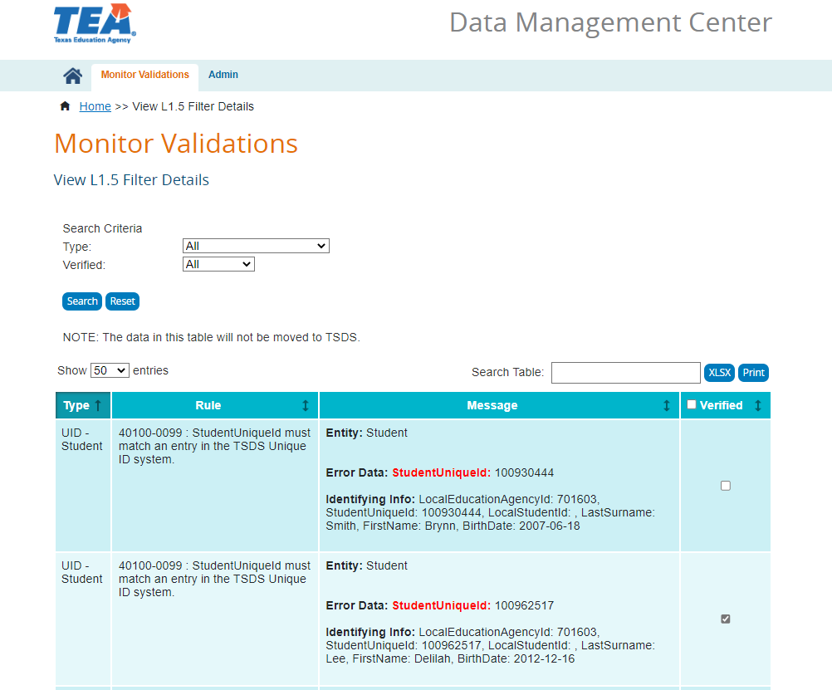



LEVEL 1.5 FILTER EXAMPLES
TEAL ROLE
SEARCH BY TYPE
Course ID, Descriptor Value, Do Not Report, Unique ID
DMC LEA Data Monitor
DMC L1.5 Filters Access
VERIFY RESULT
A result can be “verified” to assist future analysis

Slide 25
LEVEL 2 VALIDATIONS
Data
LEVEL 2 (Optional)
Business rule validation checks that are run against the data prior to promoting to PEIMS or Core data mart.
These include Fatals, Special Warnings, and Warnings. Validation errors do not prevent the data from being loaded to TSDS.
Users will need to resolve the Fatal errors prior to completing their TSDS data submissions.
Data
Data

Slide 26
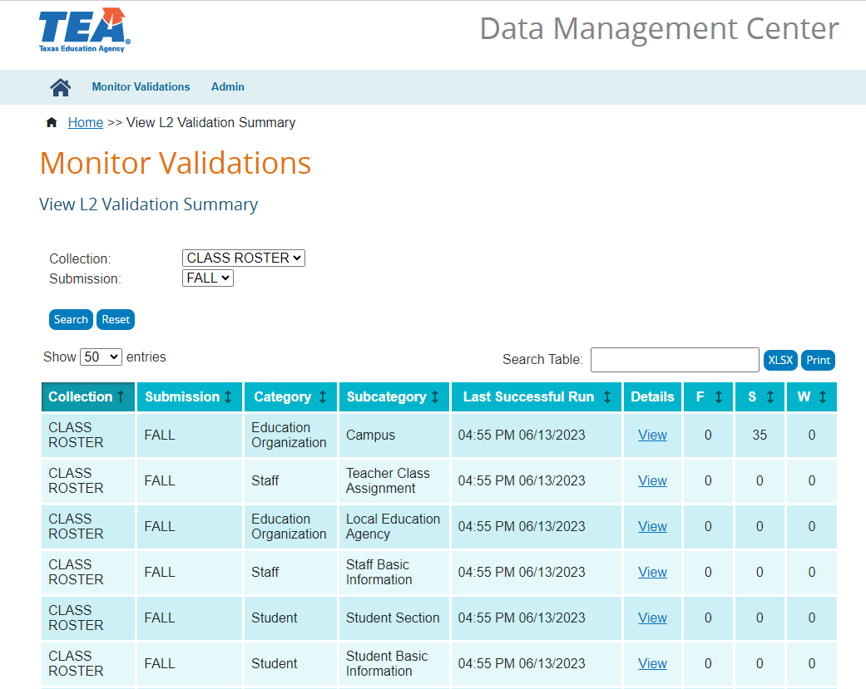
LEVEL 2 VALIDATION EXAMPLES
TEAL ROLE
RUN BY COLLECTION
Select the TSDS Collection/ Submission to validate
DMC LEA L2 Validations
Class Roster Access
SEVERITY LEVEL
View Fatal, Special Warning, and Warning
counts and results

Slide 27
VIEWING LEVEL 1.5 AND LEVEL 2
VIEW IN DMC
Level 1.5 and Level 2 results are displayed in the DMC application.

Slide 28
LEVEL 3 VALIDATIONS
Data
Data
LEVEL 3
Business rule validation checks that are run against the data after promoting to PEIMS or Core data mart. Will include some validations that could not be run at Level 2.
These include Fatals, Special Warnings, and Warnings.
Users will need to resolve the Fatal errors prior to completing their TSDS data submissions.
Data
Data

Slide 29
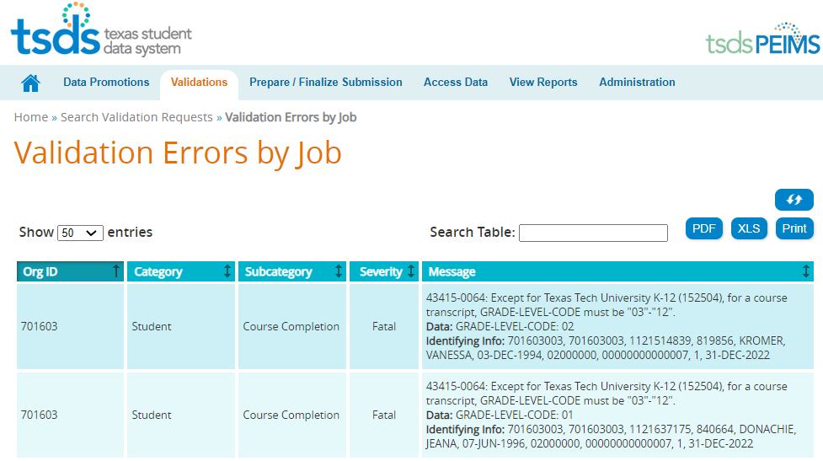
LEVEL 3 VALIDATION EXAMPLES

Slide 30
LOAD SUMMARY REPORT
LOAD SUMMARY REPORTING IN DMC:
  Reports are available at both the LEA and ESC levels.
  The report displays:
    The number of Domains loaded, as well as a record count for each Entity within each Domain.
    The ESC-level report separates LEAs with data loaded from those without any data loaded, allowing for improved monitoring of LEA activity.
TEAL Access Needed:
  Role(s): DMC LEA Data Monitor / DMC ESC Data Monitor
  Privilege: DMC Summary Access to LEA Data

Slide 31
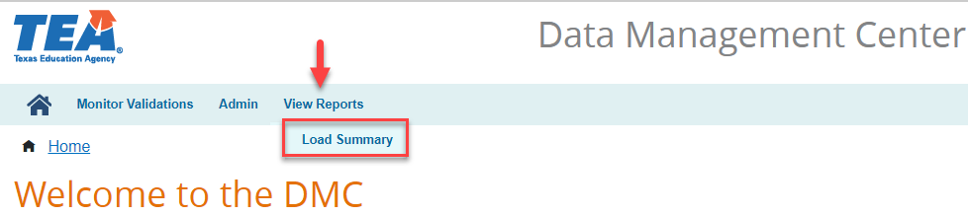
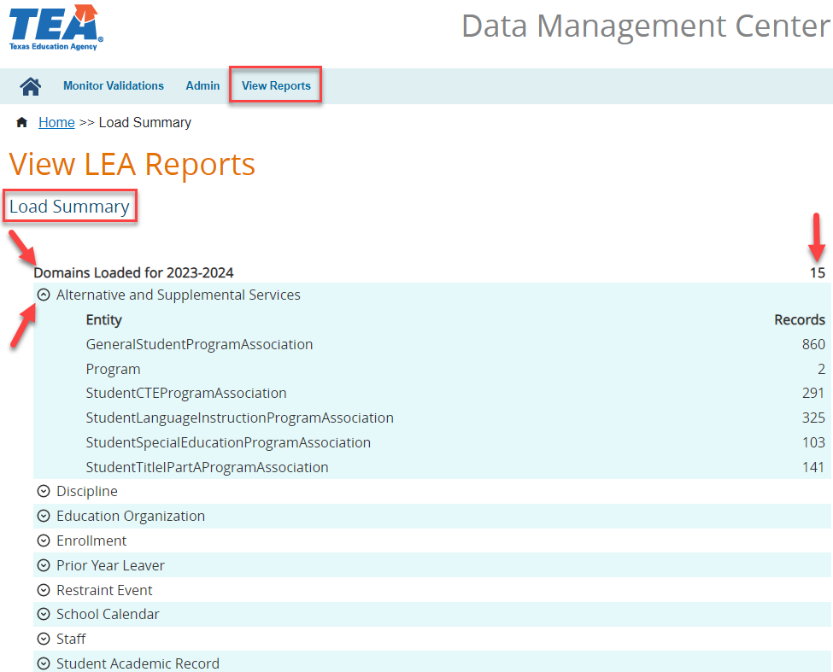
LOAD SUMMARY REPORT – LEA

Slide 32
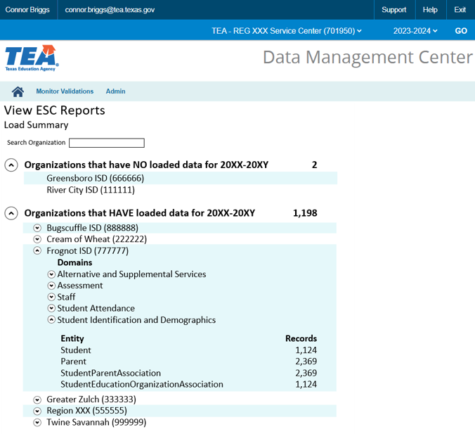
LOAD SUMMARY REPORT – ESC

Slide 33
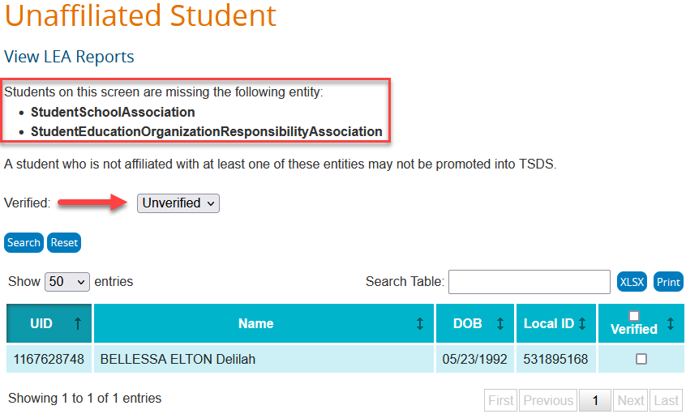
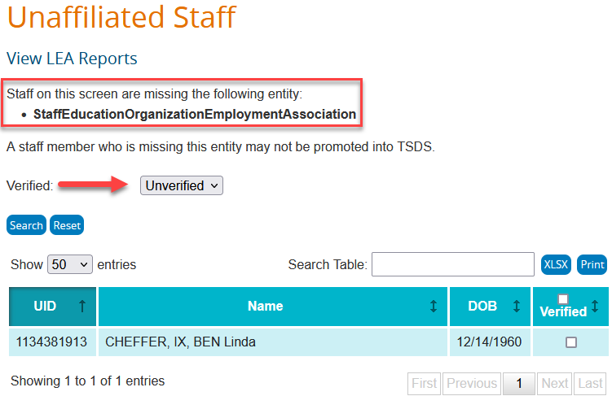
UNAFFILIATED STAFF AND STUDENT

Slide 34
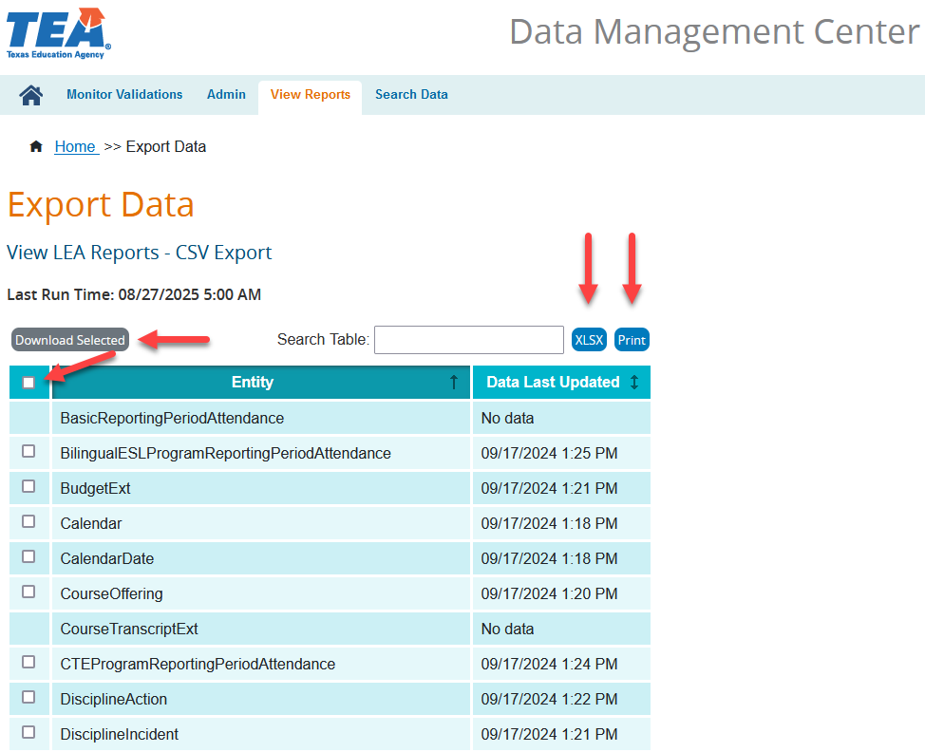
EXPORT DATA

Slide 35
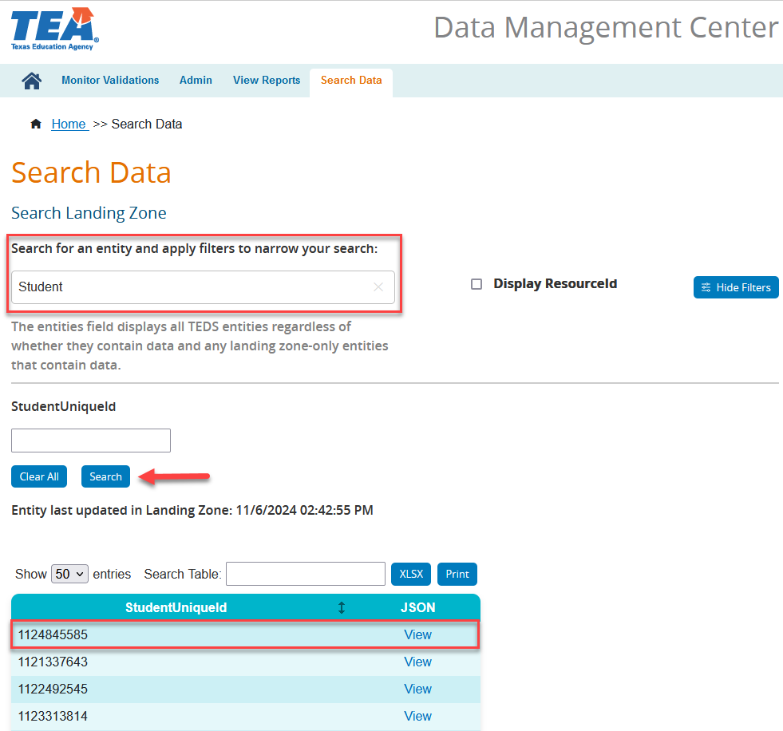
SEARCH DATA

Slide 36

TRAINING ACTIVITY
Knowledge Checks

Slide 37
KNOWLEDGE CHECK 1
Which component in the TSDS Architecture diagram will allow the user to view Level 1.5 filters and Level 2 validations?
  Data Marts
  IODS (Landing Zone)
  Data Management Center
  Vendor Source System
  Note: The DMC is your new eDM.
Notes:
NOTE
To see the answer, you must be in presentation mode.

Slide 38
KNOWLEDGE CHECK 2
2. How is data loaded?
  XML files
  API transactions
  Comma delimited files
  None of the above
Notes:
NOTE
To see the answer, you must be in presentation mode.

Slide 39
KNOWLEDGE CHECK 3
3. Singular data transactions will ensure data entered in the LEA’s source systems is being automatically published to the IODS.
  True
  False
Note: Data will be seamlessly updated in the IODS to reflect updates and corrections the LEA makes in their local source systems. However, each vendor has their own process and timeline for when they load data.
Notes:
NOTE
To see the answer, you must be in presentation mode.

Slide 40
KNOWLEDGE CHECK 4
4. Which of the following describes the checks performed in the IODS (Landing Zone) that will prevent data from being promoted to TSDS?
  Level 1
  Level 1.5
  Level 2
  Level 3
  Note: The Level 1.5 filters will identify invalid course IDs, non-TSDS descriptor values, invalid or missing Unique IDs, and all data flagged as "Do Not Report".
Notes:
NOTE
To see the answer, you must be in presentation mode.

Slide 41
KNOWLEDGE CHECK 5
5. Where can Level 2 validations be run and viewed?
  LEA’s local source system
  Data Management Center (DMC)
  PEIMS Application
  Core Application
  Note: The Level 2 validations can be run and viewed in the DMC. This will allow the LEA to begin making corrections to their data earlier in the process. These Level 2 validations will not stop the data from promoting to the TSDS Data Mart. The business rules executed at Level 2 will be run again as part as the Level 3 validations.
Notes:
NOTE
To see the answer, you must be in presentation mode.

Slide 42

WRAP UP
Key Takeaways, Resources, and Next Steps

Slide 43

KEY TAKEAWAYS
Vendors will load data via API transactions.
TSDS will utilize “effective dating” through begin and end dates to ensure the proper data is promoted.
There are levels of validations to include: Level 1, Level 2, and Level 3. There is also filtering that occurs at Level 1.5.
TRAINING RESOURCE
    Key Terms and Definitions

Slide 44
NEXT STEPS
Review the TSDS Training Catalog and Training Calendar
1
Enroll in courses aligned with your nomination from your ESC Director or their designee
2

Slide 45
WRAP UP
  In this training we talked about:
The components of the TSDS.
How data is loaded and promoted.
Where the validations and filters will be executed and viewed.

Slide 46

QUESTIONS

