Slide 1

TITLE SLIDE: TSDS ODS 3.x Project
Updates
TSDS UNIQUE ID (UID)
UID ID ASSIGNMENT
New User Certification Training

Slide 2
KEY TERMS
Begin Date
Education Service Center (ESC)
Local Education Agency (LEA)
Source System
Texas Education Agency Login (TEAL)
TSDS Web-Enabled Data Standards (TWEDS)
Texas Student Data System (TSDS)
Unique ID (UID) Number
You can find the definitions to these key terms and more here:
  Key Terms Document

Slide 3
LEARNING OBJECTIVES
  By the end of this course, the users will be able to explain:
  How UID fits into the overall TSDS Architecture.
  How UID fits into the Data Collection Process.
  The UID Assignment Process.

Slide 4
WHY IS THIS COURSE IMPORTANT
  This course will help users:
  To understand that each student and staff member at the LEA/ESC must have a Unique ID number in order for data to be promoted to TSDS.
  To understand that the ID Assignment process may involve searching in the UID System and resolving all Near Matches carefully.

Slide 5

COURSE AGENDA
Getting Started
TSDS Architecture , TEAL Roles, and Demo
Key Concepts
Unique ID Assignment and Searching in UID
Training Activity
Practice, Troubleshooting, and Knowledge Checks
Wrap Up
Key Takeaways, Resources, and Next Steps

Slide 6


GETTING STARTED
TSDS Architecture, TEAL Roles, and Demo

Slide 7
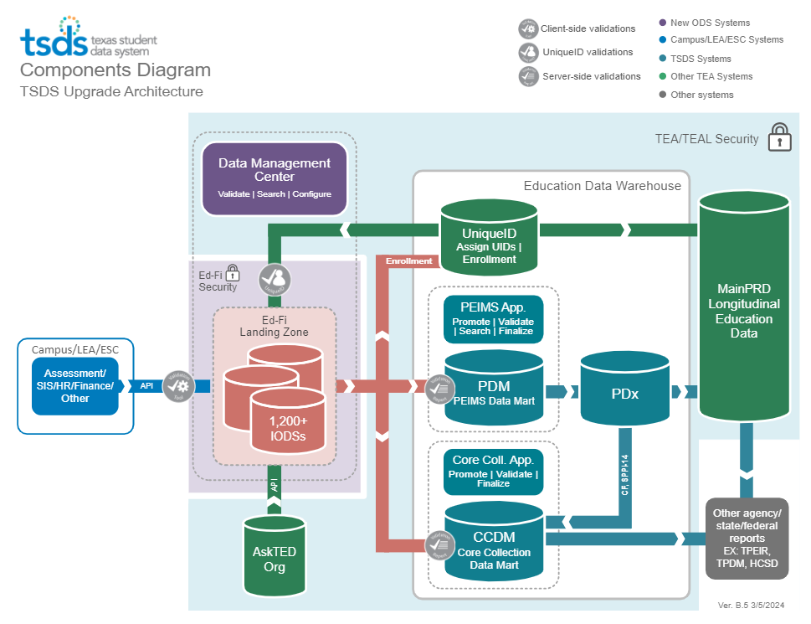
HIGH-LEVEL ARCHITECTURE

Slide 8
LEA TEAL ROLES – UNIQUE ID
Unique ID LEA
This role gives the user the ability to search, update, and edit information in the UID for the LEA.
Unique ID Campus
  This role allows the user to search, update, and edit information in the UID for a specific campus.
Unique ID Search
  This role gives the user the ability only to search and view information in UID.
More details covered in the Introduction to UID Video.
Notes:
UID LEA Role – gives the user the ability to search, update, and edit information in UID.
UID Campus Role – allows the user to search, update, and edit information in UID for a specific campus.
UID Search Role - gives them the ability only to search and view information in UID.

Slide 9
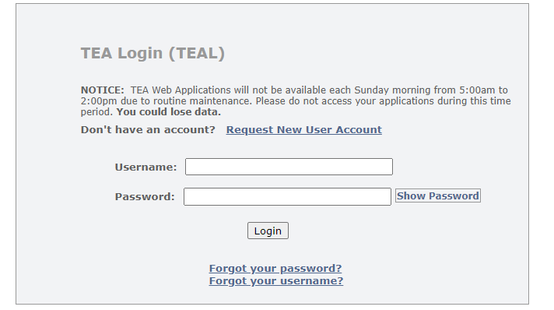

TEAL ROLES FOR UID
Log into TEAL with your username and password.
Select Add/Modify Access in the Texas Student Data System Portal.

Slide 10
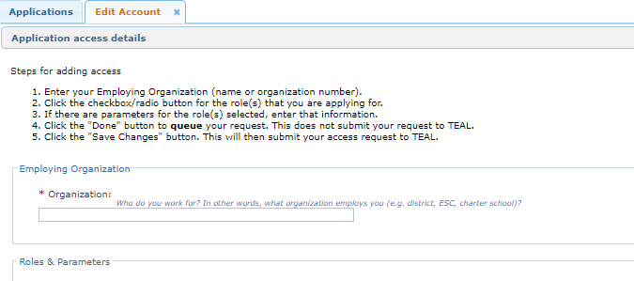
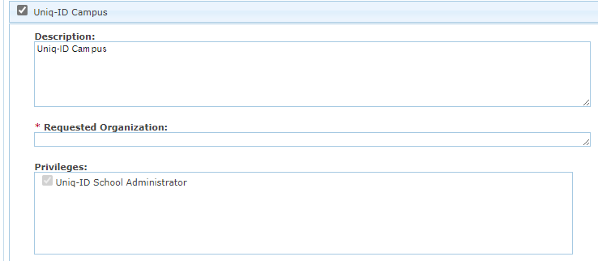
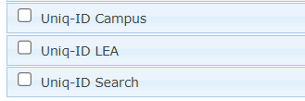
UID TEAL ROLE AND PRIVILEGE
Enter your Employing Organization and select the appropriate UID role.
Enter the Requested Organization in the Requested Organization ID field. The UID privilege for each role is checked by default. Click Done. Click Save Changes.

Slide 11
DEMO
Login to TEAL Account
Navigate to TSDS Unique ID
Upload UID Assignment File
Monitor File Validation and Data Validation
Resolve Near Matches
Download Newly Assigned UIDs
Note: The Reference Guide (RG) is a resource that provides step-by-step instructions for assigning UIDs in the UID system.
UID ID Assignment Reference Guide
Notes:
Provide a high-level demo showing the functionality within the UID application. Then, we will present the requirements and details users will need to understand for UID ID Assignments.

Slide 12


KEY CONCEPTS
Unique ID Assignment and Searching in Unique ID

Slide 13
KEY TERMS FOR ID ASSIGNMENT
Master Record – The current active record in the repository in the UID system which is used for matching.
Submission Record – A record submitted to the UID system by the LEA/ESC for matching against the master records and for UID assignment.
Submission Type – The submission type will always be 001 which indicates to the UID system that this record is being submitted as an ID Assignment record.
Person Type – The person type on each record on an ID Assignment file will either be 02 to indicate this record is for a student or 03 to indicate this record is for a staff member.

Slide 14
UNIQUE ID ASSIGNMENT
The Unique ID Assignment process provides the LEA/ESC authorized user with the ability to assign UIDs to students and staff members and download and store the UIDs in their local source system.
A Unique ID is required for each Student and LEA/ESC Staff member to load information for TSDS state reporting.
Notes:
Who is an authorized user that will be able to assign UIDs?

Slide 15
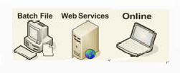
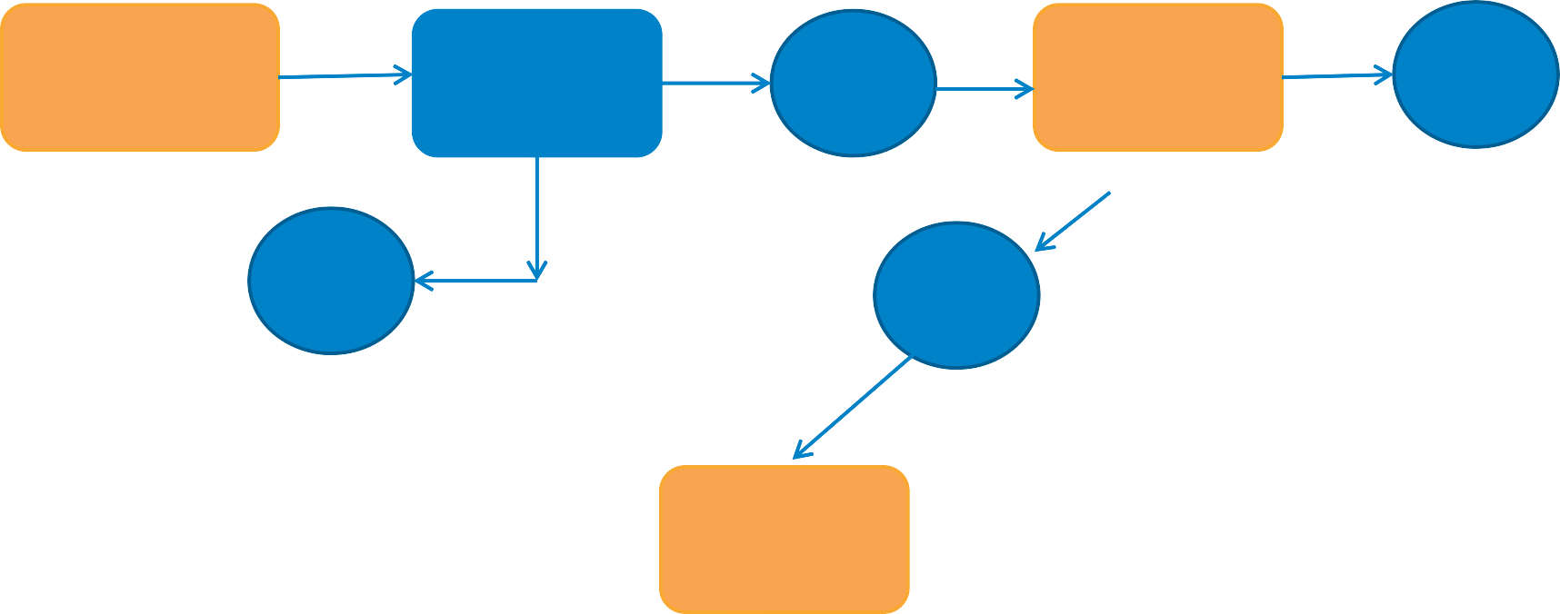
ID ASSIGNMENT PROCESS
File Validation looks at file as a whole.
Data Validation looks at each individual record on the file.
Data Submission
File Validation
Data Validation
Pass
Fail
Fail
Pass
Resolve Near Matches
Near Matches
No Near Matches
Download IDs
Assign ID
Notes:
Notes: UID Data Flow Process
Extract and Upload a UID ID Assignment Batch File
File goes through file validation – if passes it will move forward; if it fails the entire file is rejected.
Data validation – the system performs validations on each record on the file – the records that pass move forward; individual records that fail are rejected and must be corrected and loaded on another batch file.
Assign IDs – Matches and No Matches are automatically assigned a UID; Near Matches must be resolved by the user.
Last, users can download a file that will be uploaded into their local system to populate the UIDs in the local system.

Slide 16
UID ASSIGNMENT FILE
A standardized file format is submitted to the UID system for matching and ID assignment via one of the following methods:
Batch Upload – an upload of a file with one or many individuals within the application.
Online Entry – a single individual submission within the application.
Web Services – allow different applications from different sources to communicate with the TSDS Unique ID application for assigning or retrieving IDs.
Notes:
Notes: Batch files, Online Entries, and WebServices files will all go through the same validation and assignment process in UID.
Batch Files must be in .txt or .csv file format.
Online Entries should contain as much information as available.
If the user is wanting to use the WebServices upload feature, they should work with their vendor.

Slide 17
UID FILE VALIDATION
The UID system performs File Validation for file format.
If the file fails File Validation the entire batch file will be rejected.
Files are checked against the specifications set in TSDS Unique ID Specifications.
The system then performs Data Validation for file content.
Issues found during Data Validation will prevent only the records that contain errors from loading to UID.
The UID system loads the records and the UID assignment process begins.
Notes:
Validations
File validation checks the file for file format. If the file fails file validation the entire batch file is rejected.
Data validation checks each individual record on the file. The records that pass will move forward and only the records that do not pass will be rejected.

Slide 18
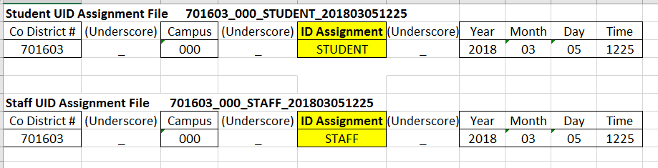
UID ASSIGNMENT FILE NAME
UID Assignment Files must conform to the following naming convention:
Notes:
UID Batch file naming convention.

Slide 19
UID ASSIGNMENT FILE FORMAT
H E A D E R
TH 05/25/2017 14:00:00 Cumfile4 3.0 delimiter=0X2C source=SIS qualifier=0X22
"ID","043905005","","Norris","Chuck","","","M","10/01/2002","09","043001",S81010100","B","","043905","2017","","","","","","","","","","","","","","","0","","","","","","","","","","","","","","","","","","","","","","","",“001",“02","","","","","","","","","","","","","","","","","","","","","",""
D E T A I L
T R A I L E R
TT Cumfile4 3
"ID","CDNCampus","","LName","Fname",“Mname","GenCode","Sex","DOB","Grade","LocalID", "S Number or SSN","Race","","CDN","Year","","","","","","","","","","","","","",""," "EthnicityCode","","","","","","","","","","","","","","","","","","","","","","","",“SubmissionType",“PersonType","","","","","","","","","","","","","","","","","","","","","",""​
Notes:
Notes: (TH) Header Record – defining record
(ID) Detail Record – individual records for each student or staff member being submitted on the batch file. (ID)
(TT) Trailer Record – like the summary line. It contains a record count that includes the header record, each detail record, and the trailer record.
UID will be blank since that is the purpose of this file – to assign a UID# for each individual on the file.
Each record on the file will have 001 to indicate the submission type is UID assignment.
02 will indicate that the person type is student; 03 will indicate the person type is staff.
All remaining fields will be blank on the assignment file.

Slide 20
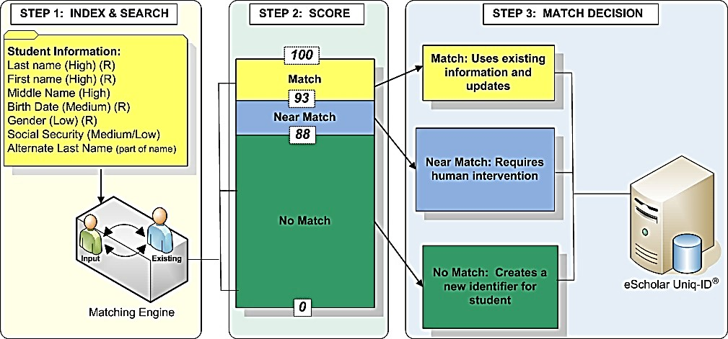
MATCH PROCESS
The matching engine within UID searches and indexes the Master Records based on the data on the Submission Records.
Each Master Record indexed for the Submission
Record is assigned a match score.
97
Submission Record
Master Record
Notes:
The last name, first name and the middle name (if available) have a high priority in the search index. (Note: Middle name is optional but has high priority if provided.)
The DOB has a medium priority and the SS# or S# has a medium/low priority. Gender has a low priority.
If a match score of 98 to 100% is returned the match decision will be Match.
If the score is between 88 to 97% it will be a Near Match.
If the score is below 88% it will be considered a No Match.

Slide 21
UID MATCH PROCESS
More details covered in the Introduction to UID Video.
Match
98-100%
No Match
Below 88%
UID found one record that matches (98-
100%)
No Human Intervention is Required
UID sees this as a brand-new person
System assigns UID from matching Master Record
System assigns a new UID number to Submission Record
Notes:
Notes: The matching engine within UID searches and indexes the Master Records based on the data on the Submission Records.
The last name, first name and the middle name (if available) have a high priority in the search index. The DOB has a medium priority and the SS# or S# has a medium/low priority. Gender has a low priority.
Each master record indexed by the matching engine is assigned a match score.
If a match score of 98 to 100% is returned the match decision will be Match.
If the score is between 88 to 97% it will be a Near Match.
If the score is below 88% it will be considered a No Match.
The Match, Near Match, and No Match scores for the different match threshold values are set by TEA system administrator.
If the match engine returns a match score of:
Match – No human intervention; the system assigns the UID of the matching master record to the submission record. It also assumes if there are minor differences in the two records that the submission record is correct and changes the demographics in the UID system to match the submission record.
No Match – No human intervention; UID sees this as a new person and assigns a new UID to the submission record.

Slide 22
UID MATCH PROCESS
Near Match
88-97%
Human Intervention IS Required
Record Returned to List
Record is Cancelled
New ID Created
Existing ID Assigned
Master is Updated OR
Master Record Retains Info
UID Near Match Resolution Video
Notes:
Notes:
All Near Matches require human intervention. (88-97%) The system cannot make a determination, and the LEA must make a decision based on proper research and documentation. The LEA must look at each near match instance carefully and at each master record flagged as a near match. The user will have four options for resolving each near match. We will discuss these options as we move through this training.

Slide 23
MATCH SCORE EXCEPTIONS
Errors in Spelling, Nicknames, and Multi-Part Names
Steven | Stephen | Jon | John
Billy | Bill | Sue | Susan
Mary Ann | Maryann | Jo Smith | Jo Smith-Ball
SSN Different and SSN Same
  If the SSN on the master record and the SSN on the submission record are different even though it may return a match score of 98-100%, the system will force a near match.
  If the SSN on the master record and the SSN on the submission record are the same but some of the other information is not the same, this will force a near match.
Multiple Matches
  If the system finds multiple records that are similar, the system will force a near match even though these multiple records return a match score of 98-100%.
  All these scenarios will trigger a near match.

Slide 24


RESOLVING NEAR MATCHES

Slide 25
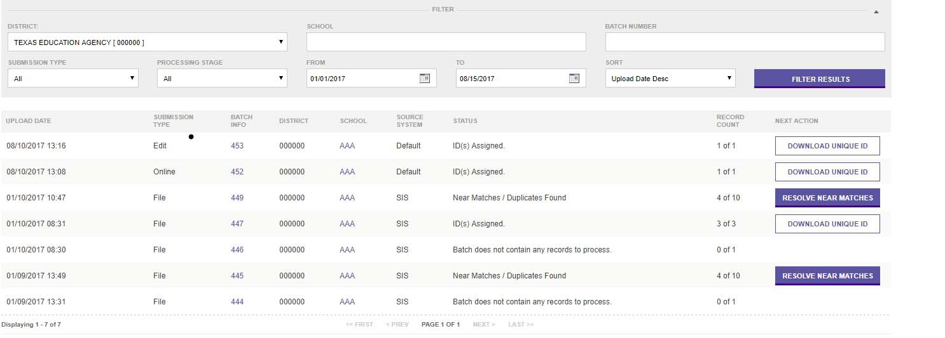
NEAR MATCH RESOLUTION
Users may see on January 10 four records that were Near Matches.
User will click Resolve Near Matches.
Notes:
Notes:
On January 10, there are 4 records that returned a match score of Near Match. User will need to look at these records and determine the appropriate action. Click Resolve Near Matches. Please note that all Near Matches must be resolved or canceled before a Unique ID can be retired.

Slide 26
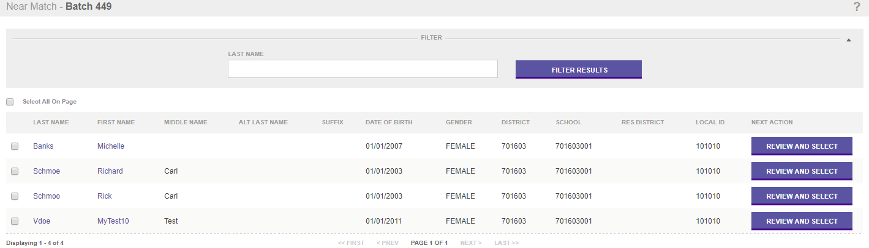
VIEWING NEAR MATCHES
When user clicks Resolve Near Matches, the next screen shows the four records that are the Near Matches for this batch.
Click Review and Select on the Richard Carl Schmoe row .
Notes:
Notes:
When I click on Resolve Near Matches on the previous screen, I can see the 4 records that are my Near Matches for this batch.
Let’s look at Richard Carl Schmoe by clicking on Review and Select.

Slide 27
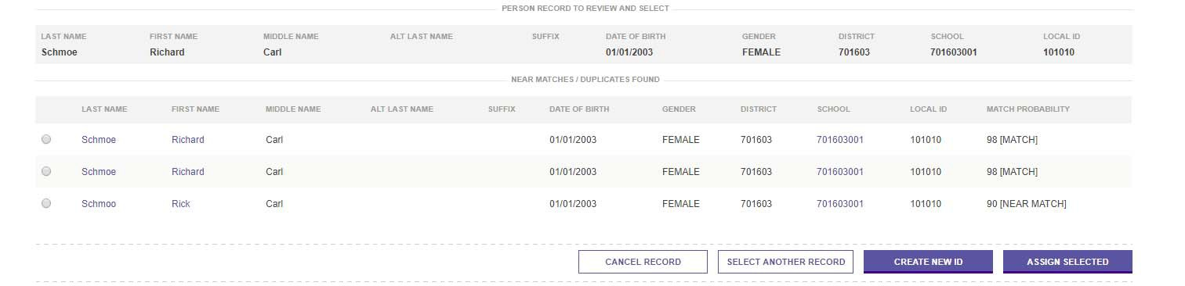
MATCH PROBABILITY SCORES
Now users will see the master records that returned a match or near match score for Richard Carl Schmoe.
Why did the system not just return a match for the first or second record and assign a UID to the Submission Record?
Users would click on the name on each row to compare the record to the submission record.
Notes:
Notes
Richard Schmoe that was on my batch file is shown at the top of the screen. The Near Matches are shown below. I can see that there are 3 near matches. All 3 have the same DOB as my Richard, same gender, school, and local ID. The third record has the name spelled differently. I should click on the name on each of the Near Matches and review the information. Let’s start by clicking on the first near match record.

Slide 28
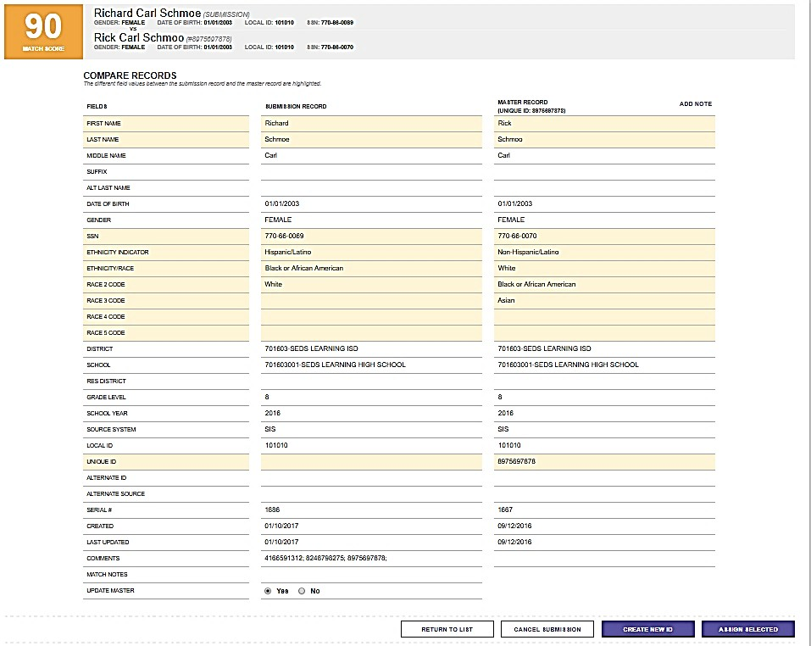
NEAR MATCH DIFFERENCES
User clicks on the near match record on the previous screen and can compare the two records.
Rows that are highlighted indicate these fields do not match on the submission record and near match master record.
Notes:
Notes
Notice the column that shows the information on the Submission Record and the column that shows the information on the Master Record in UID.
The highlighted rows show where there are differences between the Submission Record and the Master Record.
Users should look at each near match record and verify the information to determine if this is the same person or a completely different person with similar demographic information.

Slide 29
UID MATCH PROCESS
Options for resolving Near Matches:
When TWC creates a UID, why do the LEAs not use that same UID#?
Near Match
88-97%
Human Intervention is Required
Record Returned to List
Record is Cancelled
New ID Created
Existing ID Assigned
Master is Updated OR
Master Record Retains Info
UID Near Match Resolution Video
Notes:
Notes: TWC UIDs. Why does the LEA not use those UIDs?
All Near Matches require human intervention. (88-97%)
The user will have 4 options for resolving each near match.
Return the record to List and review again later.
Cancel the Submission Record as no decision could be reached.
Create a new ID
Assign the Submission Record an existing ID. (Will you update the master to match your submission record, or should you retain the info on the master record and update the information in your local soft ware to match?)
All near matches must be resolved or canceled before the LEA can extract and download the UIDs to their source system. Near matches must also be resolved or canceled before the LEA can request the retirement of a UID. This leads us to understand that users should always resolve or cancel all near matches while working through each ID assignment batch file before moving on.

Slide 30
DOWNLOAD U NIQUE IDs

Slide 31
EXTRACT & DOWNLOAD UIDs
The LEA is ready to Extract and Download the UIDs on the batch file into their local system when all records on a submission batch file have either:
Returned a match score of Match and were assigned the matching UID;
Returned a match score of No Match and were assigned a new UID;
Returned a match score of Near Match and each record has been evaluated and the LEA chose either to:
  Cancel the record and revisit and upload again later,
  Create a New UID, or
  Assign Selected thus assigning the Master Record UID to their Submission Record.
Notes:
Notes:
When all records on the batch file have either:
Returned a match score of Match & were automatically assigned a UID by the UID system.
Returned a match score of No Match & were automatically assigned a new UID by the UID system.
Returned a match score of Near Match & records were evaluated and LEA choose to:
Cancel the Record
Assign Selected
Create a New ID
The LEA is now ready to Extract and Download the UIDs into their local system.

Slide 32
DOWNLOAD UNIQUE IDs
On January 10 three records have been assigned a UID. These are ready to download and load into our local system.
Click Download Unique ID to create a download file that will be uploaded to populate these UIDs in the local system.
Notes:
Notes:
Users can see on January 10 there are 3 records that were assigned UIDs and these are ready to download and load into our SIS or HRIS.

Slide 33

DOWNLOADING UNIQUE IDs
More details covered in the Introduction to UID Video.
Download Options:
Extract & Download
IDs can be downloaded by batch at any time by authorized users.
The download can be consumed by source systems to update the State ID/Unique ID at the sources.
Download by Location
IDs can be downloaded by location/agency at any time by authorized users.
The download can be consumed by source systems to update the State ID/Unique ID at the sources.

Slide 34
EXTRACT AND DOWNLOAD
From the Hamburger Menu on the UID Home Page, users can also set the filtering options for downloading files.
Download files for a particular type record:
  IDs Assigned
  Canceled Records
  Rejected Batch Files
  Near Matches
  Near Match Details
  Options NOT used in Texas
    Errors to Fix
    Fixed Records
Download single files from the system.
Download multiple files from the system.
Manage the download cart.
Notes:
The extract and download feature can be accessed from the UID homepage or from within the batch search component. Users can filter downloads for different purposes. Some of the download files may be useful earlier in the resolution process.
IDs assigned – this download can be used to load the assigned UIDs into the SIS or HR system.
Canceled Records – download a list of records that contained data errors and were canceled by the system. This output file will also contain any records the user canceled during the near match process.
Rejected Batch Files -- this download contains files that were rejected because they did not pass File Validation. This file will contain all of the records contained within the original batch.
Near Matches – this download can be used to assist with researching and resolving near matches. This file contains a list of the submission records that were flagged as near matches.
Near Match Details – this file can be used to assist with researching and resolving near matches as it contains all the detail information and lists all the master records that were near matches.
Errors to Fix and Fixed Records – these options will be in the dropdown box but are not used in Texas.
Users can download a single file or download multiple files from the system all at one time by placing them in the download cart. Users can then manage the download cart and determine the desired actions for the files in the cart.

Slide 35
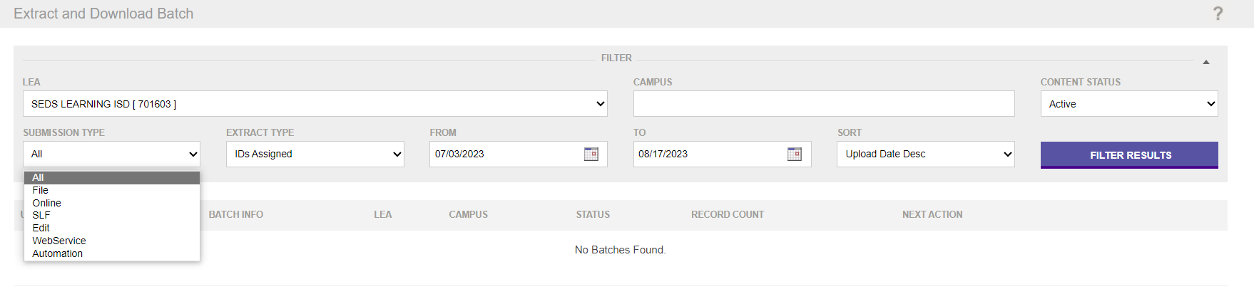
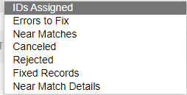
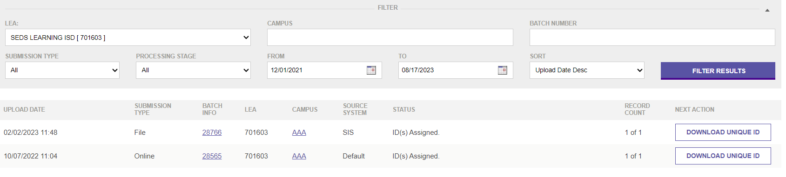
FILTERING AND EXTRACT FILES
Filtering Options for the Extract Download
Notes:
Users can see the different filtering options for filtering extract files. After the filters are set click on Filter Results to create the file you wish to extract.

Slide 36
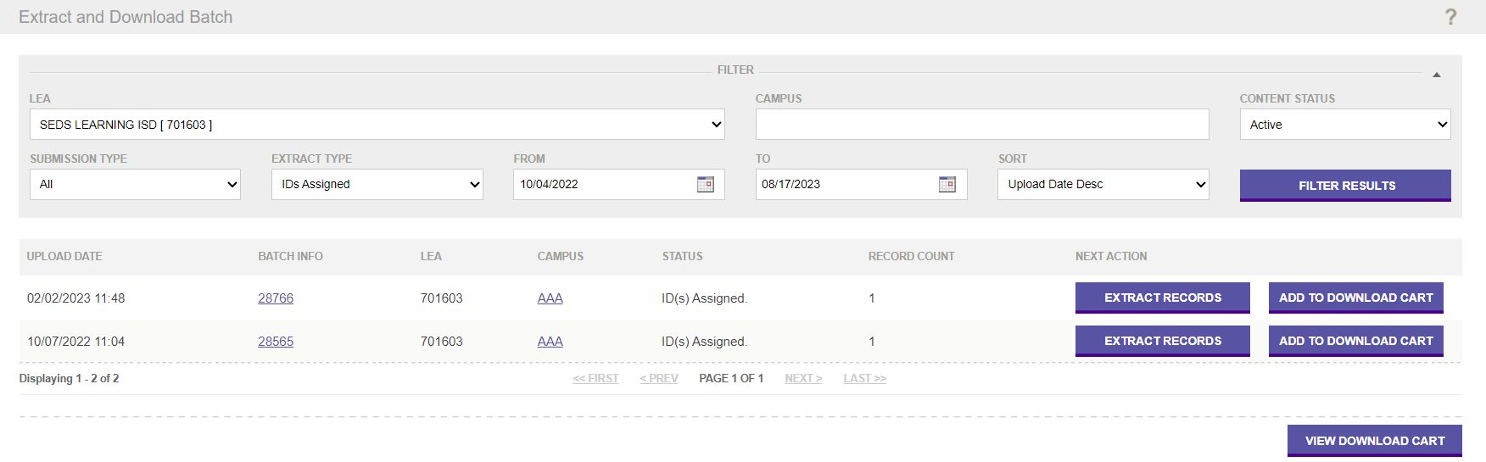
DOWNLOAD EXTRACT FILE
Extract Records or
Add to Download Cart
Notes:
All batch files that match the filter are now on our screen. If the user clicks on Extract Records the extract file will be generated and can download that file.
If the user would like to download several of the files listed on this screen, they can click on Add to Download Cart. This puts the file in the Cart and the user can then come back to this screen and select the next file to add to the Cart.
Next you would click View Download Cart to see all the files in the Cart.

Slide 37
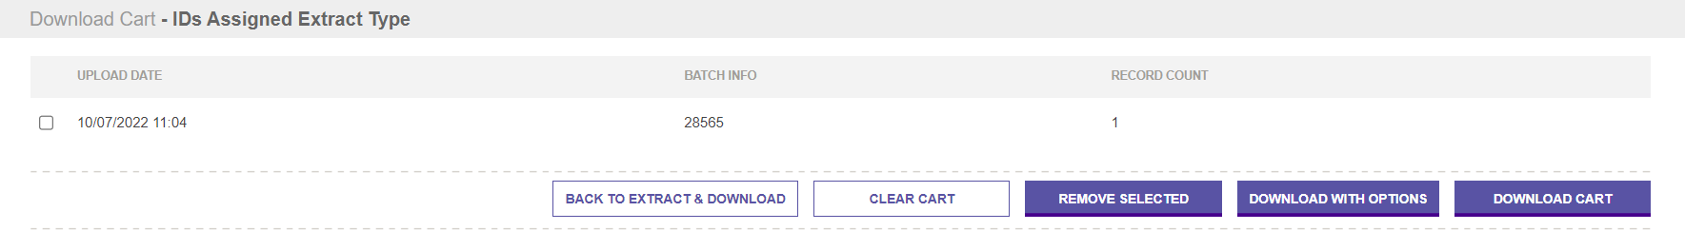
DOWNLOAD CART
View the Download Cart
Notes:
The user has one file in the Download Cart. There are several options for managing the downloads. Users can:
Click Download Cart and this will download all files currently in the Cart.
Click Download with Options will allow the user to set some options for the format of the downloaded file.
Back to Extract & Download would take users back to the extract screen where they can select more files to place in the Cart.
Remove Selected will allow the user to check the box on the left side of a particular file and remove that file.
Clear Cart will clear all files currently in the Cart.

Slide 38
UID ASSIGNED EXTRACT FILE
Record Status on ID Assignment Extract File
Unique ID Assigned
Record Status
Notes:
When users extract and download the ID Assignment File the extract file shows the UID Assigned and a comment on the record status.
The file has a Header Record with “TH” at the beginning of the row.
Users will see the detail rows that begin with “ID”. Each individual on the file will have an “ID” row.
Last is theTrailer Record beginning with “TT”. The Trailer Record has the record count for this file. Remember the count includes the header record and the trailer record.

Slide 39
NEAR MATCH EXTRACT FILE
Near Match Extract File with Record Status
Unique ID Assigned
Record Status
Notes:
If users extract a Near Match Details file the UID will be blank because no UID was assigned and the record status will let you know these records were flagged as near matches.
A Near Match output file only lists the students that need your attention to resolve the near match. The Near Match Details download file the file will list each record that was a near match to the submission record.
Output files for Canceled Records and files for a Rejected Batch File will look very similar to this output and the record status will give the user more information about the records.

Slide 40
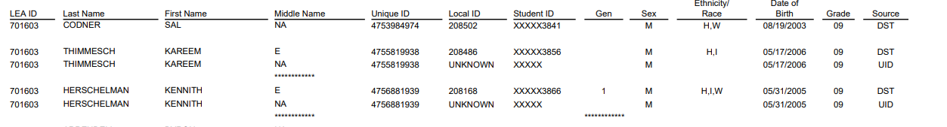
UID DISCREPANCIES
The PEIMS UID discrepancy reports will be used to identify demographics in the LEA’s source systems that do not match demographics in the Unique ID system.
LEAs can promote their PEIMS data and check these reports throughout the school year. This process will help keep the data clean and accurate in both the source systems and UID.
Notes:
The PEIMS UID discrepancy reports will provide the information about discrepancies on the data in the source system and that in UID.
The DST row indicates the data that was published to the LEAs IODS from their source system.
The UID row indicates the demographic data that resides in the UID system.

Slide 41
UNIQUE ID SYSTEM SEARCH

Slide 42
SEARCHING IN UID
UID users will be able to:
Search within UID for previously loaded batch files.
Upload a search file to search within UID for a group of students to determine if they reside in UID and have UID#s.
Search for individuals within UID.
Notes:
The batch upload search feature is especially helpful for Charter Schools who have student on a waitlist and for Child Find babies who not yet enrolled at the LEA. These students are not enrolled but they will need a UID# to be included in the CSW and CF data submissions. The LEA can upload a search batch file and when the file is processed they can download a report that will provide information to inform the LEA if the student(s) have UID#s.

Slide 43
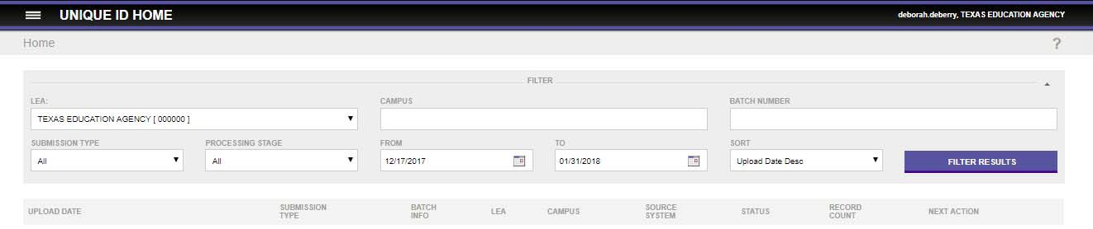
SEARCH LOADED BATCH FILES
Users can set the batch criteria to search for a specific batch file previously loaded.
On the UID home page the user can set the batch search criteria.
Search by batch number, submission type, processing state, or for a date range.
Notes:
Notes:
You will be able to search for a batch from the home screen in UID.
Each batch submitted to UID is stored as a unique entry in the system and is assigned a batch number. This batch search feature could be used if you need to verify that a group of individuals have UIDs in the system or if you loaded a file on a specific date. You can filter your search by date range and/or processing stage. You can also search by batch number.

Slide 44

UNIQUE ID SEARCH
LEAs can search within the UID system to determine if a student already has a Unique ID.
This process is valuable to ensure that students are not assigned duplicate IDs.
There are two types of searches in UID.
    Batch Search
    Person Search
More details covered in the Introduction to UID Video.
Demo
Notes:
Search within UID to determine if a student has a UID # by doing a Batch Search or a Person Search by clicking on the hamburger menu within the UID System.
For more information on the search features click on the “?” on the right side of the screen.
A person need only have UID Search TEAL role to do this type search. This is especially useful for adding students to a Charter School Waitlist.

Slide 45
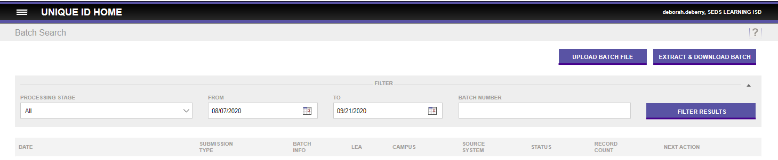
UID SEARCH BATCH FILE
  Uploading a search batch file will not update the master record in UID.
  From the hamburger menu in UID, select Upload File.
  On the next screen browse to find the search file the user created to search for a group of students and click Upload.
Notes:
Uploading a batch search file will NOT update the master record and will not assign UIDs to the students on the batch search file. It is only a “search” file.

Slide 46

UID SEARCH FILE FORMAT
Users can upload a search file into the UID system for a group of students and search to determine which students on the file already have UID numbers.
The file name for a Search File will be like the UID Assignment file name – County District Number_Campus Number_Student_Date Time Stamp.
The mandatory fields on a search file are last name and first name.
Gender, date of birth, grade and year (school year) are optional but should be supplied if available.
SSN or S Number is also an optional field on the search file.
The specifications for the search file format can be found on the TEDS website at TSDS Unique ID.
Notes:
The sample file shown here is an overview of how the file should be formatted. The link to TSDS UID Specs can also be found in TWEDS by clicking on Data Submissions tab and then Technical Resources in the panel on the left side of the page.
The file name for a Search File will be like the UID Assignment file name – County District Number_Campus Number_Student_Date Time Stamp.

Slide 47
UID SEARCH FILE RESULTS
The UID application will return one of the following for each record on the UID search file:
        No matching persons – The Unique ID column will be blank for these records in the downloaded file.
      A single matching person – The UID column will contain the Unique ID of the matching master record found.
      Multiple matching persons – The downloaded file will show the details and Unique ID for all matching master records found.
      When one or more near matching records are found, the record on the batch file will be auto-canceled and will not be listed in the downloaded file.
Notes:
LEAs can search for previously loaded batch files within UID.
They can also upload a “Batch Search” file and search within UID for a group of students.

Slide 48
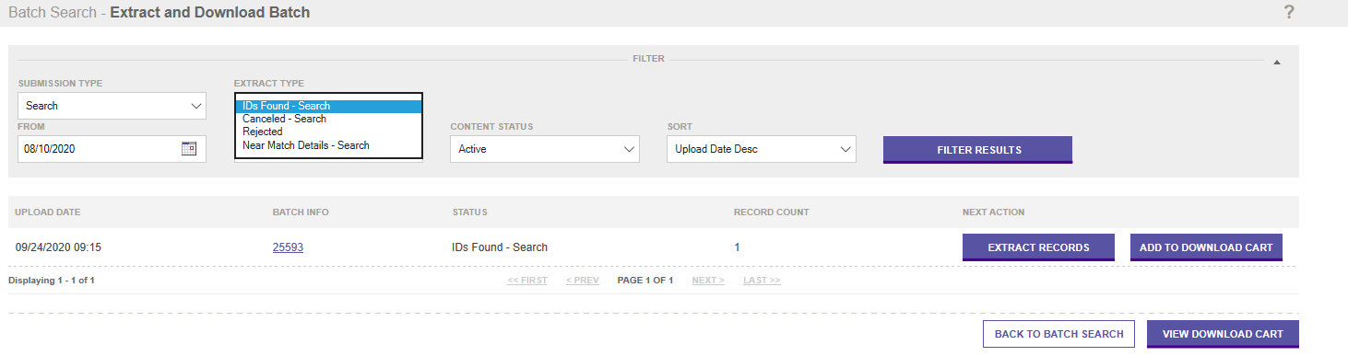
EXTRACT & DOWNLOAD SEARCH
When the batch search is completed, users will have four options under the Extract Type for extracting the search results.
In the dropdown under Extract Type, users will see the options. Select the Extract Type and click Filter Results. Next, click Extract Records.
Notes:
IDs Found-Search – This will provide a file with the names of all students on the batch search who were not found in the UID system. These students will need a new UID assigned.
Canceled – Search – Remember earlier we learned that any records on the batch search that are found with a single match or multiple matches will be canceled. This extract type will provide a list of those students who were found to have a match(es).
Rejected – This will return information if the records on the batch were rejected because they did not meet the specified criteria on the file.
Near Match Details – Search – This will provide a list showing the record you uploaded on the batch search file (submission record) and all potential matches with details.

Slide 49

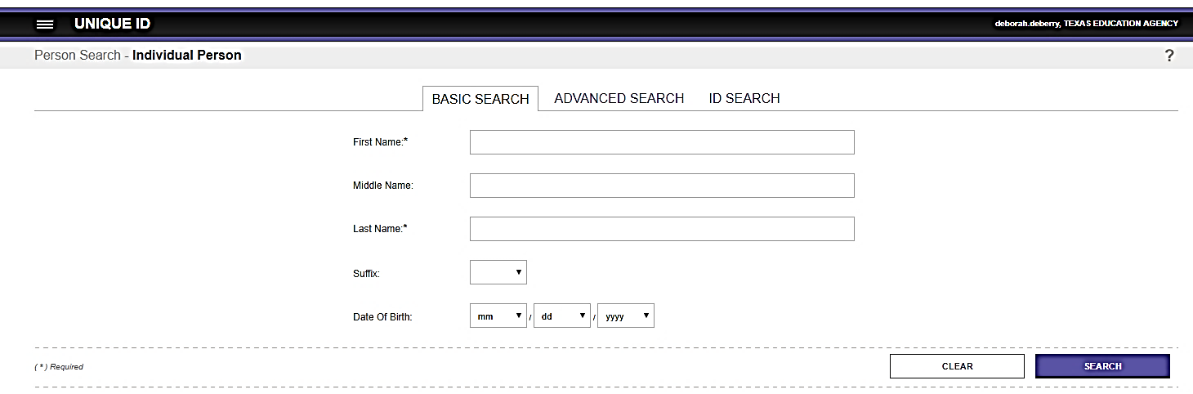
PERSON SEARCH IN UID
From the hamburger menu, click on Person Search.
Person Search can be a Basic Search, Advanced Search, or ID Search.
Notes:
Person Search will allow users to search for individuals within the UID system.
Basic Search will allow users to search with minimal information provided.
Advanced Search will allow users to provide more demographic information which will narrow the search results.
ID Search will allow the users to search by UID, SS# or Alias ID (or local ID). The ID search will narrow the search results.

Slide 50

TRAINING ACTIVITY
Practice, Troubleshooting, and Knowledge Checks

Slide 51
PRACTICE EXERCISE
Task 1: Upload ID Assignment File and Process.
Task 2: Upload Enrollment Tracking File and Verify.
Ready
Set
Go

Slide 52
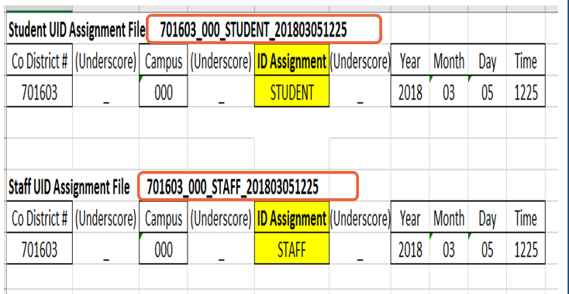
TROUBLESHOOTING 1
Scenario 1: How does the UID System know if I am uploading an ID Assignment file for students or staff?
Resolution Steps:
Review the naming convention for the ID Assignment files.
Near the middle of the file name, it should say “Student” or “Staff”.
This indicates to the UID system if this file is for assigning UIDs to student or staff.
Each individual student or staff member on the file is identified as a student or staff by the Person Type. (02-student and 03-staff) but the file is identified by the file name.

Slide 53
TROUBLESHOOTING 2
Scenario 2: When might the LEA upload a Batch Search file?
Resolution Steps:
1. LEAs who have young children who are not enrolled at the LEA but will be reported on the Child Find data submission who will need a UID.
2. Charter Schools who have students on a waitlist who will need UIDs in order to be reported on the CSW submission.
      The UID system will return one of these comments for each record on a Batch Search File:
      No matching persons – The Unique ID column will be blank for these types of records in the downloaded file.
      A single matching person – The UID column will contain the Unique ID of the matching person.
      Multiple matching persons – The downloaded file will show the details and Unique ID for all matching persons.
After the LEA performs a Batch Search, they will then determine the steps to assign UIDs to the students. The Batch Search will NOT assign UIDs.

Slide 54
TROUBLESHOOTING 3
Scenario 3: Why is the LEA continually submitting TIMS tickets to merge UIDs?
Resolution Steps:
1. When the LEA is assigning UIDs to newly enrolled students the staff does not have time to thoroughly review the near matches.
2. Many times, it seems easiest to just choose the option to “Create a New Number” for their submission records that trigger a near match.
Training.
Training.
Training.
Encourage the LEA staff members to review the Near Match Resolution Video.
Provide examples to the LEA staff illustrating how hasty ID assignments can cause more work later for themselves and others.
Remember: Haste makes Waste!! Carefully working through the ID Assignment process will help ease the burden of merging and deleting duplicate UIDs.

Slide 55
KNOWLEDGE CHECK 1
1. If a UID ID Assignment batch file does not pass file validation, are any records on the file loaded into the UID system?
  Yes
  No
  Note: If the file fails file validation, the entire batch file is rejected, and no records are loaded into the UID system.
Notes:
NOTE
To see the answer, you must be in presentation mode.

Slide 56
KNOWLEDGE CHECK 2
2. If records on a UID ID Assignment batch file do not pass data validations, are any records on the file loaded into the UID system?
  Yes
  No
  Note: All individual records that pass data validations are loaded into the UID system and the match process begins. Records that do not pass data validation are cancelled and will need to corrected and uploaded on a new batch file.
Notes:
NOTE
To see the answer, you must be in presentation mode.

Slide 57
KNOWLEDGE CHECK 3
3. What happens if the UID system finds no records in the UID master records that match the submission record the LEA uploads?
  The LEA must work through the near matches.
  The file is rejected.
  A new UID is assigned to the individual on the record.
  None of the above.
Notes:
NOTE
To see the answer, you must be in presentation mode.

Slide 58
KNOWLEDGE CHECK 4
4. A Unique ID is required for each student and LEA/ESC staff member in order to load information for the individual for TSDS reporting.
  True
  False
Notes:
NOTE
To see the answer, you must be in presentation mode.

Slide 59
KNOWLEDGE CHECK 5
5. What are the three types of person searches in UID?
  Name, Search, SSN Search, DOB Search
  Simple Search, Advanced Search, ID Search
  LEA Search, ESC Search, TEA Search
  None of the above.
Notes:
NOTE
To see the answer, you must be in presentation mode.

Slide 60

WRAP UP
Key Takeaways, Resources, and Next Steps

Slide 61

KEY TAKEAWAYS
Every student and LEA/ESC staff member must have a Unique ID to be reported for TSDS state reporting.
LEAs should resolve all near match records before importing new UIDs into their local system.
Enrollment Tracking information in UID will assist LEAs as they verify student enrollment and track leavers.
ID Assignment tasks can be batch uploaded or manually entered in the UID system.
TRAINING RESOURCES
        Key Terms and Definitions
UID ID Assignment Reference Guide

Slide 62
ADDITIONAL RESOURCES
TSDS Unique ID Information
Unique ID User Guide
TSDS Unique ID Specifications
    Support Resources
    KB Articles
      TSDSKB-278 – Retire Unique ID
      TSDSKB-557 – UID Review Canceled Record Comment
      Introduction to UID Video
      UID Near Match Resolution

Slide 63
NEXT STEPS
  Attend Part 2 of the UID training for Enrollment Tracking
  Complete a Teach Back Exercise
  Complete Unique ID Certification Test
Attend TSDS Continuing Education Trainings (CET)
Participate in TSDS Just-in-Time Trainings (JIT)
Attend Field Coordination Network (FCN) webinars for new updates and changes

Slide 64
WRAP UP
  In this training we talked about:
  How UID fits into the overall TSDS Architecture.
  How UID fits into the Data Collection Process.
  The UID Assignment Process.

Slide 65

QUESTIONS
TITLE SLIDE: TSDS ODS 3.x Project
Updates

