Slide 1

TITLE SLIDE: TSDS ODS 3.x Project
Updates
TSDS UNIQUE ID (UID)
ENROLLMENT TRACKING
New User Certification Training

Slide 2
KEY TERMS
Begin Date
Education Service Center (ESC)
Local Education Agency (LEA)
Source System
Texas Education Agency Login (TEAL)
TSDS Web-Enabled Data Standards (TWEDS)
Texas Student Data System (TSDS)
Unique ID (UID) Number
You can find the definitions to these key terms and more here:
  Key Terms Document

Slide 3
LEARNING OBJECTIVES
  By the end of this course, the users will be able to explain:
  How UID Enrollment Tracking fits into the overall TSDS Architecture.
  How UID Enrollment Tracking fits into the Data Collection Process.
  The UID Enrollment Tracking (ET) process.
The Unique ID Assignment training is a pre-requisite to this training

Slide 4
WHY IS THIS COURSE IMPORTANT
  To understand the benefits when all LEAs upload Enrollment Tracking data into the UID system to assist with leaver tracking.
  To understand the importance of communicating with other LEAs concerning overlapping enrollment/withdrawal dates.

Slide 5

COURSE AGENDA
Getting Started
TSDS Architecture , TEAL Roles, and Demo
Key Concepts
Enrollment Tracking
Training Activity
Practice, Troubleshooting, and Knowledge Checks
Wrap Up
Key Takeaways, Resources, and Next Steps

Slide 6


GETTING STARTED
TSDS Architecture, TEAL Roles, and Demo

Slide 7
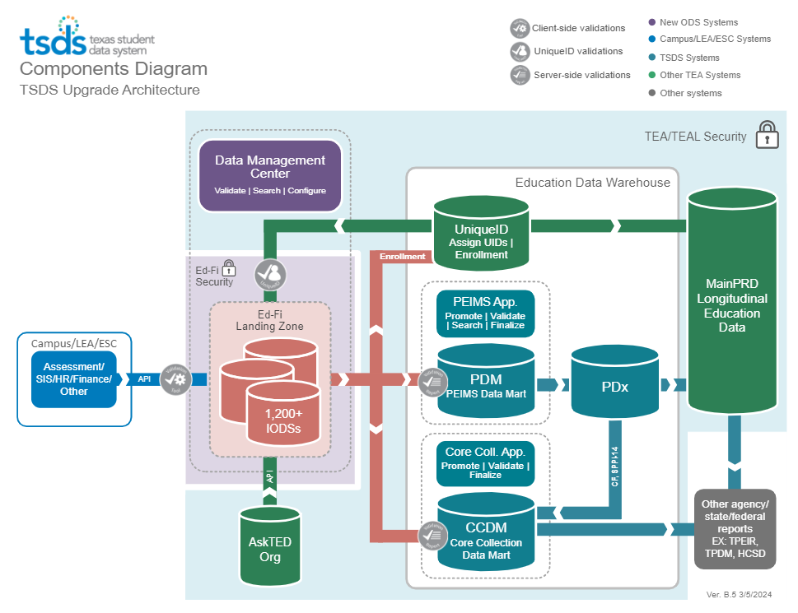
HIGH-LEVEL ARCHITECTURE

Slide 8
LEA TEAL ROLES – UNIQUE ID
Unique ID LEA
This role gives the user the ability to search, update, and edit information in the UID for the LEA.
Unique ID Campus
  This role allows the user to search, update, and edit information in the UID for a specific campus.
Unique ID Search
  This role gives the user the ability only to search and view information in UID.
More details covered in the Introduction to UID Video.
Notes:
UID LEA Role – gives the user the ability to search, update, and edit information in UID.
UID Campus Role – allows the user to search, update, and edit information in UID for a specific campus.
UID Search Role - gives them the ability only to search and view information in UID.

Slide 9
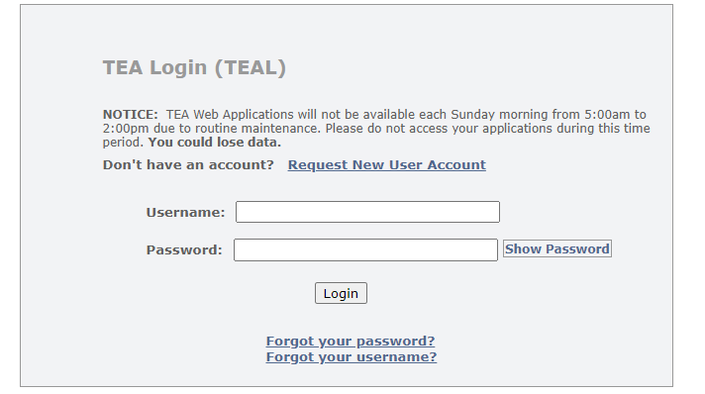

TEAL ROLES FOR UID
Log into TEAL with your username and password.
Click Add/Modify Access in the Texas Student Data System Portal.

Slide 10
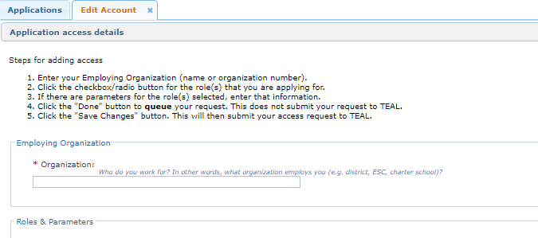
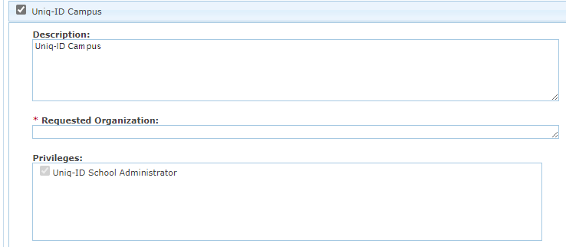
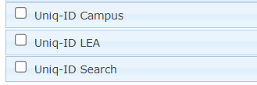
UID TEAL ROLE AND PRIVILEGE
Enter your Employing Organization and select the appropriate UID role.
Enter the Requested Organization in the Requested Organization ID field. The UID privilege for each role is checked by default. Click Done. Click Save Changes.

Slide 11
DEMO
Login to TEAL Account
Navigate to TSDS Unique ID
Upload Enrollment Tracking File
Review Download Options and Details
Download the ET files
Note: The Reference Guide (RG) is a resource that provides step-by-step instructions for uploading Enrollment Tracking batch files.
Enrollment Tracking Reference Guide
11
Notes:
Provide a high-level demo showing the functionality within the UID application. Then, we will present the requirements and details users will need to understand for UID Enrollment Tracking.

Slide 12


KEY CONCEPTS
Enrollment Tracking

Slide 13
KEY TERMS FOR ENROLLMENT TRACKING
Submission Type –The submission type will be 002 for all Enrollment Tracking records.
Person Type – The person type on each record on an Enrollment Tracking file will always be 02 to indicate this record is for a student.
Enroll/Withdraw Date – The date on which the student enrolled at the LEA or withdrew from the LEA.
Enroll/Withdraw Code – On each record an Enroll/Withdraw code of 01 indicates to the system that this is an enroll event and 02 indicates this is a withdraw event.

Slide 14
ENROLLMENT TRACKING
For enrollment data to be of value in recovering leavers and for other special projects, it is imperative that all LEAs submit this data for all students at the beginning of the year. (Remember, at the beginning of the year all students will have a new entry date and should be included on the ET batch file.)
LEAs extract and upload UID Enrollment Tracking batch files to populate student enrollment and withdrawal information in the UID system throughout the school year as students enter and withdraw. (After the initial ET batch file is submitted, LEAs will only submit student records that have new enroll/withdrawal information.)

Slide 15
VALIDATION INDICATOR #6 & #7
LEAs are not required to submit ET files throughout the school year. However, for the data to be useful in tracking leavers, LEAs should submit ET files frequently as students enroll and withdraw.
There are 2 performance reporting indicators tied to ET submissions.
  Leaver Records Data Validation Indicator #6: Missing Enrollment Tracking Submission. This indicator identifies districts that did not complete at least one enrollment tracking submission during the current year school start window.
  Leaver Records Data Validation Indicator #7: Missing Enrollment Tracking Submission. This indicator identifies districts that did not complete at least one enrollment tracking submission during the previous school year.
Notes:
#6 Missing ET Submission during the school start window
#7 Did not complete at least one ET submission during the previous school year

Slide 16
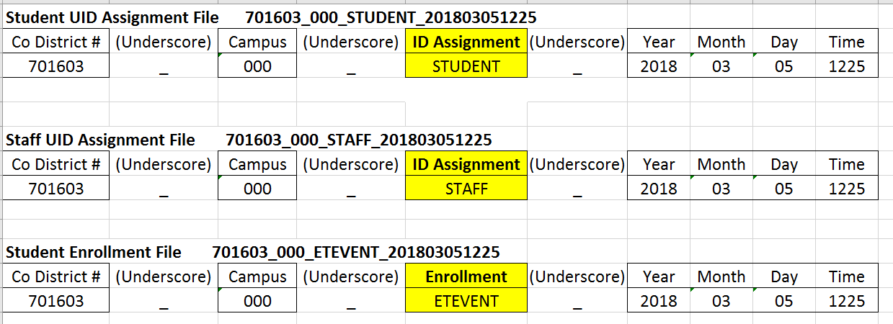
ENROLLMENT TRACKING FILE NAME
Enrollment Tracking Event Files must conform to the following naming convention:
Student UID Assignment File 701603_000_Student_201803051225
Staff UID Assignment File 701603_000_Staff_201803051225
Student Enrollment Tracking Event File 701603_000_ETEvent_201803051225
All files uploaded into the UID system will be delimited files.
Enrollment Tracking files will have either the .csv, .txt, or .zip file extension.
Notes:
The LEA will submit the UID Assignment file and work through the assignment process just as they are accustomed to doing.
LEAs will extract an ET Event file from their Student Information System each week that will contain only changes since the last enrollment event file was successfully loaded and processed into the UID system. This ET Event file will be uploaded in the UID system and will replace their weekly PET submission.
LEAs should always submit the UID Assignment File first before the ET Event file to ensure that all individuals on the ET Event file have a UID#.
All files submitted to the UID system will be delimited files. Enrollment tracking files will have either the .txt, .csv, or .zip file extension.

Slide 17
FIELDS FOR ET BATCH FILE
REQUIRED
001=UID Assignment 002=Enrollment Event | Submission Type
02=Student 03=Staff (Only on Assignment Batch Files for staff) | Person Type
04/04/2018 | Enroll/Withdraw Date
01=Enroll 02=Withdraw | Enroll/Withdraw Type
1=Verified 3=Calendar 4=Delete | Enroll/Withdraw Verified Flag (Optional)
OPTIONAL
Notes:
Submission Type Code indicates whether this is an UID Assignment Record or an Enrollment Event Record.
Person Type Code on the ET file will always be 02-student; on the UID Assignment file is will be either 02-student or 03-staff.
Enroll/Withdraw Date
Enroll/Withdraw Type Code indicates if it is an enrollment-01 or withdrawal-02 (optional format with V. 11 tentatively set to roll out on October 18, 2019)
Enroll/Withdraw Verified Flag – Optional
Verified = the registrar verified the student was enrolled (and was physically present) or actually withdrew on the posted date.
Calendar = an overlap in enroll/withdraw dates is attributable to a difference between the two campus calendars.
Delete = the event record was deleted. The record is NOT deleted from the database but is flagged “Delete” and displays on-screen with a strikethrough. Records that are flagged Delete will not appear on the UID Enrollment Reports. TEA is working to ensure that when an enrollment record is deleted it is ignored and ownership stays with the organization with the latest enrollment record.
The File format does allow for these optional Enroll/Withdraw Verified Flags. However these flags are usually manually added not through the upload process. - If an LEA found that they had the incorrect entry date on 100 students. They could flag these 100 students with the “delete” code in a couple of different ways:
A manual on-line entry within the UID system on each student. 100 manual updates in UID, OR
Enter the “Delete” code directly on the batch file and upload a new file that contains the “4” delete code. Then the LEA would extract and upload another ET event file with the correct enrollment date. (User would do a find and replace -- find – “01”,””,””, and then replace - “01”,””,”4”, This would put the 4 (delete code) on every student record on the batch file.)
It is possible that some SIS vendors’ software allows the users to enter these codes directly in their SIS and extract the flag to the batch file, but that may vary from vendor to vendor.

Slide 18
ET EVENT FILE FORMAT
TH 01/22/2018 10:00:00 DEVTEST2 3.0 delimiter=0X2C source=SIS qualifier=0X22 "ID","007901001","","Hogan","Ben","","","M","12/25/2001","10","001022","S81510200 ","B","6618792118","007901","2018","","","","","","","","","","","","","","","0","","","","
","","","","","","","","","","","","","","","","","","","","002","02","","","08/28/2017","01", ""," 4 ","","","","","","","","","","","","","","","",""
TT DEVTEST2 3
The fields shown in the blue boxes MUST NOT be blank on the ET Event File:
  Unique ID Field
  “002” Indicates this is an Enrollment Event File.
  “02” Indicates the Person Type is Student. ^{Left Blanks}
  Enroll/Withdraw Date
  Enroll/Withdraw Type Code – 01 Enroll; 02 Withdraw
    “4” Indicates this record is to be marked “delete”. (Optional)
Notes:
Enrollment Tracking Event File Format
A valid Unique ID is required on each enrollment event record as this is the only matching criteria used.
Submission type will always be 002 – ET event
Person type will always be 02 – student
Each record must have an enroll/withdraw date and an enroll/withdraw type code - 01 to indicate that this is an enrollment event or 02 for a withdrawal.
Verified flag is an optional field.
We will talk about the verified flag in more detail later in the presentation.

Slide 19
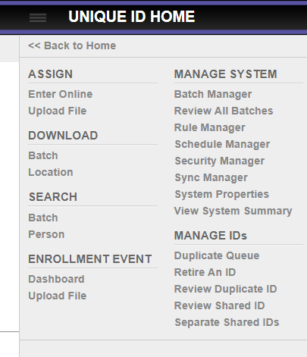
ET EVENT FILE LOADING
More details covered in the Introduction to UID Video.
Uploading File to UID
  ID Assignment File Upload
  Enrollment Tracking Event File Upload
Notes:
Loading an ET Event Batch File
Notice near the top of the page under Assign you have an option to Upload File. This where LEAs will upload their UID Assignment files.
Near the bottom of the page under Enrollment Event you see another Upload File option. This where they will upload their Enrollment Event files.

Slide 20
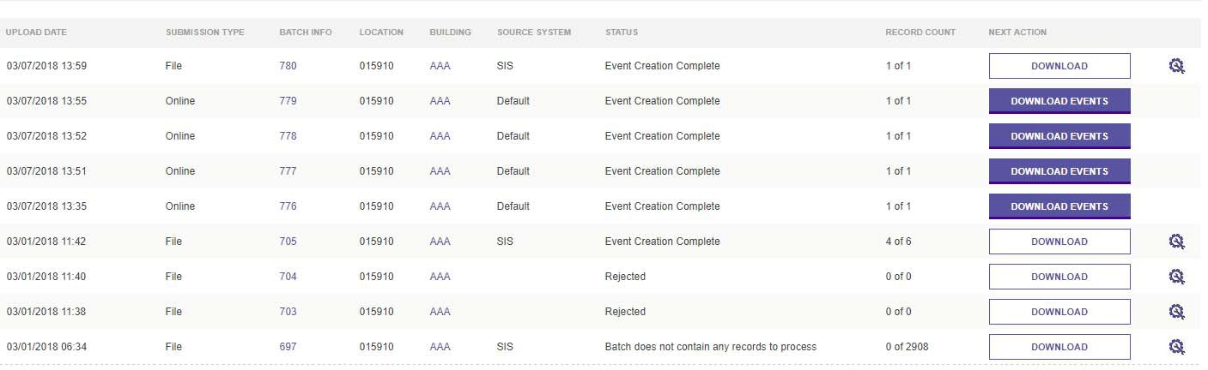
UID ET DASHBOARD
Dashboard for ET Files
Notes:
ET Dashboard
Now let’s look at the Enrollment Tracking Dashboard screen. On the ET Dashboard we can see recent ET Event batch files with the status of the file and the next action.
In the status column you will see “Event Creation Complete”, “Rejected” or “Batch does not contain any records to process”.
On the files where the submission type is Online, you will see “Download Events”. All online submissions will be processed and you can download the file for that 1 event that you entered online which was processed.
On the other files, you will see “Download” and the gear icon on the right side. Best practice – always click on the gear icon. Let’s take a look at batch 705. The record count show us that there were 4 of 6 records processed. If I click on “Download”, the download file will only contain the 4 records that processes. I still won’t know why the other 2 records did not process. However, if I click on the gear icon I will be able to see my processed records and my canceled records.

Slide 21
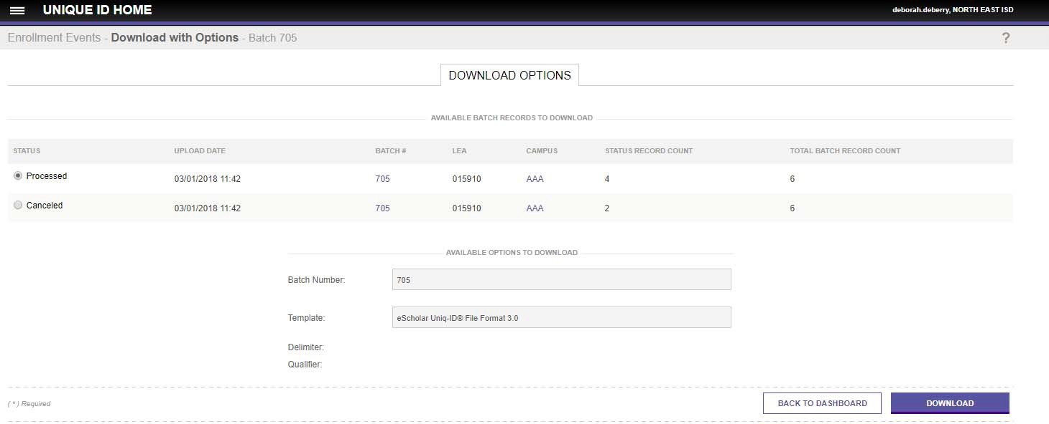
ET FILE DOWNLOADS
ET File Download Options – Processed and Canceled
Notes:
When you click on the gear icon, you will see the records that processed as well as any records that canceled. By clicking on the radio button beside the status you will be able to download the file for the processed and then for the canceled records.
The download file will list each record on the file and give you details about that record.
TEA recommends that LEAs always save these downloads locally. These will be helpful when verifying when they uploaded the last ET Events and the status of the records on the batch file and for working through any errors. (Can’t always base tracking on when they extracted from their SIS – Suppose something happened and the extract from the SIS never got loaded into UID or was rejected.)

Slide 22
PROCESSED RECORDS
Processed Records Download with Details
TH 01/22/2018 10:00:00 DEVTEST2 3.0 delimiter=0X2C
source=SIS qualifier=0X22
"ID","007901001","","Hogan","Ben","","","M","12/25/200
1","10","001022","S81510200","B","6618792118","007
901","2018","","","","","","","","","","","","","","","0","","","","
","","","","","","","","","","","","","","","","","","","","002","02","
","","08/28/2017","01","","","","","","","","","","","","","Master Record Not Updated during Event Processing","Location Not Updated during Event Processing","Event Added - Master Record Not updated","81889126","11056","01/25/2018"
TT DEVTEST2 3
Notes:
Here is a download file for an ET Enrollment File for record that “Processed”. In blue you can see the details about this record.
Things to ask: “Looking at this record detail type into the question area of your control panel why do you think the record status is what you see?”
Answer: “Looking at the date it is likely a beginning of year enrollment and student was also at your campus last year, thus no Master Record Update.”
The fields after the message are for tracking purposes – first a tracking number, next the user number, and then the date file was uploaded.

Slide 23
PROCESSED FILE COMMENTS
Processed File
Event Added – Master Record NOT Updated
  Withdrawal Record for a student at the same campus
Event Updated – Master Record NOT Updated
  Enrollment or Withdrawal Record with a Verified Flag added
Event Added – Master Record Updated and History Created
  Enrollment Record for new LEA, Campus, School Year, Grade, or with new Local ID
Duplicate Event – Master Record NOT Updated
  Enrollment or Withdrawal Record currently in UID
  If a file is loaded with cumulative records (from beginning of year), you will get this message on each record that was previously loaded into UID.
Notes:
These are the comments you could see for each record on a Processed Files.

Slide 24
CANCELED RECORDS
Canceled Records Download with Details
TH 03/02/2018 11:33:13 0000000002 3.0
delimiter=, source=SIS qualifier=0X22
"ID","109914001","","Allenscr","Justin","S","","M","04/2 0/2004","08","22038","654561231","B","167921636
8","109914","2018","","","","","","","","","","","","","","","0
","","","","","","","","","","","","","","","","","","","","","","",""," 002","02","","","08/21/2017","01","","04","","","","","","
","","","","","Master Record Not Updated during Event Processing","Location Not Updated during Event Processing","Canceled - During Data Validation","","",""",""Entry/Exit Verified Flag is invalid"
TT 0000000002 3
Notes:
Here is an example of a download file for an ET Enrollment File for a record that was “Canceled”. In blue you can see the details about this record.
This record was canceled because it has a Delete Verified Flag but there was not an enrollment event for this student with this date.
Since this file was canceled, there are no fields after the message for tracking purposes.

Slide 25
CANCELED FILE COMMENTS
Canceled File
Prior Enrollment Must Exist for Withdrawal Events
  Cannot load withdrawal record if there is not a prior enrollment at same LEA.
Duplicate Event
  This record is canceled because it was a duplicate record within the batch file.
Event Not Updated – Invalid Logical Delete
  Attempting to delete an event never added.
Canceled During Data Validation
  State ID (Unique ID) Invalid, School Year Invalid
  Lookup Code Invalid (e.g., Gender is invalid)
  Submission Type is Invalid
  Other Errors as Described in Output File
Notes:
These are the comments you could see for each record on a Canceled File.

Slide 26
ENROLLMENT TRACKING
Master Record Ownership will be updated based on the most current enrollment date.
The LEA with the latest (most current) enrollment date will “own” the master record.
Information on the ET Enrollment File that will be updated on the Master Record if the:
Student is at a new LEA
Student is at a new campus
Student is in a new grade
Student has a new local ID
File indicates a new school year

Slide 27
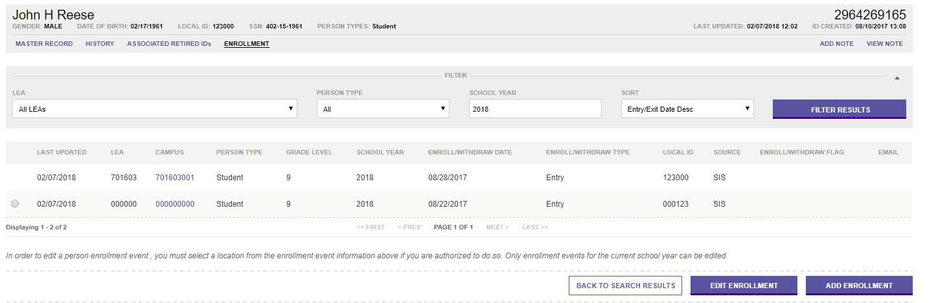
ENROLLMENT TAB IN UID
LEAs will view student Enrollment/Withdrawal details in UID by searching for the student.
Next, they will click on the Enrollment tab.
Notes:
On the Enrollment tab, users can see the enrollment/withdrawal history for the student. It shows the LEA and the Entry date or Withdrawal date.
The radio button on the far left indicates this is a record from my LEA and I can edit this master record to add an optional flag to this event – Delete, Calendar, or Verified flag.

Slide 28
EMAIL LINK ON ENROLLMENT
Sending an Email from the Enrollment Tab in UID
Notes:
Email Link – the little envelope can be used for resolving enrollment discrepancies
Click on the email link on the ET Event for the LEA you wish to email will generate an email to the Enrollment Tracking Email address in AskTED.

Slide 29
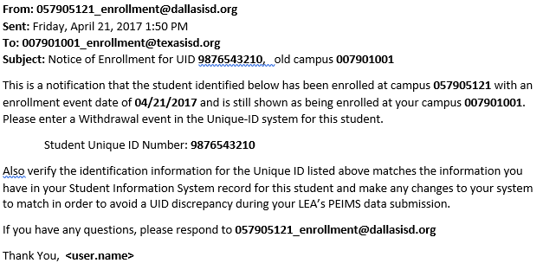
UID SAMPLE EMAIL
Notes:
An email similar to this will be generated. Bolded data are populated from the Unique ID Master and Enrollment event records.
Note – The old campus is included in the subject line enabling LEAs who use one LEA level email address rather than campus. This allows users to determine to which campus the email is directed.
The sending LEA can edit or add to the content of the email message. Emails generated through this feature in UID are NOT encrypted as they were in PET. These emails are going through the LEAs local email system. Unless their local system encrypts the email, they should be very cautious of all FERPA implications if they choose to edit the email template.

Slide 30
EMAIL SETUP FOR UID ET
The LEA Technology Staff will determine how the email address will be setup locally and determine who will be associated with the email. Next, set everything up locally.
The District AskTED Administrator will go into AskTED and set up the Enrollment Tracking Email information using the email tab.
Charter schools will need to submit a TIMS ticket to get this set up in AskTED.
More details covered in the Introduction to UID Video.
Notes:
The Email Setup is a Two Part Process
Email address is set up locally and those associated with the email are designated
District AskTED administrator at the LEA sets up the email in AskTED.
Charter school submit a TIMS ticket to have the new email box set up.

Slide 31
EMAIL FEATURE IN UID
Email Functionality within UID
  Assists with enrollment event resolution
LEA Sets Up a New Email Inbox
  This should be a group inbox and not associated to a specific person.
    Example: Learning_ISD_enrollment@learningisd.org
  Individual Inboxes may be setup for each campus (optional).
    Example: Learning_HS _enrollment@learningisd.org
    Example: Learning_MS enrollment@learningisd.org
Notes:
Email functionality in UID
Each LEA should set up a New Email Inbox
TEA strongly recommends that this be a group inbox and not associated to a specific person. LEAs should ensure that the group email box parameters are properly set in the local email application. Otherwise emails will be blocked.
LEAs can optionally set up inboxes for each campus (again, this is optional)

Slide 32
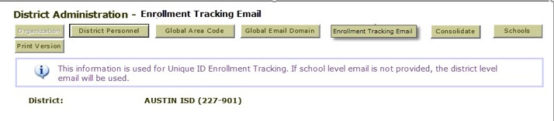
ET EMAIL SETUP IN ASKTED
Email Addresses will be Entered and Maintained in AskTED by the District AskTED Administrator.
  The AskTED Administrator will Log in to AskTED.
  Next, click on the New Enrollment Tracking Email Tab.
LEARNING ISD (701-603)
Notes:
The AskTED Administrator at the District will Enter and Maintain the Enrollment Tracking Email address in AskTED.
After logging in to AskTED they will see a new Enrollment Tracking Email tab.
NOTE: If a school level email is not set up, the district level email will be used. If no email address is set up for the LEA in AskTED, all Enrollment Tracking emails will go to the Superintendent specified in AskTED.

Slide 33


ENROLLMENT TRACKING REPORTS

Slide 34

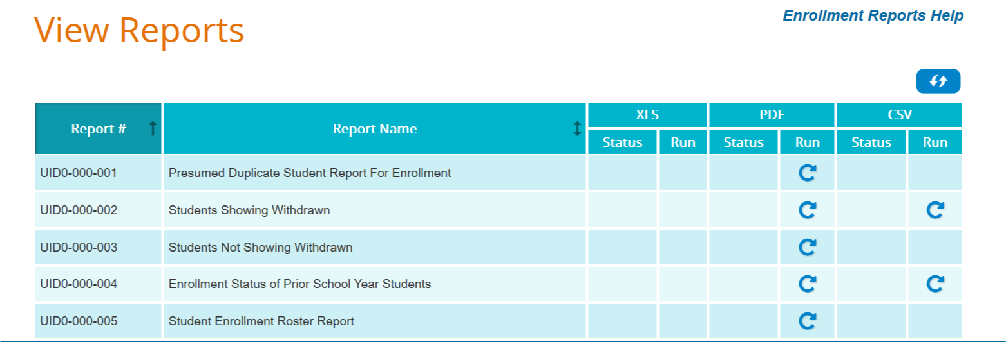
ET REPORTS IN UID
Enrollment Tracking reports can be helpful in verifying enrollment and to assist with leaver tracking.
Users can access the reports by clicking on the View ET Reports easy button on the UID home page.

Slide 35
UNIQUE ID ET REPORTS
UID0-000-001 – TSDS UID Presumed Duplicate Student Report for Enrollment
UID0-000-002 – TSDS UID Students Showing Withdrawn
UID0-000-003 – TSDS UID Students Not Showing Withdrawn
UID0-000-004 – TSDS UID Fall Enrollment Status of Prior School Year
UID0-000-005 – TSDS UID Student Enrollment Roster Report
UID0-000-006 – TSDS UID Missing Enrollment Event Submission Report
PEIMS UID Discrepancy Report PDM3-600-002 – PEIMS Statement of Unique ID Student Discrepancy Report PDM3-601-002 – PEIMS Statement of Unique ID Staff Discrepancy Report
ESC Report
Notes:
UIDO-000-006 – Report for ESC and TEA only
PDM3-600-002 is available in the TSDS PEIMS Application and should be run to verify that the information submitted on PEIMS files matches the information in the UID System.

Slide 36

TRAINING ACTIVITY
Practice, Troubleshooting, & Knowledge Checks

Slide 37
PRACTICE EXERCISE
Task 1: Upload ID Assignment File and Process.
Task 2: Upload Enrollment Tracking File and Verify.
Ready
Set
Go

Slide 38
TROUBLESHOOTING 1
Scenario 1: Why do I not see any staff members on my Enrollment Tracking batch file?
Resolution Steps:
When looking at the Enrollment Tracking batch file, I only see students on the extracted file.
Enrollment Events are only report for students.
The “Person Type” on the Enrollment Tracking batch file will always be 02 which indicates the record is for a student.

Slide 39
TROUBLESHOOTING 2
Scenario 2: Will uploading an Enrollment Tracking batch file update the student’s master record?
Resolution Steps:
1. Yes, the master record will be updated based on the most current enrollment date.
2. The LEA with the latest (most current) enrollment date will “own” the master record.
Information on the ET Enrollment File that will be updated on the Master Record:
  If the student is at a new LEA,
  If the student is at a new campus,
  If the student is in a new grade,
  If the file indicates a new school year,
  If the student has anew local ID.

Slide 40
KNOWLEDGE CHECK 1
1. There are two download options for ET batch files.
  True
  False
Note: ET File Download Options – Processed and Canceled. Users should review both options to determine which records were processed and which were canceled.
Notes:
NOTE
To see the answer, you must be in presentation mode.

Slide 41
KNOWLEDGE CHECK 2
2. Which of the following are required for each record submitted on an Enrollment Tracking batch file?
  Basic demographic data for the student, including a UID#,
  Submission Type and Person Type,
  Enroll/Withdraw Date and Enroll/Withdraw Type,
  All of the above.
  Note: Every student record on the ET batch file must have a valid UID. The Submission Type must be 002 and the Person Type will be 02. The Enroll/Withdraw date with the Enroll/Withdraw type indicate if it is an Enroll event (01) or a Withdraw event (02)
Notes:
NOTE
To see the answer, you must be in presentation mode.

Slide 42
KNOWLEDGE CHECK 3
3. What is one example of why a record on an ET batch file might be canceled?
  Prior Enrollment Must Exist for Withdrawal Events.
  Valid UID# is required for each record.
  The student’s name is misspelled.
  Both A and B.
  Note: Users cannot load a withdrawal record if there is not a prior enrollment at same LEA for the student. Every record is required to have a valid UID#.
Notes:
NOTE
To see the answer, you must be in presentation mode.

Slide 43
KNOWLEDGE CHECK 4
4. The email feature on the Enrollment tab will allow users to communicate with other LEAs when they find overlapping enroll/withdraw dates to avoid duplicate enrollments.
  True
  False
Notes:
NOTE
To see the answer, you must be in presentation mode.

Slide 44
KNOWLEDGE CHECK 5
5. Enrollment Tracking events in UID will have
  Only student enrollment data.
  Only student withdrawal data.
  Both student enrollment and withdrawal data.
  Staff contract begin dates.
Notes:
NOTE
To see the answer, you must be in presentation mode.

Slide 45

WRAP UP
Key Takeaways, Resources, and Next Steps

Slide 46

KEY TAKEAWAYS
Every student and LEA/ESC staff member must have a Unique ID to be reported for TSDS state reporting.
LEAs should resolve all near match records before importing new UIDs into their local system.
Enrollment Tracking information in UID will assist LEAs as they verify student enrollment and track leavers.
ID Assignment tasks can be batch uploaded or manually entered in the UID system.
TRAINING RESOURCES
        Key Terms and Definitions
        Enrollment Tracking Reference Guide

Slide 47
ADDITIONAL RESOURCES
TSDS Unique ID Information
Unique ID User Guide
TSDS Unique ID Specifications
    Support Resources
    KB Articles
      TSDSKB-278 – Retire Unique ID
      TSDSKB-557 – UID Review Canceled Record Comment
      Introduction to UID Video
      UID Near Match Resolution

Slide 48
NEXT STEPS
  Complete a Teach Back Exercise
  Complete Unique ID Certification Test
Attend TSDS Continuing Education Trainings (CET)
Participate in TSDS Just-in-Time Trainings (JIT)
Attend Field Coordination Network (FCN) webinars for new updates and changes

Slide 49
WRAP UP
  In this training we talked about:
  How UID Enrollment Tracking fits into the overall TSDS Architecture.
  How UID Enrollment Tracking fits into the Data Collection Process.
  The UID Enrollment Tracking (ET) process.

Slide 50

QUESTIONS
TITLE SLIDE: TSDS ODS 3.x Project
Updates

