Slide 1

TSDS Incident Management System
New User Certification Training

Slide 2
KEY TERMS
You can find the definitions to these key terms and more here:
  Key Term Document
Education Service Center (ESC)
Local Education Agency (LEA)
Texas Education Agency Login (TEAL)
Texas Education Data Standards (TEDS)
Texas Student Data System (TSDS)
TSDS Incident Management System (TIMS)

Slide 3
LEARNING OBJECTIVES
  By the end of this course, the users will be able to explain:
How to create an incident (ticket).
TIMS incident workflow.
Support portal for TSDS users.
Best practices for using the TIMS.

Slide 4
WHY IS THIS COURSE IMPORTANT
This course is important because it provides users with the knowledge and guidance on how to use the Texas Student Data System (TSDS) Incident Management System (TIMS) for receiving support and guidance on TSDS applications and data submissions.

Slide 5

COURSE AGENDA
Getting Started
Levels of Support
Key Concepts
Incidents, Workflows, Best Practices
Training Activity
Practice and Knowledge Checks
Wrap Up
Key Takeaways, Resources, and Next Steps

Slide 6


GETTING STARTED
Support Portal for TSDS Users

Slide 7
LEVELS OF SUPPORT – PART 1
Level | TEAL Role/Description | Description/Privileges
TSDS User | Any user with a role in one or more of the TSDS Portal applications | • Searches Knowledge Base for help • Submits incidents, questions, and requests for enhancements to TIMS, and view incidents submitted
Notes:
Trainer Notes​
On this screen, you will learn about the TIMS TSDS User, TIMS Level 1 Support, and TIMS Level 2 Support roles.

Slide 8
DEMONSTRATION 1
The Support Portal
Access the TSDS Knowledge Base (KB)
  Search for Knowledge Base Articles
Create an Incident
Notes:
Trainer Notes
Log in to TIMS and complete a demo. The steps to be included in the demo are covered on slides 62-64.

Slide 9
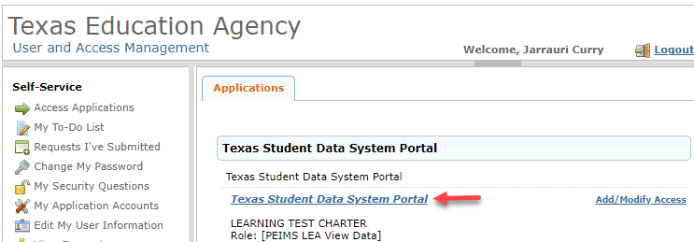
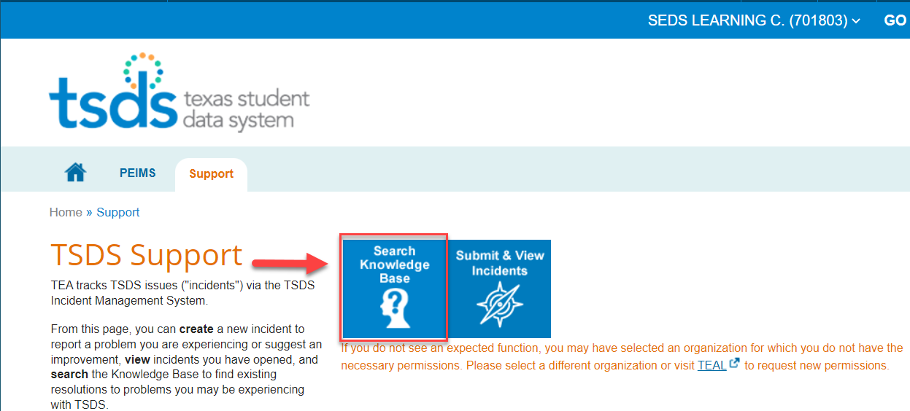
ACCESS TSDS SUPPORT PORTAL
Notes:
Trainer Notes
Top image
To access the TSDS Support portal:
Log in to TEAL with your username and password.
Click on the blue hyperlink for Texas Student Data System Portal.
Bottom image
This image displays the Support tab for the TSDS Support Portal.
To access the Knowledge Base, click the Search Knowledge Base easy button.

Slide 10
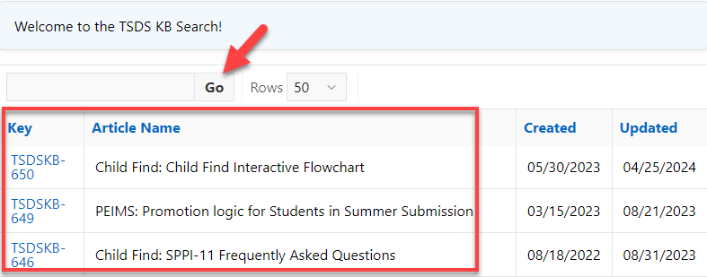
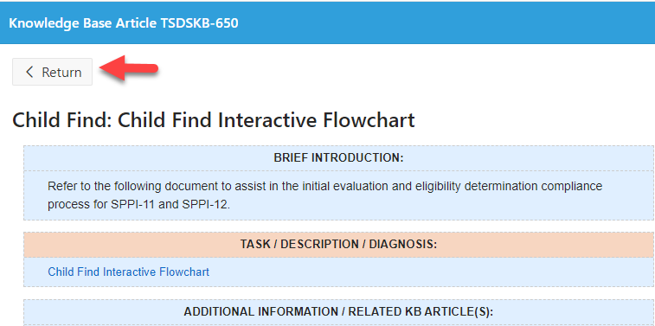
SEARCH KNOWLEDGE BASE
Notes:
Trainer Notes​
Top image
To Search the Knowledge Base for KB Articles:
Scroll through the list of KB articles.
To narrow your search, enter a word, key phrase, or KB article number (TSDS-###) in the search box and click Go.
The search results will return KB articles based on the search you executed.
Bottom image
When you click on the KB article number in the Key column, the window displaying the details of the KB article will open.
Click Return to go back to the homepage.

Slide 11
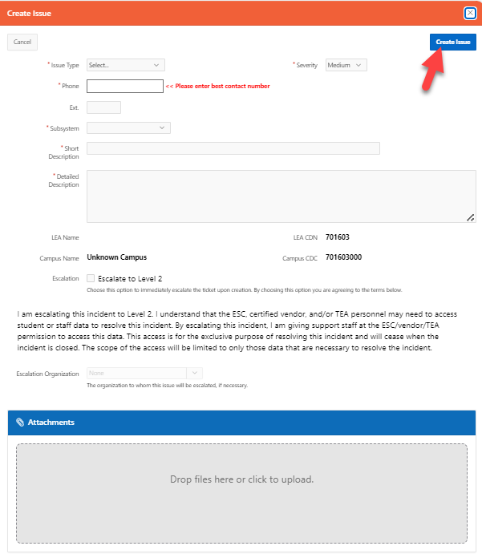
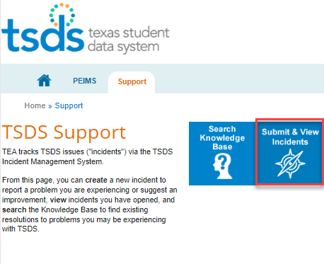

CREATE ISSUE/INCIDENT
Notes:
Trainer Notes​
Top left image
A user who is not support staff and does not have the TIMS Level 1 or Level 2 Support role will access TIMS to submit or view incidents by clicking on the Submit & View Incidents easy button.
Bottom left image
Before creating an incident, research the Knowledge Base and the Known Issues Report for known/resolved incidents.
Click + Create Issue.
Right image
To submit an incident:, fill out the Create Issue form, then click Create Issue.

Slide 12


KEY CONCEPTS
Incidents, Workflows, Best Practices

Slide 13
DEMONSTRATION 2
Process for Creating an Incident
From the dashboard homepage, click the Create button.
Click Auto-fill my name, telephone and email.
Click the Submitter Org dropdown menu and select the submitter’s organization from the list.
Click the appropriate Subsystem.
Click the appropriate Subcategory.
In the Summary field, enter a summary of the incident that identifies where the incident occurred.
Type a brief, but detailed description about the incident.
Click the Priority dropdown menu to select the severity of the incident.
To include an attachment, click browse or drag and drop files.
In the Environment field, type information about the user’s workspace such as browser type, URL link where the error occurred, software platform, or hardware information.
To escalate an incident when creating an incident, read the data use agreement, then click the box next to Escalation.
To submit the incident, click the Create button.
Notes:
Trainer Notes
Log in to TIMS and complete a demo. The steps to be included in the demo are covered on slides 35-43.

Slide 14
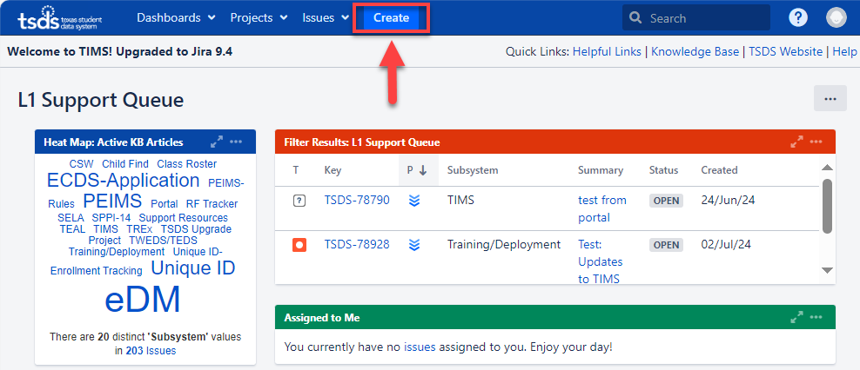
HOW TO CREATE AN INCIDENT
Notes:
Trainer Notes​
To create an incident in TIMS:
From the dashboard homepage, click the Create button.
This process is the same for TSDS users, except for the Subsystem and Subcategory dropdowns.

Slide 15
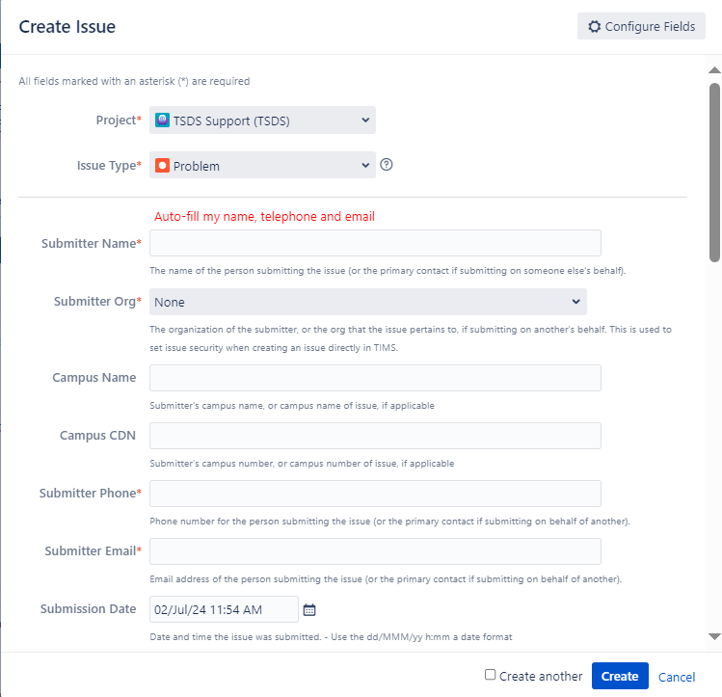
INCIDENT CREATION FORM
Notes:
Trainer Notes
This image shows a screen capture of the incident creation form that will appear once you click the Create button shown on the previous slide.

Slide 16
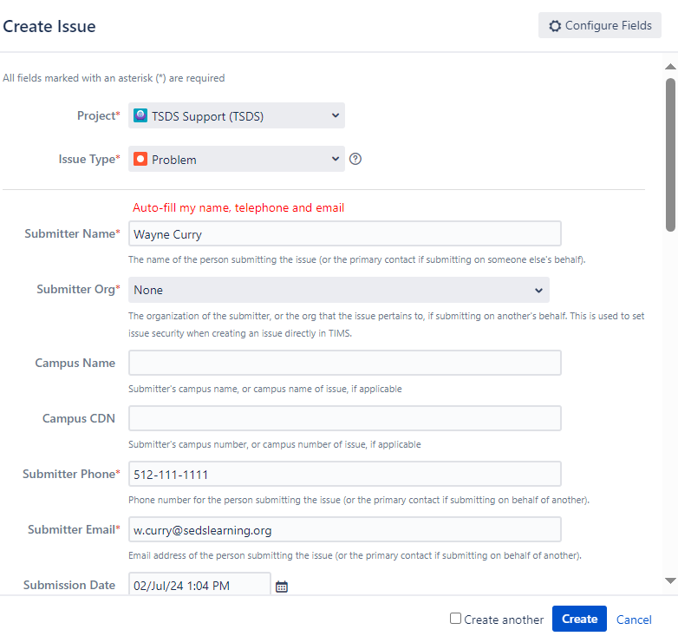
CREATING AN INCIDENT
Notes:
Trainer Notes​
​
Click Auto-fill my name, telephone and email.
If your information does not auto-populate, enter your name in Submitter Name, your phone number in Submitter Phone, and your email address in Submitter Email.
Click the Submitter Org dropdown menu and select the submitter’s organization from the list.
If you are creating an incident on behalf of another organization, select their organization from the dropdown menu.
Optional Steps
If applicable, in the Campus Name field, enter the name of the campus that was affected by the incident.
If applicable, in the Campus CDN field, enter the county-district number of the campus that was affected by the incident.
The Submission Date field is automatically set for the current date and time. If the incident occurred at a different date and time, click the calendar to select the correct date, and change the time at the bottom of the calendar.

Slide 17
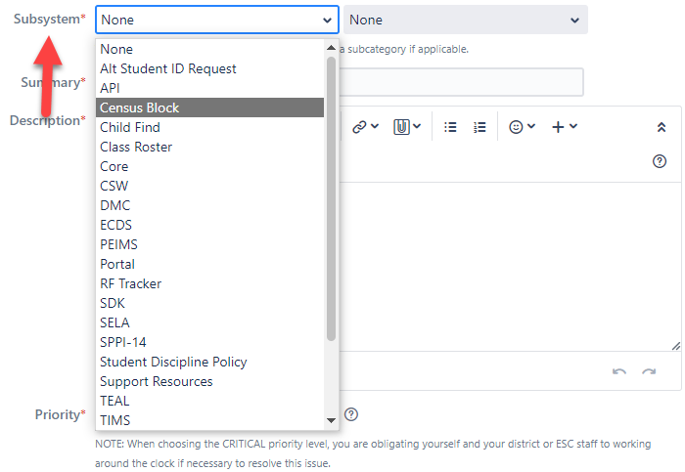

SUBSYSTEM AND SUBCATEORGY
Notes:
Trainer Notes
Top image
Click on the appropriate Subsystem.
The Subsystem has a list of applications and products to choose from based on where the incident occurred.
Bottom image
Click the appropriate Subcategory.
The Subcategory is the second dropdown menu next to the Subsystem dropdown.
This menu provides multiple options depending on the Subcategory.
Example: If you select the subsystem Census Block, the available subcategories are Calculator and Map.
For TSDS users, the Subcategory dropdown menu is intuitive.
Once you select the subsystem from the Subsystem dropdown menu, the Subcategory menu appears if there are subcategories available to choose.

Slide 18
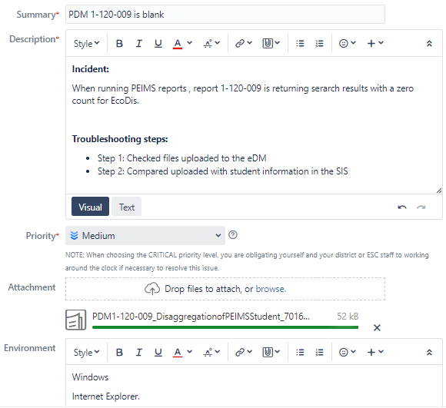
CREATING AN INCIDENT CONT.
Notes:
Trainer Notes​
In the Summary field, enter a summary of the incident that identifies where the incident occurred.
Example: PDM1-120-009 is blank.
Do not include personal identifying information in the summary field (student or staff names, social security numbers, student or staff IDs, DOB, addresses, etc).
Type a brief, but detailed Description about the incident.
Include what you were doing in the system when the incident occurred.
Include what troubleshooting steps you executed to try and resolve the problem.
If it is necessary to help resolve the incident, you may add personal identifying information in the description field, or you can create and refer to attachments that contain personal information.
Click the Priority dropdown menu to select the severity of the incident. See definitions on slide 44.
To include an attachment, click browse or drag and drop files.
In the Environment field, type information about the user’s workspace such as browser type, URL link where the error occurred, software platform, or hardware information.

Slide 19
INCIDENT PRIORITY LEVELS
  Low – questions, enhancement in functionality, or problems with the display or formatting of information
  Medium (default value) – application works but produces incorrect, incomplete, or inconsistent results, or impairs usability
  High – problem with a specific application functionality
  Critical – system failure

Slide 20
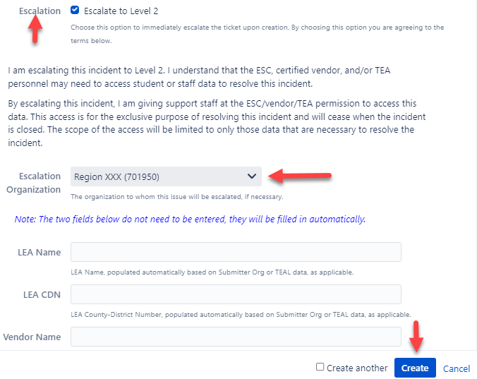
ESCALATION AND DATA USE AGREEMENT
Notes:
Trainer Notes
To escalate an incident when creating an incident, read the data use agreement, then click the box next to Escalation.
This will allow TIMS Level 1 Support to escalate the incident to TIMS Level 2 Support.
To submit the incident, click the Create button.

Slide 21
INCIDENT WORKFLOWS

Slide 22
DEMONSTRATION 3
TIMS Workflow
Start progress on an incident
Add comments
Escalate an incident
Resolve an incident
Put an incident on hold
For ESCs/Vendors Only
Return an incident
Log data access
Log work
Submit incident on behalf of an LEA as TIMS Level 1 Support
Notes:
Trainer Notes
Log into TIMS and complete a demo. The steps for this Demo are covered on slides 48-59. Slides 57-59 are for ESC/Vendors only.

Slide 23
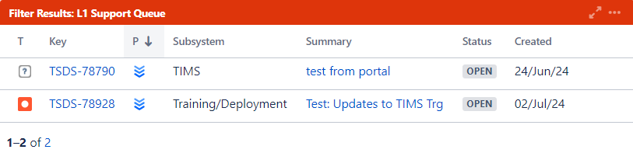
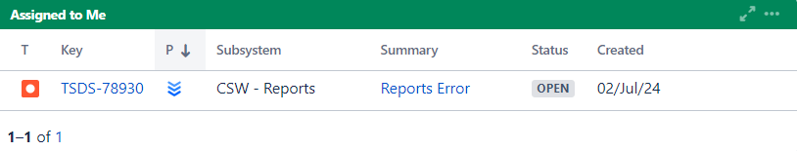
START WORK ON AN INCIDENT
Notes:
Trainer Note:
Top image
This image displays the L1 Support Queue with the incoming incidents that need to be worked.
Second image
This image displays the Assigned to Me queue where an incident will move to once it has been assigned to you to work.

Slide 24
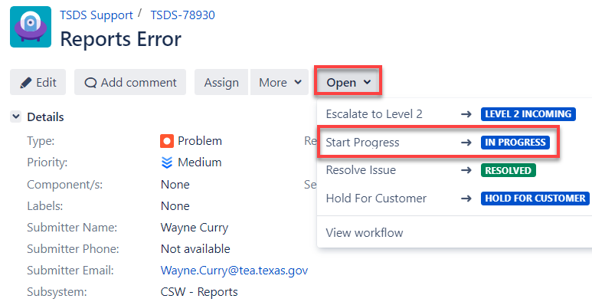
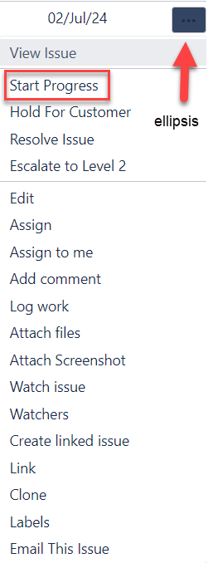
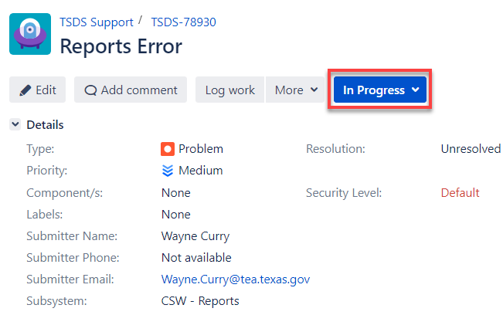
WORK ON AN INCIDENT
Notes:
Trainer Note:
Top image
To start work on an incident:
The initial status of the incident shows Open.
From the detail view of the incident, click the Open dropdown menu, then click Start Progress.
Right image
From the dashboard queues, hover over the right side of the incident, click the ellipsis, and click Start Progress.
Bottom image
Once you click Start Progress, the status changes to In Progress.

Slide 25
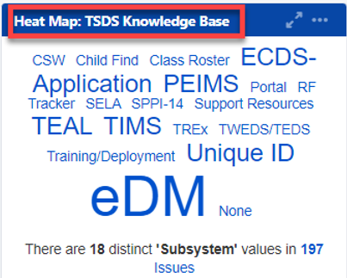
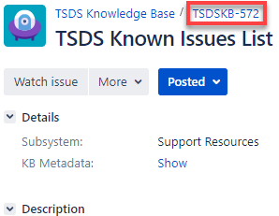
WORKING THE INCIDENT
When you are working an incident:
  Consult the Knowledge Base to see if a solution to the incident has been identified.
    To do so, go to the dashboard and click on the Subsystem from the Heat Map, use the Quick Search box, or the Knowledge Base quick link.
  Search the Known Issues Report to see if the incident you are working has been reported, has any troubleshooting steps, or a resolution timeframe. Click here to access.

Slide 26
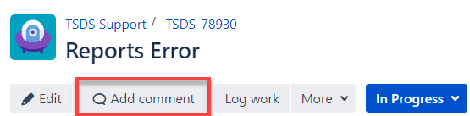
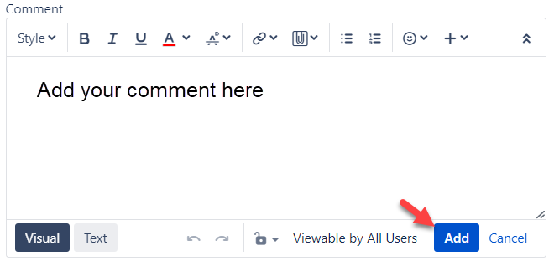
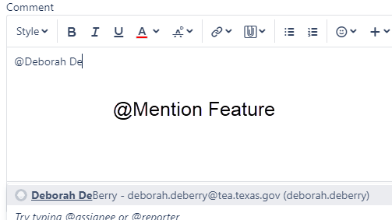
HOW TO ADD COMMENTS
To add a comment to an incident:
  In the detail view, click the Add Comment button, type in your comment, and click Add.
  From the queues, hover over the right side of the incident, click the ellipsis, select Add Comment, type in your comment, and click Add.
Note
  To notify a person of a comment via email, use the @mention feature.
    Enter the @ symbol, type in their name, and click on their name.
  You can restrict the view to a set of users by clicking the lock icon.

Slide 27
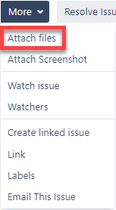
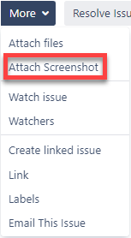

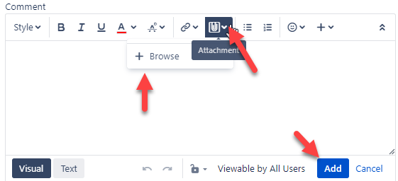
ADD ATTACHMENT OR SCREENSHOT
Notes:
Trainer Notes
Top left image
To attach a file:
Click on More, then click Add files.
From the queues, hover over the right side of the incident, click the ellipsis, and then click Attach files.
This will open a dialogue box where you can search your computer for the files you want to upload.
Once you have selected your file, click Open.
To delete a file, go to the Attachments section and click the trash can icon next to the file.
Top right image
To attach a screen capture:
Click on More, then click Attach Screenshot.
From the queues, hover over the right side of the incident, click the ellipsis, and then click Add Screenshot.
This will open a dialogue box where you can insert your screen capture.
You can insert your screen capture by dragging and dropping your image or copying and pasting your image in the box that says, ‘your image will be pasted here’.
Once you have your screen capture inserted, name your file, and then click Upload.
To delete a screen capture, go to the Attachments section and click the trash can icon next to the image.
Snipping Tool
If using Windows, the Snipping tool can capture a screenshot.
Use ctrl+c or copy the screenshot in Snipping Tool.
Then ctrl+v or paste to paste the image into the TIMS issue
Top Middle image
This image displays the option to drag and drop files in the Attachment section of an incident.
Bottom image
To use the attachment feature in the comments sections:
Click on Add Comment.
From the queues, hover over the right side of the incident, click the ellipsis, and then click Add Comment.
Click the attachment icon (paper clip symbol) and click +Browse.
This will open a dialogue box where you can search your computer for the files or image you want to upload.
Once you have selected your file, click Open.
You can restrict the view to a set of users by clicking the lock icon.
To delete a file, go to the Attachments section and click the trash can icon next to the file.

Slide 28
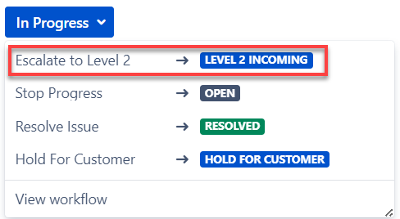
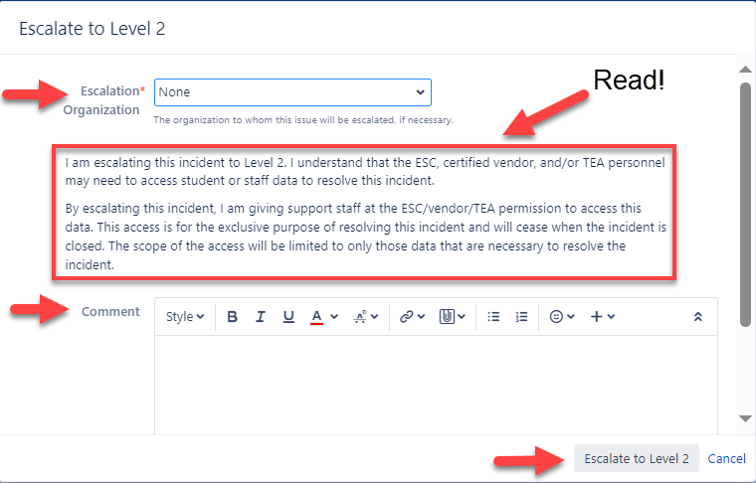
ESCALATE AN INCIDENT
To escalate an incident:
  From the In Progress dropdown menu, click Escalate to Level #.
  From the queues, hover over the right side of the incident, click the ellipsis, then select Escalate to Level #.
  When the dialogue box opens, choose the organization to which you are going to escalate the incident.
  Add an optional comment explaining why you are escalating the incident.
  Click Escalate to Level # to escalate the incident.
Notes:
Trainer Notes​
Be sure to remember FERPA and read the data use agreement.
This is where Level 1 gives authority for Level 2 along with TEA, to view the data specific to that incident.
For ESCs/Vendors ONLY:
Escalation reasons for escalating from Level 2 to Level 3 (image not shown):
Exhausted Troubleshooting Steps: Select this step after you have exhausted all options to resolve the incident.
Required for TEA Action: Select this if the reason you are escalating requires TEA assistance such as retiring a UID.
Need more Training: Select this if you require additional training related to the incident.
TEA Recommended Escalation:
Don’t Support this LEA: Select this if you do not have a support contract with this LEA or this LEA is not in your region.
Support Staff Unavailable: Select this if you lack the bandwidth to work this incident.
Other – See Comments: Select this and enter a comment if the reason you are escalating is not covered in any of the other available options.

Slide 29
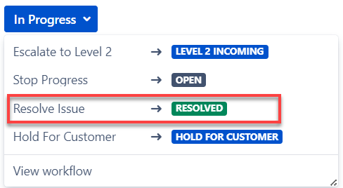
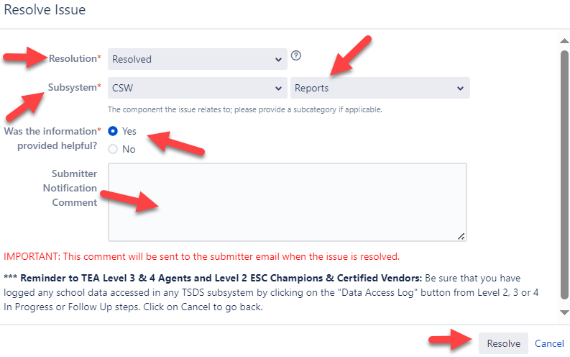
RESOLVE AN INCIDENT
To resolve an incident:
  From the In Progress dropdown menu, click Resolve Issue.
  From the queues, hover over the right side of the incident, click the ellipsis, and select Resolve Issue.
  Select the Resolution dropdown and select the appropriate resolution.
  The subsystem and subcategory will auto-populate with what was selected when the incident was created.
  Answer the question about the information being helpful.
  Add an optional comment regarding the resolution.
  Click Resolve.
Notes:
Trainer Notes
From the Resolution dropdown menu, select:
Resolved if a resolution has been found.
Work-around Provided to Customer if a workaround for the problem was found and provided to the customer.
Won’t Fix if the incident will not be fixed.
Duplicate if the incident is a duplicate of another incident.
Incomplete if there is not enough information has been provided to understand the incident.
Cannot Reproduce when attempts were made to reproduce the incident, they were not successful.

Slide 30
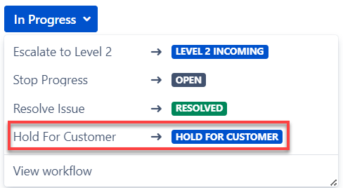
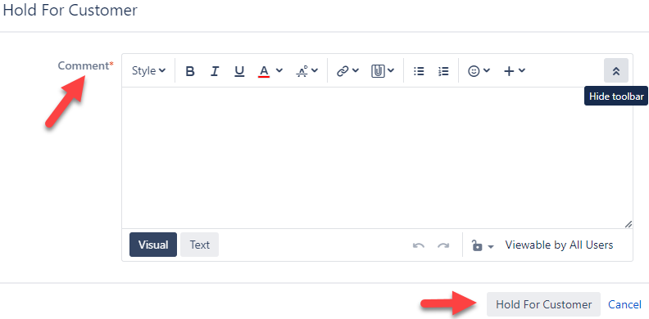
PUT AN INCIDENT ON HOLD
To put an incident on hold:
  From the In Progress dropdown menu, click Hold for Customer.
  From the queues, hover over the right side of the incident, click the ellipsis, and select Hold for Customer.
  Type a comment about why you are placing the incident on hold.
  Click Hold for Customer to put the incident on hold.
Notes:
Trainer Notes
The reason you would want to put an incident on hold is if you are working the incident and do not have enough information or need more clarification to help resolve the incident.
For levels higher than Level 1, you will click Level # Hold, where ”#” corresponds to your support level.
The dialogue box appears slightly different depending on whether it is opened from the detail view or queues.
You can restrict the view to a set of users by clicking the lock icon.

Slide 31
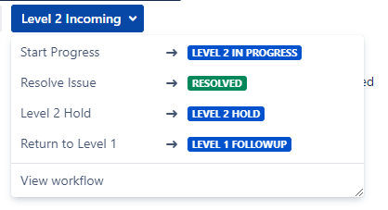
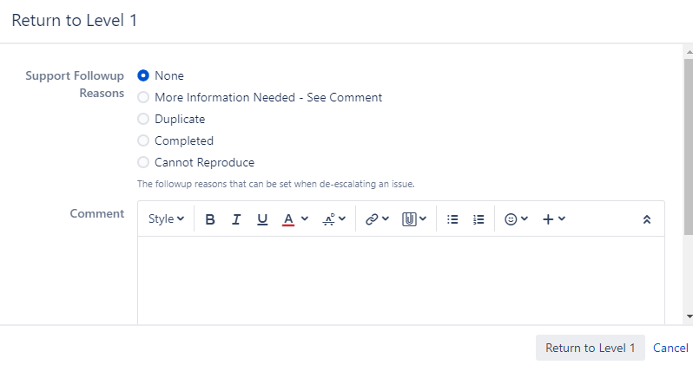
RETURN AN INCIDENT
FOR ESC or CERTIFIED VENDOR ONLY
To return an incident:
  From the detail view, click Workflow, and then click Return to Level 1.
  From the queues, hover over the right side of the incident, click the ellipsis, and click Return to Level 1.
  Select the Support Follow-up Reason to indicate why you are returning the incident.
  Add an optional comment detailing the reason for returning the incident.
  Click Return to Level 1.
Notes:
Trainer Notes
You would return an incident to get more information to help with resolving the incident.
Level 1 Support cannot Return to a lower level since they are the lowest level.
The options available to Level 1 Support are Hold for Customer or to resolve the incident.

Slide 32
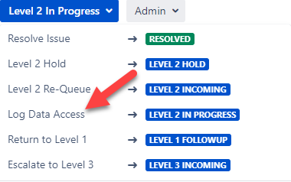
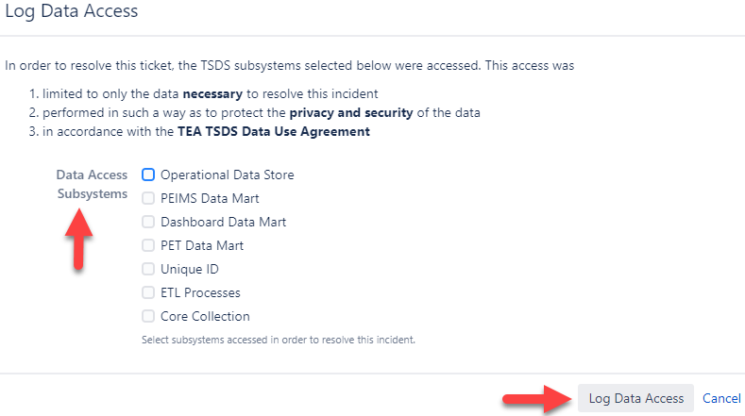
LOG DATA ACCESS
FOR ESC or CERTIFIED VENDOR ONLY PART 1
To log data access:
  From the detail view, click More, and then click Log Data Access.
  From the queues, hover over the right side of the incident, click the ellipsis, and select Log Data Access.
Ensure the following:
  The inclusion of data meets the restrictions listed at the top of the Log Data Access window.
  Check the boxes that indicate the types of data that are included in the incident.
  Add an optional comment explaining the inclusion of data.
Notes:
Trainer Notes
This section does not apply to TIMS LEA (Level 1) Support.
The incident has to be in Progress for Level 2 to access Log Data Access.
To maintain compliance with TEA policies and with the FERPA:
The LEA or ESC data that is escalated beyond Level 1 (TIMS LEA) Support must be logged into the system by Level 2 Support or higher.
Once an incident that has student or teacher data attached to it reaches Level 2, 3, or 4 and is put in In Progress or Follow-up status, use Log Data Access to comply with this requirement.

Slide 33
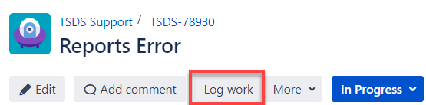
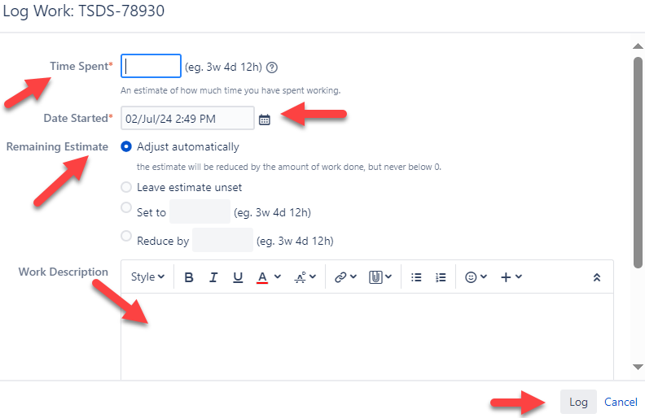
LOG DATA ACCESS CONTINUED
FOR ESC or CERTIFIED VENDOR ONLY PART 2
To Log Work:
  From the detail view, click Log Work.
  From the queues, hover over the right side of the incident, click the ellipsis, and click Log Work.
  If you have already logged work, in the detail view, click the + icon next to Time Tracking.
  Type an estimate of the amount of time you spend on the incident.
  Add an optional description of the work you have done.
  Click Log to log your work.
Notes:
Trainer Notes
For the Remaining Estimate section, select one of the choices below for how you would like to update the work estimation.
Adjust automatically to have the system update the estimate as time is added.
Use existing time estimate of # minutes which will not track time worked.
Set to which allows the user to set a specific estimate for work time remaining.
Reduce by which reduces the estimate already entered that seems excessive.

Slide 34
FOR ESC OR CERTIFIED VENDOR
Submit an Incident on Behalf of an LEA
  ESC or Certified Vendor needs to fill out the incident creation form.
  For the Submitter Org, you will select the name of the LEA who incurred the problem.
  Click Auto-fill my name, telephone, and email as the point of contact.
  You will immediately be able to see and work the incident.
Notes:
Trainer Notes
If your information does not upload when you click the Auto-fill my name, telephone and email, enter your name in Submitter Org, your email address in Submitter Email, and your contact number in Submitter Phone.

Slide 35
BEST PRACTICES

Slide 36
TIPS ON CREATING AN INCIDENT
Determine if it is a data or an application issue.
Search the Knowledge Base first.
Review the Known Issues Report.
When creating an incident:
  Attach screenshots and/or files.
  Include the error message.
  Describe the steps followed before the error occurred.
  Mention troubleshooting you already completed.
  Be concise but detailed in your description.
  Be specific about what you see.
  Provide any feedback on applicable Knowledge Base articles for potential future updates.

Slide 37
DEMONSTRATION 8
Best Practices
Searching for Incidents
Creating Filters
  Subscriptions to Filters
Linking Incidents
Emailing Incidents
Watching Incidents
Notes:
Trainer Notes
Log into TIMS and complete a demo. The steps for this Demo are covered slides 67-74.

Slide 38
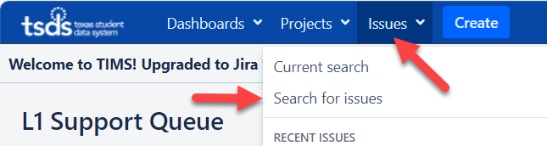
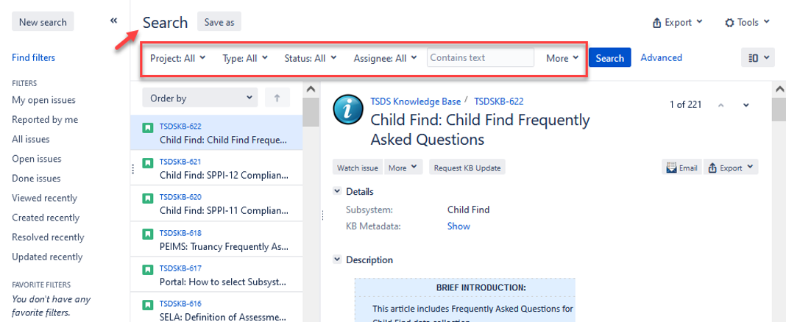
SEARCH FOR INCIDENTS
Notes:
Trainer Notes​
Top image
To search for an incident, click the Issues dropdown and then click Search for issues.
You may also type your search criteria in the Quick Search box and click Enter on keyboard (image not shown).
Bottom image
Use search parameters to narrow search:
Project: TSDS Support
Type: Enhancement Request, Problem, Question, or User Request
Status: Open, In Progress, etc.
More: Additional search parameters such as Subsystem
Narrow search further by entering word(s) or key phrases and click Search.

Slide 39
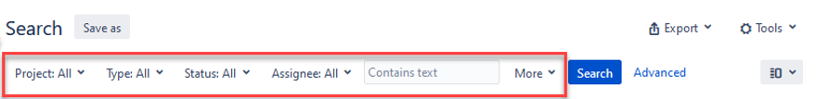
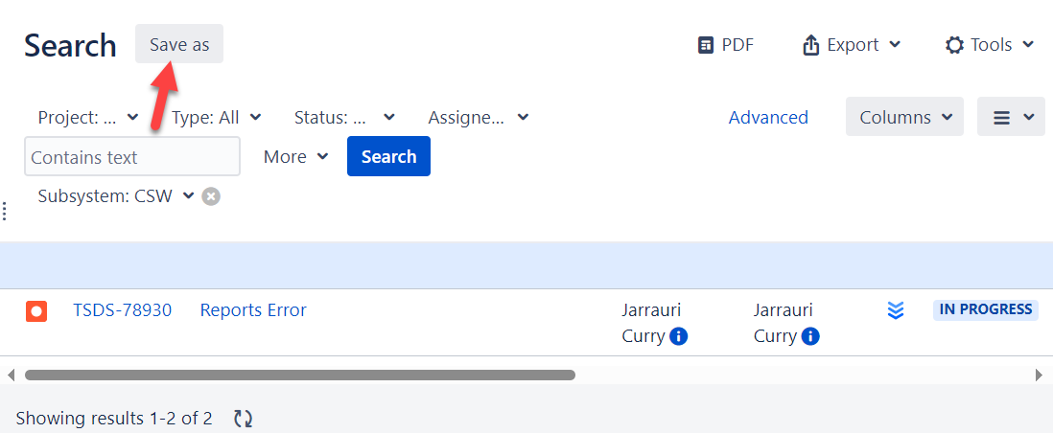
CREATE A FILTER
Notes:
Trainer Notes​
A filter is a saved issue search.
Top image
To create a filter, click the Issues dropdown, then click Search for Issues.
Middle image
Use search parameters to narrow search.
Project: TSDS Support
Type: Enhancement Request, Problem, Question, or User Request
Status: Open, In Progress, etc.
More: Additional search parameters such as Subsystem
To narrow your search more, enter word(s) or key phrase.
Bottom image
Once you have finished choosing your search parameters, click Save as.

Slide 40
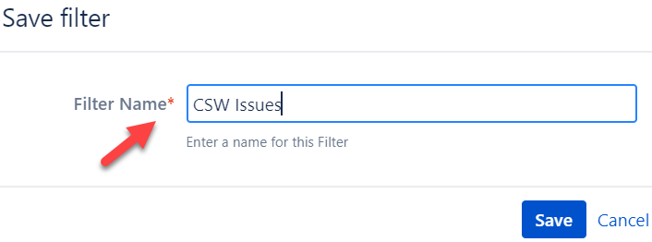
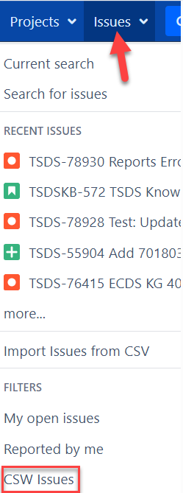
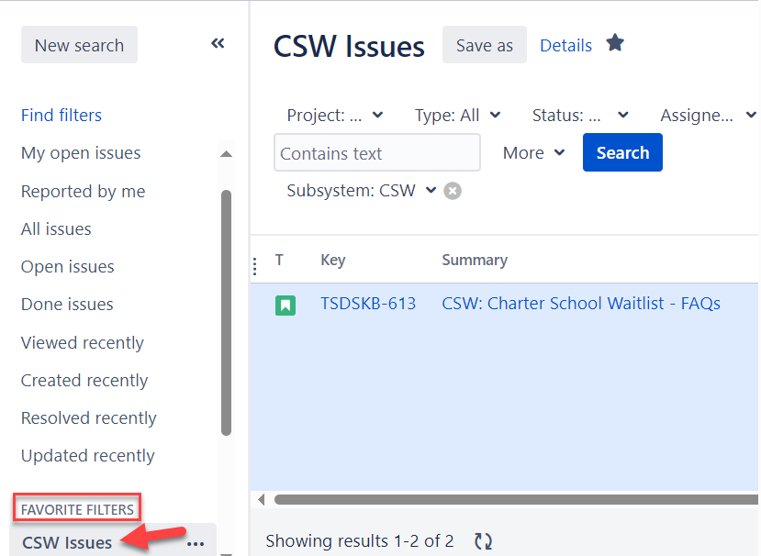
SAVE A FILTER
Notes:
Trainer Notes​
Top left image
To create a Filter, enter a name for your filter, and click Save.
Bottom left image
Locate the name of your filter by looking under the Favorite Filters section on the left-hand side of the Search landing page.
Right image
To access your newly created filter from the homepage, click the Issues dropdown menu, and look under the Filters section.

Slide 41
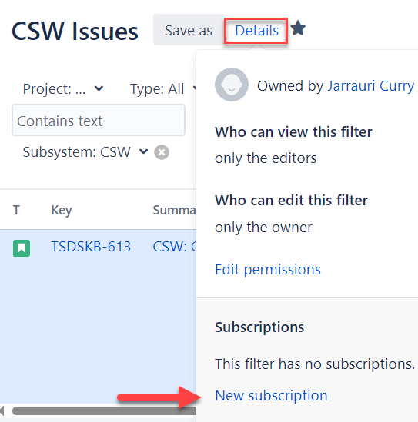
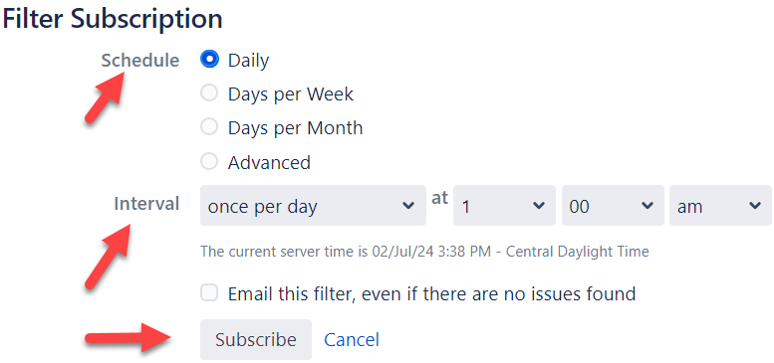
CREATE A SUBSCRIPTION
Notes:
Trainer Notes​
A subscription is a query that will run a scheduled basis and email the result to you via a push notification.
Top image
a Subscription, rom the Search page, next to Save as, click Details.
At the bottom, click New subscription.
Bottom image
Select the schedule and interval for the push notifications you will receive about your filter via email.
Check the box Email this filter, even if there are no issues found to receive a push notification.
Click Subscribe.

Slide 42
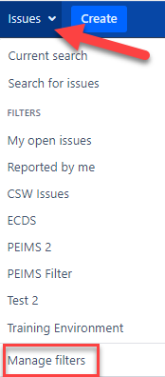
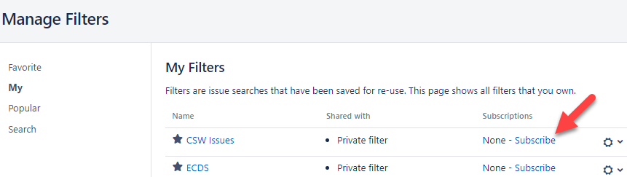
SUBSCRIBE TO A SUBSCRIPTION
Notes:
Trainer Notes​
Left image
Another method to create a subscription is to click the Issues dropdown menu and click Manage filters.
Right image
On the Manage Filters page, click My or Search.
Click Subscribe for the filter that you want to create a subscription.
Select the schedule and interval for the push notifications you will receive about your filter via email.
Check the box Email this filter, even if there are no issues found to receive a push notification.
Click Subscribe.
You’re now subscribed!
The gear icon on the far-right side of the screen allows you to edit or delete the subscription.

Slide 43
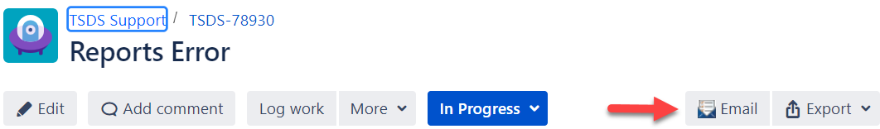
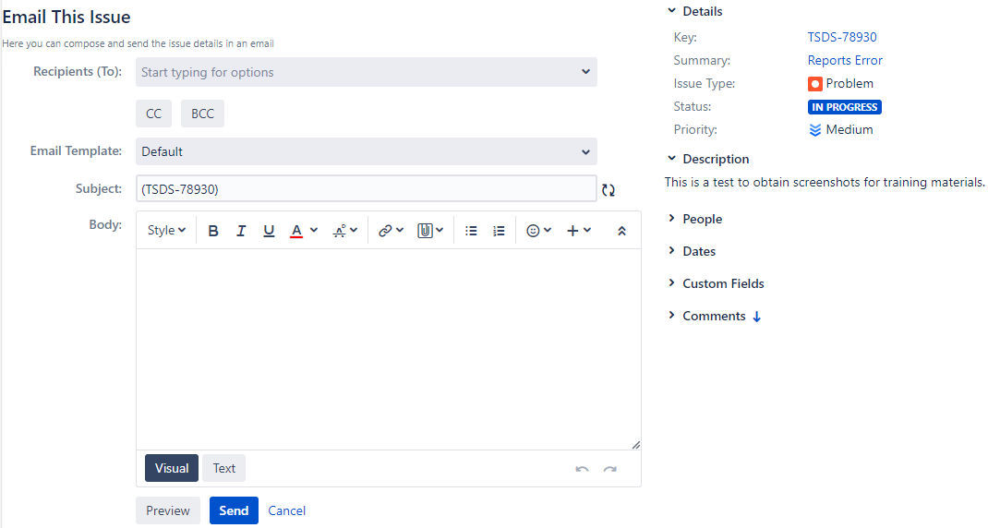
EMAIL IN TIMS
Notes:
Trainer Notes​
You can manually send email updates to other TIMS Support users from the detail view of the incident.
Do not put any personally identifying information in this email.
Top image
From the detail view of the incident, click Email.
Enter in the recipient's email.
Enter an optional comment in the Body.
Click Send.
Image not displayed
From the queues, hover over the right side of the incident, click the ellipsis, and click Email This Issue.
Click the More dropdown menu and click Email This Issue.

Slide 44


WATCH AN INCIDENT
Notes:
Trainer Notes​
Top image
To watch an issue, click Start watching this issue, or click the More dropdown menu and click Watch issue.
Bottom image
The name of the water and the number of people watching is indicated.
Anytime there is a change in status of this incident, the watcher feature will notify you via email.
To stopping watching an issue, click Stop watching this issue or click the More dropdown menu and click Stop watching.

Slide 45

LINK AN INCIDENT
How to Link an Incident
  From the detail view of the incident, click More Actions, then select Link.
  From the queues, on the line of the incident, click the ellipsis, then click Link.
To Link an Incident
  Select the reason for linking* - This issue.
  Select the incident from list or search for an incident.**
  Add an optional comment explaining why the incidents are connected.
  Add attachments if necessary.
  Click Link.
Notes:
Trainer Notes
Why would you link an incident?
If an incident is related to another incident
If an incident is a duplicate of another
Reasons for Linking:
Blocks: For TEA use only
Is blocked by: For TEA use only
Clones: a clone of the original incident
Is cloned by: the other incident is a clone of this incident
Duplicates: a duplicate of the other incident
Is duplicated by: the other incident is a duplicate of this incident
Relates to: is related to the other incident
NOTE:
You would link an incident as a clone when you are reporting the same incident this month that you did last month. You would need to update the incident details such as date, time, etc.
You would link an incident as a duplicate when you have submitted multiple incidents about the same problem.
**To Search for an Incident:
Select the incident from the queues or click the Issues dropdown menu and click Search for issues.
Type part of the description of the incident or the incident number in the search field.
Click Search.
Select the appropriate incident.
Type a comment explaining why the incidents are connected.
Click Link.

Slide 46

TRAINING ACTIVITIES
Practice, Knowledge Checks

Slide 47
PRACTICE EXERCISE
Task 1: Submit a TIMS incident.
Task 2: Locate and view the TIMS incident submitted.
Ready
Set
Go

Slide 48
KNOWLEDGE CHECK 1
Level 1 Support (LEA) user can create an incident and immediately escalate it to Level 3 Support (TEA).
  True
  False
Notes:
NOTE
To see the answer, you must be in presentation mode.

Slide 49
KNOWLEDGE CHECK
When an ESC or Certified Vendor creates an incident on behalf of an LEA, the ESC or Certified Vendor should select the name of the LEA under the dropdown for Submitter Org.
  True
  False
Notes:
NOTE
To see the answer, you must be in presentation mode.

Slide 50
KNOWLEDGE CHECK 3
When an issue is identified in a TSDS application, which of the below is the first step a TIMS Level 1 Support user should take?
  Double check your TIMS role
  Send an email to Level 3 support staff
  Search the Knowledge Base for a resolution
  Submit a TIMS incident
Notes:
NOTE
To see the answer, you must be in presentation mode.

Slide 51

WRAP UP
Key Takeaways, Resources, and Next Steps

Slide 52

KEY TAKEAWAYS
TIMS allows users to submit incidents when a problem is encountered or there are questions about TSDS applications.
When creating an incident, be sure to attach screenshots and/or images, and include previous troubleshooting steps.
TRAINING RESOURCES
      TIMS User Guide

Slide 53
TECHNICAL RESOURCES
TSDSKB-232 User Guide​​
TSDSKB-187 Creating a Filter​
TSDSKB-260 Setting up a Watch Issue ​
TSDSKB-196 Email Function ​
TSDSKB-243 Subscription

Slide 54
NEXT STEPS
  Complete a Teach Back Exercise
  Complete the TIMS Certification Test
Attend TSDS Continuing Education Trainings (CET)
Participate in TSDS Just-in-Time Trainings (JIT)
Attend Field Coordination Network (FCN) webinars for new updates and changes

Slide 55
WRAP UP
  In this training we talked about:
How to create an incident (ticket).
TIMS incident workflow.
Support portal for TSDS users.
Best practices for using the TIMS.

Slide 56

QUESTIONS

