Slide 1

TSDS Incident Management System
New User Certification Training

Slide 2
KEY TERMS
You can find the definitions to these key terms and more here:
Key Term Document
Education Service Center (ESC)
Local Education Agency (LEA)
Texas Education Agency Login (TEAL)
Texas Education Data Standards (TEDS)
Texas Student Data System (TSDS)
TSDS Incident Management System (TIMS)

Slide 3
LEARNING OBJECTIVES
By the end of this course, the users will be able to explain:
The TIMS.
TIMS user levels and roles.
How to request access.
Family Educational Rights and Privacy Act (FERPA).
How to access TIMS.
How to setup a TIMS dashboard.
How to search the TSDS Knowledge Base (KB).

Slide 4
WHY IS THIS COURSE IMPORTANT
This course is important because it provides users with the knowledge and guidance on how to use the Texas Student Data System (TSDS) Incident Management System (TIMS) for receiving support and guidance on TSDS applications and data submissions.

Slide 5

COURSE AGENDA
Getting Started
TSDS Overview, TIMS Overview, TIMS TEAL Roles
Key Concepts
FERPA, Access, Dashboards, Knowledge Base
Training Activity
Practice and Knowledge Checks
Wrap Up
Key Takeaways, Resources, and Next Steps

Slide 6


GETTING STARTED
TSDS Overview, TIMS Overview, TIMS TEAL Roles

Slide 7

OVERVIEW OF TSDS
The Texas Student Data System (TSDS), a major initiative by the Texas Education Agency, is a statewide system that modernizes and improves the quality of data collection, management, and reporting in Texas education.

Slide 8
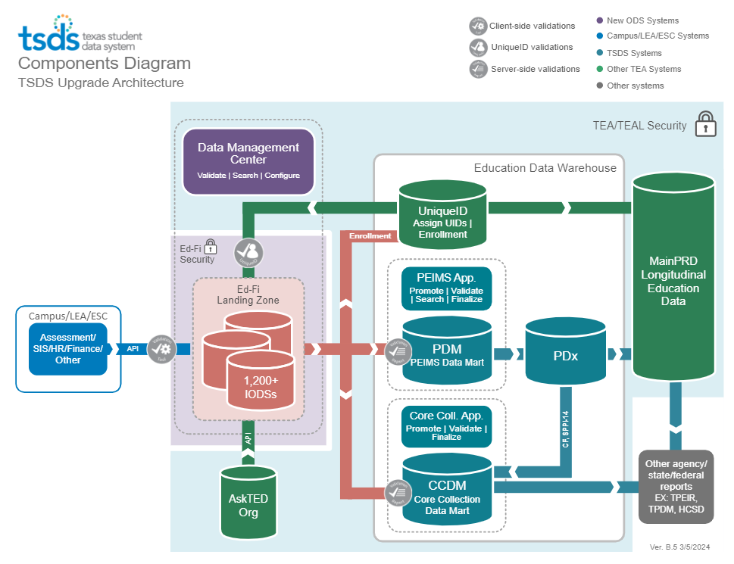
HIGH-LEVEL ARCHITECTURE

Slide 9
OVERVIEW OF TIMS
The Texas Student Data System (TSDS) Incident Management System, or TIMS, is a web-based system that allows you to submit incidents when you encounter problems, have questions about TSDS applications, or want to request software enhancements. If additional support is needed to resolve an incident, the ticket can be escalated to the next level of support. Escalation can occur from:
The LEA to the education service center ESC or TSDS certified vendor(s); or
The ESC or TSDS certified vendor(s) to the Texas Education Agency (TEA), if necessary.
TIMS support users are provided with a dashboard-like view of the latest activity on incidents, assigned incidents, and lists of incidents by various categories.
Notes:
Trainer Notes
TIMS has the following features:
• Incident reporting and management
• Incident escalation
• A knowledge base
• History tracking
• Subscription service for receiving notifications about specific updates or changes

Slide 10
LEVELS OF SUPPORT – PART 1
Level | TEAL Role/Description | Description/Privileges
TSDS User | Any user with a role in one or more of the TSDS Portal applications | • Searches Knowledge Base for help • Submits incidents, questions, and requests for enhancements to TIMS, and view incidents submitted
Level 1 Support | TIMS Level 1 Support The first contact for questions by district or charter school users, who work with internal district source data experts to diagnose and resolve incidents | • Searches Knowledge Base for help • Submits incidents in TIMS • Monitors and manages the TIMS Level 1 queue • Resolves incidents • Escalates incidents to Level 2 Support when necessary
Level 2 Support | TIMS Level 2 Support Support personnel at the ESC or certified vendor who monitor and receive escalated incidents from Level 1 Support staff, and assist in diagnosing, resolving, or escalating incidents. | • Searches Knowledge Base for help •Submits incidents in TIMS • Monitors and manages incidents in TIMS for LEAs for whom they provide support • Escalates incidents to Level 3 Support when necessary
Notes:
Trainer Notes​
On this screen, you will learn about the TIMS TSDS User, TIMS Level 1 Support, and TIMS Level 2 Support roles.

Slide 11
LEVELS OF SUPPORT – PART 2
Level | TEAL Role/Description | Description/Privileges
Level 3 Support | Support staff at TEA who monitor and receive escalated incidents from Level 2 Support staff and assist in diagnosing, resolving, or escalating incidents. | • Searches Knowledge Base for help • Monitors and manages incidents in TIMS that have been escalated to Level 3 • Escalates incidents to Level 4 Support when necessary • Maintains the Knowledge Base Articles (KBAs) • Closes incidents that are resolved at Levels 1 and 2 • Provides triage support with appropriate TSDS staff
Level 4 Support | Appropriate roles needed for advanced TEA technical support | Monitors and manages incidents in TIMS for the specific component for which they provide support
Notes:
Trainer Notes​
On this screen, you will learn about the TIMS Level 3 Support and TIMS Level 4 Support roles.
NOTE:
Level 3 has the same privileges as Level 1 Support and Level 2 Support.
For Level 3 Support role, the support personnel close tickets which is different than resolving or providing a solution to an incident.

Slide 12
DEMONSTRATION AGENDA
During this demonstration, you will see the following:
Add TIMS Access
Setup a TIMS dashboard.
Search the TSDS Knowledge Base (KB).

Slide 13
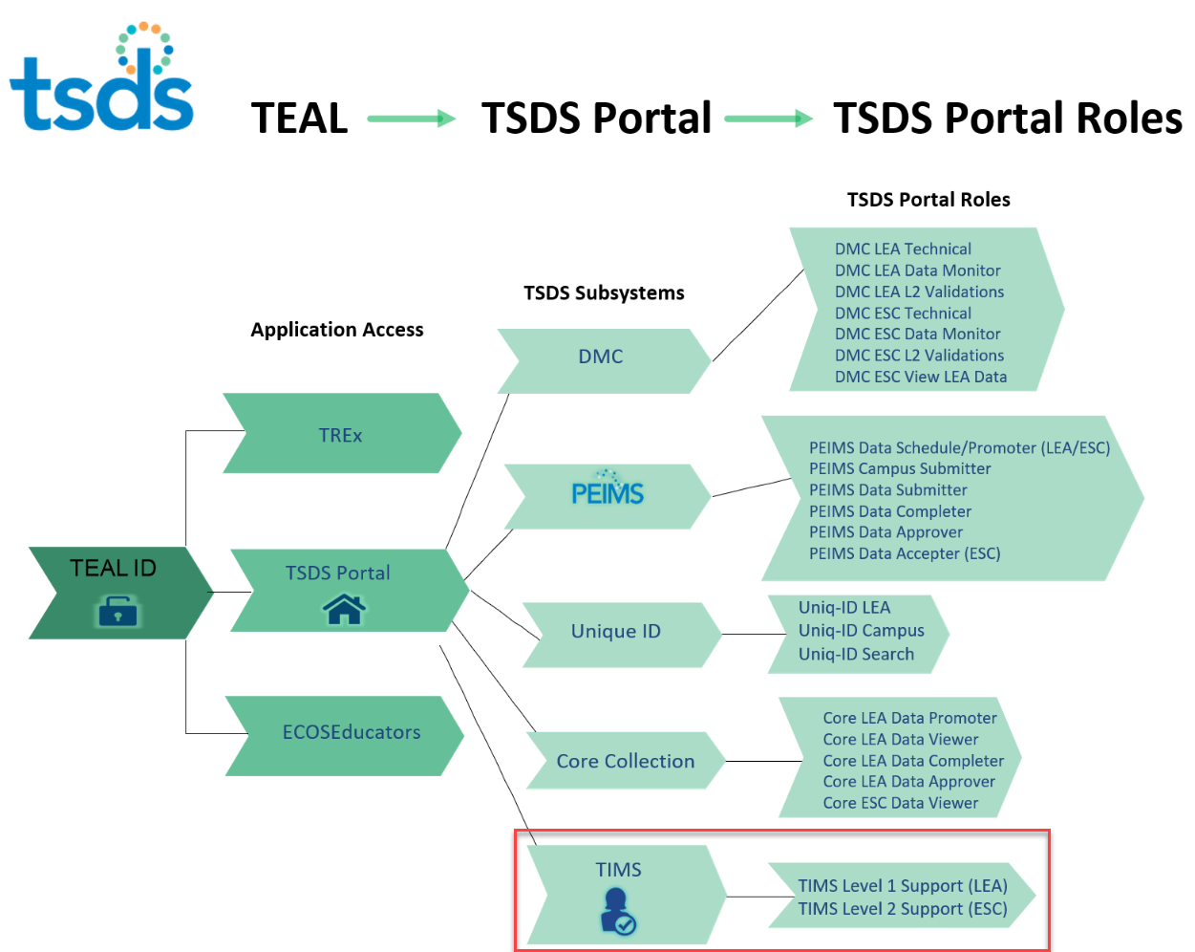
TSDS TIMS Portal Roles
Notes:
Trainer Notes​
TIMS Roles
TIMS Level 1 Support is for Local education agencies LEAs.
TIMS Level 2 Support is for ESCs and certified vendor(s), except when the ESC needs to act on behalf of an LEA in which they would request TIMS Level 1 Support role for that LEA.

Slide 14
DEMONSTRATION 1
Adding TIMS Access
Log in to your TEAL account.
In the TSDS Portal section, click Add/Modify Access.
Once the Edit Account page loads, click Add Access.
Type in your organization number for Employing Organization.
Scroll to TIMS and select Level 1 Support (for LEAs) or Level 2 Support (for ESCs).
Type in your organization number for Requested Organization ID.
Select the Privileges for the components for which you will be providing support (i.e. Class Roster, Charter School Waitlist, Child Find).
Click Done.
Click Save Changes.
You will receive an email confirmation providing you the status of your request, approved or not.

Slide 15
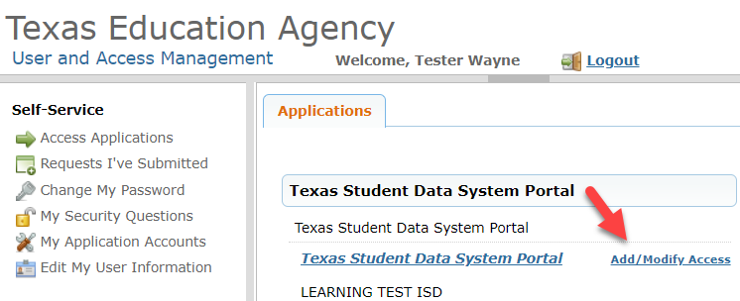
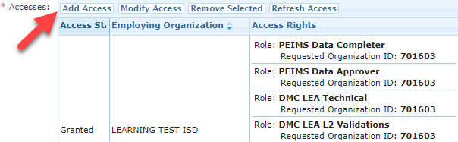
REQUESTING TIMS ACCESS
Notes:
Trainer Notes​
​
To add TIMS Level 1 Support or TIMS Level 2 Support role and privileges:
Top image
Log in to your TEAL account.
In the TSDS Portal section, click Add/Modify Access.
Bottom image
Once the Edit Account page loads, click Add Access.

Slide 16
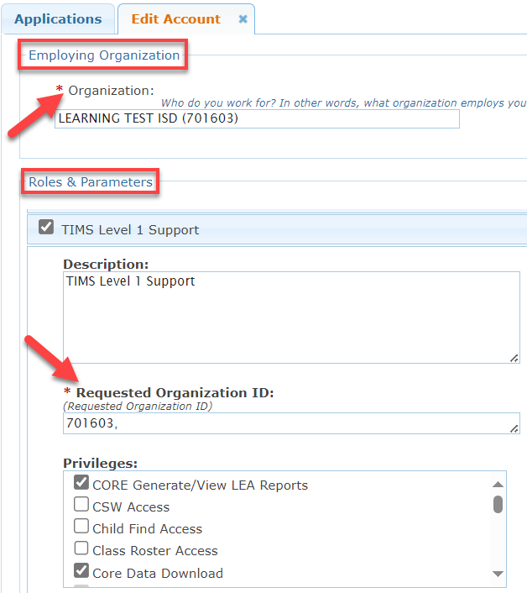
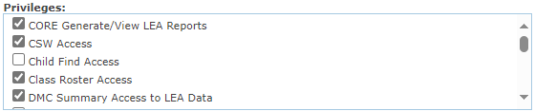
SELECT ROLE & PRIVILEGES
Notes:
Trainer Notes​
​
Type in your organization number for Employing Organization.
Scroll to TIMS and select Level 1 Support (for LEAs) or Level 2 Support (for ESCs).
Type in your organization number for Requested Organization ID.
Select the Privileges for the components for which you will be providing support (i.e. Class Roster, Charter School Waitlist, Child Find).

Slide 17
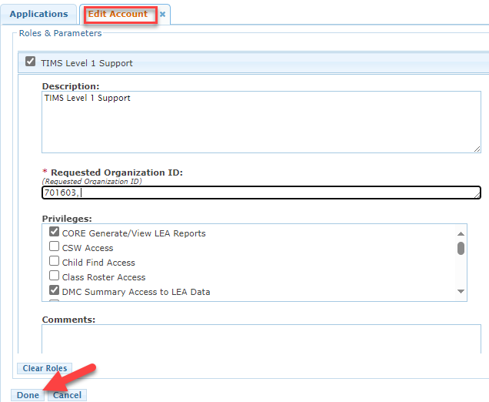
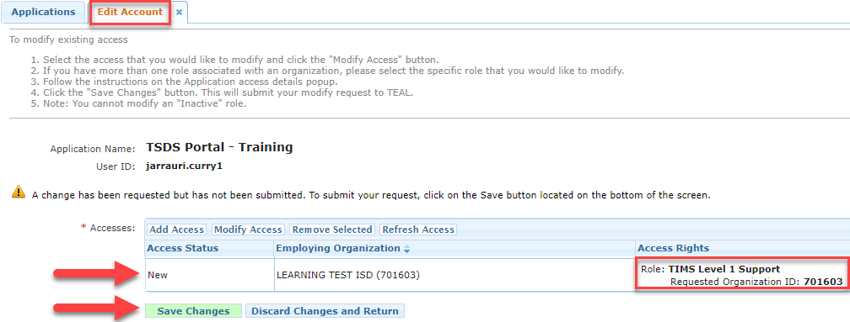
HOW TO SUBMIT REQUEST
Notes:
Trainer Notes​
Top image
Click Done.
Bottom image
Click Save Changes.
You will receive an email confirmation providing you the status of your request, approved or not.

Slide 18
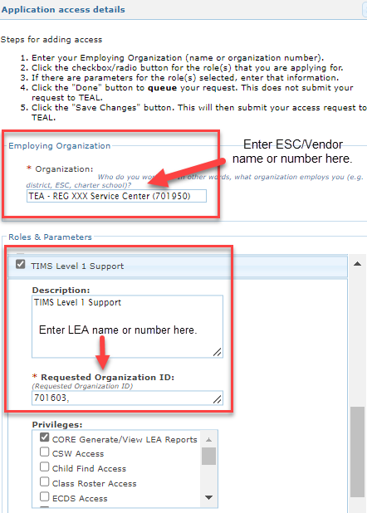
ESC OR CERTIFIED VENDOR ONLY
To add TIMS Level 1 access as an ESC or Certified Vendor:
You must have a contractual agreement to act as TIMS Level 1 Support on behalf of the LEA.
To add Level 1 Access:
Click Add/Modify Access.
In the Employing Organization section, enter your organization name or ID.
Check the box next to TIMS Level 1 Support.
In the Requested Organization ID, enter the organization name or ID of the organization requesting access.
In the Roles and Parameters section, enter the name or number of the LEA for which you have written/contractual permissions to submit TIMS incidents and have data use agreement permission.
Notes:
Trainer Notes​
​
For ESCs and Vendors, adding the TIMS Level 1 Support role is OPTIONAL.
ESC/Vendors with the TIMS Level 2 Support role can create tickets on behalf of the LEA.
To add the TIMS Level 1 Support role, the ESC/Vendor:
Should have a contract with the LEA to act on their behalf in the role of Level 1 Support.
May request the TIMS Level 1 Support role and have the Superintendent or their designee approve their access.

Slide 19


KEY CONCEPTS
FERPA, TIMS Access, TIMS Dashboard, Searching the Knowledge Base

Slide 20

DATA USE REMINDER
Like the adage in Spider Man…
With GREAT power
comes great responsibility

Slide 21
FERPA
It is very important to follow stringent guidelines when accessing sensitive LEA and ESC data specific to an assigned TIMS incident. TEA policy and the Family Educational Rights and Privacy Act (FERPA) dictate that personally identifying data for students and teachers be kept private. Therefore, the following rules are applicable to all users of TIMS:
Data will be used for the sole purpose of resolving the reported incident, and no attempt will be made to identify specific individuals.
If the identity of any student should be inadvertently discovered, no use will be made of this information nor will it be shared by anyone else, and the identifying information will be safeguarded or destroyed.
Only the personnel providing support for the incident will have access to the contents of the data files, including any files derived from these files.
Inquiries from the LEA regarding compliance with this agreement or the expected date of resolution of an incident must be responded to promptly and in writing.
All electronic and paper files containing identifying data that are created or used during incident resolution must be destroyed when the incident is closed.

Slide 22
TIMS ACCESS

Slide 23
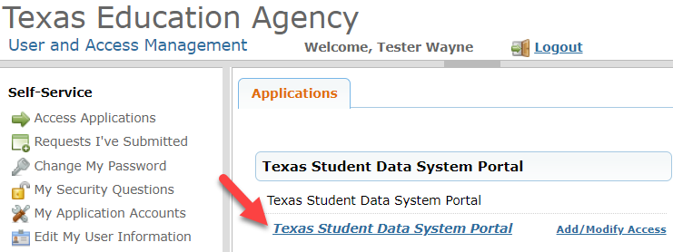
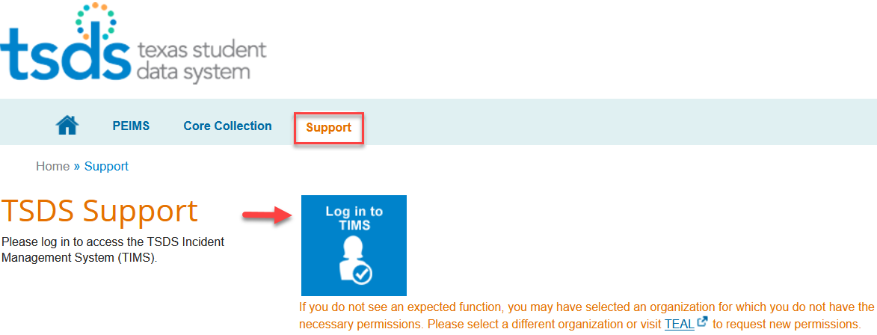
ACCESSING TIMS
Notes:
Trainer Notes​
TIMS Support Levels
TIMS Level 1 Support – LEA
TIMS Level 2 Support – ESC or Vendor
Top image
To log in TIMS:
Click Texas Student Data System Portal.
Bottom image
To finish the process of logging in to TIMS:
Click on the Support tab.
Click the Log in to TIMS easy button.

Slide 24
TIMS DASHBOARD

Slide 25
DEMONSTRATION 2
TIMS Dashboard Setup
From the Dashboards menu, select Manage Dashboards.
Click on Search in the left pane of the page.
To view all available dashboards based on your role and privileges, leave the search field blank and click the Search button.
From the list of dashboards in returned results, click on the star next to the one that corresponds to your support role level, and it will be added as a favorite to your Dashboards menu.
Level 1 Support – LEA
Level 2 Support – ESC
Notes:
Trainer Notes
Log in to TIMS and complete a demo. The steps to be included in the demo are covered on slides 27-29.

Slide 26
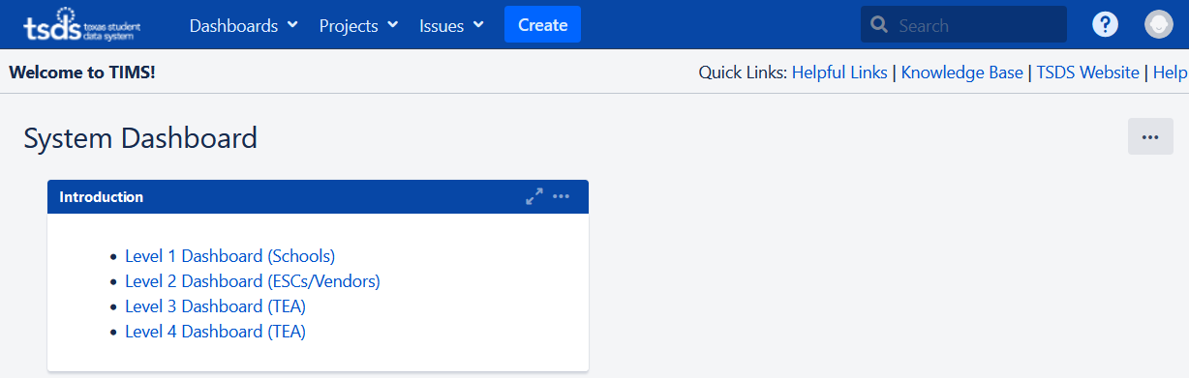
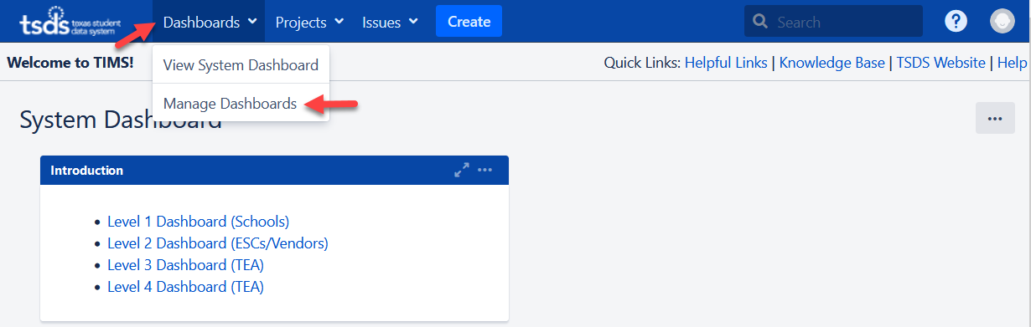
TIMS DASHBOARD SETUP
Notes:
Trainer Notes​
Top image
The first image shows you how your dashboard will look when you log in for the first time.
There are pre-designed dashboards available for users at each level of support.
Bottom image
From the Dashboards menu, select Manage Dashboards.

Slide 27
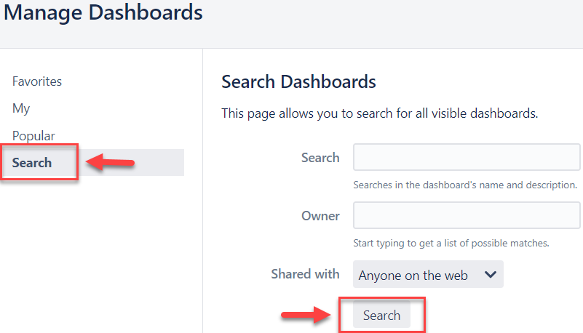
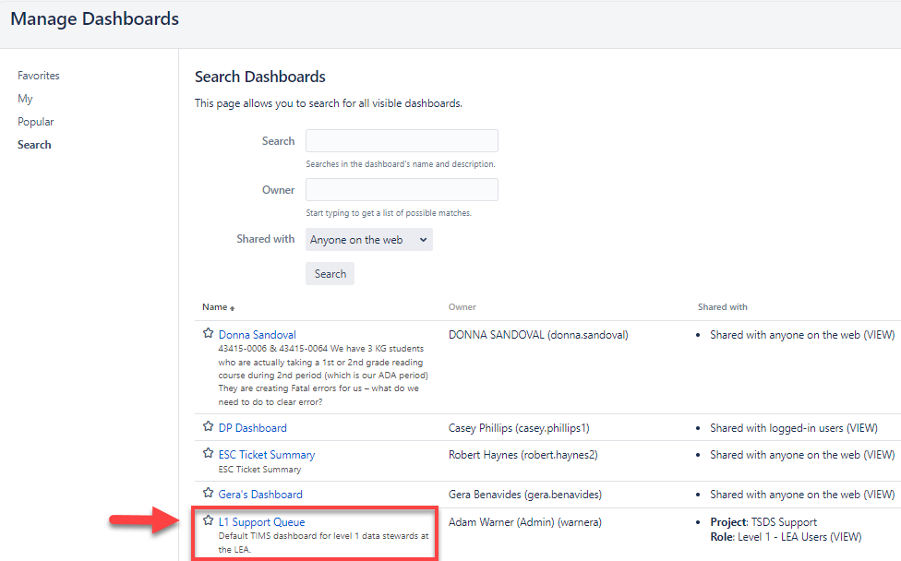
MANAGE DASHBOARDS
Notes:
Trainer Notes​
Click on Search in the left pane of the page.
To view all available dashboards based on your role and privileges, leave the search field blank and click the Search button.
From the list of dashboards in returned results, click on the star next to the one that corresponds to your support role level, and it will be added as a favorite to your Dashboards menu.
Level 1 Support – LEA
Level 2 Support – ESC

Slide 28
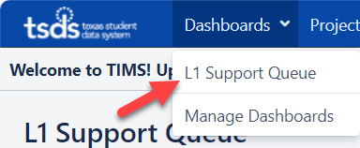
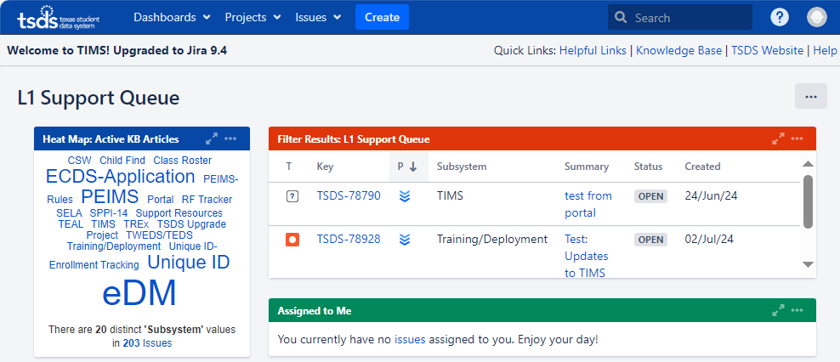
TIMS DASHBOARD HOMEPAGE
Notes:
Trainer Notes​
Top image
To choose your dashboard:
Click the Dashboards dropdown menu.
Click L1 Support Queue.
The TIMS Dashboards or Support Queue:
Allows the LEA Data Steward to monitor and easily access the support issues in their queue.
Displays specific views of TSDS incident information.
Bottom image
Now that you have setup your dashboard, you can view the following support view panes:
Heat Map: a way to search Knowledge Base articles. The subsystems are listed in the pane, their size indicating the relative number of articles. Click on the name of a subsystem to see the list of articles for that subsystem.
Activity Stream: a summary of recent activity.
Support Queue: the unassigned incidents for the specific level of support.
Assigned To Me: a list of incidents assigned to the current user.
My Incident Tracking: the list of incidents that you have commented on, moved back to the previous level, or escalated to the next level.
All Unresolved Support Issues: all the unresolved incidents for that specific level of support.
All Support Issues: all incidents for the specific level of support.

Slide 29
SEARCHING THE KNOWLEDGE BASE

Slide 30
DEMONSTRATION 3
Searching the TIMS Knowledge Base
Access Knowledge Base (KB) Articles via:
Heat Map
Quick Search
Quick Link
Notes:
Trainer Notes
Log in to TIMS and complete a demo. The steps to be included in the demo are covered on slides 32-35.

Slide 31
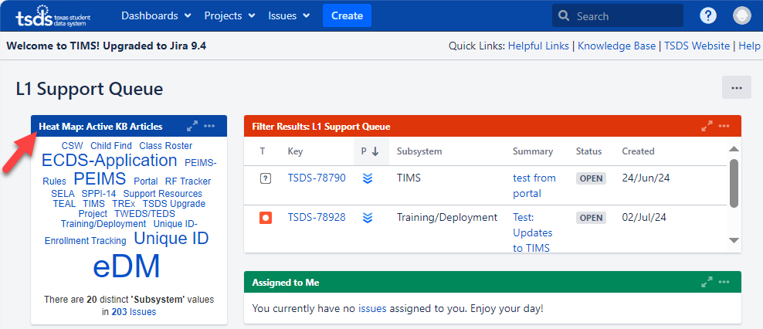
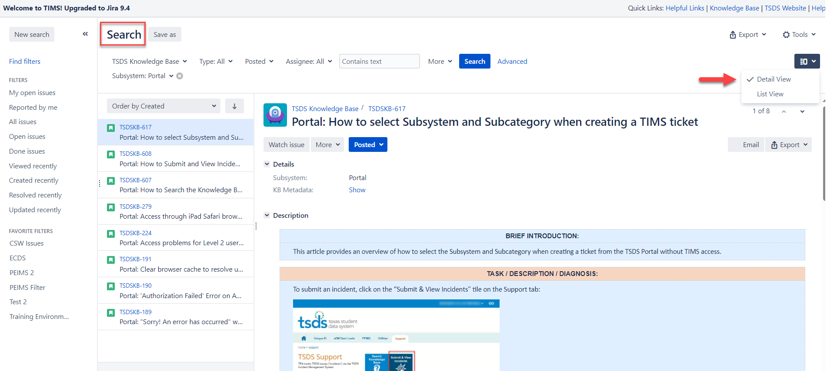
THE HEAT MAP
Notes:
Trainer Notes
Top image
The Heat Map is a way to search for Knowledge Base articles.
The subsystems are listed in the pane, their size indicating the relative number of articles.
Click on the name of a subsystem to see the list of articles for that subsystem.
Bottom image
This image displays the Search landing page that will show once you click on a subsystem from the Heat Map.
You may view the search homepage in two ways using the dropdown view menu:
Detail View – this view displays a list of your open incidents to the left side while displaying the full details of each incident
List View - this view displays a summary list of your open incidents

Slide 32
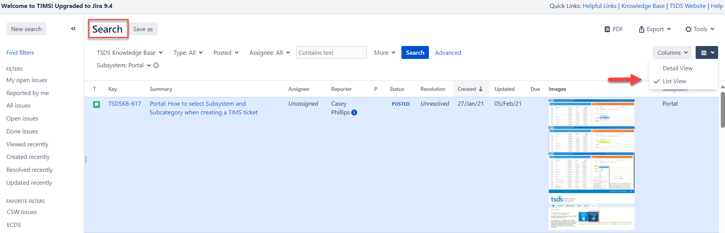
USING THE QUICK SEARCH BOX
Notes:
Trainer Notes​
Top image
Use the Quick Search in the upper right-hand corner of the TIMS dashboard to search for KB articles. box, you can search for incidents and knowledge-based articles using key words, phrases and KB article numbers (TSDSKB-####).
Bottom image
This image shows an example of the Search homepage that appears when using the Quick Search box.
You may view the search homepage in two ways using the dropdown view menu:
Detail View – this view displays a list of your open incidents to the left side while displaying the full details of each incident
List View - this view displays a summary list of your open incidents

Slide 33
KNOWLEDGE BASE QUICK LINK
Notes:
Trainer Notes​
Top image
This image shows an example of the Search homepage that appears when using the Knowledge Base quick link.
Use the Knowledge Base quick link in the upper right-hand corner of the TIMS dashboard to search for KB articles.
Bottom image
This image shows an example of the Active KB Articles homepage that appears when using the Knowledge Base quick link.
You can filter your results by using the dropdown menus under the page title, Active KB Articles.
You may view the KB articles homepage in two ways using the page view dropdown menu:
Detail View – this view displays a list of your open incidents to the left side while displaying the full details of each incident
List View - this view displays a summary list of your open incidents.

Slide 34
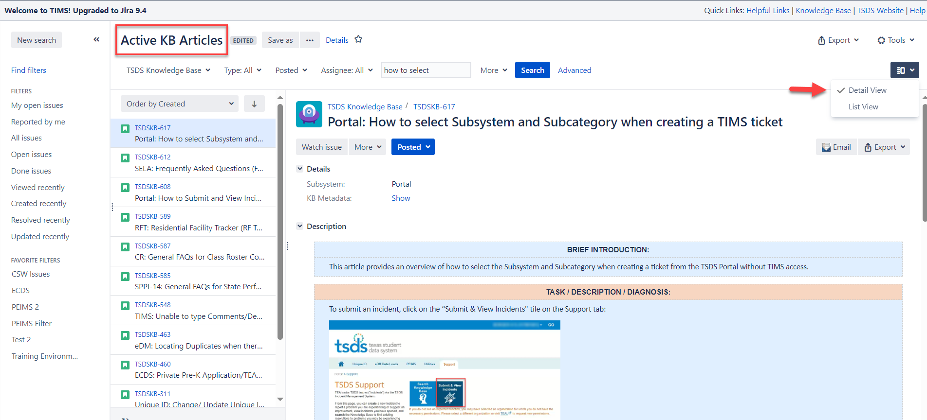
KNOWLEDGE BASE DETAIL VIEW
Notes:
Trainer Notes​
Show slide and go to a KB article to show the elements of it (i.e., details, description, attachments, and additional information).

Slide 35

TRAINING ACTIVITIES
Practice, Knowledge Checks

Slide 36
PRACTICE EXERCISE
Task 1: Access the TSDS Knowledge Base
Task 2: Perform a search for at least two KB Articles
Ready
Set
Go

Slide 37
KNOWLEDGE CHECK 1
Which of the following is correct?
TIMS Level 1 Support is for LEAs, and TIMS Level 2 Support is for ESCs/Vendors.
TIMS Level 1 is for ESCs/Vendors, and TIMS Level 2 Support is for LEAs.
TIMS Level 1 Support is for LEAs, and TIMS Level 2 Support is for TEA.
TIMS Level 3 Support is for ESCs/Vendors, and TIMS Level 4 Support is LEAs.
Notes:
Note
To see the answer, you must be in presentation mode.

Slide 38
KNOWLEDGE CHECK 2
When creating an incident, there are four priority levels: Critical, High, Medium, and Low. When should the end user select Critical as the priority?
Enhancement request, question on functionality, or display/formatting issues.
Unplanned system outage/application unavailable.
Problem with specific application functionality, major impact.
Application functioning, but not as desired/expected.
Notes:
NOTE
To see the answer, you must be in presentation mode.

Slide 39
KNOWLEDGE CHECK 3
The first step when accessing TIMS for the first time is to set up your dashboard.
True
False
Notes:
NOTE
To see the answer, you must be in presentation mode.

Slide 40

WRAP UP
Key Takeaways, Resources, and Next Steps

Slide 41

KEY TAKEAWAYS
TIMS allows users to submit incidents when a problem is encountered or there are questions about TSDS applications.
Data use agreement is required from the LEA to access their data, even if the incident is submitted by the ESC or Certified Vendor.
Be sure to search the Knowledge Base in TIMS before submitting an incident to see if a resolution exists.
TRAINING RESOURCES
TIMS User Guide

Slide 42
TECHNICAL RESOURCES
TSDSKB-232 User Guide​
TSDSKB-272 Setting up the Dashboard ​

Slide 43
NEXT STEPS
Attend TIMS Part II: Create Incidents, Incident Workflows, Best Practices training

Slide 44
WRAP UP
In this training we talked about:
The TIMS.
TIMS user levels and roles.
How to request access.
FERPA.
How to access TIMS.
How to setup a TIMS dashboard.
Searching the TSDS Knowledge Base (KB).

Slide 45

QUESTIONS

