Slide 1

TITLE SLIDE: TSDS ODS 3.x Project
Updates
Special Education Language Acquisition
New User Certification Training

Slide 2
KEY TERMS
Application Program Interface (API)
Data Element
Data Management Center (DMC)
Data Promotion
Data Submission
Data Validation
Domain
Education Service Center (ESC)
Entity
Individual Operational Data Store (IODS)
Local Education Agency (LEA)
Source System
Texas Education Agency Login (TEAL)
Texas Student Data System (TSDS)
TSDS Incident Management System (TIMS)
TSDS Web-Enabled Data Standards
You can find the definitions to these key terms and more here:
Key Terms and Definitions Document.

Slide 3
LEARNING OBJECTIVES
By the end of this course, the users will be able to explain:
The requirements for the Special Education Language Acquisition (SELA) data submission.
The data that comprises the SELA data submission. ​
How to promote SELA data.
TSDS report for SELA.

Slide 4
WHY IS THIS COURSE IMPORTANT
To understand that the language acquisition of children eight years of age or younger who are deaf or hard of hearing (DHH) or deafblind (DB) are regularly assessed using a tool or assessment.
To identify those students who are often at risk for language delay or deprivation.

Slide 5

COURSE AGENDA
Getting Started
TSDS Architecture, TEAL Roles, and Promotion Demo
Key Concepts
SELA and SELA Report
Training Activity
Practice, Troubleshooting, and Knowledge Checks
Wrap Up
Key Takeaways, Resources, and Next Steps

Slide 6


GETTING STARTED
TSDS Architecture, TEAL Roles, and Promotion Demo

Slide 7
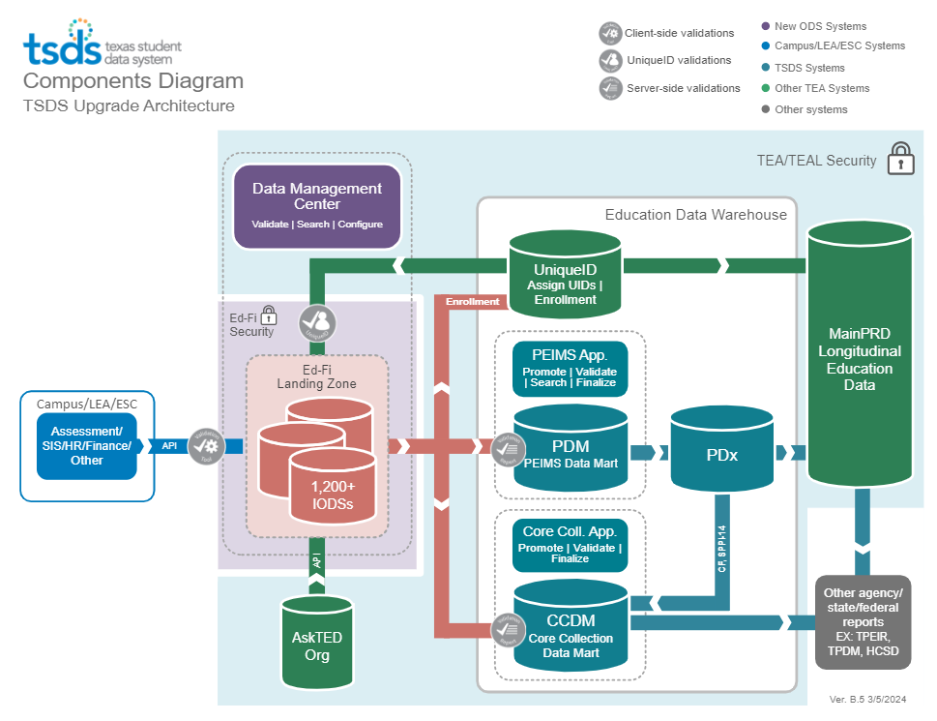
TSDS ARCHITECTURE

Slide 8
LEA TEAL ROLES - SELA
Core LEA Data Viewer
This role monitors data promotions and data validations and generates reports.
Core LEA Data Promoter
This role schedules and monitors promotions, schedules and monitors validations, and generates reports.
Core LEA Data Completer
This role formally certifies the completeness and accuracy of the data and finalizes the submission. In addition, this role also schedules and monitors promotions, schedules and monitors validations, and generates reports.
Core LEA Data Approver
This role will be for the superintendent or his/her designee at the LEA. This role requests an extension if needed.
Notes:
The role the LEA staff would request will depend on the individual’s level of responsibility.

Slide 9
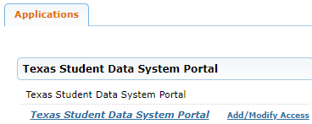
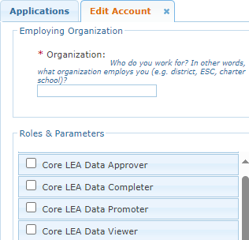
APPLY FOR SELA ROLE
Login to your TEAL account; Click Add/Modify Access.
Enter your Employing Organization and select the appropriated Core LEA TEAL role.

Slide 10
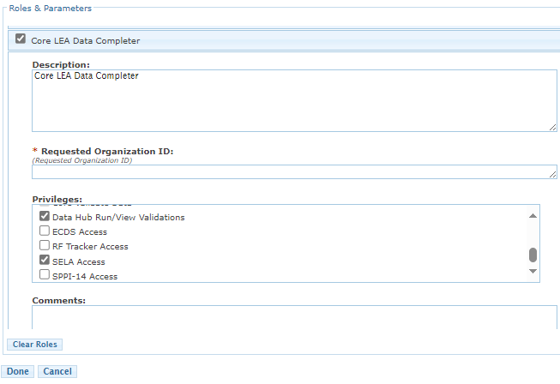
SELA TEAL ROLE & PRIVILEGE
Users will check the appropriate role based on their level of responsibility at the LEA and in the Requested Organization ID enter their Organization ID.
Next, check the Privilege “SELA Access” and click Done.
The final step is to click Save Changes on the next screen.
Notes:
Check ECDS Access under the Privileges.

Slide 11
ESC ROLE FOR SELA
Core ESC Data Viewer
This role will be able to view and monitor SELA activity in TSDS for the LEAs the ESC supports.
Notes:
The ESC Data Viewer role will allow the ESC to monitor the data promotions for SELA for the LEAs in their region.

Slide 12
PROMOTION DEMO
Login to TEAL Account
Navigate to Core Collection Application
Promote SELA data
Monitor data promotion
NOTE: The Reference Guide (RG) is a resource that provides step-by-step instructions for Promoting, Validating, and Completing the SELA Submission.​
SELA Reference Guide

Slide 13


KEY CONCEPTS
SELA and SELA Report

Slide 14
SELA: PART 1
As part of House Bill 548, which was passed in the 86th Legislative Session, TEA is required to ensure that the language acquisition of children eight years of age or younger who are deaf or hard of hearing (DHH) or deafblind (DB) is regularly assessed using a tool or assessment.
LEAs will only be required to report data throughout the school year if they have eligible students.
Notes:
Note:
While TEA does collect some of the disability information in PEIMS, the timing of this data collection does not align with when this data is needed for reporting; therefore, a new Core Collection is necessary.

Slide 15
SELA: PART 2
The SELA data submission will be due to TEA on the fourth Thursday in June.
No later than August 31st of each year, TEA, the Texas School for Deaf, and HHSC shall jointly publish a report on their websites with the data collected of children eight years of age or younger who are deaf and hard of hearing (DHH) or deafblind (DB). Data from the SELA collection will be used to help prepare this report.

Slide 16
DEAF AND HARD OF HEARING
TEA fulfills a requirement for a comprehensive statewide plan for educational services for students who are deaf or hard of hearing (DHH).
The State DHH Plan is intended to be a tool to:
• Identify needs,
• Set priorities and guide development, and
• Provision services for students who are deaf or hard of hearing.
URL Link to State DHH Plan
Please refer to the Services to Students Who are Deaf or Hard of Hearing at the following link: Sensory Impairments | Texas Education Agency.
Notes:
Note:
Once HB2 has been signed into law by Governor Abbott, the DHH state plan will change. Once approved, updates will be made to the website.

Slide 17
DEAF-BLINDNESS
Deaf-Blindness is defined as:
The combination of visual and auditory impairments.
The impairments that cause severe communication and other developmental and educational needs.
Educational needs that cannot be accommodated in programs solely for children with deafness or children with blindness.
The process:
Requires an admission, review, and dismissal (ARD) committee.
Involves the ARD committee working with the parents, staff, and professionals to develop an Individual Education Plan (IEP) for the student who are deafblind.
Requires the ARD committee to work with certified professionals in the education of students with visual and auditory impairments.
Please refer to the Services to Students Who are Deaf-Blind at the following link: Sensory Impairments | Texas Education Agency.

Slide 18
SELA TIMELINE
Special Education Language Acquisition Collection
SELA ready for users to complete | Third Monday in May
SELA submission due to TEA | Fourth Thursday in June

Slide 19
DOMAIN DEFINITIONS
Education Organization Domain – provides information about any public or charter school, education service center, organization or agency.
Alternative & Supplemental Services Domain – provides information about language acquisition services provided to deaf or hard of hearing students.
Student Identification and Demographics Domain – provides the characteristics and demographics of a student and the education organization associated with the student.
Notes:
Note:
The data on these domains will be published to the LEAs IODS and the data required for the SELA submission will be promoted from data on these domains.
Only submission specific data on these domains will be promoted for the SELA submission.

Slide 20
SELA SPECIFIC DATA ELEMENTS
Data Elements
E1337 – ProgramType
E3015 – Disability
E3039 – OrderofDisability
E1723 – EligibilityDateDisabilities
E3016 – DisabilitySetBeginDate
E3017 – DisabilitySetEndDate
E0173 – InstructionalSetting
E1662 – LangAcqServicesProvided
E1663 – FrequencyOfServices
E1664 – HoursSpentReceivingServices
E1665 – HearingAmplificationType
E1666 – HearingAmplificationAccess
E1667 – HearingAmplificationDailyUse
E1668 – ToolOrAssessmentUsed
E1669 – AssessmentResultsObtained
Note: More information about the data can be found in the TSDS Web-Enabled Data Standards (TWEDS).
Notes:
Note:
These represent data elements that are specific to the SELA collection.​
More information about the data can be found in the TEDS Combined Document.​
Path to access: go to texasstudentdatasystem.org, hover over TEDS Data Standards, click on Pilot ODS 3.x Data Standards.
ELIGIBILITY-DATE (E1723) indicates the date when an LEA identifies that a student who is deaf or hard of hearing is enrolled and eligible for services.
This date may be outside of the current school year.
Typically, this is when the ARD committee identifies a student as being deaf or hard of hearing and it is recorded in their IEP.
This data element is only collected for the SELA data collection and shall only be reported with the following two DISABILITY codes:
03 – Deaf or Hard of Hearing (DHH)
05 – DeafBlind (DB)
TWEDS
Go to the TSDS website at https://www.texasstudentdatasystem.org
Hover over the TEDS Data Standards tab.
Next, click on ‘TWEDS Upgrade’
Finally, click on the “XXXX-XXXX Texas Education Data Standards via TWEDS” hyperlink.

Slide 21
CATEGORIES TO PROMOTE
Categories
Education Organization
Student
Sub-Categories
Campus, Local Education Agency
Special Education Program, Student Basic Information
TSDS Data Collection Documentation
Notes:
Note:​
Categories and Sub-Categories that will be promoted for SELA.
Only students matching all the following will be promoted:
8 years of age or younger as of September 1st of the school year – Core calculates this based on the DATE-OF-BIRTH (E0006).
DISABILITY (E3015) must be either Deaf And Hard Of Hearing or Deafblind.
Note – other disabilities can be reported for the student, but they must have one of these two to be promoted.
PROGRAM-TYPE (E1337) in the StudentProgramAssociation must be ‘Special Education’.

Slide 22
SELA VALIDATIONS 1
As part of checking your data validations, check with your DMC Technical Steward to make sure that none of your SELA data is appearing in L1.5 filters.
Additionally, check your staff and student Unaffiliated Reports.

Slide 23
SELA VALIDATIONS 2
SELA includes business validations such as:
40100-0205 On the submission date for the Special Education Language Acquisition (SELA) collection, if Disability is Deafblind ("05") or Deaf or Hard Of Hearing ("03"), and the students age is less than 9 on September 1, then EligibilityDateDisabilities must not be blank.
41163-0070 If HearingAmplificationType is "00" (Not Applicable), then HearingAmplificationAccess and HearingAmplificationDailyUse must be blank/not reported.
Review the Texas Education Data Standards (TEDS) via the TWEDS website for all business validations for SELA.
Notes:
Note:
40100-0205
This rule will trigger a fatal if there is no value entered for E1723 but there is a student with a disability of DB of 05 or DHH of 03 and the Birthdate is greater than 9 years of age on September 1.
Make the correction in the SIS and the correction will publish automatically in the IODS via an API call. The error should be resolved, and you may then promote the SELA data again.
NOTE: Promotion logic states, “is eight (8) years of age or younger on September 1st of the current school year using the value from data element 'BirthDate’” which applies to “age is less than 9 on September 1” in the validation rule.
40100-0070
This rule will trigger a fatal if HearingAmplificationType (E1665) code table is “00”, but HearingAmplificationAccess (E1666) and HearingAmplificationDailyUse (E1667) is reported.
Make the correction in the SIS and the correction will publish automatically in the IODS via an API call. The error should be resolved, and you may then promote the SELA data again.
TWEDS
Go to the TSDS website at https://www.texasstudentdatasystem.org
Hover over the TEDS Data Standards tab.
Next, click on ‘TWEDS Upgrade’
Finally, click on the “XXXX-XXXX Texas Education Data Standards via TWEDS” hyperlink.

Slide 24
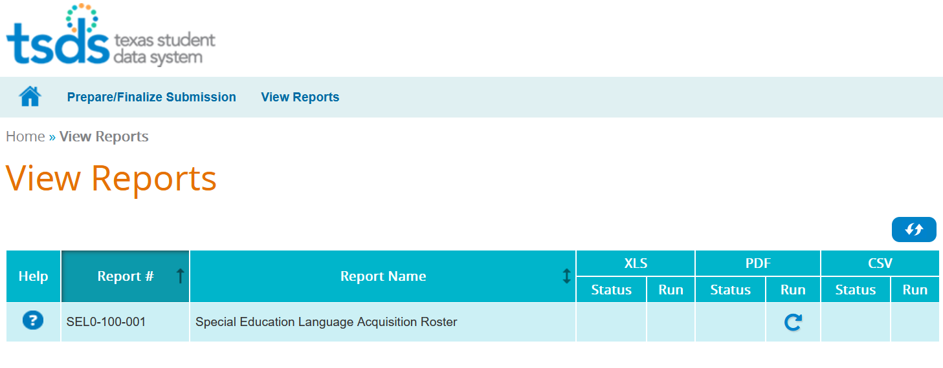
SELA REPORTS
Notes:
There is one report for the SELA submission. The report will generate a PDF document. The Help document provides more details about the report layout and report fields. It is vital that the report be run and all data on the report verified. Sometimes data on the report will reveal incorrect information that did not trigger an error message. Go back to SIS, make corrections, and go through the process again.

Slide 25
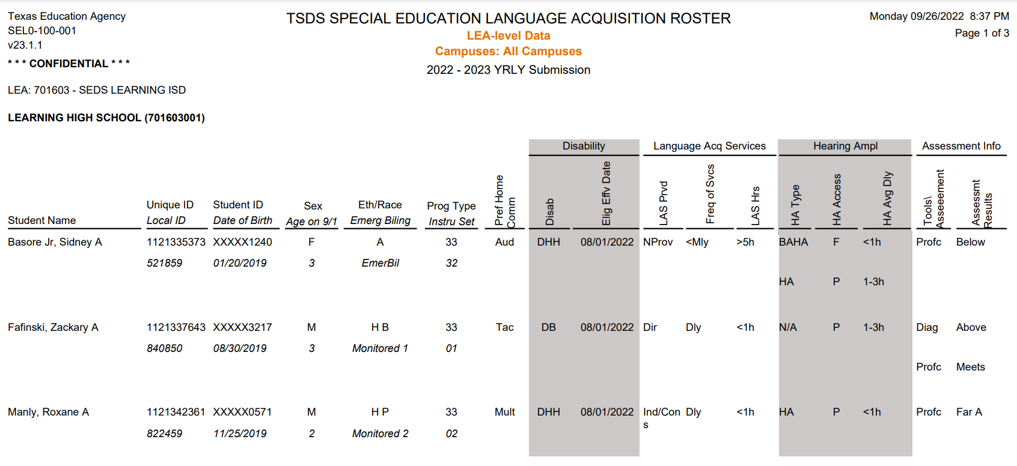
SEL0-100-001
This report shows a summary of the deaf and hard of hearing(DHH) or deaf-blind (DB) students, language acquisition services, hearing amplification devices, and assessments for each student.
LEAs should verify the report for data accuracy for all students before completing the SELA collection.

Slide 26
SEL0-100-001: BASIC INFORMATION
LEAs should verify the accuracy of the following:
Basic information for each student by campus,
Age of students must be between 0-8 years of age (as of September 1st) of the current school year school year for student to promote to SELA, and
Students that are Emergent Bilingual.

Slide 27
SEL0-100-001: DISABILITY
LEAs should verify the accuracy of the following:
Disability data submitted for each student,
Eligibility Effective Date for each student (The effective date will only be promoted for two disability codes - Deaf And Hard Of Hearing or Deafblind Instructional Setting code listed for each student, and
Preferred Home Communication method used by the child at home.

Slide 28
SEL0-100-001: LANGUAGE ACQ SERVICES
LEAs should verify the accuracy of the following:
Language Acquisition Services provided for each student,
Frequency of Services each student receives, and
Amount of time the student receives the services.

Slide 29
SEL0-100-001: HEARING AMPL
LEAs should verify the accuracy of the following:
Type of Hearing Amplification device used by the student at time of submission,
Whether the student has access to the hearing amplification device full-day or partial day, and
Average amount of time the hearing amplification device is used.

Slide 30
SEL0-100-001: ASSESSMENT INFO
LEAs should verify the accuracy of the following:
Assessment/tool used to assess the student’s language acquisition, and
Assessment result(s) for each student.

Slide 31

Training Activity
Practice, Troubleshooting, and Knowledge Checks

Slide 32
PRACTICE EXERCISE
Task 1: Promote SELA data.
Task 2: Monitor data promotions.
Ready
Set
Go

Slide 33
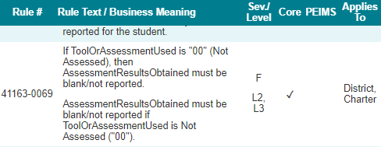
TROUBLESHOOTING 1
Scenario 1: Level 2 or Level 3 Fatal error for on 41163-0069.
Resolution Steps:
View the Validation error report in the Core application to determine the cause of error.
Use TWEDS to review the business rule and verify the data in your source system is TEDS-compliant.
Use Search Data to view the JSON record to determine what data your vendor published to your IODS.
Verify in your source system that all students who were not accessed do not have AssessmentResultsObtained data entered.
If there is an error, make corrections in your source system and republish the data to your IODS.
Submit a TIMS incident for ESC support.

Slide 34
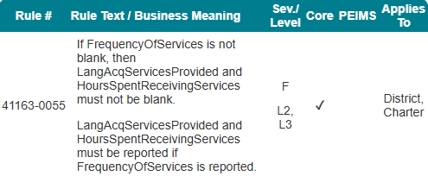
TROUBLESHOOTING 2
Scenario 2: Fatal errors after validating.
Resolution Steps:
After validating SELA data, there were several Fatals for business rule 41163-0055.
In the source system, you have 4 students whose FrequencyOfServices is not blank.
View the Validation error report in the Core application to determine the cause of error.
Use TWEDS to review the business rule and verify the data in your source system is TEDS-compliant.
Use Search Data to view the JSON record to determine what data your vendor published to your IODS.
Verify in your source system that there is data entered for LangAcqServicesProvided and HoursSpentReceivingServices.
If there is an error, make corrections in your source system and republish the data to your IODS.
Submit a TIMS incident for ESC support.

Slide 35
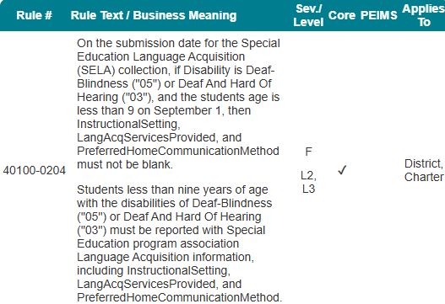
TROUBLESHOOTING 3
Scenario 3: Fatal errors after validating.
Resolution Steps:
After validating SELA data, there were two Fatals for business rule 40100-0204. After verifying the data, you noticed that two students’ birthdates indicate they are older than nine years as of September 1st.
Research to determine if there was an error with the entry of the DOB.
If there is an error with the birthday, make the correction in the source system and republish data via API.
If there was no error with birthday, students should not be reported for SELA.

Slide 36
KNOWLEDGE CHECK 1
1. SELA data will be collected through:
Core Collection
PEIMS
None of the above
Notes:
NOTE
To see the answer, you must be in presentation mode.

Slide 37
KNOWLEDGE CHECK 2
2. The purpose of the SELA data collection is to ensure that the language acquisition of children eight years of age or younger who are deaf or hard of hearing is regularly assessed using a tool or assessment.
True
False
Notes:
NOTE
To see the answer, you must be in presentation mode.

Slide 38
KNOWLEDGE CHECK 3
3. Every LEA will submit SELA data for students who are ____________.
Speech Impaired
Deafblind
Deaf or Hard of Hearing
Both B and C
Notes:
NOTE
To see the answer, you must be in presentation mode.

Slide 39
KNOWLEDGE CHECK 4
4. The communication, development, and educational needs of a student who is deafblind can be accommodated in programs solely for students with deafness or blindness.
True
False
Notes:
NOTE
To see the answer, you must be in presentation mode.

Slide 40
KNOWLEDGE CHECK 5
5. The State Deaf or Hard of Hearing (DHH) Plan is intended to be a tool to do which of the following?
Identify needs
Set priorities
Guide the development and provision services for students who are deaf or hard of hearing
All the above
Notes:
NOTE
To see the answer, you must be in presentation mode.

Slide 41

WRAP UP
Key Takeaways, Resources, and Next Steps

Slide 42

KEY TAKEAWAYS
Special Education Language Acquisition data is submitted through TSDS.
All LEAs must regularly assess, using a tool or assessment, the language acquisition of students eight years of age or younger.
LEAs are required to begin promoting and validating SELA data by the fourth Thursday in June.
LEAs will only complete the SELA Submission if they meet the criteria.
TRAINING MATERIALS
Requesting Access to TSDS Parallel Portal in TEAL
Click Sheet 1
Step-by-Step Video
Requesting TEAL Roles and Privileges for Promoting from TSDS Parallel Portal
Click Sheet 3
Step-by-Step Video
TRAINING RESOURCES
Key Terms and Definitions
Reference Guide for SELA

Slide 43
TECHNICAL RESOURCES
TEA Website and Communication Resources
Sensory Impairments
Students with Visual Impairments or Who Are Deaf Blind TEA Forms
Texas Education Data Standards Resources
TSDS Web-Enabled Data Standards (TWEDS)
Support Resources
KB Articles
TSDSKB-616 – SELA: Definition of Assessment Types
TSDSKB-612 – SELA: Frequently Asked Questions
TSDSKB-615 – SELA: Definition of Language Acquisition Services
Notes:
Note:
TWEDS
Go to the TSDS website at https://www.texasstudentdatasystem.org
Hover over the TEDS Data Standards tab.
Next, click on ‘TWEDS Upgrade’
Finally, click on the “XXXX-XXXX Texas Education Data Standards via TWEDS” hyperlink.

Slide 44
ADDITIONAL RESOURCES
Program Area Resources
State guidance resources for DHH students​
Frequently Asked Questions – HB 548​
HB 548 Langage Acquisition Assessments​
HB 548 List of Assessments​​
Scoring Rubric for HB 548 Language Acquisition

Slide 45
NEXT STEPS
Complete a Teach Back Exercise
Complete SELA Certification Test – Part 1
Complete Core Collection Certification Test – Part 2
Attend TSDS Continuing Education Trainings (CET)
Participate in TSDS Just-in-Time Trainings (JIT)
Attend Field Coordination Network (FCN) webinars for new updates and changes

Slide 46
WRAP UP
In this training we talked about:
The requirements for the Special Education Language Acquisition (SELA) Submission.
The data that comprises the SELA Submission. ​
How to promote SELA data.
The TSDS report for SELA.

Slide 47
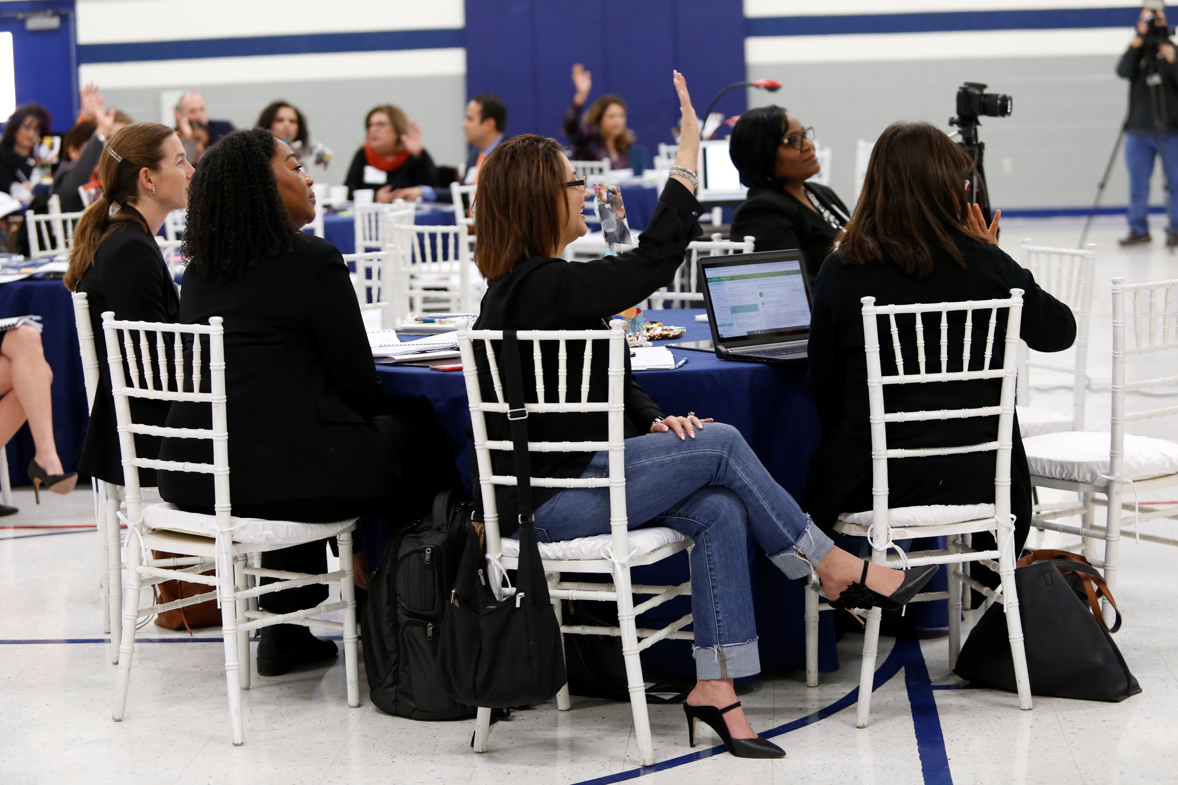
QUESTIONS
TITLE SLIDE: TSDS ODS 3.x Project
Updates

