Slide 1

Public Education Information Management System (PEIMS) PEIMS Fall
New User Certification Training
TITLE SLIDE: TSDS ODS 3.x Project
Updates

Slide 2
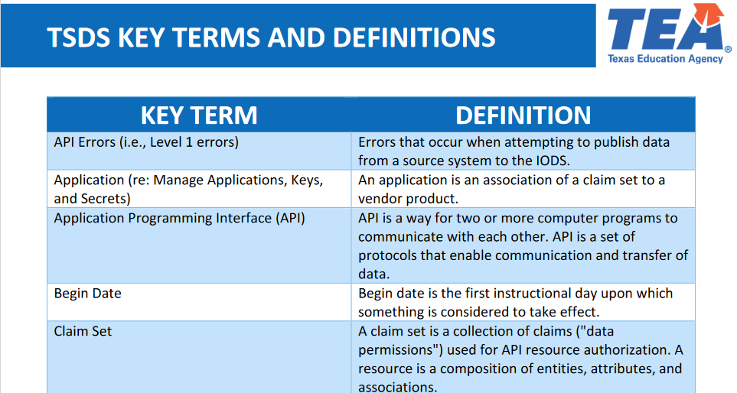
KEY TERMS
Please take a moment to familiarize yourself with common terminology by accessing the Key Terms and Definitions Document.
Access the Key Terms and Definitions Document.

Slide 3
LEARNING OBJECTIVES
By the end of this course, the users will be able to explain:
The PEIMS Fall Domains and Data Elements
How to promote and validate the PEIMS Fall Submission
How to review PEIMS Fall validations
How to run and view TSDS Reports for the PEIMS Fall Submission.
How to verify and complete the PEIMS Fall Submission

Slide 4
WHY IS THIS IMPORTANT
To understand that an LEA’s funding and accountability are impacted by accurately reporting PEIMS data.
To better understand the data that is submitted for the PEIMS Fall Submission and steps taken to validate and finalize the submission.
4

Slide 5

COURSE AGENDA
Getting Started
PEIMS Fall Demo
Key Concepts
Timeline, PEIMS Fall Data, Validations, and Reports
Training Activity
Practice, Troubleshooting, and Knowledge Checks
Wrap Up
Key Takeaways, Resources, and Next Steps

Slide 6


GETTING STARTED
PEIMS Fall Demo

Slide 7
PEIMS FALL DEMO
Login to your TEAL account.
Navigate to the PEIMS Application.
Promote PEIMS data.
Validate PEIMS data.
Generate PEIMS reports and verify the data on each report.
Prepare/Finalize the PEIMS Submission
Note: The Reference Guide (RG) is a resource that provides step-by-step instructions for Promoting, Validating, and Completing the PEIMS Submission.
PEIMS Reference Guide
Notes:
This will be a high-level overview demonstration of the processes within the Texas Student Data System where LEAs will submit your PEIMS data submission. We will then take a deep look into the requirements and data that will be submitted for the PEIMS submission.

Slide 8


KEY CONCEPTS
PEIMS Fall Data, Validations, and Reports

Slide 9
PEIMS SUBMISSION TIMELINES
Submission | Date Due to TEA*
PEIMS Fall Snapshot | Late October
PEIMS Fall Submission | Early December
PEIMS Fall Resubmission | Mid-January
PEIMS Mid-Year Submission | Late January
PEIMS Mid-Year Resubmission | Mid-February
PEIMS Summer Submission | Mid-June
PEIMS Summer Resubmission | Mid-July
PEIMS Extended Year Submission | Late August
PEIMS Extended Year Resubmission | Mid-September
*These are reference dates, please see the actual due dates in TWEDS.
LEAs registered with TEA with year-round tracks ending later than the third Thursday in June may delay Summer resubmission until two weeks following completion of the latest year-round track or the second Thursday in August, whichever comes first. However, the initial data delivery for the PEIMS Summer Submission must still be made by the third Thursday in June for all LEAs.
Coming Soon:
Beginning this year (2025-2026) we are adding a new PEIMS Attendance Submission where LEAs will report the first 5 six-weeks reporting periods. Reporting period six and the initial five will be submitted in the PEIMS Summer Submission.
Coming for 2026-2027 a new PEIMS submission will be added – PEIMS Fall Enrollment.
Notes:
Coming Soon: As mandated by the 98th legislature, all LEAs will report attendance each six weeks with the final attendance data still being submitted on the PEIMS Summer Submission. For 2025-26 the PEIMS Attendance Submissions will be due on January 30, 2026, for 1st-3rd six weeks, March 20, 2026, for 4th six weeks, May 18, 2026, for 5th six weeks, with 1st - 6th six weeks attendance submitted on PEIMS Summer. Beginning in the 2026-27 school year the submissions will be submitted each six weeks.
PEIMS Fall Enrollment Submission - TEA will collect a “snapshot” of what is occurring at the LEA on the first Friday in October. This submission will consist of (1) all students enrolled on the first Friday in October with their SPED determination and (2) students in grades 7-12 enrolled at any point during the school start window (BOY through the last Friday in September). Continuers information will use data reported in PY PEIMS Summer. New submission will be due the third Thursday in October. PEIMS Fall will only include students enrolled, staff, employed, and budget data as of the last Friday in October and will be due the second Thursday in December.

Slide 10
PEIMS FALL DOMAINS 1
Alternative & Supplemental Services Domain:
This domain provides program information such as Title I, Special Education, and Emergent Bilingual.
Education Organization Domain:
This domain provides information about any public, charter, education service center, organization or agency.
Enrollment Domain:
This domain provides the enrollment and withdrawal information for a student and the relationship between a particular education organization.

Slide 11
PEIMS FALL DOMAINS 2
Finance Domain:
This domain provides the budgeted financial information.
Prior Year Leaver Domain:
This domain represents student leavers in grades 7-12 during the prior school year and the student contact information for the State Performance Plan Indicator 14 (SPPI-14) collection. (Note: This domain will no longer be reported after the 2025-2026 Fall PEIMS Submission and the information for SPPI-14 will be collected differently.)
Staff Domain:
This Staff domain provides the general staff information for a local education agency.

Slide 12
PEIMS FALL DOMAINS 3
Student Academic Record Domain:
This domain provides the cumulative record of academic achievement for a student and the final record of a student's performance in their course at the end of a semester or school year.
Student Identification and Demographics Domain:
This domain provides the characteristics and demographics of a student, and the education organization associated with the student.

Slide 13
PEIMS FALL DOMAINS 4
Teaching and Learning Domain:
This domain provides course information, including the students assigned to a course offered on a particular campus and the staff member who provides instruction for the course.

Slide 14
PROMOTION LOGIC RESOURCES
Promotion logic documentation provides details that explain how the data is promoted for each of the annual PEIMS submissions.
These resources are available through the Texas Student Data System (TSDS) website on the PEIMS Data Collection Documentation page.

Slide 15
FALL PROMOTION 1
Categories
Education Organization
Finance
Staff
Sub-Categories
Education Service Center,
Local Education Agency,
Campus,
SSA Org Association
Budget
Staff Basic,
Payroll,
Contracted Instructional Staff,
Employment Payroll Summary,
Staff Responsibility for Non-instructional and Instructional staff.
PEIMS Data Collection Documentation
Notes:
Speaker Note:​
Categories and Sub-Categories that will be promoted for PEIMS Fall

Slide 16
FALL PROMOTION 2
Categories
Student
Sub-Categories
Student Basic Information,
Enrollment (School Association),
Enrollment (Program),
Special Education Program,
Title 1, Part A Program,
School Leaver, and
School Graduation Program
PEIMS Data Collection Documentation
Notes:
Speaker Note:​
Categories and Sub-Categories that will be promoted for PEIMS Fall

Slide 17
PEIMS VALIDATIONS

Slide 18
LEVELS OF VALIDATIONS
LEVEL 1
(Vendor Source System)
Includes basic data integrity checks that occur during the process of loading data via API transactions into the Individual Operational Data Store (IODS) in the Landing Zone. Data that fails Level 1 validations does not enter the IODS.
LEVEL 1.5
(DMC: DMC Data Monitor)
Includes filters that prevent invalid or non-TSDS data from being loaded into TSDS. These filters include Unique ID checks, descriptor value checks, Do Not Report flag checks, and Course ID checks.
LEVEL 3
(PEIMS/Core: Existing TEAL Roles)
Business rules that are executed in TSDS. Level 3 validations contain all Level 2 validations, plus any additional validations required for the TSDS submissions. Fatal errors prevent TSDS submissions from being completed or finalized.
LEVEL 2
(DMC: DMC L2 Validations)
Business rules that are executed on the data destined for TSDS. Fatal, Special Warning, and Warning validation errors do not prevent data from being loaded to TSDS.
Prevents data from loading to IODS
Prevents data from loading to TSDS.
Does not prevent data from loading to TSDS.
Fatals prevent from completing submission
Notes:
L 1.5
The data being filtered out does not indicate that the data is right or wrong.
The LEA can move local data into their IODS that is not appropriate to move to TSDS.
The IODS is the LEA’s own separate operational data store that houses all the data it loads to the IODS in the Landing Zone for TSDS data and/or local use data.
The LEA will need to check all of their results that are generated by Level 1.5 filters and either verify the data should not move to TSDS or correct the data so that it can move to TSDS.

Slide 19
PEIMS VALIDATIONS
As part of checking your data validations, check with your DMC Technical Steward to make sure that none of your PEIMS data is appearing in L1.5 filters.
Additionally, check your staff and student Unaffiliated Reports.

Slide 20
PEIMS FALL VALIDATIONS
Tools to assist with resolving PEIMS Fall Validations:
Use Search Data in the DMC to verify what data was published to the IODS and view the JSON.
Use Data Search in the PDM to verify the PEIMS Fall data that was promoted to TSDS.
Promotion Logic
PEIMS Fall Promotion Logic
TWEDS
Domain Dependencies
PEIMS Fall Domain Dependency (TSDSKB-660)

Slide 21
PEIMS FALL VALIDATIONS
PEIMS includes business validations such as:
Level 1.5 Example:
30040-0038 StaffUniqueId must match an entry in the TSDS Unique ID system.
Level 2 Example:
10020-0001 Campus data must be provided for each campus registered with the TEA with campus status of active or under construction.
Level 3 Example:
40100-0078 A student’s September 1 age should not be greater than 25.
Note: Most PEIMS Fall Validations will fire at Level 2 and again at Level 3.
Review the Texas Education Data Standards (TEDS) via the TSDS Web-Enabled Data Standards (TWEDS) for all business validations for PEIMS.

Slide 22
TSDS PEIMS FALL REPORTS

Slide 23
VERIFYING PEIMS REPORTS
LEAs must verify the data on all reports. Report verification should be a team effort.
All Special Program staff should review the reports for their program.
Special Education Staff, GT Coordinator, ESL/BIL Program Staff, Homeless Liaison, Migrant Coordinator, Title 1 Director, etc.
Business Office/Human Resources should verify reports with staff and budget/actual data.
Campus Principals/Assistant Principals should review all campus level reports.
Attendance, Enrollment, Special Programs, Staff, Calendar, Discipline, Master Schedule, etc.
Campus Counselors should verify appropriate reports.
Pregnancy Related Services reports, Discipline, Course Completion & Dual Credit, Graduate data, Dropout and Leaver reports, etc.
Begin verification early to allow time for each team member to review and approve the data on the reports.
Review all reports for accuracy and completeness.
Failure to review the reports carefully could affect the LEA’s funding and/or accountability rating!
Notes:
Verification – Team effort. Funding and accountability ratings.
Economically disadvantaged is one that is seen most often as not being verified carefully.

Slide 24
PEIMS FALL REPORTS
The TSDS PEIMS Fall Reports are divided into the following categories:
Fall Standard Reports
Fall Special Reports
Fall Student Leaver Reports
Fall Statewide Reports
Fall Region-Wide Detail Reports (ESC Only)
Fall Region-Wide Aggregate Reports (ESC Only)
Fall UID Discrepancy Reports
Notes:
TEA envisions this submission as a 2-part process with responsibilities shared between the DMC Technical Steward and the LEA Special Program Staff.

Slide 25
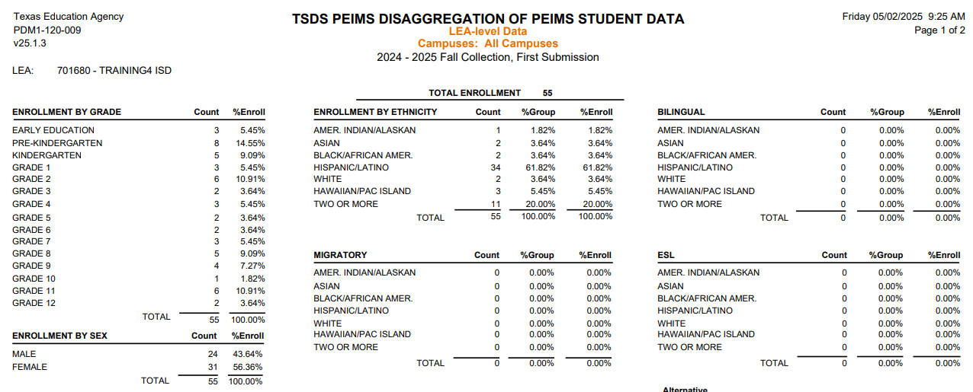
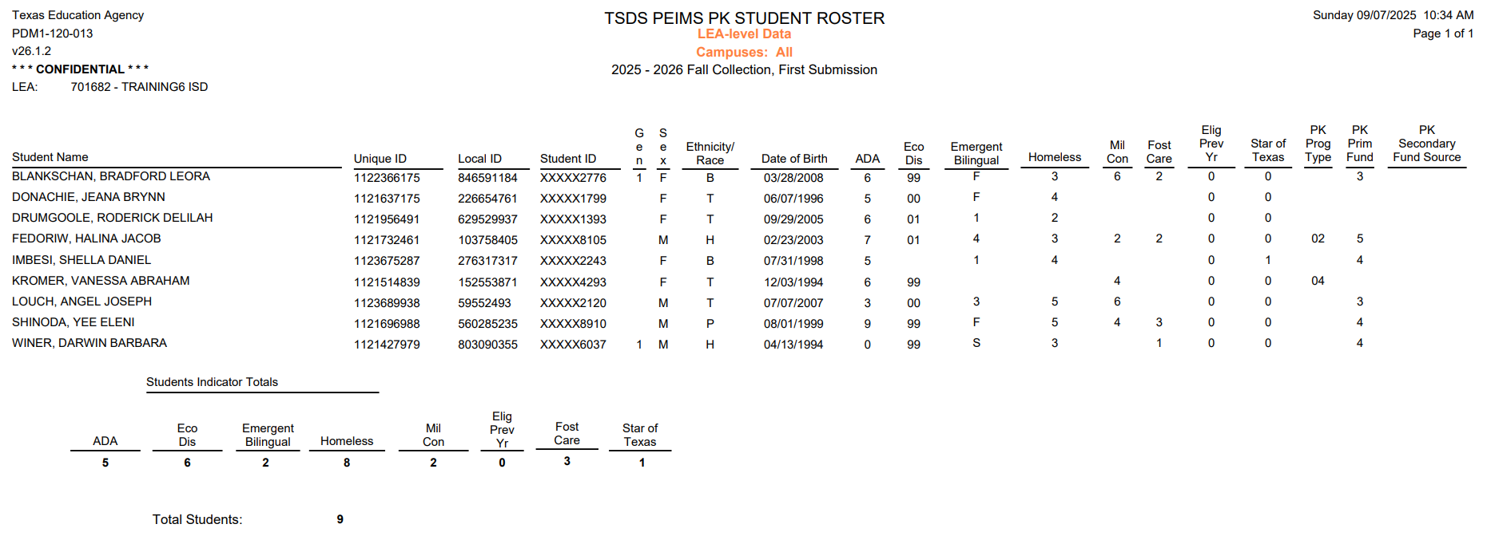
PEIMS FALL STANDARD REPORTS 1
Standard Student Report - PDM1-120-009
Standard Student Report - PDM1-120-013
Notes:
PDM1-120-009 - Disaggregation of PEIMS Student Data is a great summary showing the counts and percentages for the special programs. This report only includes students with an as-of status code of B, D, F, or X. It is a great report for administrators to begin their verification of the data.
The roster reports provide a list of students in many of the special programs for a more detailed verification of the data.
PDM1-120-013 – PK Student Roster provides a list of the PK students showing basic demographic information along with the PK funding source(s).

Slide 26
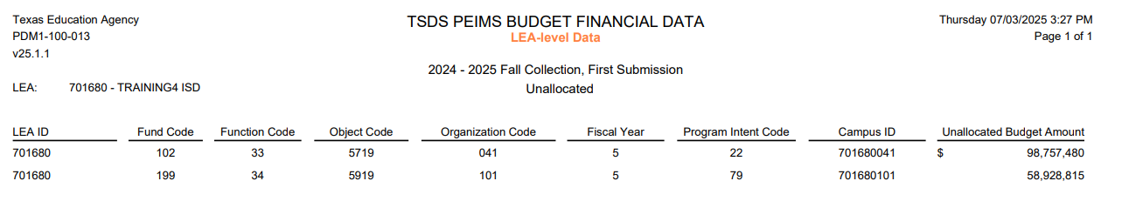
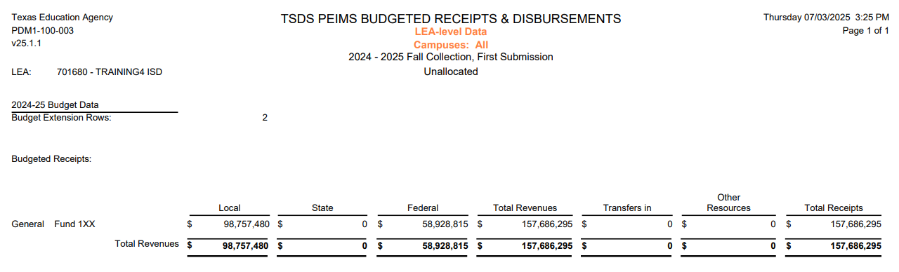
PEIMS FALL STANDARD REPORTS 2
Standard Budget Report - PDM1-100-013
Standard Budget Report - PDM1-100-003
Notes:
Many of the reports have settings that will allow the LEA to generate the reports in different ways – for the entire LEA, by campus, by specific special programs, etc. These budget reports should be generated for the LEA and reviewed by the CFO and the campus level reports should be reviewed by the campus principals.
PDM1-100-013 – Budget Financial Data – For each program intent code, it shows the budget amount, fund code, function code, and object code for each campus.
PDM1-100-003 – Budgeted Receipts and Disbursements – This report lists budget receipts and disbursements grouped by fund and broken down by object and function. The first section displays the budgeted financial receipts. Receipts include local, state, and federal revenues, transfers in, and Other Resources. The second section displays budgeted financial disbursements for objects 6XXX (payroll costs, supplies, operating costs, debt service, capital outlay) and 8XXX (transfers out and other uses).

Slide 27
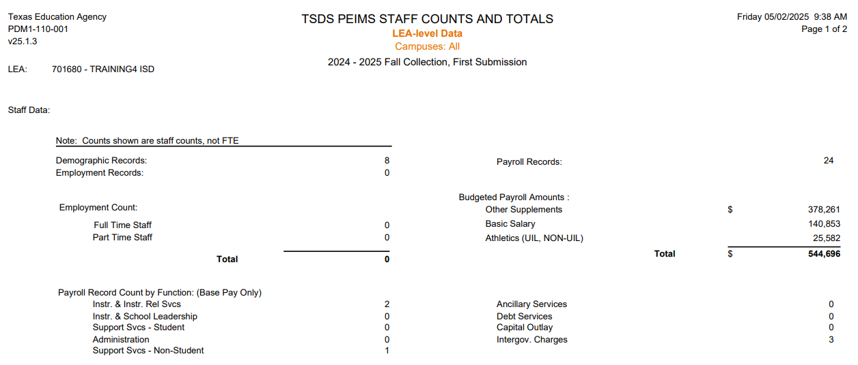
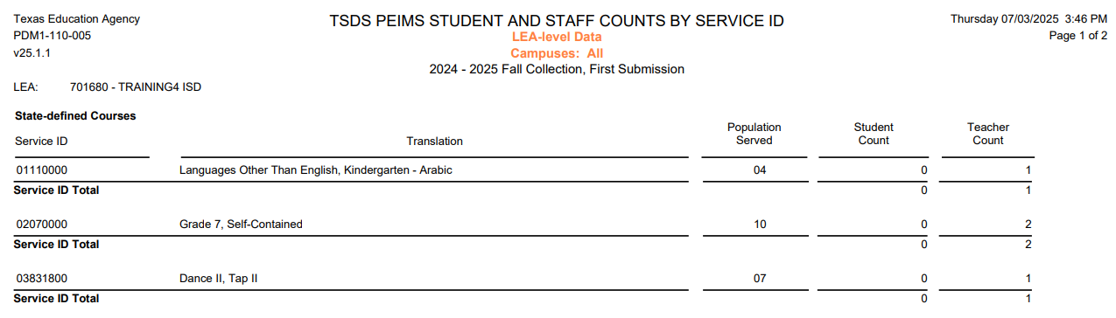
PEIMS FALL STANDARD REPORTS 3
Standard Staff Report - PDM1-110-001
Standard Staff Report - PDM1-110-005
Notes:
PDM1-110-001 – Staff Counts and Totals – This report summarizes staff counts by employment data, payroll data, and services performed. It summarizes staff counts only, not FTEs. The first part summarizes staff counts and budgeted payroll amounts. The second part summarizes payroll record counts by function and staff classification counts.
PDM1-110-005 – Student and Staff Counts by Course Code – This report summarizes the student and staff counts for each course code reported on staff responsibility records. Counts are based on the number of students in class and the count of all staff for each course code and population served. Counts only include staff classification 087.

Slide 28
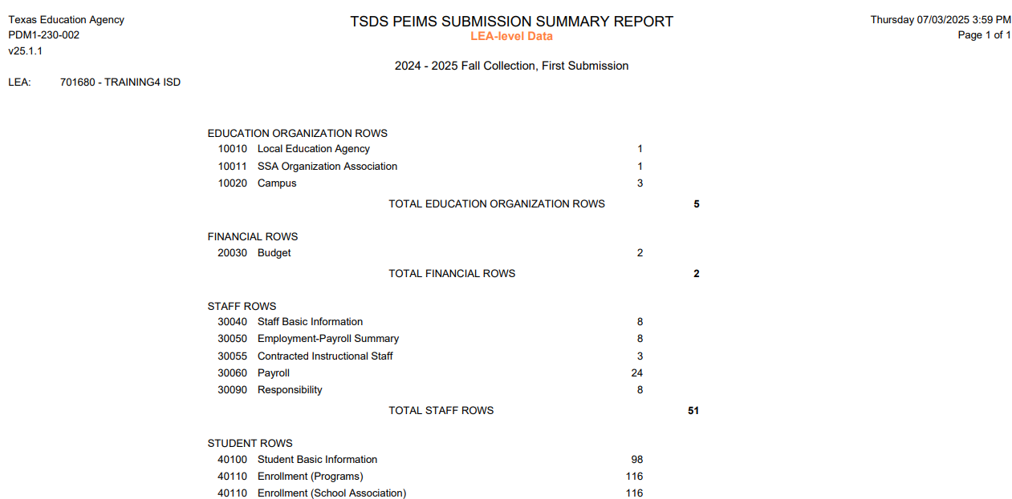
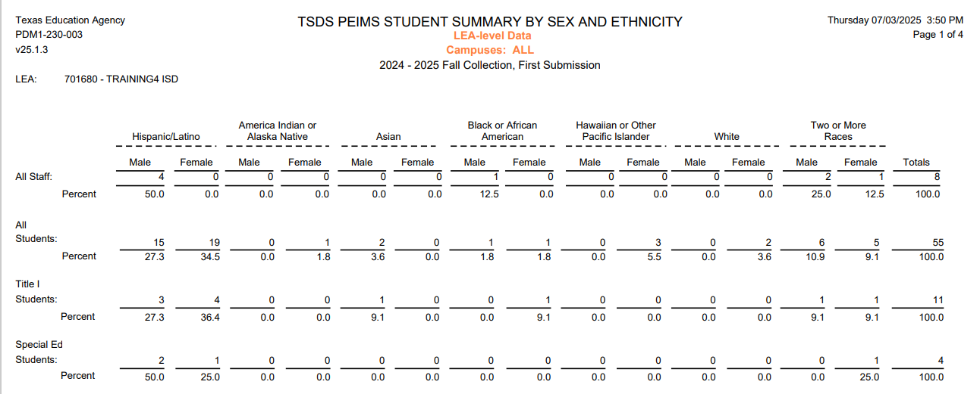
PEIMS FALL SPECIAL REPORTS
Special Submission Summary - PDM1-230-002
Special Student Summary - PDM1-230-003
Notes:
PDM1-230-002 – Data Element Summary Report – This report summarizes all data contained in the promoted PEIMS data. It provides an analysis of data contained within the PEIMS Fall submission, including data elements, descriptor tables, subcategories, and record counts.
PDM1-230-003 – Student Summary by Sex and Ethnicity – This report summarizes information about student populations (Title 1, SPED, GT, Emergent Bilingual, ESL, Migratory, Eco Dis, At Risk, Immigrant, Homeless, ADA eligibility, and graduates with grad type. It shows the breakdown of staff and students by sex and ethnicity. Only students enrolled with as-of status codes of B, D, F, or X are included.

Slide 29
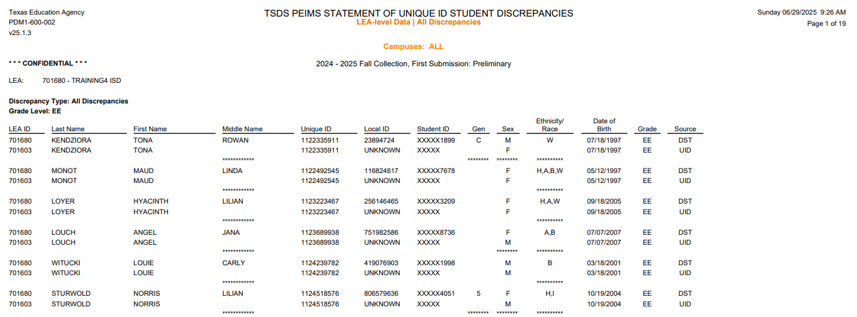
UID DISCREPANCIES REPORTS
UID Student Discrepancies - PDM1-600-002
Notes:
PDM1-600-002 – Statement of Unique ID Student Discrepancies – This report identifies discrepancies between the TSDS Unique ID demographic data and student demographic information reported through PEIMS. There are several parameter selections users can choose when generating this report. The report can be run for enrolled students, for dropout/leaver students, graduates, major or minor discrepancies, etc. Or the report can run for all discrepancies. At the bottom of the report it will show total discrepancies by grade, by campus, and for the LEA. The report can be run by campus or for the entire LEA.

Slide 30
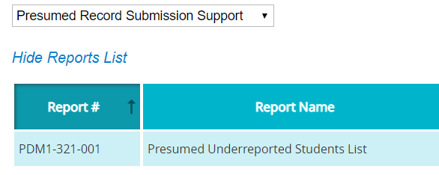
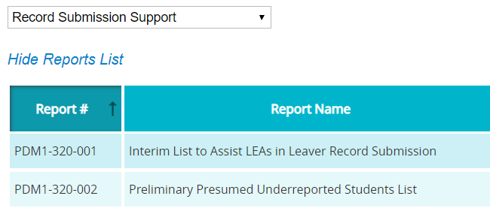
STUDENT LEAVER REPORTS
Presumed Record Submission Support Group
The Presumed Underreported Student List report is only available after the PEIMS Fall First Submission is closed and TEA has performed the leaver calculations. The report only displays finalized submission data.
Record Submission Support Group
The Interim List to Assist LEAs in Leaver Record Submission report can be run at any time.
The Preliminary Presumed Underreported Students List report can be run at any time.
2
1
Hint: PDM1-320-001 & 002 reports will be generated BEFORE the PDM1-321-001
Notes:
The Fall Student Leaver report groups are individual LEA reports that help LEAs identify students for whom a school leaver record may need to be submitted.
1. The Presumed Underreported Students List report is only available after the submission is closed and TEA has performed the leaver calculations. This report only displays finalized submission data. This report lists students who attended or were enrolled in grades 7-12 during the previous school year. Individual LEA reports help identify students for whom a leaver record may be needed. This report is very similar to the PDM1-320-002 report, but this report is a state-wide report. If at least one of the indicators is not listed, the student is not presumed underreported at the time the report is generated. An asterisk to the left of the Student ID indicates that the student is presumed underreported.
2. The Record Submission Support group of Fall Leaver Reports has two reports.
a. The Interim List to Assist LEAs in Leaver Record Submission report can be run at any time to help LEAs identify students who attended or were enrolled in grades 7-12 during the previous school year and for whom a leaver record may be needed. This report lists students who attended or were enrolled in grades 7012 during the prior school year. The report flags students as School Year Mover, prior Texas Graduate, or a Texas GED Recipient. Students with these flags do not need a leaver record.
b. The Preliminary Presumed Underreported Student List report lists students who attended or were enrolled in grades 7-12 during the previous school year. This report can also be run at anytime. This report lists students who attended or were enrolled in grades 7-12 during the prior school year. Students on this list can be flagged as Presumed Summertime Mover, Presumed Returned Student, a Presumed Leaver, a School year Mover, a Prior Texas Graduate, or a Texas GED Recipient. (The three underlined indicators are also on the PDM1-320-001 report.) If at least one of these indicators is not listed, the student is not presumed underreported at the time the report is generated. An asterisk to the left of the Student ID indicates that the student is presumed underreported.

Slide 31
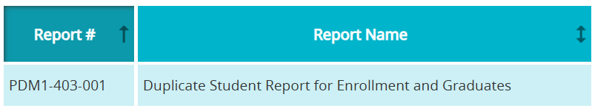
PEIMS FALL STATE-WIDE REPORT
Duplicate Student Report for Enrollment and Graduates
This report is only available after the PEIMS Fall First Submission and/or Resubmission is closed and TEA has performed the data aggregation from across the state.
This report lists all students who have been submitted on an enrollment or graduate record by more than one LEA in the state.
Notes:
PDM1-403-003 lists all students who have been submitted on an enrollment or graduate record by more than one LEA in the state. This report relies on state-wide data and is only available after the fall submission or resubmission closes.
The LEA can choose to run the report with an Enrollment parameter. On this report students listed will have an As of Status code of B, D, F, or X with an enrollment record from a Texas LEA. This report might help identify students who left the LEA but who do not have a withdrawal.
The LEA can choose to run the report with the Graduate parameter selected. This report lists students with an As of Status code of A, D, or E who have been reported as a graduate by a Texas LEA.

Slide 32
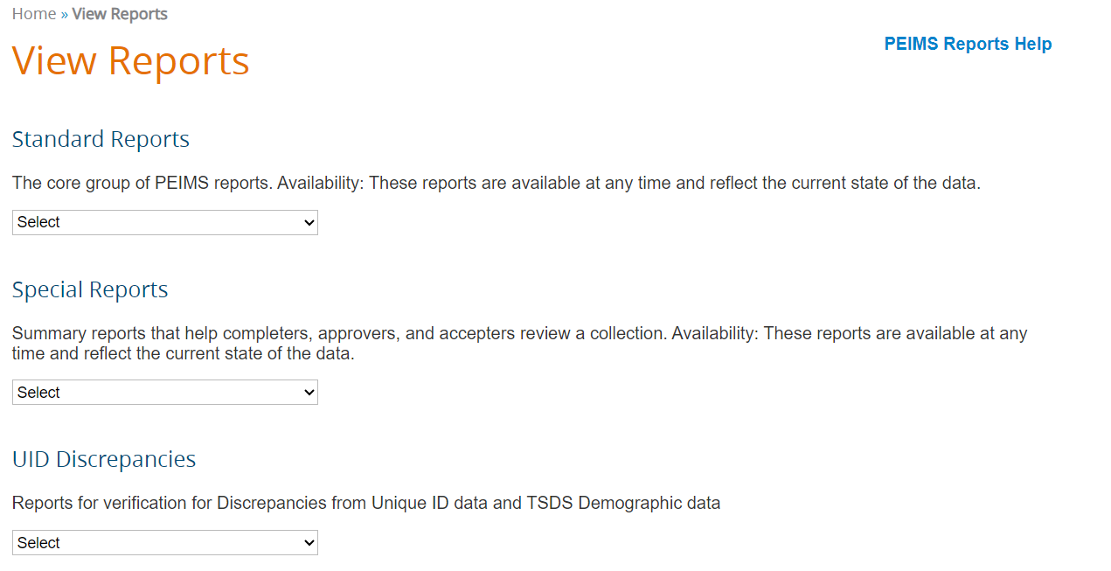
PEIMS REPORTS HELP
PEIMS Reports Help is available on the View Reports landing page and contains detailed information concerning the content of the report.
The help documentation is PEIMS submission specific. For example, if you click on the PEIMS Reports Help on the PEIMS Fall reports page you will only see the PEIMS Fall Reports listed.

Slide 33
PEIMS FALL APPROVER
TEA requires the PEIMS Data Approver to review the ‘PDM1-231-002 Percentage of Change from Prior Year: Student Demographics, Characteristics, and Programs’ report before approving the PEIMS Fall Submission.
PDM1-231-002
Includes 2 Sections:
Summary of student status.
Program section which provides information about the programs selected.
When the PEIMS Completer clicks ‘Complete’, the email on the next slide will be sent to the PEIMS Data Approver.
This report is available for the PEIMS Coordinator to use outside the Approval process.

Slide 34
PDM1-231-002
Student Section
Programs Section
Notes:
Many of the reports have settings that will allow the LEA to generate the reports in different ways – for the entire LEA, by campus, by specific special programs, etc. These budget reports should be generated for the LEA and reviewed by the CFO and the campus level reports should be reviewed by the campus principals.
PDM1-100-013 – Budget Financial Data – For each program intent code, it shows the budget amount, fund code, function code, and object code for each campus.
PDM1-100-003 – Budgeted Receipts and Disbursements – This report lists budget receipts and disbursements grouped by fund and broken down by object and function. The first section displays the budgeted financial receipts. Receipts include local, state, and federal revenues, transfers in, and Other Resources. The second section displays budgeted financial disbursements for objects 6XXX (payroll costs, supplies, operating costs, debt service, capital outlay) and 8XXX (transfers out and other uses).

Slide 35
PEIMS FALL NOTIFICATION
The PEIMS Data Approver can download report ‘PDM1-231-002’ by clicking on the link in the email.
Email Notification Text
SUBJECT: Learning ISD; PEIMS Fall Submission Data: COMPLETE
ATTACHMENTS:
PDM1-231-002: Percentage of Change from Previous Year
BODY:
Dear Dr. Superintendent
The District PEIMS Coordinator has marked the Learning ISD PEIMS Fall Submission as "COMPLETE."
The submission will now go to the Superintendent for approval and the ESC for acceptance. The submission is now locked and cannot be changed, unless the ESC rejects the collection.
The following report(s) have been automatically generated for your organization and attached to this email. The Superintendent is required to review the attached report and verify its contents before approving the PEIMS Summer Submission as “COMPLETE”:
PDM1-231-002: Percentage of Change from Previous Year
This notification was sent to the following roles: Data Approver
Regards,
The TSDS PEIMS System
REMINDER: If you need TSDS PEIMS customer support, create an incident in the TIMS system using the Support link in the PEIMS header.

Slide 36
PEIMS DATA APPROVER PROCESS
The PEIMS Data Approver should review report PDM1-231-002.
Click on the link in the email received after the submission is completed, or
Log into the PEIMS Application, go to the ‘Prepare/Finalize’ tab, click ‘Approve’, and download and review the report.
After the report has been downloaded and reviewed, the PEIMS Data Approver will click ‘Confirm’ to confirm that he/she has reviewed the report or ‘Cancel’ to go back and make corrections.
After clicking ‘Confirm’ the PEIMS Fall Submission is ready for the ESC to Accept, and the Statement of Approval (SOA) can be viewed.

Slide 37

TRAINING ACTIVITY
Practice, Troubleshooting, and Knowledge Checks

Slide 38
PRACTICE EXERCISE
Task 1: Promote and Validate PEIMS Fall data.
Task 2: Verify data on Reports.
Ready
Set
Go

Slide 39
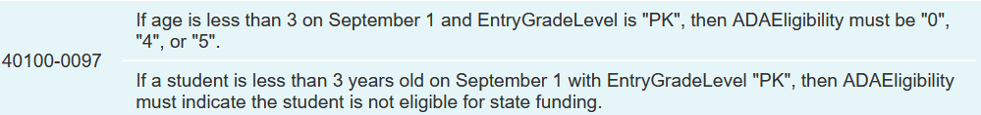
TROUBLESHOOTING 1
Scenario 1: Johnny is enrolled at the LEA and is in PK. Johnny qualified for PK since his family’s income indicates he qualifies for the free-lunch program.
Resolution Steps:
Verify Johnny’s date of birth and age as indicated on his birth certificate.
If Johnny is less than 3 years of age on September 1, then he is ineligible for funding in PK. Change his ADA eligibility to 0, 4, or 5 in the SIS.
If Johnny was 3 on September 1, update his date of birth in the SIS .
Verify that the updated coding is published to the IODs.
Check to see that the Level 2 error has cleared. Promote and validate the student data again and check the validation errors in the PEIMS application.
After a review of the students’ coding the LEA determines that the students were not coded in the local SIS with the Associate Degree Indicator until after the PEIMS Fall First Submission was finalized and accepted by TEA.
Since the due date for the PEIMS Fall First Submission has passed, the LEA will need to utilize the PEIMS Fall Resubmission window to capture and report all 150 students with an Associate Degree indicator.
All reports and data should be once again inspected for reasonableness to ensure that all the previously reported data and this correction is contained in the new PEIMS Fall Resubmission file.
Why is the LEA receiving fatal error 40100-0097?

Slide 40
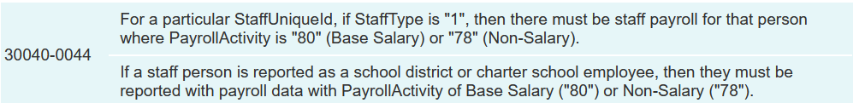
TROUBLESHOOTING 2
Scenario 2: Mr. Trumpet is the band teacher at the LEA. The LEA is reporting his salary with Payroll Activity Code of 05-Band or Orchestra.
Resolution Steps:
Verify that Mr. Trumpet’s Staff Type code is 1-School District or Charter School Employee.
Mr. Trumpet’s regular base salary should be reported with Payroll Activity Code 80.
Payroll Activity Code 05 should be used to report supplemental pay Mr. Trumpet receives for extra duties.
Update the coding in the HR software system and ensure that the updated coding is published to the IODs.
Verify that the Level 2 error has cleared. Promote and validate the staff data again and check the validation errors in the PEIMS application.
After a review of the students’ coding the LEA determines that the students were not coded in the local SIS with the Associate Degree Indicator until after the PEIMS Fall First Submission was finalized and accepted by TEA.
Since the due date for the PEIMS Fall First Submission has passed, the LEA will need to utilize the PEIMS Fall Resubmission window to capture and report all 150 students with an Associate Degree indicator.
All reports and data should be once again inspected for reasonableness to ensure that all the previously reported data and this correction is contained in the new PEIMS Fall Resubmission file.
Why is the LEA receiving fatal error 30040-0044?

Slide 41
TROUBLESHOOTING 3
Scenario 3: Marco is listed on PDM1-124-002-Dropout Roster report as a dropout for Learning High School.
Resolution Steps:
The registrar and counselor at LHS should review Marco’s entries and withdraws.
Marco withdrew on March 5th to get a job. The registrar withdrew Marco with a withdrawal code of 98.
On May 1st, Marco returned to school. He worked out a plan with the counselor to catch up on the classroom work he missed.
Marco completed all the graduation requirements and graduated on May 28th. However, no one let the registrar know that Marco returned and did not enter a new entry on May 1st. Marco did not have a withdrawal code of 01 on May 28th in the SIS.
The LEA should make the updates in the SIS, promote, validate and then verify that Marco is no longer listed on the PDM1-124-002 report and is on the graduate reports.
A review of TEDS reveals that the CTE code is a calculated value that occurs after the PEIMS Summer First Submission and PEIMS Summer Resubmission. TEDS provides an overview of the CTE indicator calculation process.
After a review of the students coding, the LEA determines that the students have a course sequence code of 1.
TEDS states that course sequence codes 0,2,5 and 9 are the only codes used to calculate the CTE value that populates these reports.
By changing the course sequence codes in the PEIMS Summer Resubmission these students will be included in the CTE indicator calculation process.
All reports and data should be once again inspected for reasonableness to ensure that all the previously reported data and this correction is contained in the new PEIMS Summer Resubmission file.
LEA Verifies:
The principal and counselor at Learning High School were asked to verify the information on this report.
Both are reporting that Marco graduated from LHS on May 28.
Why is Marco listed on this report as a dropout?

Slide 42
KNOWLEDGE CHECK 1
1. A PEIMS submission with Fatal Errors can be marked complete by the PEIMS Data Completer.
True
False
Notes:
NOTE
To see the answer, you must be in presentation mode.

Slide 43
KNOWLEDGE CHECK 2
2. Starting a data Promotion to the PDM is a manual process.
True
False
Notes:
NOTE
To see the answer, you must be in presentation mode.

Slide 44
KNOWLEDGE CHECK 3
3. PEIMS data affects the LEA’s funding and accountability rating.
True
False
Notes:
NOTE
To see the answer, you must be in presentation mode.

Slide 45
KNOWLEDGE CHECK 4
4. The LEA’s PEIMS Coordinator is the only one who should review and verify the data on the TSDS PEIMS Fall reports.
True
False
Note: Campus Principals, Assistant Principals, HR and Finance staff, Special Education staff, GT Coordinator, Emergent Bilingual Coordinator, Title 1 Coordinator, and other special program staff, along with the Superintendent at the LEA should review and verify the data on the reports for their campus/program.
Notes:
NOTE
To see the answer, you must be in presentation mode.

Slide 46
KNOWLEDGE CHECK 5
5. All students who are enrolled by December 1 will be reported on the PEIMS Fall Submission.
True
False
Note: Only students enrolled on the Fall Snapshot Date will be reported on the PEIMS Fall Submission. The Snapshot Date is a "picture" of what is happening at the LEA on the last Friday in October. This includes student data, staff data, and budget data as it is on the last Friday in October.
Notes:
NOTE
To see the answer, you must be in presentation mode.

Slide 47
KNOWLEDGE CHECK 6
6. Which of these Leaver Reports can only be run after the PEIMS Fall Submission/Resubmission closes and TEA has performed leaver calculations?
PDM1-320-001 – Interim List to Assist LEAs in Leaver Record Submission
PDM1-320-002 – Preliminary Presumed Underreported Students List
PDM1-321-001 – Presumed Underreported Students List
None of the above.
Note: PDM1-320-001 and PDM1-320-002 can be generated at any time after the LEA has promoted PEIMS Fall data to assist with their leaver record validations.
PDM1-321-001 can only be generated after the PEIMS Fall Submission closes and TEA has performed leaver calculations using data from across the entire state. This report can help identify students for whom a leaver record may be needed on a PEIMS Fall Resubmission.
Notes:
NOTE
To see the answer, you must be in presentation mode.

Slide 48

WRAP UP
Key Takeaways, Resources, and Next Steps

Slide 49

KEY TAKEAWAYS
PEIMS data is submitted through TSDS.
PEIMS Fall Submission data is a snapshot of the LEA/ESC on the last Friday in October.
The collection of PEIMS data is required of all Local Education Agencies (LEAs) by Texas Education Code §48.008.
Viewing Level 2 Validations in the DMC will allow users to begin correcting errors prior to promoting their data in the PEIMS application.
The PEIMS Data Approver must review PDM1-231-002 prior to approving the PEIMS Fall submission.
TRAINING RESOURCES
Key Terms and Definitions
PEIMS Reference Guide
SOA Resource Document
Financial Accountability System Resource Guide

Slide 50
TECHNICAL RESOURCES
Training Resources
PEIMS Reference Guide
SOA Resource Document
TEA Website and Communication Resources
Student Attendance Accounting Handbook(SAAH)
Link to Key Terms Document
Texas Education Data Standards Resources
TSDS Web-Enabled Data Standards (TWEDS)
Support Resources
KB Articles
TSDSKB-375 - PEIMS- Submission Process Chart
TSDSKB-600 – TSDS Known Issues List
TSDSKB 606 - TEAL Roles for TSDS Collections

Slide 51
NEXT STEPS
Ensure that you attend Overview and Key Concepts, TEDS Overview, DMC Level 1.5, DMC Level 2 Validations, DMC Descriptor Mapping, and TEAL Roles trainings.
Complete a Teach Back Exercise.
Complete PEIMS Fall Certification Test.
Attend PEIMS Mid-Year, PEIMS Summer, and PEIMS Extended Year trainings.
Attend TSDS Continuing Education Trainings (CET).
Participate in TSDS Just-in-Time Trainings (JIT).
Attend Field Coordination Network (FCN) webinars for updates and changes.

Slide 52
WRAP UP
In this training we talked about:
The PEIMS Objectives and Purpose
TEAL Roles for PEIMS
The PEIMS Fall Domains and Data Elements
How to promote and validate the PEIMS Fall Submission
How to review PEIMS Fall validations
How to run and view TSDS Reports for the PEIMS Fall Submission.
How to verify and complete the PEIMS Fall Submission

Slide 53

QUESTIONS

