Slide 1

Public Education Information Management System (PEIMS) Introduction to PEIMS
New User Certification Training
TITLE SLIDE: TSDS ODS 3.x Project
Updates

Slide 2
LEARNING OBJECTIVES
By the end of this course, the users will be able to explain:
The TSDS High-level Architecture
TEAL Roles for PEIMS
PEIMS Overview
The Levels of Validations

Slide 3
WHY IS THIS IMPORTANT
To understand that an LEA’s funding and accountability are impacted by accurately reporting PEIMS data.
To recognize that aggregated data from PEIMS is used in statewide longitudinal data reporting to track student performance over their educational lifetime in Texas as well as the LEA's performance from year to year.
3

Slide 4

COURSE AGENDA
Getting Started
TSDS Architecture and TEAL Roles
Key Concepts
PEIMS Overview, Timelines, and Validations
Training Activity
PEIMS Knowledge Checks
Wrap Up
Key Takeaways, Resources, and Next Steps

Slide 5


GETTING STARTED
TSDS Architecture and TEAL Roles

Slide 6
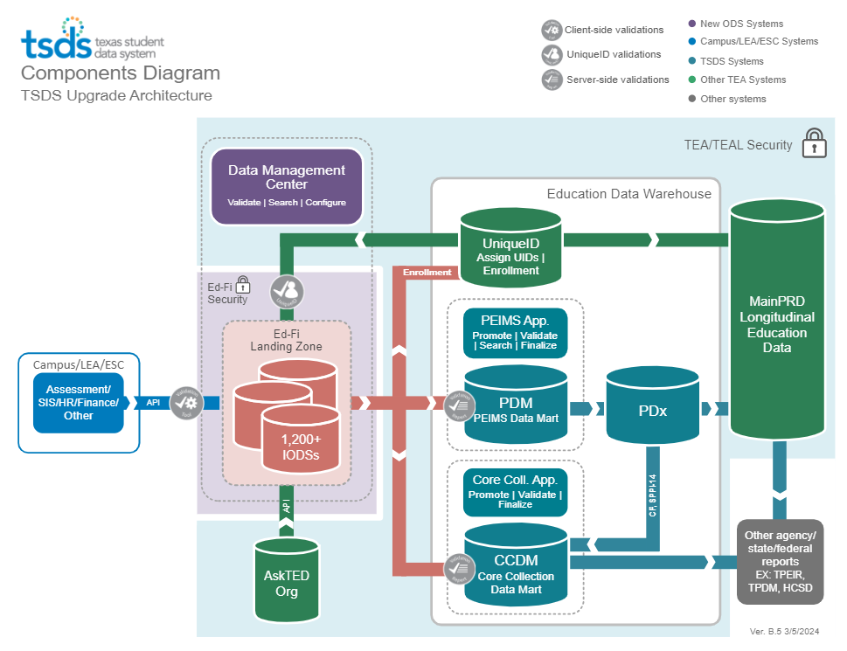
HIGH-LEVEL ARCHITECTURE

Slide 7
LEA TEAL ROLES FOR PEIMS
LEA roles for staff who will promote, validate, complete, and approve the PEIMS submissions.
PEIMS Data Scheduler / Promoter
This role can schedule promotions of PEIMS data, view all submissions, and search PEIMS data.
PEIMS Data Submitter
This role can promote PEIMS data, view all submissions, and search PEIMS data. In addition, this role can validate the data and generate and view TSDS PEIMS Reports.
PEIMS Data Completer
This role can promote PEIMS data, view all submissions, and search PEIMS data. In addition, this role can validate the data and generate and view TSDS PEIMS Reports. The Completer formally certifies the completeness and accuracy of the PEIMS data.
PEIMS Data Approver
This role will be for the superintendent or his/her designee at the LEA. This role can view reports, approve the submission, and request extensions if needed.
Notes:
The role the LEA staff would request will depend on the individual’s level of responsibility.

Slide 8
ESC TEAL ROLES FOR PEIMS
ESC roles for staff who will promote, validate, complete, and approve the PEIMS Fall & Mid-Year Submissions for the ESC.
PEIMS Data Scheduler/Promoter
This role can schedule promotions of PEIMS data, view all submissions, and search PEIMS data.
PEIMS Data Submitter
This role can promote PEIMS data, view all submissions, and search PEIMS data. In addition, this role can validate the data and generate and view TSDS PEIMS Reports.
PEIMS Data Completer
This role can promote PEIMS data, view all submissions, and search PEIMS data. In addition, this role can validate the data and generate and view TSDS PEIMS Reports. The Completer formally certifies the completeness and accuracy of the PEIMS data.
PEIMS Data Approver
This role will be for the Executive Director or his/her designee at the ESC. This role can view reports, approve the submission, and request extensions if needed.
Notes:
The role the LEA staff would request will depend on the individual’s level of responsibility.

Slide 9
ESC ACCEPTER ROLE FOR PEIMS
PEIMS Data Accepter
The Accepter at the ESC can view reports for the ESC and will accept the ESC’s PEIMS Fall and Mid-Year Submissions. This action will send the ESC’s submission to TEA as final.
PEIMS Data Accepter
The Accepter at the ESC can view reports for the LEAs in their Region and accept the LEAs’ PEIMS Fall, Mid-Year, Summer, and Extended-Year Submissions. This action will indicate to TEA that the LEAs' submissions are final.
Notes:
The ESC accepter role allows the ESC to accept their data for Fall and Mid-year and will allow them to also accept the completed LEA data and send them both as final to TEA.

Slide 10
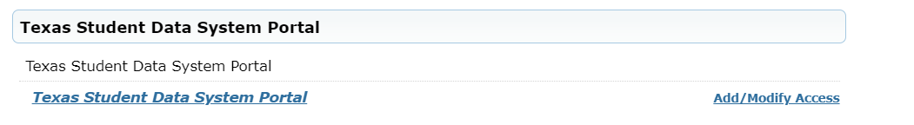
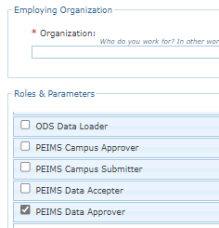

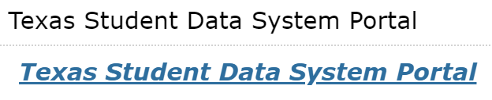

APPLYING FOR PEIMS ROLE
Login to your TEAL account; Click Add/Modify Access.
Enter your Employing Organization and select the appropriated PEIMS LEA TEAL role.

Slide 11
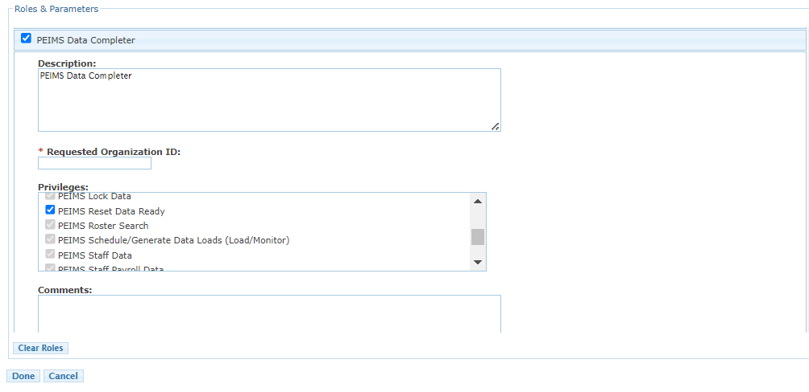
PEIMS TEAL ROLES & PRIVILEGES
Users will check the appropriate role based on their level of responsibility at the LEA and in the Requested Organization ID enter their Organization ID.
Next, check the Privileges that are appropriate based on their job responsibilities.
The final step is to click Done and then Save Changes on the next screen.

Slide 12


KEY CONCEPTS
PEIMS Overview, Timelines, and Validations

Slide 13
PEIMS
PEIMS encompasses all data requested and received by TEA about public education, including student demographic and academic performance, personnel, financial, and organizational information.
In compliance with the Texas Education Code, PEIMS contains only the data necessary for the legislature and TEA to perform their legally authorized functions in overseeing public education.
The collection of PEIMS data is required of all Local Education Agencies (LEAs) by Texas Education Code §48.008.
The Texas Education Data Standards (TEDS) provides instructions regarding the submission of PEIMS data from LEAs and ESCs to the Texas Education Agency.

Slide 14
PEIMS SUBMISSIONS
Submission 1 - PEIMS Fall Snapshot (including prior year student leaver and graduate, demographic and program information for students, current year budget, and staff) data,
Submission 2 - Mid-Year (prior year financial Actual) data,
Submission 3 - Summer (school year attendance, discipline, restraint, course completion, and current year student leaver and graduate) data, and
Submission 4 - Extended Year (summer programs including ESY and EB student summer school and CTE, Dual Credit, College Prep ELA and Math courses completed during the summer, ADSY program, and current year leaver and graduate) data.
Submission 5 – PEIMS Attendance (submitted five times)
2025-2026 - LEAs will report attendance for the first 3 six-weeks reporting periods in January, the 4th six-weeks reporting period in March, and the 5th six-weeks reporting period in May. The final attendance for period six and the initial five six weeks will be submitted in the PEIMS Summer Submission as it is currently done.
2026-2027 - LEAs will report attendance for the first 5 six-weeks reporting periods near the end of each six weeks reporting period as outlined in TWEDS. The final attendance for reporting period six and the initial five six weeks will be submitted in the PEIMS Summer Submission as it is currently done.
Notes:
The online tool where you can view TEDS is TSDS Web-enabled Data Standards (TWEDS).
2025-26 is the last year leavers will be reported on PEIMS Fall

Slide 15
PEIMS ACCURACY
Users can ensure the accuracy and completeness of each TSDS PEIMS data submission through validations and careful review of all PEIMS application reports.
Notes:
The online tool where you can view TEDS is TSDS Web-enabled Data Standards (TWEDS).
2025-26 is the last year leavers will be reported on PEIMS Fall

Slide 16
IS PEIMS REQUIRED?
LEAs are required to send complete and accurate PEIMS data, free of fatal errors, by the first submission deadline for each data submission as specified in the Data Submission Timelines in the TSDS Web-Enabled Data Standards.
The PEIMS data must be approved by the superintendent and accepted by the LEA’s Education Service Center PEIMS Coordinator before it can be accepted by TEA.
Failure to submit PEIMS data for a collection will result in the LEA being referred to the TEA General Counsel for further action. LEA’s may also be subject to Texas Administrative Code (TAC) 19 Rule §97.1055 (b)(2)(A)(ii).
Notes:
The online tool where you can view TEDS is TSDS Web-enabled Data Standards (TWEDS).
TAC searchable database: https://www.sos.state.tx.us/tac/index.shtml
The Texas Administrative Code (TAC) is a compilation of all state agency rules in Texas. There are 17 titles in the TAC. Each title represents a subject category, and related agencies are assigned to the appropriate title.

Slide 17
IS RESUBMISSION REQUIRED?
The PEIMS submissions all have a one-time optional “Resubmission” to allow LEAs to correct or update data submitted in the first submission.
LEAs are not required to send a resubmission of PEIMS data. The period between the first submission and the resubmission deadlines is an extension provided to all LEAs to review their original submission for any errors and make corrections.
If an LEA does not submit data during the resubmission window, TEA will use the PEIMS data sent for the first submission.

Slide 18
PEIMS SUBMISSION TIMELINES
Submission | Date Due to TEA*
PEIMS Fall Snapshot | Late October
PEIMS Fall Submission | Early December
PEIMS Fall Resubmission | Mid-January
PEIMS Mid-Year Submission | Late January
PEIMS Mid-Year Resubmission | Mid-February
PEIMS Summer Submission | Mid-June
PEIMS Summer Resubmission | Mid-July
PEIMS Extended Year Submission | Late August
PEIMS Extended Year Resubmission | Mid-September
*These are reference dates, please see the actual due dates in TWEDS.
LEAs registered with TEA with year-round tracks ending later than the third Thursday in June may delay Summer resubmission until two weeks following completion of the latest year-round track or the second Thursday in August, whichever comes first. However, the initial data delivery for the PEIMS Summer Submission must still be made by the third Thursday in June for all LEAs.
Coming Soon:
Beginning this year (2025-2026) we are adding a new PEIMS Attendance Submission where LEAs will report the first 5 six-weeks reporting periods. Reporting period six and the initial five will be submitted in the PEIMS Summer Submission.
Coming for 2026-2027 a new PEIMS submission will be added – PEIMS Fall Enrollment.
Notes:
Coming Soon: As mandated by the 98th legislature, all LEAs will report attendance each six weeks with the final attendance data still being submitted on the PEIMS Summer Submission. For 2025-26 the PEIMS Attendance Submissions will be due on January 30, 2026 for 1st-3rd six weeks, March 20, 2026 for 4th six weeks, and May 18, 2026 for 5th six weeks, with 1st - 6th six weeks attendance submitted on PEIMS Summer. Beginning in the 2026-27 school year the attendance submissions will be submitted each six weeks.
PEIMS Fall Enrollment Submission - TEA will collect a “snapshot” of what is occurring at the LEA on the first Friday in October. This submission will consist of (1) all students enrolled on the first Friday in October with their SPED determination and (2) students in grades 7-12 enrolled at any point during the school start window (BOY through the last Friday in September). Continuers information will use data reported in PY PEIMS Summer. New submission will be due the third Thursday in October. PEIMS Fall will only include students enrolled, staff, employed, and budget data as of the last Friday in October and will be due the second Thursday in December.

Slide 19
LEVELS OF VALIDATIONS
LEVEL 1
(Vendor Source System)
Includes basic data integrity checks that occur during the process of loading data via API transactions into the Individual Operational Data Store (IODS) in the Landing Zone. Data that fails Level 1 validations does not enter the IODS.
LEVEL 1.5
(DMC: DMC Data Monitor)
Includes filters that prevent invalid or non-TSDS data from being loaded into TSDS. These filters include Unique ID checks, descriptor value checks, Do Not Report flag checks, and Course ID checks.
LEVEL 3
(PEIMS/Core: Existing TEAL Roles)
Business rules that are executed in TSDS. Level 3 validations contain all Level 2 validations, plus any additional validations required for the TSDS submissions. Fatal errors prevent TSDS submissions from being completed or finalized.
LEVEL 2
(DMC: DMC L2 Validations)
Business rules that are executed on the data destined for TSDS. Fatal, Special Warning, and Warning validation errors do not prevent data from being loaded to TSDS.
Prevents data from loading to IODS
Prevents data from loading to TSDS.
Does not prevent data from loading to TSDS.
Fatals prevent from completing submission
Notes:
L 1.5
The data being filtered out does not indicate that the data is right or wrong.
The LEA can move local data into their IODS that is not appropriate to move to TSDS.
The IODS is the LEA’s own separate operational data store that houses all the data it loads to the IODS in the Landing Zone for TSDS data and/or local use data.
The LEA will need to check all of their results that are generated by Level 1.5 filters and either verify the data should not move to TSDS or correct the data so that it can move to TSDS.

Slide 20

TRAINING ACTIVITY
PEIMS Knowledge Checks

Slide 21
KNOWLEDGE CHECK 1
1. PEIMS data is promoted into the:
Core Collection Data Mart (CCDM)
Individual Operational Data Store (IODS)
PEIMS Data Mart (PDM)
None of the above
Note: PEIMS Data Mart (PDM)
Notes:
NOTE
To see the answer, you must be in presentation mode.

Slide 22
KNOWLEDGE CHECK 2
2. Which of the following TEAL roles can mark the PEIMS submission complete?
PEIMS Data Promoter
PEIMS Data Submitter
PEIMS Data Completer
All of the above
Note: ONLY the PEIMS Data Completer can mark the submission complete.
Notes:
NOTE
To see the answer, you must be in presentation mode.

Slide 23
KNOWLEDGE CHECK 3
3. A PEIMS submission with Fatal Errors can be marked complete by the PEIMS Data Completer.
True
False
Notes:
NOTE
To see the answer, you must be in presentation mode.

Slide 24
KNOWLEDGE CHECK 4
4. PEIMS data affects the LEA’s funding and accountability rating.
True
False
Notes:
NOTE
To see the answer, you must be in presentation mode.

Slide 25
KNOWLEDGE CHECK 5
5. The PEIMS Data Approver is the role the Superintendent will request to approve the PEIMS submissions.
True
False
Note: ONLY the individual listed in AskTED as the Superintendent or Interim Superintendent should request this role.
Notes:
NOTE
To see the answer, you must be in presentation mode.

Slide 26

WRAP UP
Key Takeaways, Resources, and Next Steps

Slide 27

KEY TAKEAWAYS
PEIMS data is submitted through TSDS.
The collection of PEIMS data is required of all Local Education Agencies (LEAs) by Texas Education Code §48.008.
Failure to submit PEIMS data for a collection will result in the LEA being referred to the TEA General Counsel for further action.
The Texas Education Data Standards (TEDS) provides instructions regarding the submission of PEIMS data from LEAs and ESCs to the Texas Education Agency.
The PEIMS data must be approved by the superintendent and accepted by the ESC before it can be accepted by TEA.
TRAINING RESOURCES
Key Terms and Definitions
PEIMS Reference Guide
SOA Resource Document
Financial Accountability System Resource Guide

Slide 28
TECHNICAL RESOURCES
TEA Website and Communication Resources
Student Attendance Accounting Handbook(SAAH)
Link to Key Terms Document
Texas Education Data Standards Resources
TSDS Web-Enabled Data Standards (TWEDS)
Support Resources
KB Articles
TSDSKB 606 - TEAL Roles for TSDS Collections

Slide 29
NEXT STEPS
Ensure that you have attended Overview and Key Concepts, TEDS Overview, DMC Technical, Level 2 Validations, and TEAL Roles trainings.
Attend PEIMS Fall, PEIMS Mid-Year, PEIMS Summer, and/or PEIMS Extended Year trainings.
Attend TSDS Continuing Education Trainings (CET).
Participate in TSDS Just-in-Time Trainings (JIT).
Attend Field Coordination Network (FCN) webinars for updates and changes.

Slide 30
WRAP UP
In this training we talked about:
The TSDS High-level Architecture
TEAL Roles for PEIMS
PEIMS Overview
The Levels of Validations

Slide 31

QUESTIONS

