Slide 1

TITLE SLIDE: TSDS ODS 3.x Project
Updates
Common Steps for TSDS Core Collections
New User Certification Training
Notes:
This is Part 2 of the Core Certification trainings and focuses on navigation and workflow.

Slide 2
KEY TERMS
Core Application
Data Element
Data Promotion
Data Submission
Data Validation
Domain
You can find the definitions to these key terms and more here:
Key Terms and Definitions Document

Slide 3
LEARNING OBJECTIVES
By the end of this course, the users will be able to explain:
The TEAL roles for TSDS Core Submissions.
How to promote, validate and complete Core Submission.
How to run and view TSDS Reports for Core Submission.
How to reset a submission.

Slide 4
WHY IS THIS COURSE IMPORTANT
To understand the common process for completing your TSDS Core submissions.
To be able to view and correct your data prior to promoting.
To be more self-sufficient in all the above.
Notes:
See slide.

Slide 5

COURSE AGENDA
Getting Started
TSDS Architecture and TEAL Roles
Key Concepts
Core Application
Training Activity
Practice, Troubleshooting, Knowledge Checks
Wrap Up
Key Takeaways, Resources, and Next Steps

Slide 6


GETTING STARTED
TSDS Architecture & TEAL Roles

Slide 7
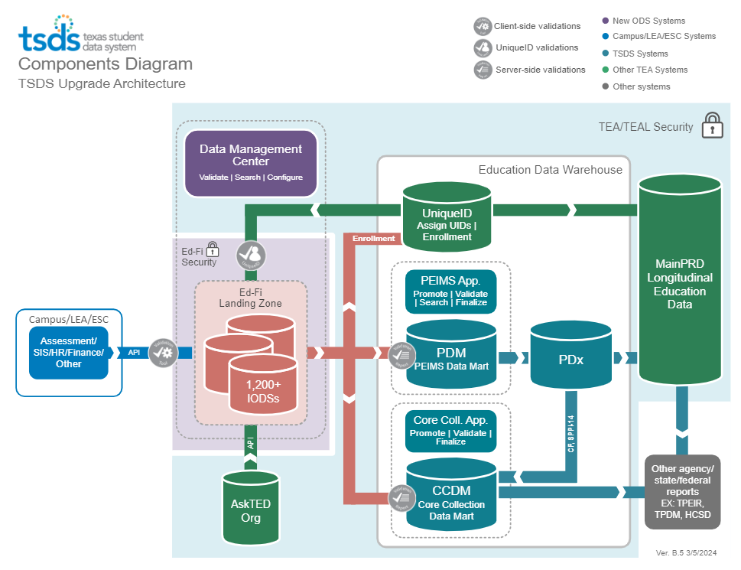
HIGH-LEVEL ARCHITECTURE

Slide 8
LEA TEAL ROLES – CORE COLLECTION
Core LEA Data Viewer
This role monitors data promotions and data validations and generates reports.
Core LEA Data Promoter
This role schedules and monitors promotions, schedules and monitors validations, and generates reports.
Core LEA Data Completer
This role formally certifies the completeness and accuracy of the data and finalizes the submission. In addition, this role also schedules and monitors promotions, schedules and monitors validations, and generates reports.
Core LEA Data Approver
This role will be for the superintendent or his/her designee at the LEA. This role requests an extension if needed.
Notes:
The role the LEA staff would request will depend on the individual’s level of responsibility.

Slide 9
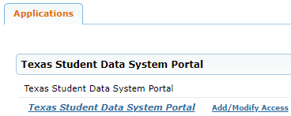
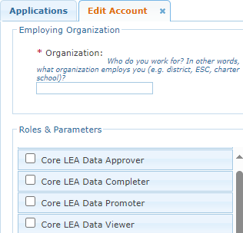
APPLY FOR CORE ROLE
Login to your TEAL account; Click Add/Modify Access.
Enter your Employing Organization and select the appropriated Core LEA TEAL role.

Slide 10
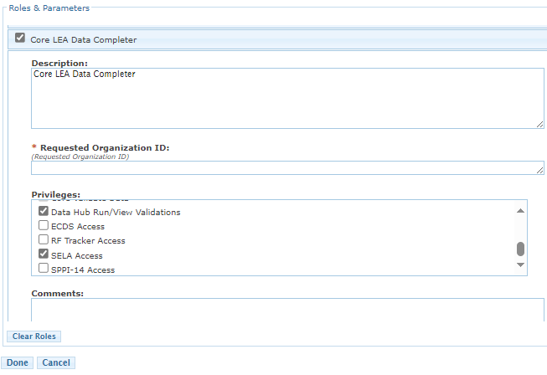
CORE TEAL ROLE & PRIVILEGES
Users will check the appropriate role based on their level of responsibility at the LEA and in the Requested Organization ID enter their Organization ID.
Next, check the appropriate Privilege and click Done.
The final step is to click Save Changes on the next screen.

Slide 11
ESC TEAL ROLES – CORE COLLECTION
Core ESC Data Viewer
This role will be able to view and monitor activity for any Core Collection in TSDS for the LEAs the ESC supports.
Notes:
The ESC Data Viewer role will allow the ESC to monitor the data promotions for all Core Collections for the LEAs in their region.

Slide 12


KEY CONCEPTS
Core Application

Slide 13
CORE APPLICATION

Slide 14
DEMONSTRATION
Login to TEAL Account
Navigate to Core Collection Application:
Promote data
Validate data
Generate reports
Request an extension
Complete a submission
Reset a Submission
Note: Refer to the respective Reference Guides (RG) for each Core collection for detailed, step-by-step instructions on how to promote, validate, and complete each Core submission.

Slide 15
CORE OVERVIEW
Charter School Waitlist
(CSW)
Special Education Data System (SPEDS) Summer
Class Roster
Early Childhood Data System (ECDS)
Residential Facility Tracker
(RF Tracker)
Special Education Language Acquisition
(SELA)
State Performance Plan Indicator 14
(SPPI-14)
What is the Core Collection?

Slide 16
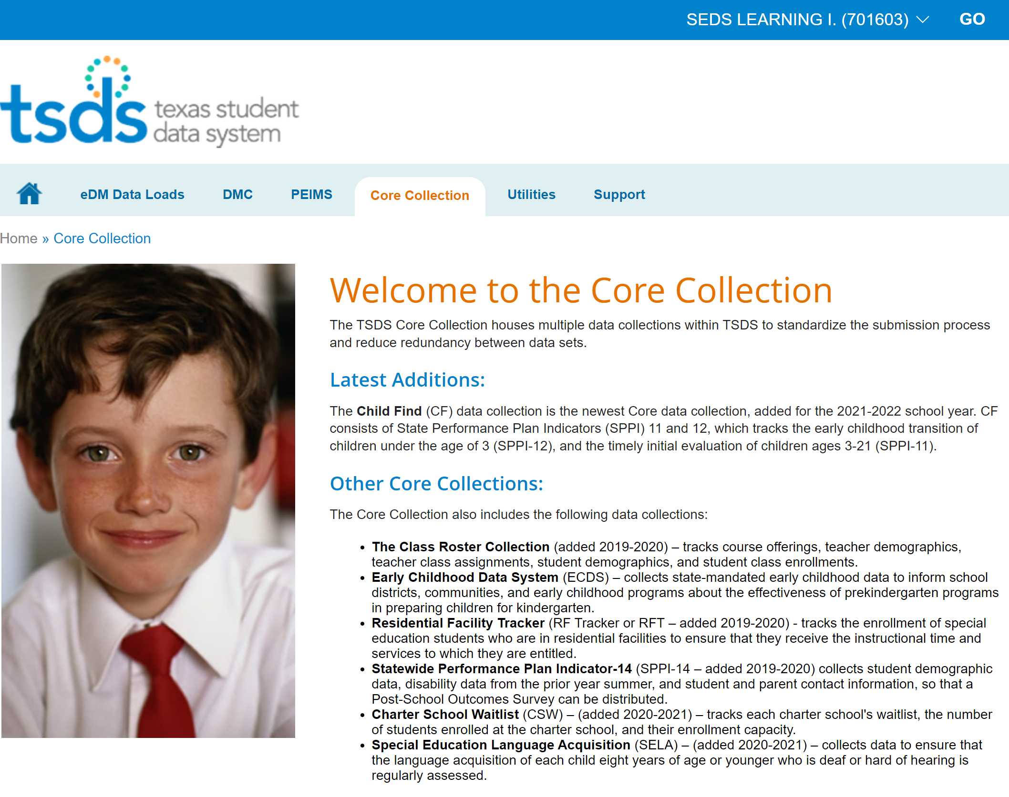
CORE COLLECTION APPLICATION
In the ribbon near the top of the page, click on Core Collection.

Slide 17
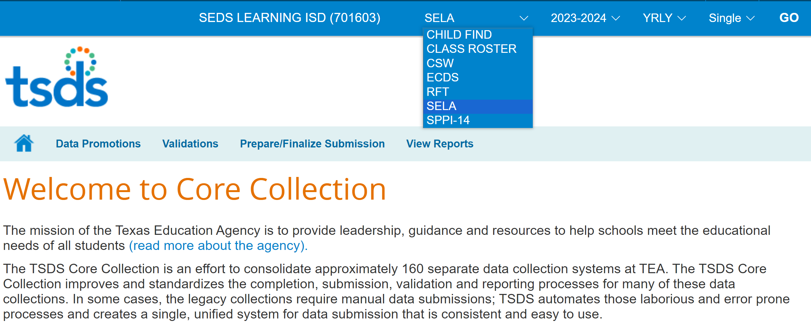
SUBMISSION DETAILS
Once inside the Core Collection, you will select the specific collection:
Select the collection from the collection drop down menu,
Select the School Year,
Select the Submission, and
Click Go. (Note: There is no resubmissions for any Core collections, you will only see ‘Single’ instance.)

Slide 18
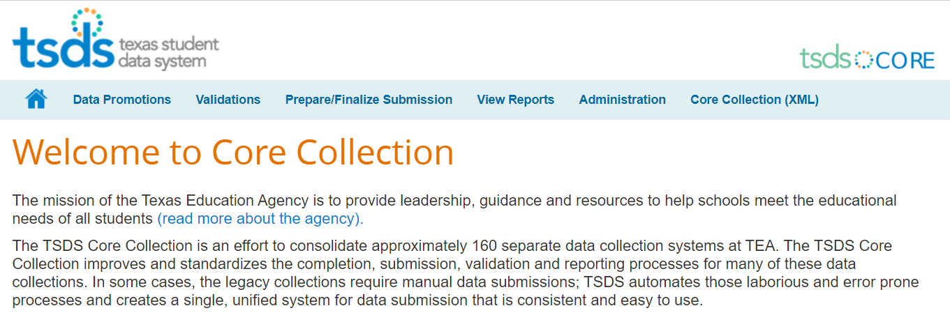
SUBMISSION STEPS IN CORE APPLICATION
Promotion – moves state reported data from the IODS to the Core Collection Data Mart.
Validation – the LEA will verify the accuracy and completeness of data.
Reports – reports should be reviewed to ensure the data promoted is accurate and complete.
Administration – will allow the Approver to request an extension.
Prepare/Finalize – will complete the submission and send it to TEA. (Note: Collection can be ‘Reset’ before the submission due date if data corrections are required.)
1
2
5
3
4

Slide 19
PROMOTE LOADED DATA (STEP 1)

Slide 20
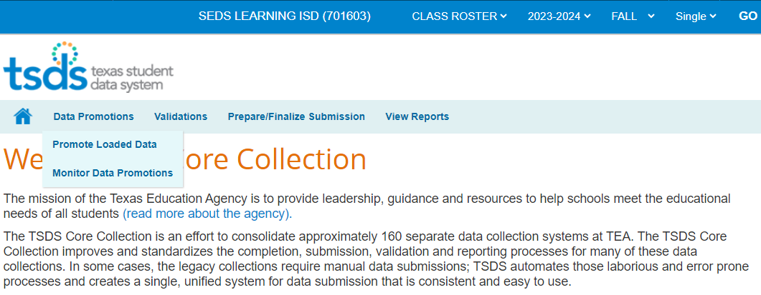
DATA PROMOTION
To Promote data for a TSDS core collections (SPPI-14, RFT, Class Roster, ECDS, CSW, SELA or SPEDS Summer), hover over Data Promotions.
Click on Promote Loaded Data.

Slide 21
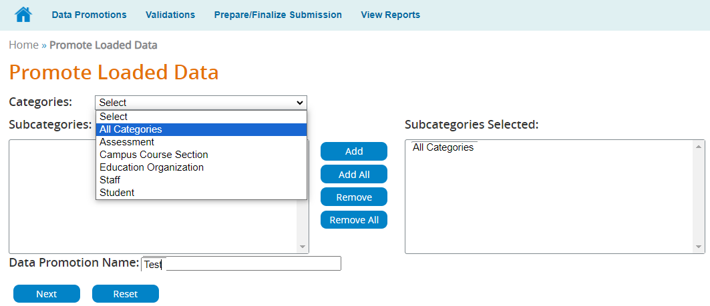
SELECT THE CATEGORIES TO PROMOTE
Click on the dropdown arrow for Categories.
Select the Categories you wish to promote.
Highlight and double click your selection.
Click on the Next button.
Notes:
Note: You can use the ‘Add’ and ‘Add All.’ buttons also to move the categories to the Subcategories Selected box.

Slide 22
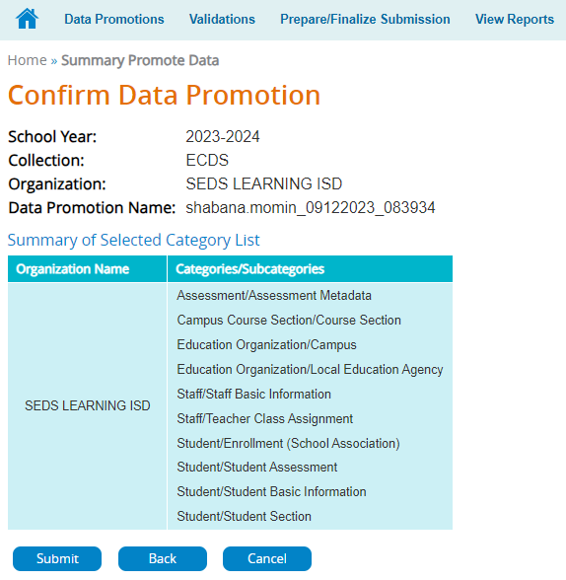
CONFIRM DATA PROMOTION
The confirmation screen will show what you will be promoting.
Confirm this is correct. Then, click Submit.

Slide 23
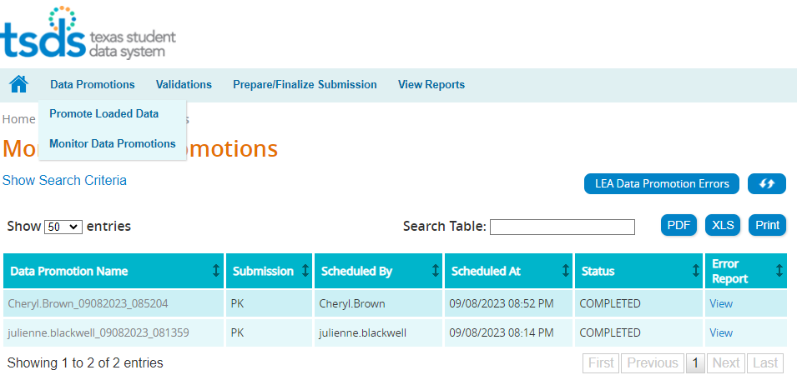
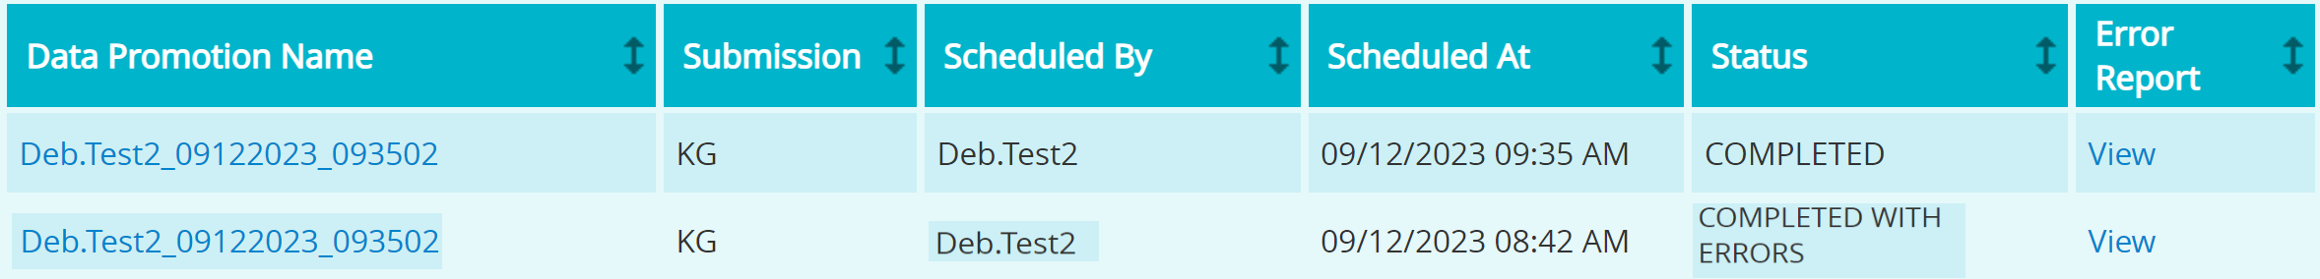
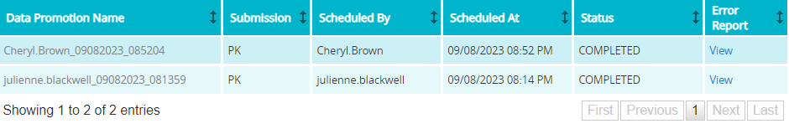
MONITOR DATA PROMOTION
To monitor promotions for a submission, hover over Data Promotions, then click on Monitor Data Promotions.

Slide 24
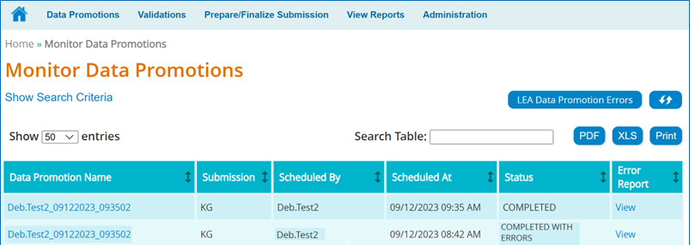
PROMOTION DETAILS AND STATUS
The Monitor Promotions screen will show each data promotion for this collection.
The Status column will indicate Failed, Completed, Completed with Errors, or In Progress for each promotion.
24

Slide 25
VIEWING PROMOTION DETAILS
Click on the Data Promotion Name to view the details for this promotion.
Click on View in the Error Report column to view all errors for this promotion.
Click on LEA Data Promotion Errors to see errors for all promotions for this collection.

Slide 26
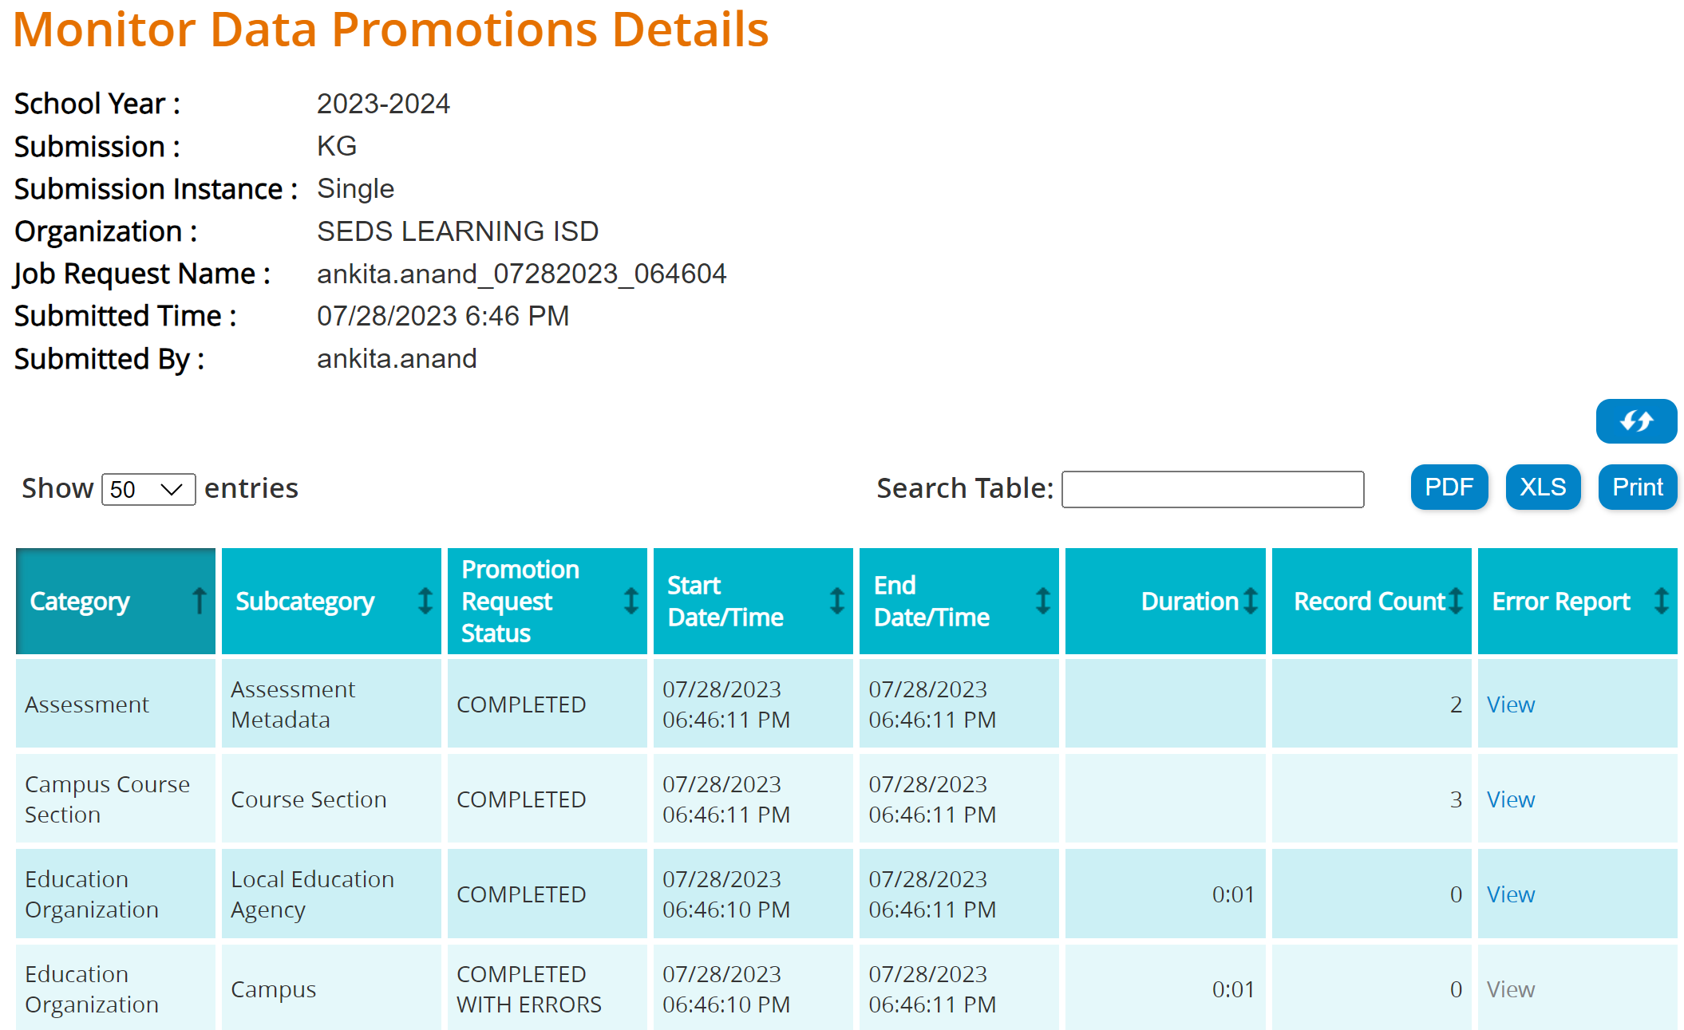
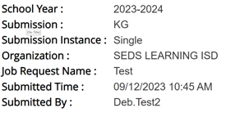
DATA PROMOTION DETAILS
This screen will show the details for each Promoted Category and Subcategory.
Click View in the Error Report column to see the errors.

Slide 27
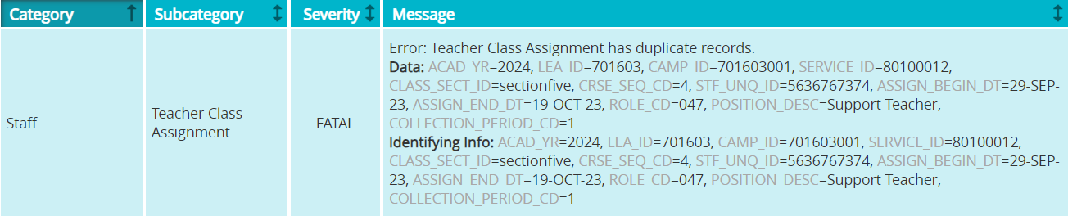
VIEWING A DATA PROMOTION ERROR
We see ‘Teacher Class Assignment’ has duplicate records. The LEA or Vendor would need to determine why a duplicate record was submitted.
Resolve the error in the vendor software and verify the duplicate record has been removed.
Promote the data again to the Core Collection Data Mart and view the Promotion status and errors again.

Slide 28
VALIDATE DATA (STEP 2)

Slide 29
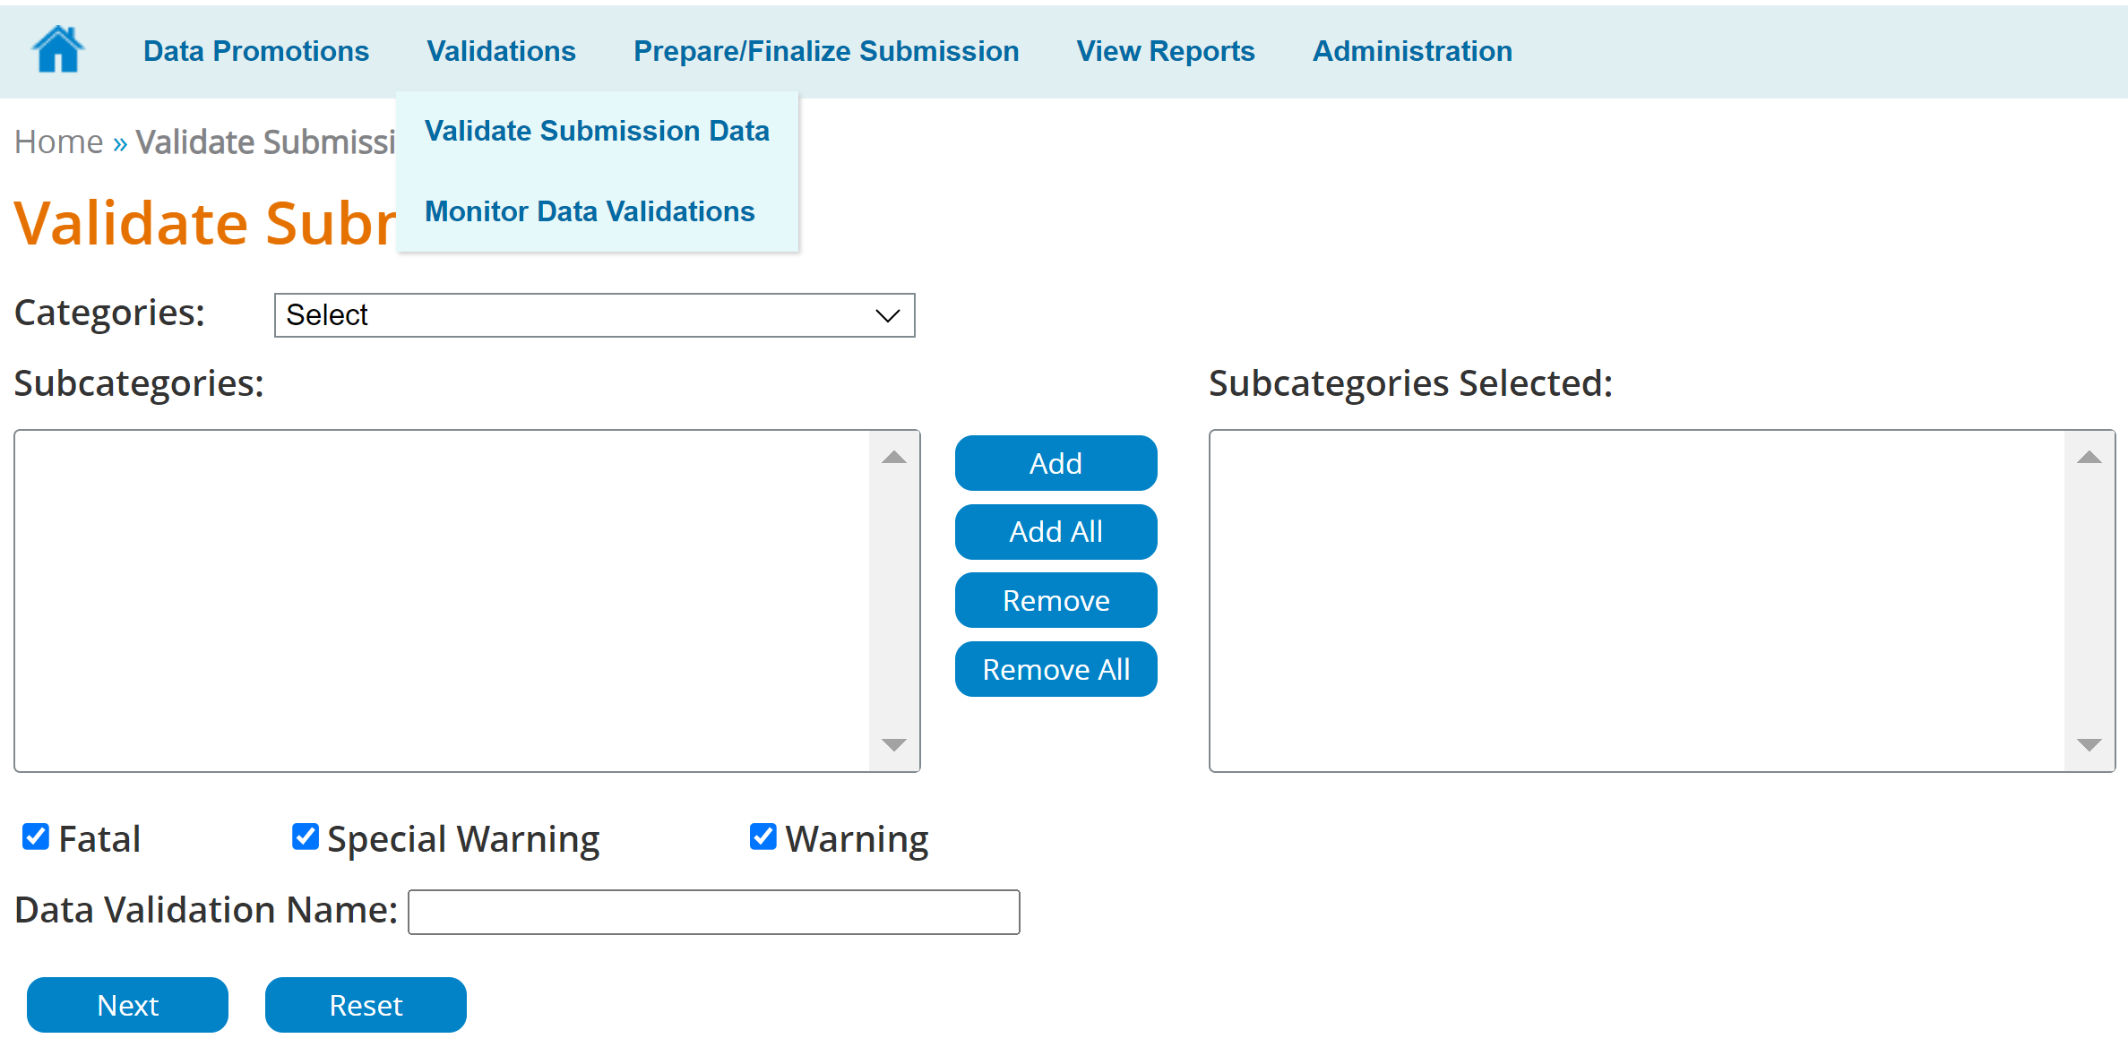
VALIDATION PROCESS
Hover over Validations. Click on Validate Submission Data.
The Validation screen is very similar to the Promotion screen.
You will be able to check the type errors for which you wish to Validate. (Fatal and Special Warning,)
Note: Warnings do not apply to any of the Core Collections.
Enter Data Validation Name. Click Next.
Notes:
Note: You can use the ‘Add’ and ‘Add All.’ buttons also to move the categories to the Subcategories Selected box.

Slide 30
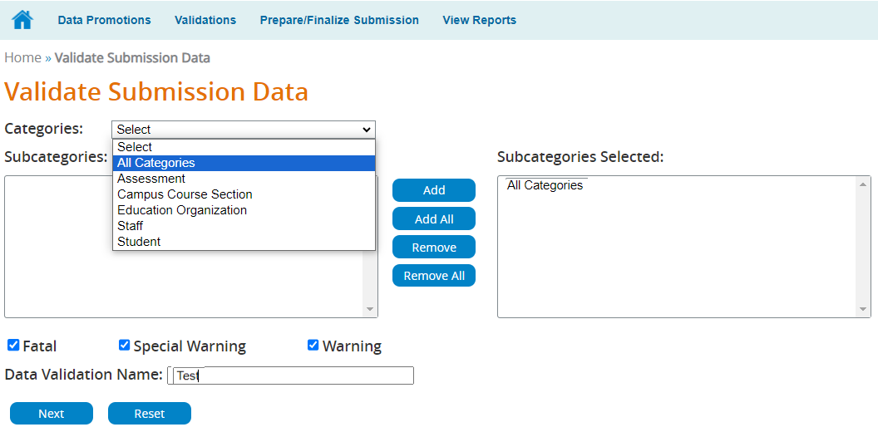
SELECT THE CATEGORIES TO VALIDATE
Click on the dropdown arrow for Categories.
Select the categories you wish to validate.
Highlight and double click your selection.
Click on the Next button.

Slide 31
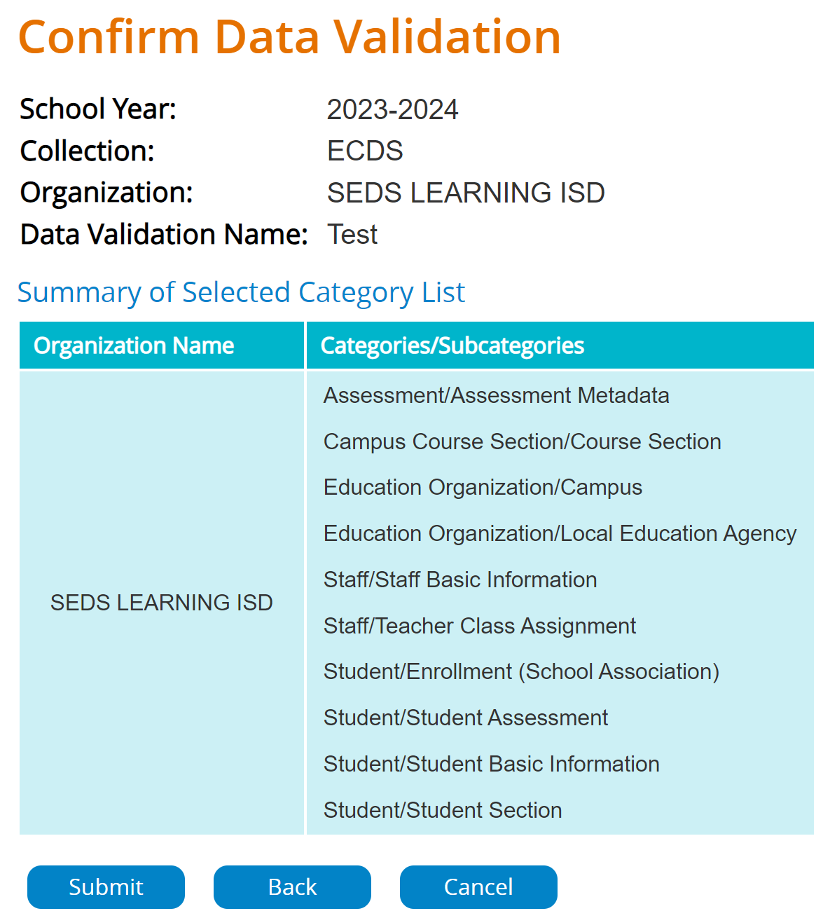
CONFIRM DATA VALIDATION
Next, you will confirm this is the data you wish to Validate.
Click Submit.

Slide 32
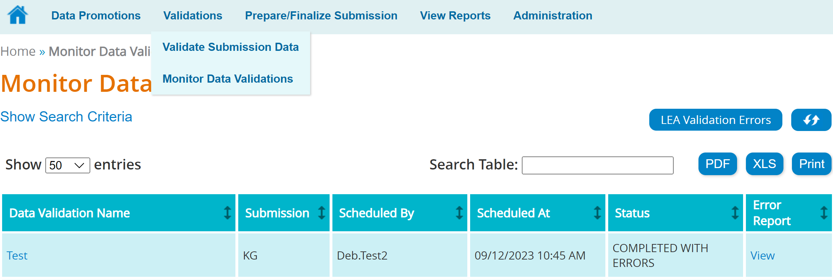
MONITOR DATA VALIDATION
Hover over Validations.
Click on Monitor Data Validations.
Just as with the Monitor Data Promotions, this will allow you to see your errors.

Slide 33
MONITOR DATA VALIDATION (CONTINUED)
The Monitor Validations screen will show all data validation jobs processed for this collection.
The Status column will indicate Completed, Completed with Errors, In Progress or Failed for each validation job.

Slide 34
VIEWING VALIDATION DETAILS
Click on the Data Validation Name to view the details by Category and Subcategory for this validation job.
Click on View in the Error Report column to view all errors for the validation job.
Click on LEA Validation Errors to see errors for all validations for this collection.

Slide 35
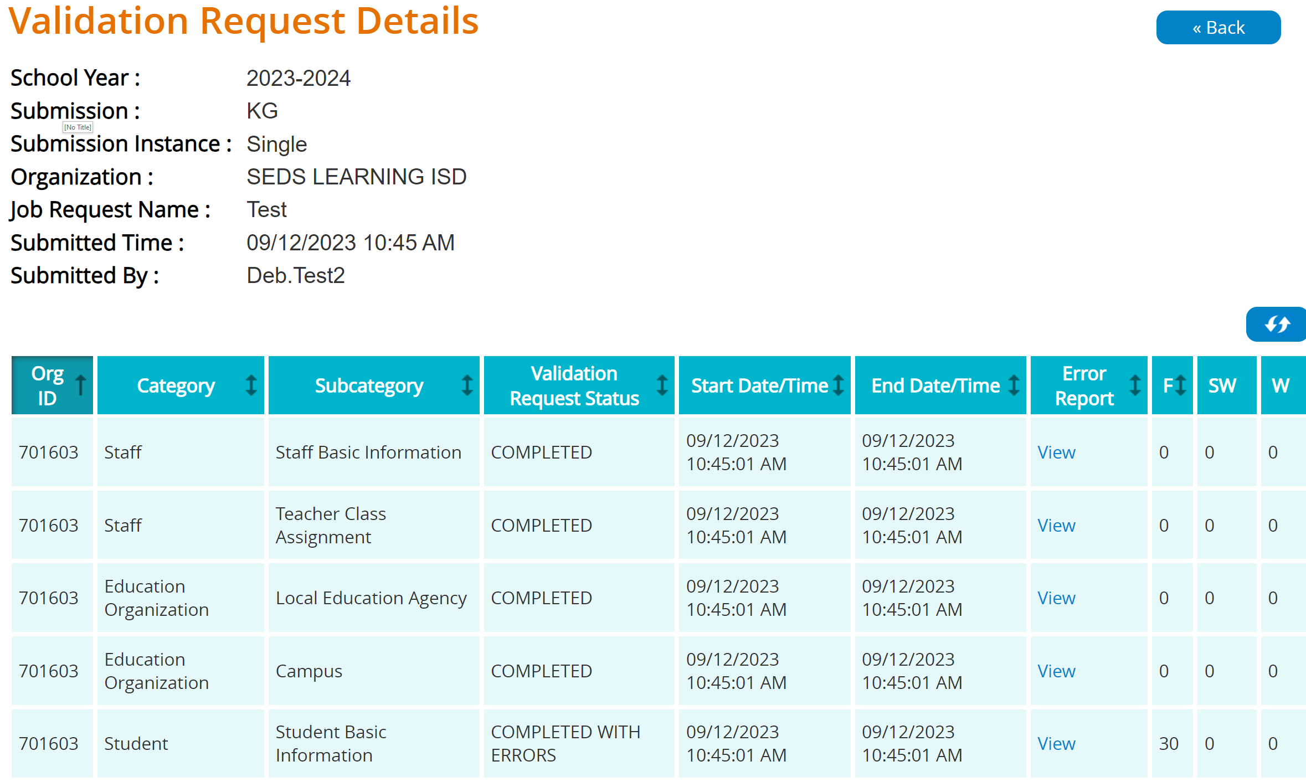
VIEWING VALIDATION DETAILS (CONTINUED)
Each Category/Subcategory will show the status of Completed or Completed with Errors.
Click View in the Error Report column to see error details.

Slide 36
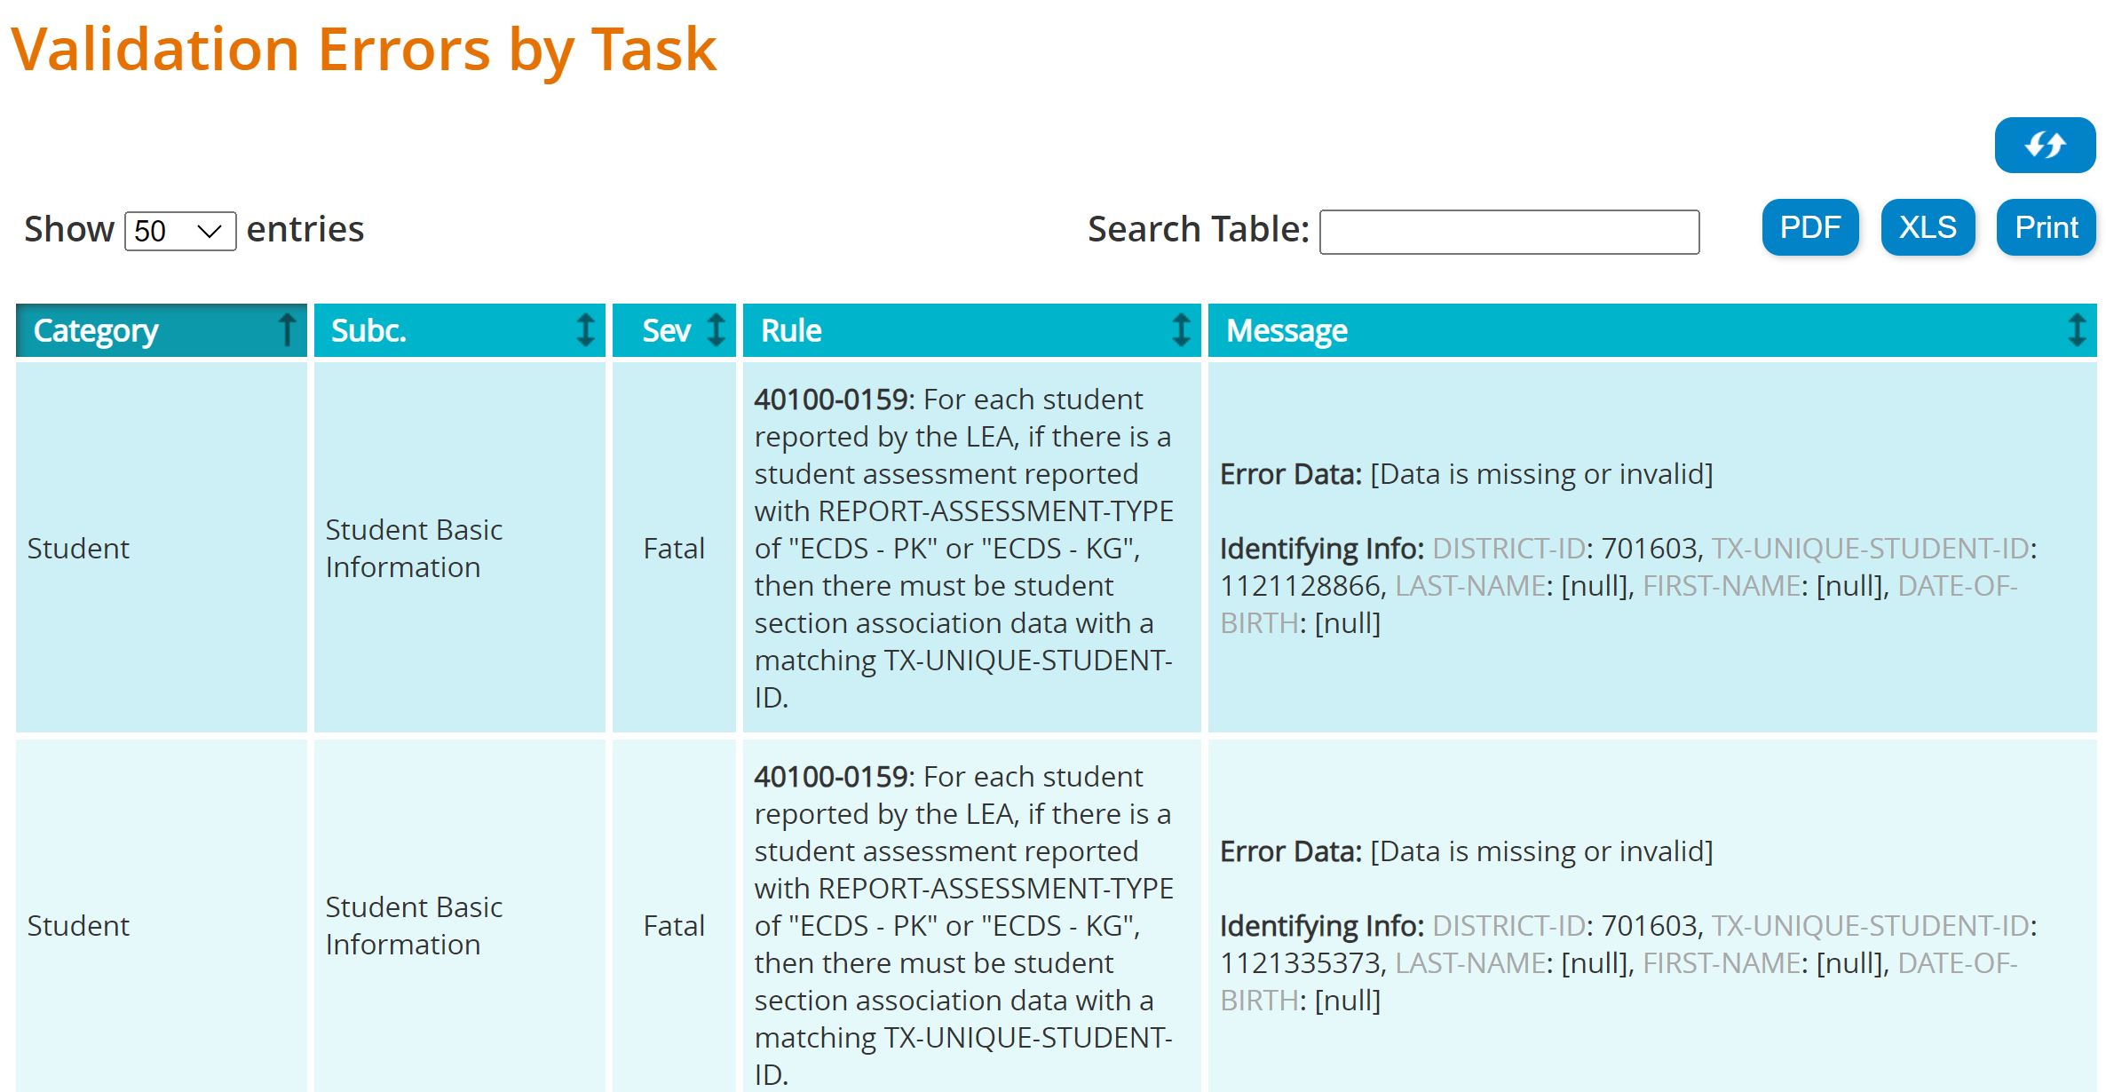
VALIDATION ERRORS
Evaluate the errors and determine what actions should be taken to correct the errors.
Correct the errors in your vendor software.
Once the correct data is published via the API, promote and validate the data again to verify the errors have cleared.

Slide 37
VERIFY REPORTS (STEP 3)

Slide 38
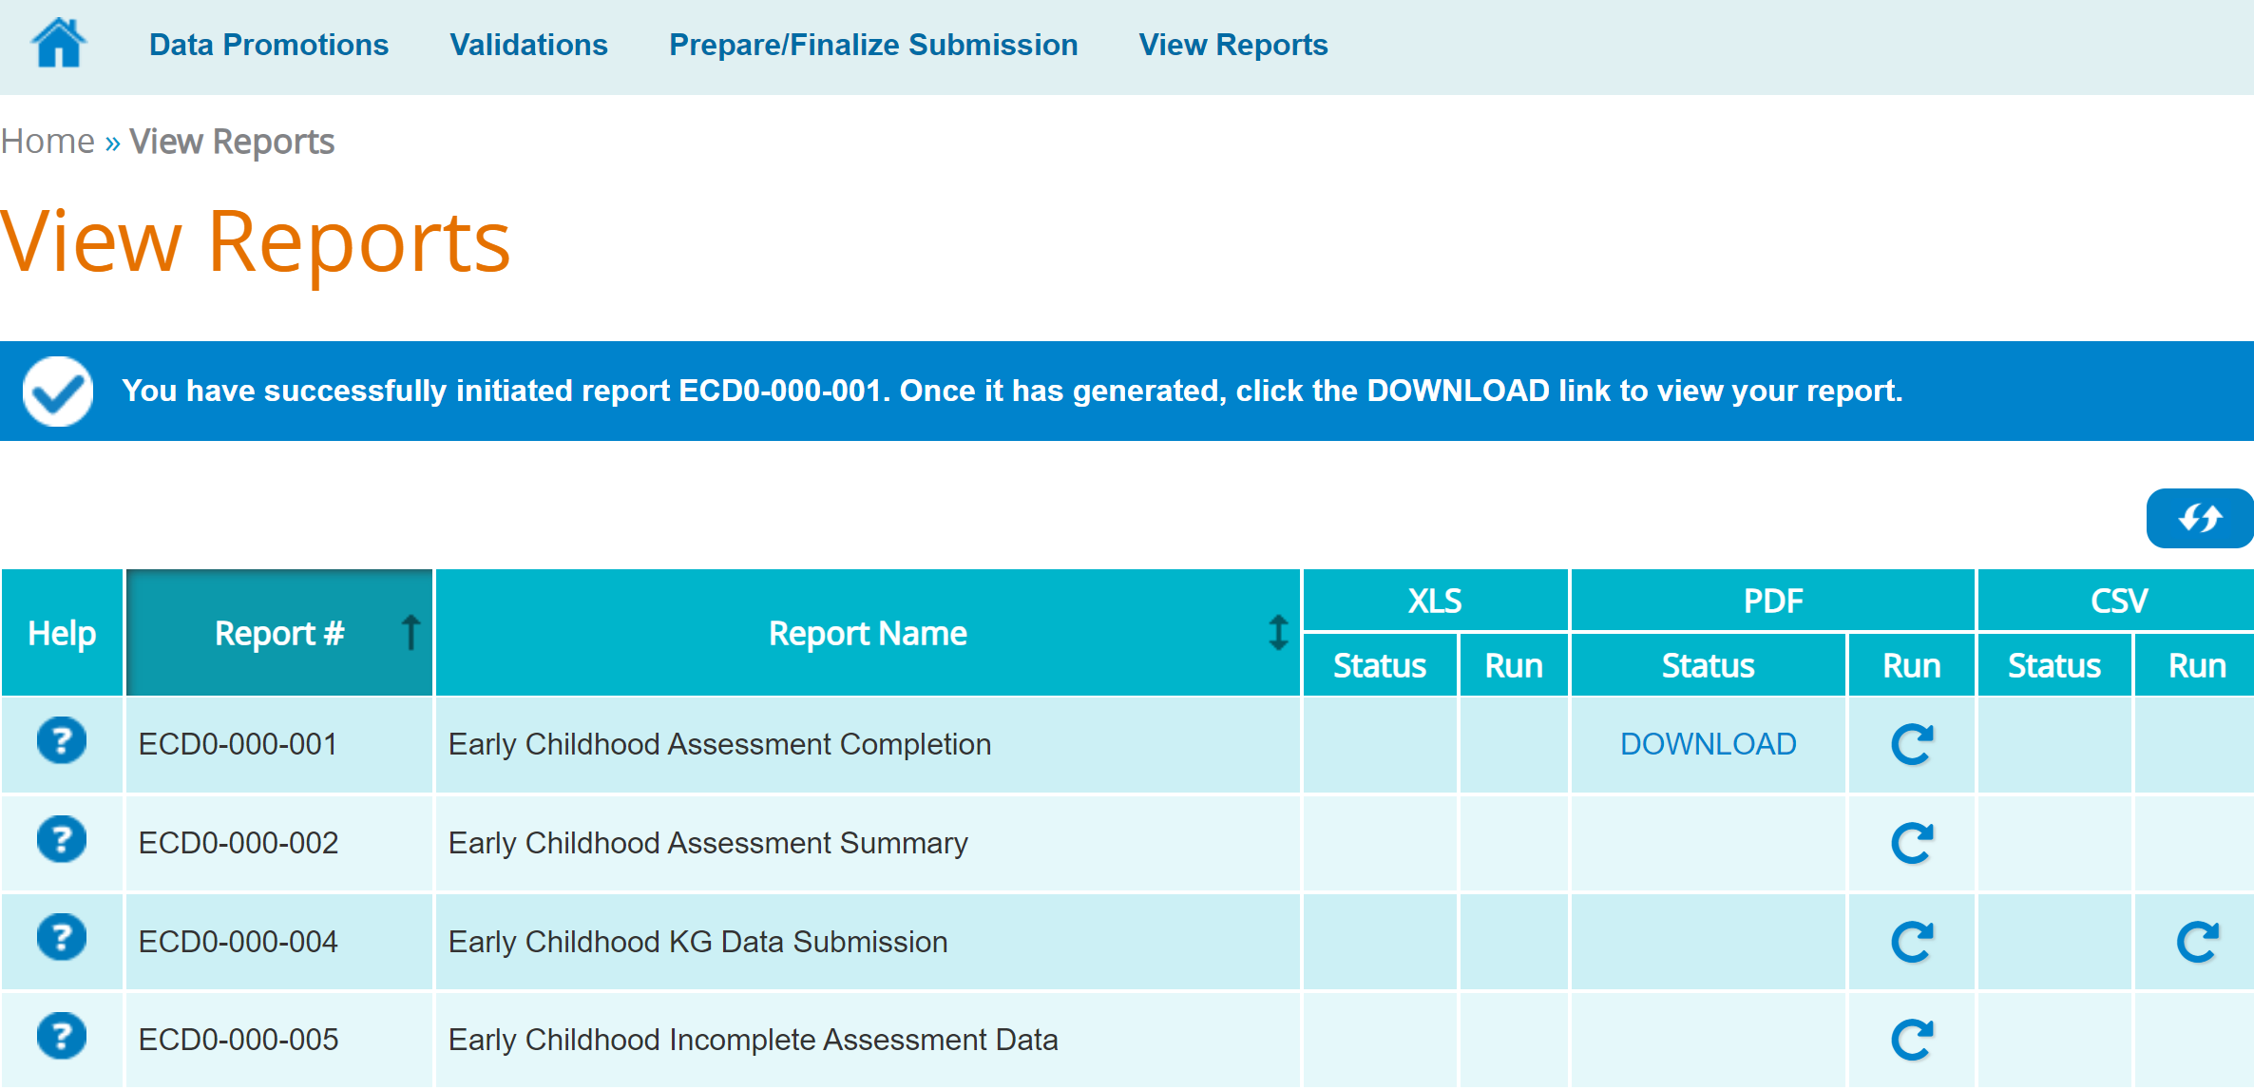
RUN & DOWNLOAD REPORTS
Click on View Reports.
Click the Run icon to generate the report.
Click Download to view the reports.

Slide 39
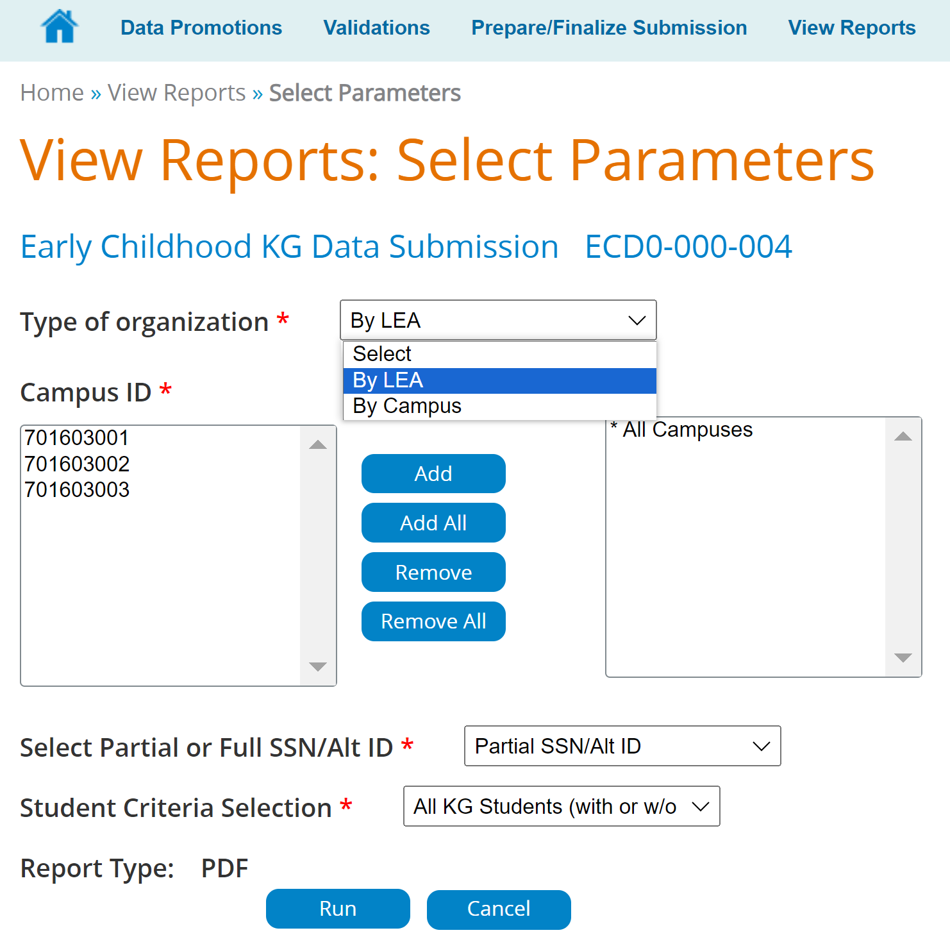
REPORT PARAMETERS
You may be redirected to the parameter screen after clicking the Run icon.
Select the parameters for the report you are running.
Click Run after parameters are set.

Slide 40
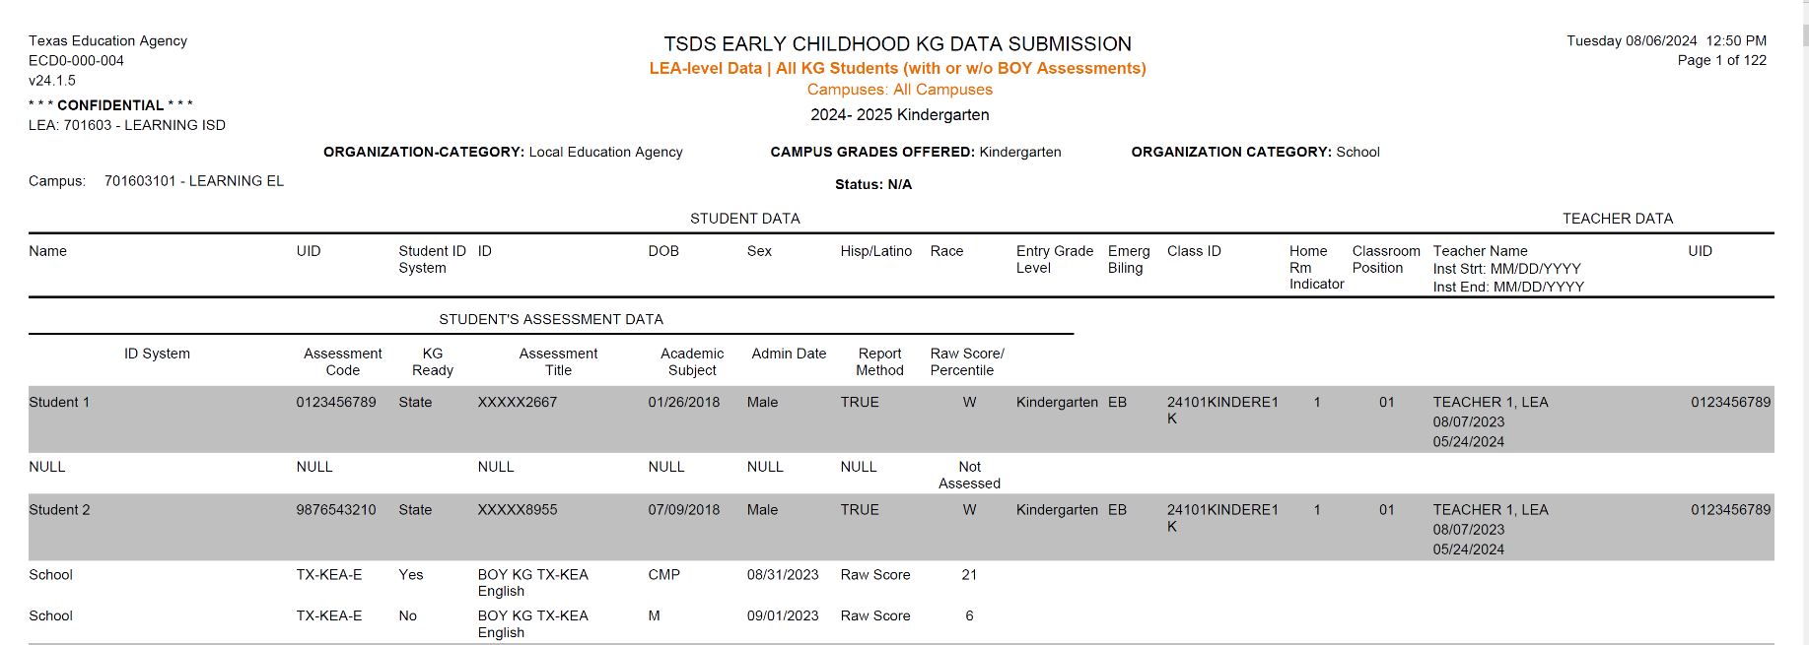
VERIFY DATA IN REPORTS
Verify the data before you complete the collection.

Slide 41
REQUEST EXTENSION (STEP 4 - OPTIONAL)

Slide 42
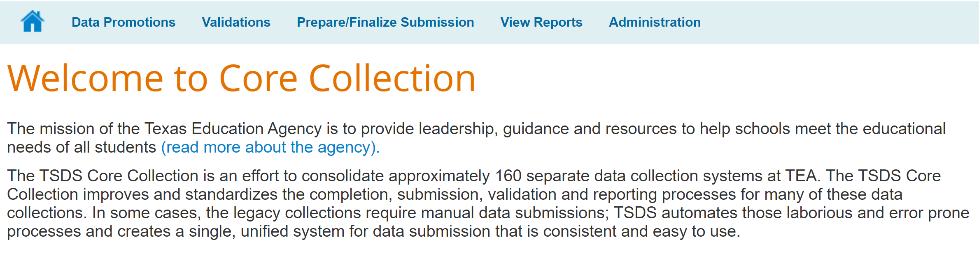
ADMINISTRATION TAB
The Approver at the LEA can request an extension in extreme situations (except for RF Tracker).
The request should be submitted prior to completing the data submission.
The Administration tab will only be available to the individual at the LEA who has the Core Data Approver role.

Slide 43
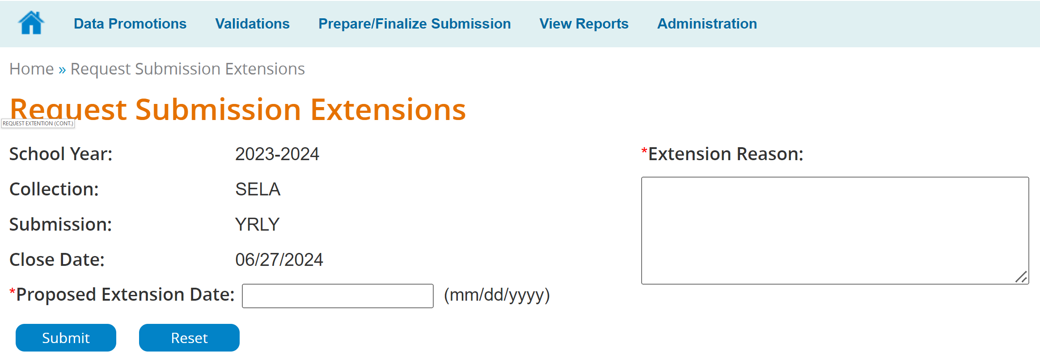
REQUEST EXTENSION
The Approver of the LEA will enter the Proposed Extension Date and Extension Reason. Then click Submit.
Notes:
Extension requests are reviewed by the program area. Not all requests are granted.

Slide 44
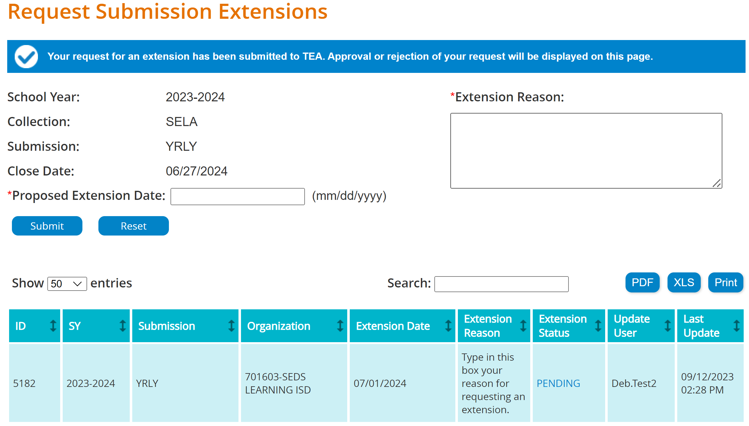
REQUEST EXTENSION (CONTINUED)
Extension requests will be reviewed by TEA and approved or denied.
LEAs must monitor the status of their extension requests directly; no email notification will be sent regarding approval or denial.
TEA staff may adjust the extension date based on program area guidance, even after an extension is approved.

Slide 45
COMPLETING THE COLLECTION (STEP 5)

Slide 46
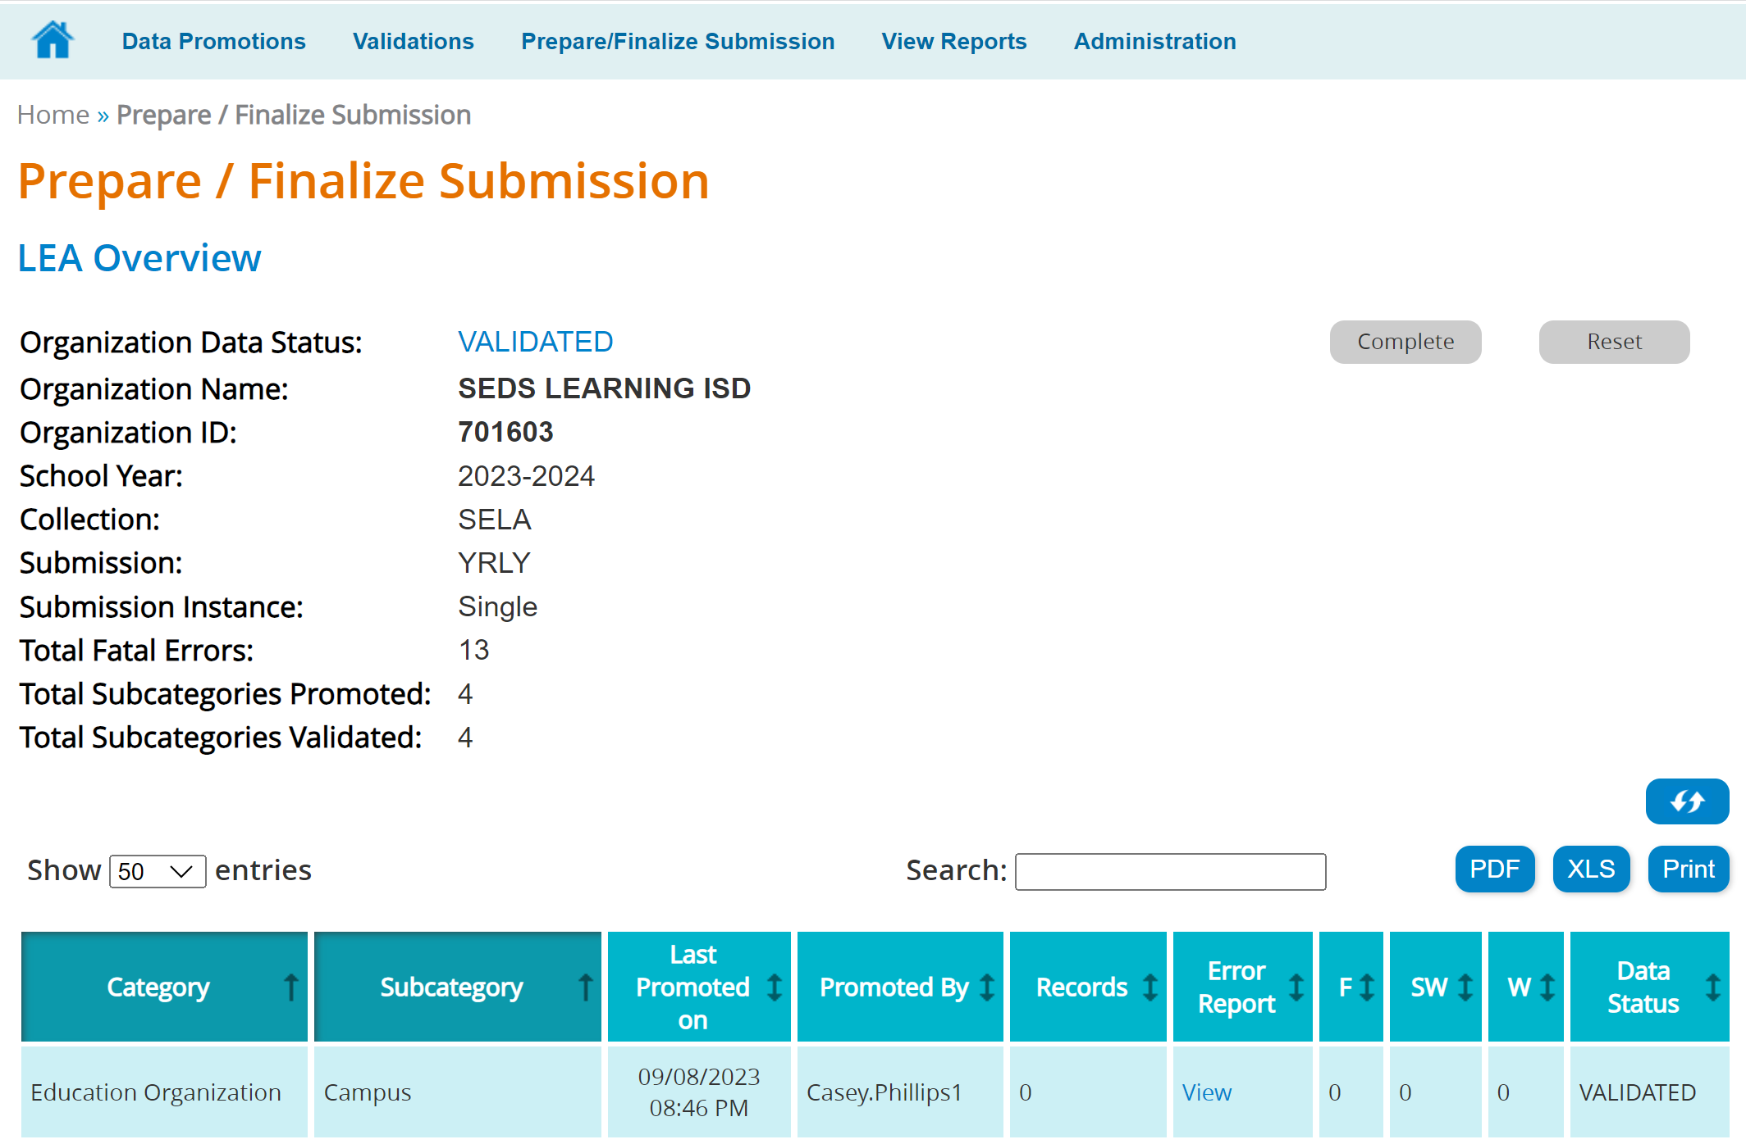
FINALIZE THE SUBMISSION
Finalize the Collection only when:
The Collection is Fatal free,
All Special Warnings have been verified, and
All Reports have been reviewed for completeness, reasonableness and accuracy.
From the Home Page, click on Prepare/Finalize Submission.
Notes:
When assessing the reasonableness of reports, it's crucial to compare the current data to the data from prior year reports. This comparison helps identify trends, anomalies, and potential errors.

Slide 47
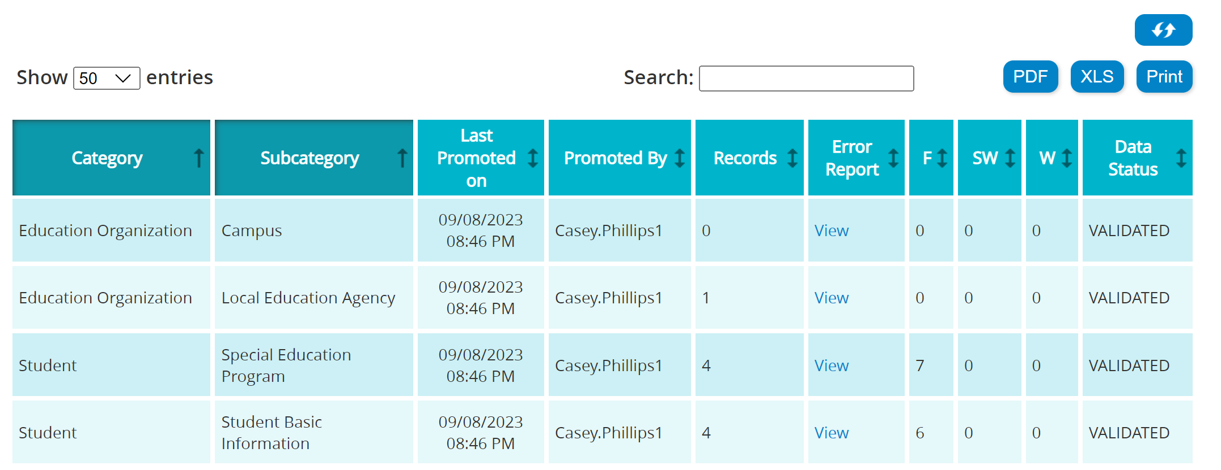
MARK SUBMISSION AS COMPLETE
On the Prepare/Finalize screen
You will see summary of the Categories and Subcategories you have Promoted and Validated.
You will also see the error counts for the Collection. (If you have any Fatals, you will not be able to Complete the Submission.)
Continue working through all errors until each has been resolved or verified. Review each report carefully.

Slide 48

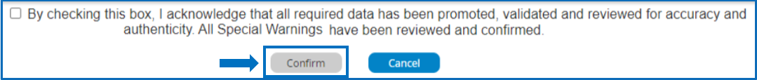
MARK SUBMISSION AS COMPLETE (CONTINUED)
When Fatal free, click the Complete button, read the acknowledgement, and check the box.
Click Confirm. Your Collection has now been submitted to TEA and is final.

Slide 49
RESETTING SUBMISSION (OPTIONAL STEP)

Slide 50
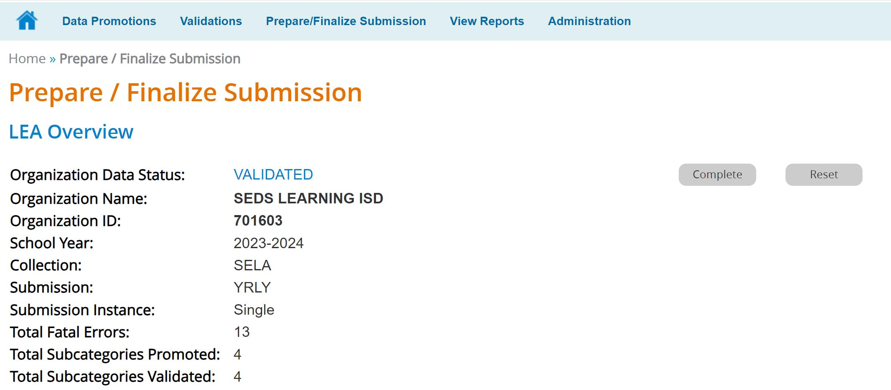
RESETTING SUBMISSION
Click the Reset button, read the acknowledgement statement and check the box.
Then, click the Confirm button.

Slide 51

TRAINING ACTIVITIES
Practice, Troubleshooting, Knowledge Checks

Slide 52
PRACTICE EXERCISE (CORE APPLICATION)
Task 1: Promote, Validate data and Generate reports
Task 2: Monitor the promotion.
Ready
Set
Go

Slide 53
TROUBLESHOOTING 1
Scenario 1: Why don’t I see the Core Collection tab in the TSDS Portal?
Resolution Steps:
The Core Collection tab will only appear in the TSDS Portal if you have one of the following roles and appropriate privileges:
LEA roles:
Core LEA Data Viewer
Core LEA Data Promoter
Core LEA Data Completer
Core LEA Data Approver
ESC roles:
Core ESC Data Viewer
To add a LEA/ESC Core role:
Log into TEAL with your username and password.
Select Add/Modify Access in the Texas Student Data System Portal.
Enter your Employing Organization and select the appropriate Core LEA/ESC role.
Enter the Requested Organization.
Review the Privileges and check those that are appropriate for your job function.
Click Done. Click Save Changes.

Slide 54
TROUBLESHOOTING 2
Scenario 2: Why don’t I see the Administration tab in the Core Collection application to request an extension for ECDS?
Resolution Steps:
The Administration tab will only appear in the Core Collection application for ECDS if you have added the ECDS Access privilege to the Core LEA Data Approver role.
To modify a LEA/ESC Core role:
Log into TEAL with your username and password.
Select Add/Modify Access in the Texas Student Data System Portal.
Select the Core LEA Data Approver role and select Modify Access.
From the list of roles, find ‘Core LEA Data Approver’ and click Modify.
In the privileges section, ensure ‘ECDS Access’ is selected.
Click Done. Click Save Changes.

Slide 55
TROUBLESHOOTING 3
Scenario 3: Why can’t I reset a submission after the Submission due date?
Resolution Steps:
It is best practice to promote, validate and review all Fatal and Special Warning errors.
Run report and verify information on the reports is accurate.
Once all Fatal errors are resolved and the data is validated, mark the submission as Complete.
If discrepancies or missing information are discovered after marking the submission as Complete, LEAs can reset their submission during the submission open window period.
Core submissions can only be reset during the submission open window period.

Slide 56
KNOWLEDGE CHECK 1
Which TSDS tab should be used to prepare and finalize the RF Tracker, Class Roster, ECDS, SELA, CSW, SPPI-14 and SPEDS Submissions?
TSDS PEIMS
TSDS Core Collection
TSDS Unique ID
Notes:
NOTE:
To see the answer, you must be in presentation mode.

Slide 57
KNOWLEDGE CHECK 2
The ‘Promote’ function promotes the TSDS Core Collection data from the IODS to the Core Collection Data Mart.
True
False
Notes:
NOTE
To see the answer, you must be in presentation mode.

Slide 58
KNOWLEDGE CHECK 3
In the Core Collection, the Administration tab should be used for which of the following tasks?
Promote data
Request an extension
Run Reports
Notes:
NOTE: To see the answer, you must be in presentation mode.

Slide 59
KNOWLEDGE CHECK 4
Once users have identified data errors or incomplete data records they should:
Click the acknowledgement checkbox and click complete even though the data is incorrect
Research the data errors in the vendor software and make the necessary corrections.
Click prepare to finalize the data submission
All of the Above
Notes:
NOTE: To see the answer, you must be in presentation mode.

Slide 60
KNOWLEDGE CHECK 5
The TSDS Core Collections cannot be completed if there are:
Special Warnings
Fatal errors
Notes:
NOTE: To see the answer, you must be in presentation mode.

Slide 61
KNOWLEDGE CHECK 6
6. L2 Validations in the DMC can be scheduled and viewed:
One week before the submission is due to TEA.
Only on Tuesdays.
At any time after the collection opens and prior to when the specific collection closes.
Only after the data has been promoted to TSDS.
Note: Running L2 Validations in the DMC will allow the LEA to begin clearing up errors before they promote the data to the Data Marts.
Notes:
NOTE
To see the answer, you must be in presentation mode.

Slide 62

WRAP UP
Key Takeaways, Resources, and Next Steps

Slide 63

KEY TAKEAWAYS
Currently there are seven core collections in TSDS.
The Core role the LEA staff would request will depend on the individual’s level of responsibility.
The Administration tab should be used to request an extension.
TRAINING RESOURCES
Key Terms and Definitions

Slide 64
TECHNICAL RESOURCES
TEA Website and Communication Resources
Texas Student Data System
What is the Core Collection?
Link to Key Terms Document
Texas Education Data Standards Resources
TSDS Web-Enabled Data Standards (TWEDS)

Slide 65
NEXT STEPS
Complete a Teach Back Exercise
Complete Core Collection Certification Test
Attend TSDS Continuing Education Trainings (CET)
Participate in TSDS Just-in-Time Trainings (JIT)
Attend Field Coordination Network (FCN) webinars for updates and changes

Slide 66
WRAP UP
In this training we talked about:
The TEAL roles for TSDS Core Submissions.
How to promote, validate and complete Core Submission.
How to run and view TSDS Reports for Core Submission.
How to reset a submission.

Slide 67

QUESTIONS

