Slide 1

TITLE SLIDE: TSDS ODS 3.x Project
Updates
Common Steps for TSDS Core Collections
New User Certification Training
Notes:
This is Part 2 of the Core Certification trainings and focuses on navigation and workflow.

Slide 2
KEY TERMS
Application Programming Interface (API)
Core Application
Data Element
Data Promotion
Data Submission
Data Validation
Descriptor Table/Value
Domain
Entity
Level 2 (L2) Validations
Level 3 (L3) Validations
Texas Education Data Standards (TEDS)
TSDS Incident Management System (TIMS)
TSDS Web-Enabled Data Standards (TWEDS)
You can find the definitions to these key terms and more here:
Key Terms and Definitions Document

Slide 3
LEARNING OBJECTIVES
  By the end of this course, the users will be able to explain:
The TEAL roles for TSDS Core Submissions.
How to navigate TWEDS.
How to run and view Level 2 validations.
How to promote, validate and complete Core Submission.
How to run and view TSDS Reports for Core Submission.
How to reset a submission.

Slide 4
WHY IS THIS COURSE IMPORTANT
  To understand the common process for completing your TSDS Core submissions.
  To understand the reporting requirements in the TEDS via TWEDS to effectively address data validation errors when they occur.
  To be able to view and correct your data prior to promoting.
  To be more self-sufficient in all the above.
Notes:
See slide.

Slide 5

COURSE AGENDA
Getting Started
TSDS Architecture and TEAL Roles
Key Concepts
TWEDS and L2 Validations
Training Activity
Practice and Knowledge Checks
Wrap Up
Key Takeaways, Resources, and Next Steps

Slide 6


GETTING STARTED
TSDS Architecture & TEAL Roles

Slide 7
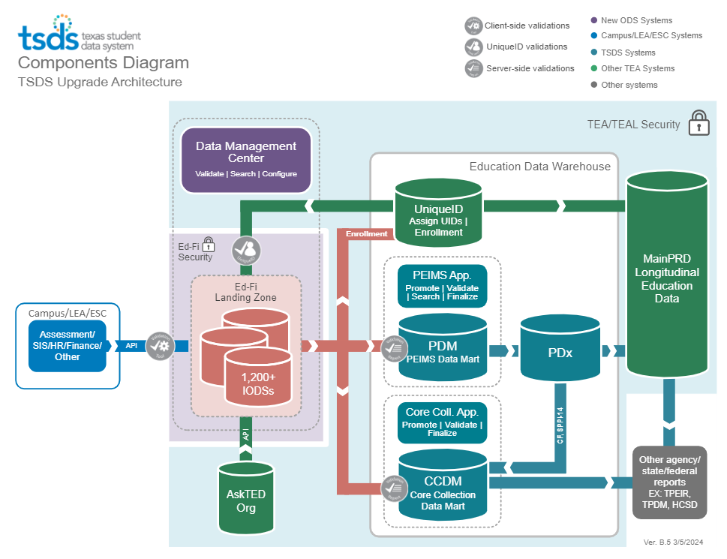
HIGH-LEVEL ARCHITECTURE
Notes:
Note
If you have covered this material in another training, this content can be skipped.

Slide 8
LEA TEAL ROLES – CORE COLLECTION
Core LEA Data Viewer
This role monitors data promotions and data validations and generates reports.
Core LEA Data Promoter
  This role schedules and monitors promotions, schedules and monitors validations, and generates reports.
Core LEA Data Completer
  This role formally certifies the completeness and accuracy of the data and finalizes the submission. In addition, this role also schedules and monitors promotions, schedules and monitors validations, and generates reports.
Core LEA Data Approver
This role will be for the superintendent or his/her designee at the LEA. This role requests an extension if needed.
Notes:
The role the LEA staff would request will depend on the individual’s level of responsibility.

Slide 9
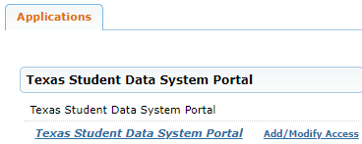
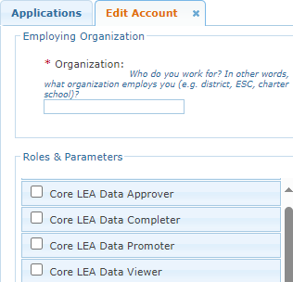
APPLY FOR CORE ROLE
Login to your TEAL account; Click Add/Modify Access.
Enter your Employing Organization and select the appropriated Core LEA TEAL role.

Slide 10
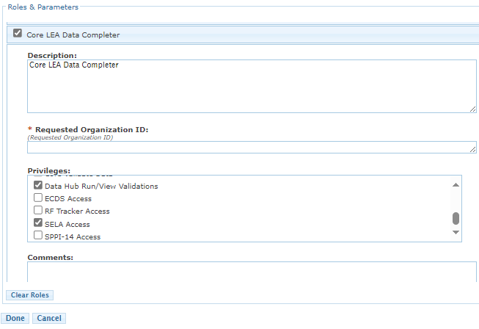
CORE TEAL ROLE & PRIVILEGES
Users will check the appropriate role based on their level of responsibility at the LEA and in the Requested Organization ID enter their Organization ID.
Next, check the appropriate Privilege and click Done.
The final step is to click Save Changes on the next screen.

Slide 11
ESC TEAL ROLES – CORE COLLECTION
Core ESC Data Viewer
  This role will be able to view and monitor activity for any Core Collection in TSDS for the LEAs the ESC supports.
Notes:
The ESC Data Viewer role will allow the ESC to monitor the data promotions for all Core Collections for the LEAs in their region.

Slide 12


KEY CONCEPTS
TWEDS and Level 2 Validations

Slide 13

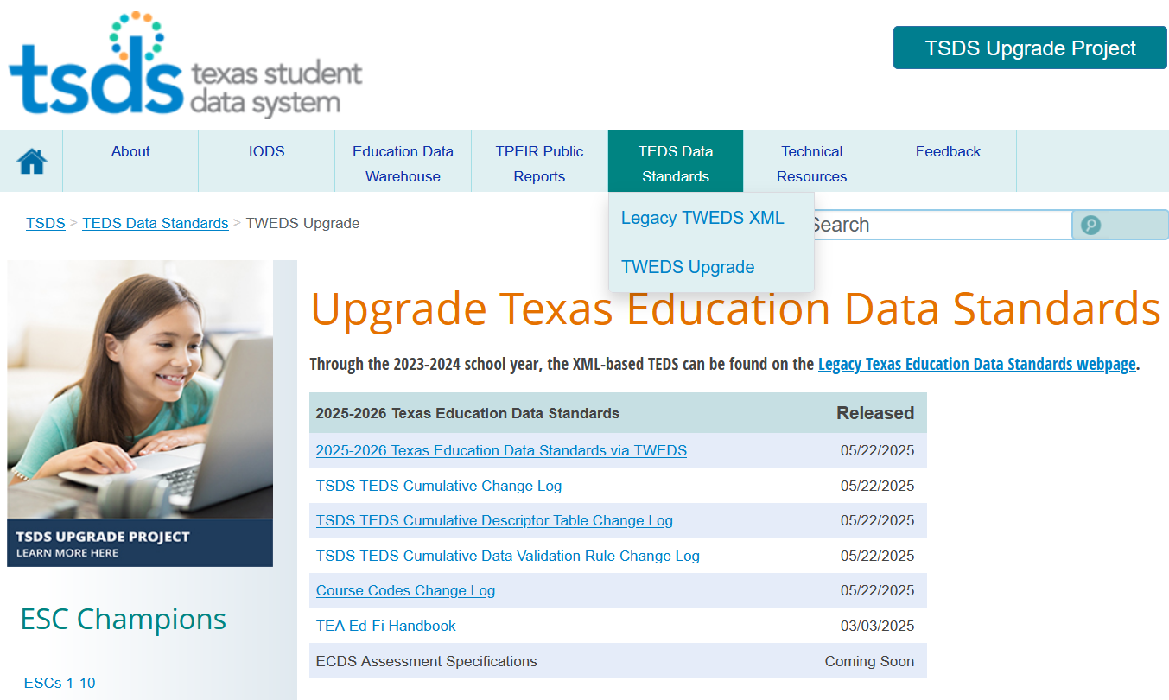
WHERE IS TWEDS
  Go to the TSDS website at https://www.texasstudentdatasystem.org
  Hover over the TEDS Data Standards tab.
  Next, click on ‘TWEDS Upgrade’
  Finally, click on the “XXXX-XXXX Texas Education Data Standards via TWEDS” hyperlink.
Texas Education Data Standards
Notes:
Explain what are TEDS and TWEDS at the start of the demo.

Slide 14
DEMONSTRATION 1
Navigate to the TSDS Web-Enabled Data Standards (TWEDS).
TWEDS Tabs
  Overview
  Data Components
  Descriptor Tables
  References
  Rules
  Change Logs
  Early Notice
Search Features
Notes:
Trainer: explain and show the following information in the demo:
1.What is TEDS/TWEDS
TEDS stands for the Texas education data standard – these are the standards on how to report data for TSDS State reporting.
TWEDS stands for the TSDS web enabled data standards – A web-based version of TEDS. These standards describe the data reporting requirements.
2, Overview of each TWEDS tab (Overview
Data Components
Descriptor Tables
References
Rules
Change Logs
Early Notice
3, How to search in TWEDS

Slide 15
TWEDS

Slide 16
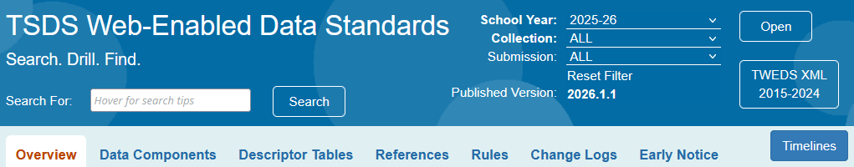
TWEDS – SETTING SEARCH CRITERIA
  Year – You will specify the information you wish to view first by school year.
  Collection – Next, you can select to view information for all collections or for a specific data collection.
  Submission – If the collection selected has multiple submissions, you will select the submission, i.e., PEIMS Fall, ECDS-KG.
  Published Version – You can see the current version of TEDS.
  Open – You will be prompted to click “Open” to set the selected criteria.

Slide 17
TWEDS – SEARCH FEATURE
  Use key words to find information across data elements, descriptor tables, entities, rules, categories, and more.
  Use quotation marks to search for a whole phrase: “staff serving” only returns components containing the exact phrase “staff serving”.
  Use an asterisk (*) to search for parts of words: educat* returns both EducatedAtResidentialFacility and EducationServiceCenterId. Currently, the system does not require an asterisk to search for a part of words.
  Use multiple search terms with no quotation marks to return results for any of the search terms: emergent bilingual returns BilingualESLFunding, ParentalPermission, and EmergentBilingualIndicator, each containing only one of the search terms. The search is performed on the data element name and the data element definition.

Slide 18
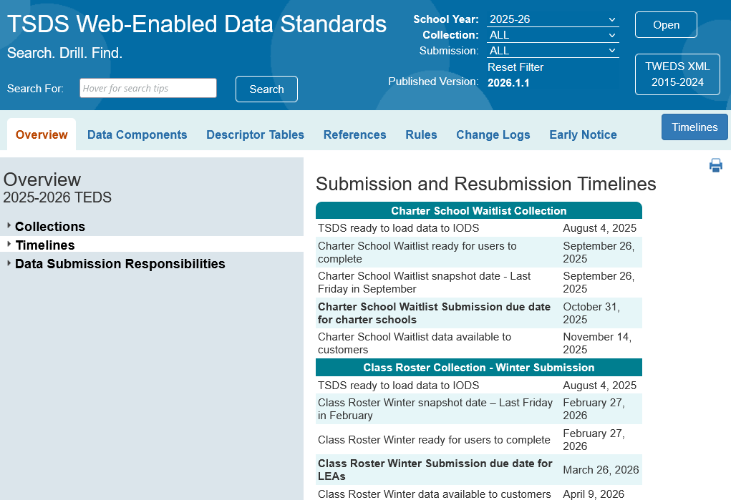
TWEDS – TIMELINES BUTTON
  Timelines button provides easy access to the Submission and Resubmission Timelines.
18

Slide 19
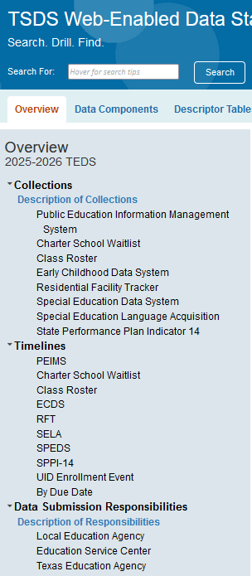
TWEDS – OVERVIEW
  Overview Tab:
      Collections menu provides a brief introduction to TEDS, PEIMS, and each of the TSDS Data Collections
      Timelines menu provides the important dates for each data collection.
      Data Submission Responsibilities menu provides data submission specifications and responsibilities for the LEA, ESC and TEA.

Slide 20
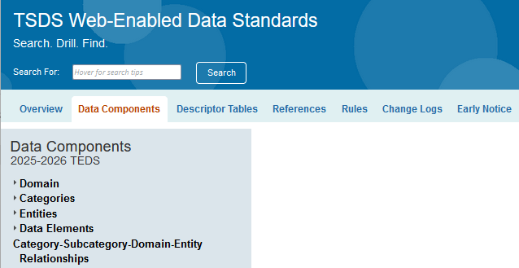
TWEDS – DATA COMPONENTS
  Data Components Tab:
    Domains: Lists all relevant Domains based on your selected criteria.
    Categories: Shows all applicable Categories for your chosen criteria.
    Entities: Summarizes Entities by their Submission details.
    Data Elements: Lists all applicable Data Elements based on your selected criteria.

Slide 21
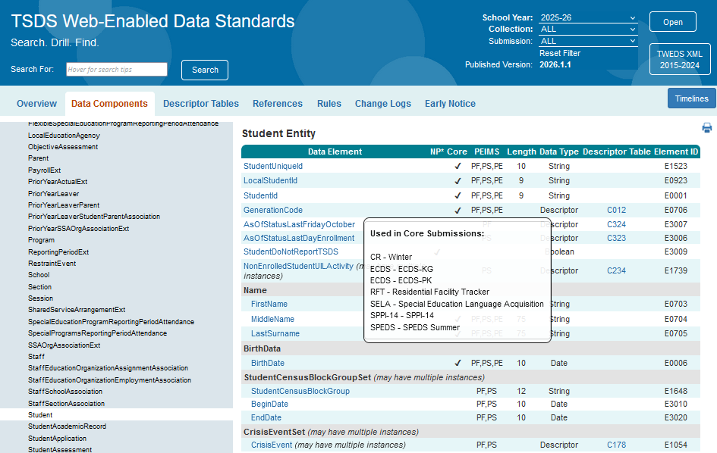
TWEDS – DATA COMPONENTS 1
  Within each Entity, every data element will display to which Collection/Submission the data element will be reported for TSDS state reporting.

Slide 22
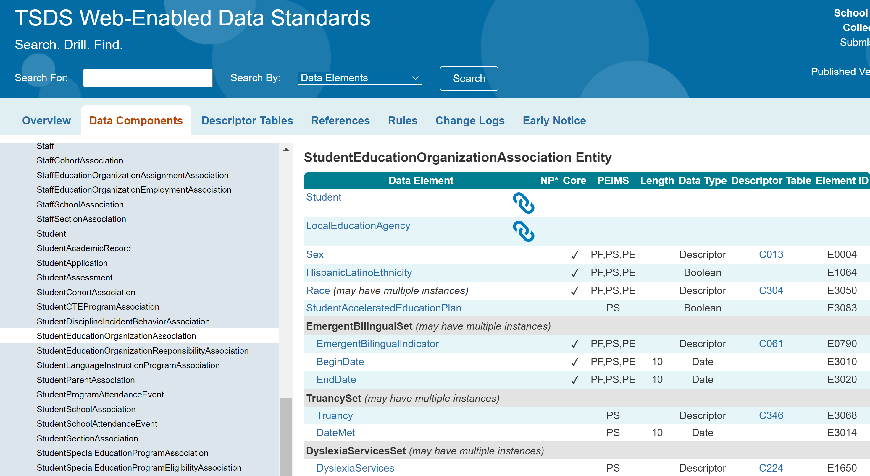
TWEDS – DATA COMPONENTS 2
The Reference icon means that the information for a data element will come from a previously published data element.
For example, the StudentEducationOrganizationAssociation entity will reference the Student Entity, which was previously published to the IODS, to capture basic information about a student. (Also referred to as Referential Integrity.)
22

Slide 23
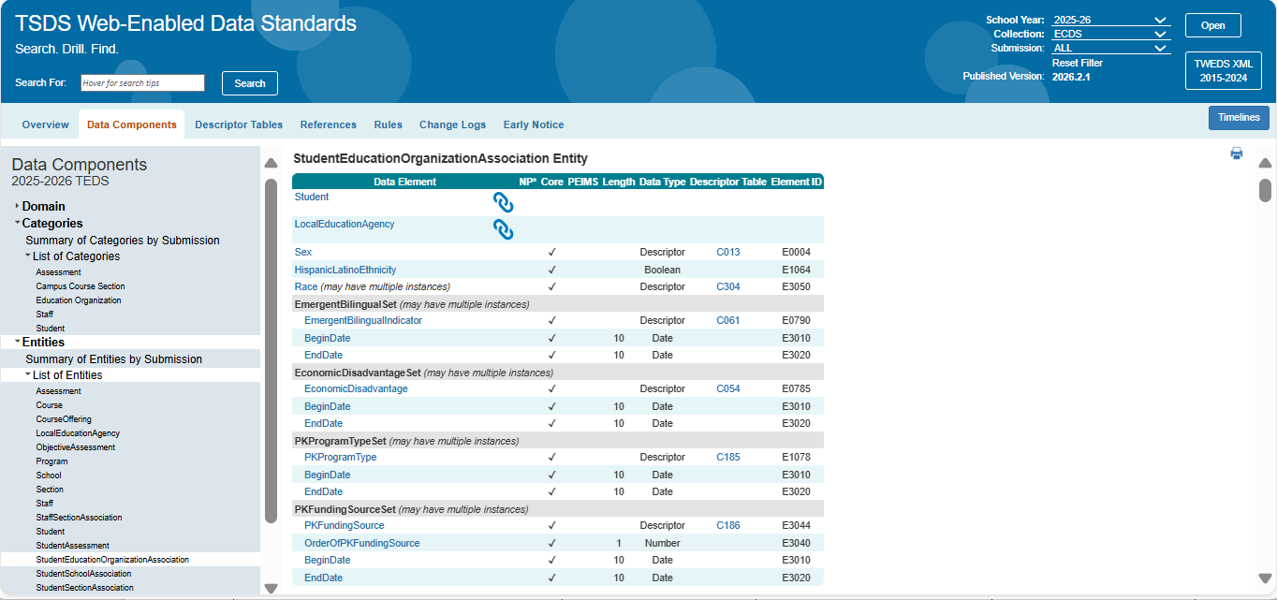
TWEDS – DATA COMPONENTS 3
  May Have Multiple Instances: This means more than one set of this data may be reported in a single instance of this entity.
For instance, in this example, you can have multiple EconomicDisadvantageSet depending on if the student’s qualification changes.
23

Slide 24
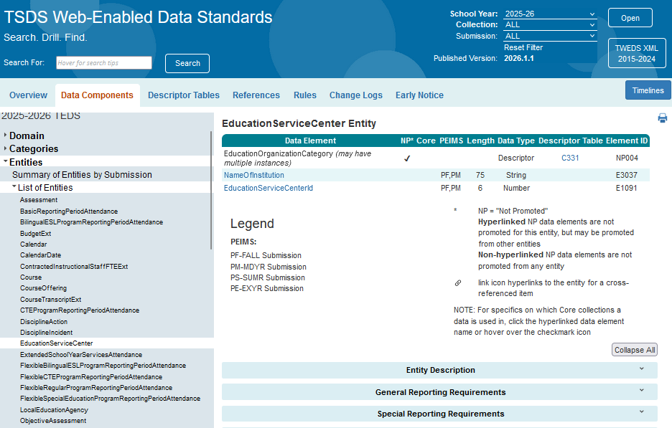
TWEDS – DATA COMPONENTS 4
NP* (Not Promoted Data Elements)
    Data elements that are part of the key or mandatory for Ed-Fi but not used by TEA. These data elements will be loaded into the IODS but will not be promoted to the Core Collection Data Mart.
    In this example, within the EducationServiceCenter Entity the EducationOrganizationCategory data element will not be promoted to TSDS since it has a check mark under the NP* column.

Slide 25
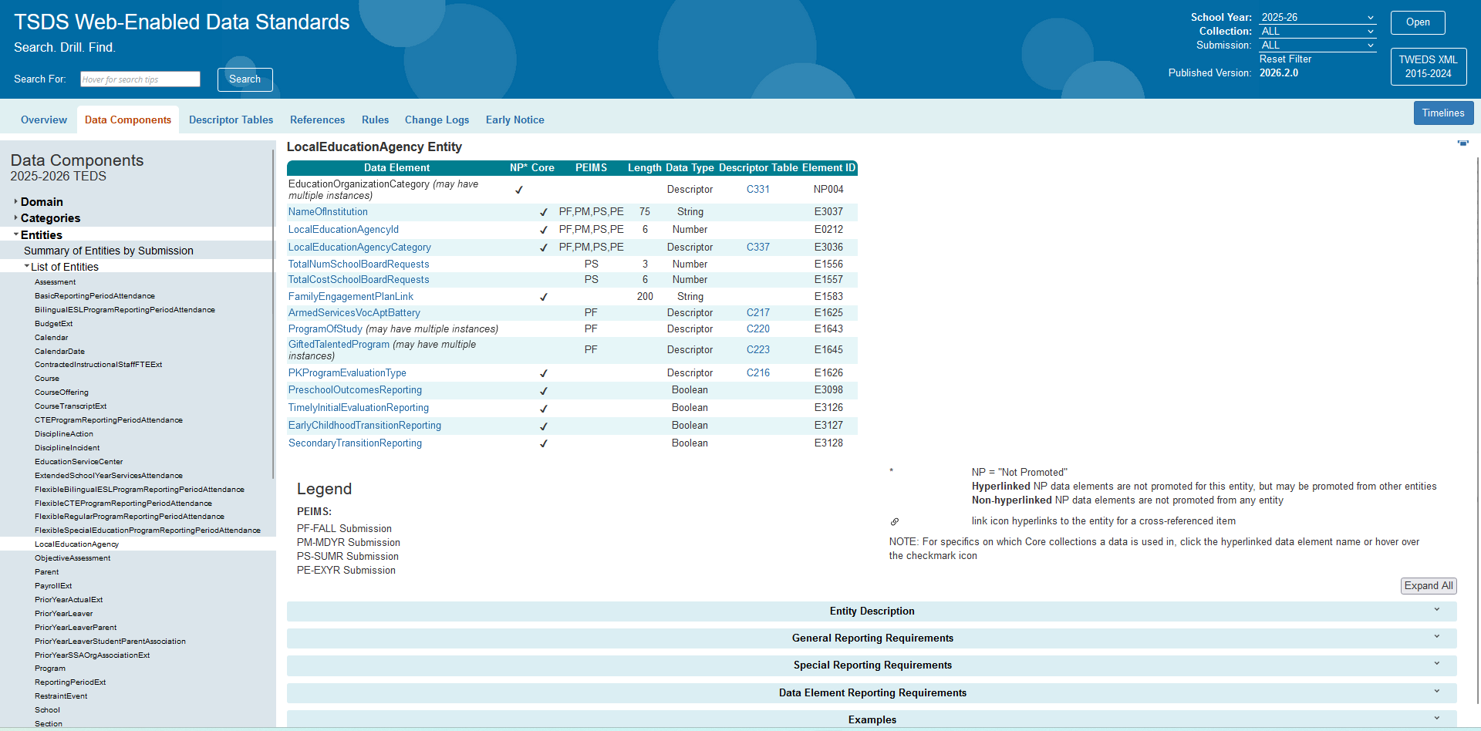
TWEDS – DATA COMPONENTS 5
  The Data Submission Requirements information is included at the bottom of each entity.

Slide 26
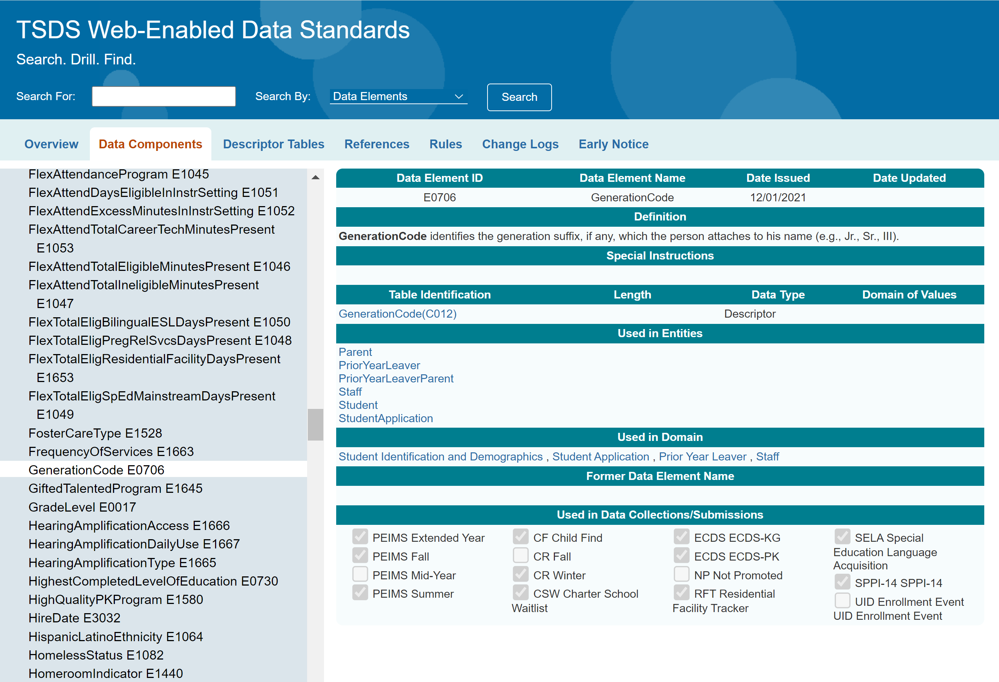
TWEDS – DATA COMPONENTS 6
  Within each data element, you can see to which Collection/Submission the data element will be reported for TSDS state reporting.

Slide 27
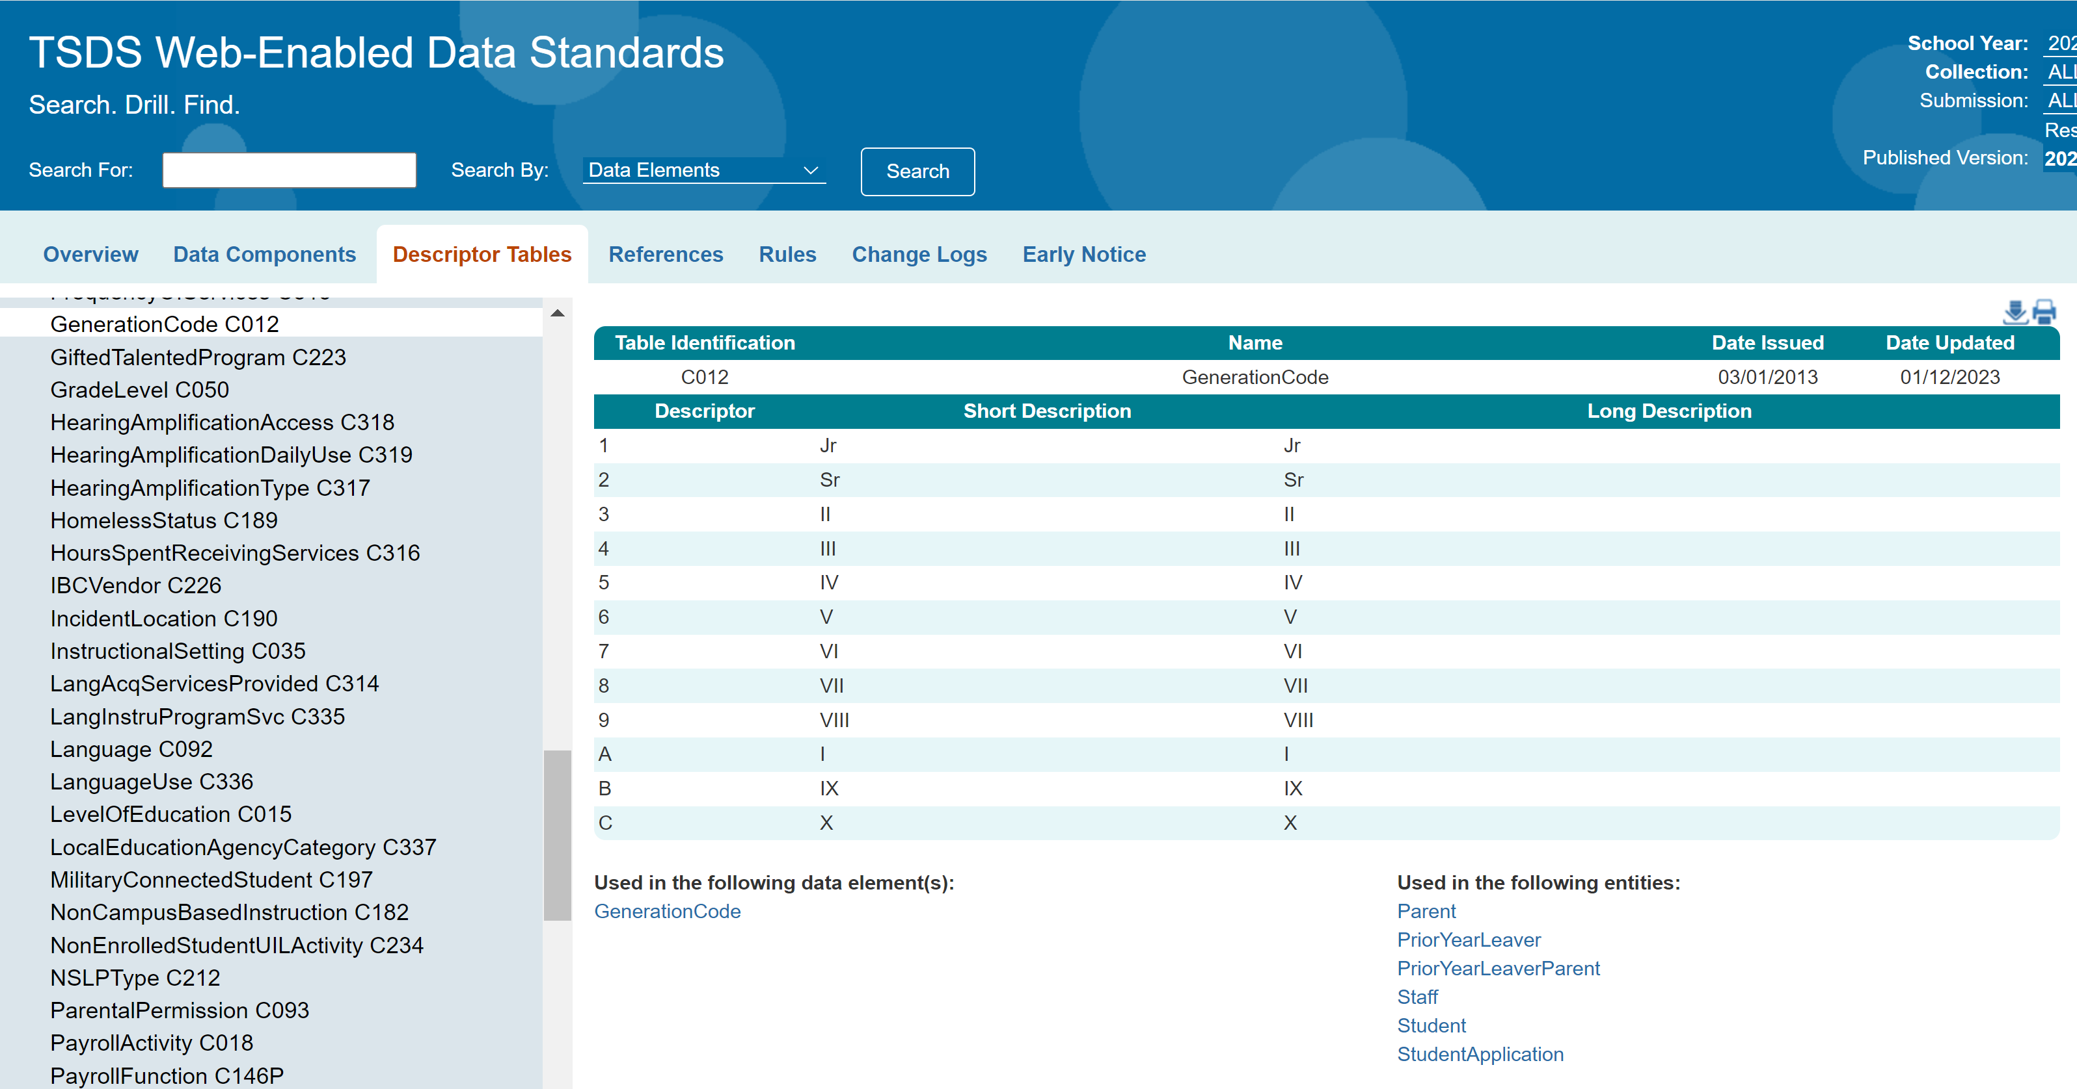
TWEDS – DESCRIPTOR TABLE
  For example, for data element GenerationCode, the LEA’s vendor(s) should publish the descriptor value “1” to the LEA’s IODS, not “Jr”. If the vendor publishes "Jr" or any other local value that means "Jr" to the LEA's IODS, mapping will be required to promote the appropriate state descriptor value to TSDS.

Slide 28
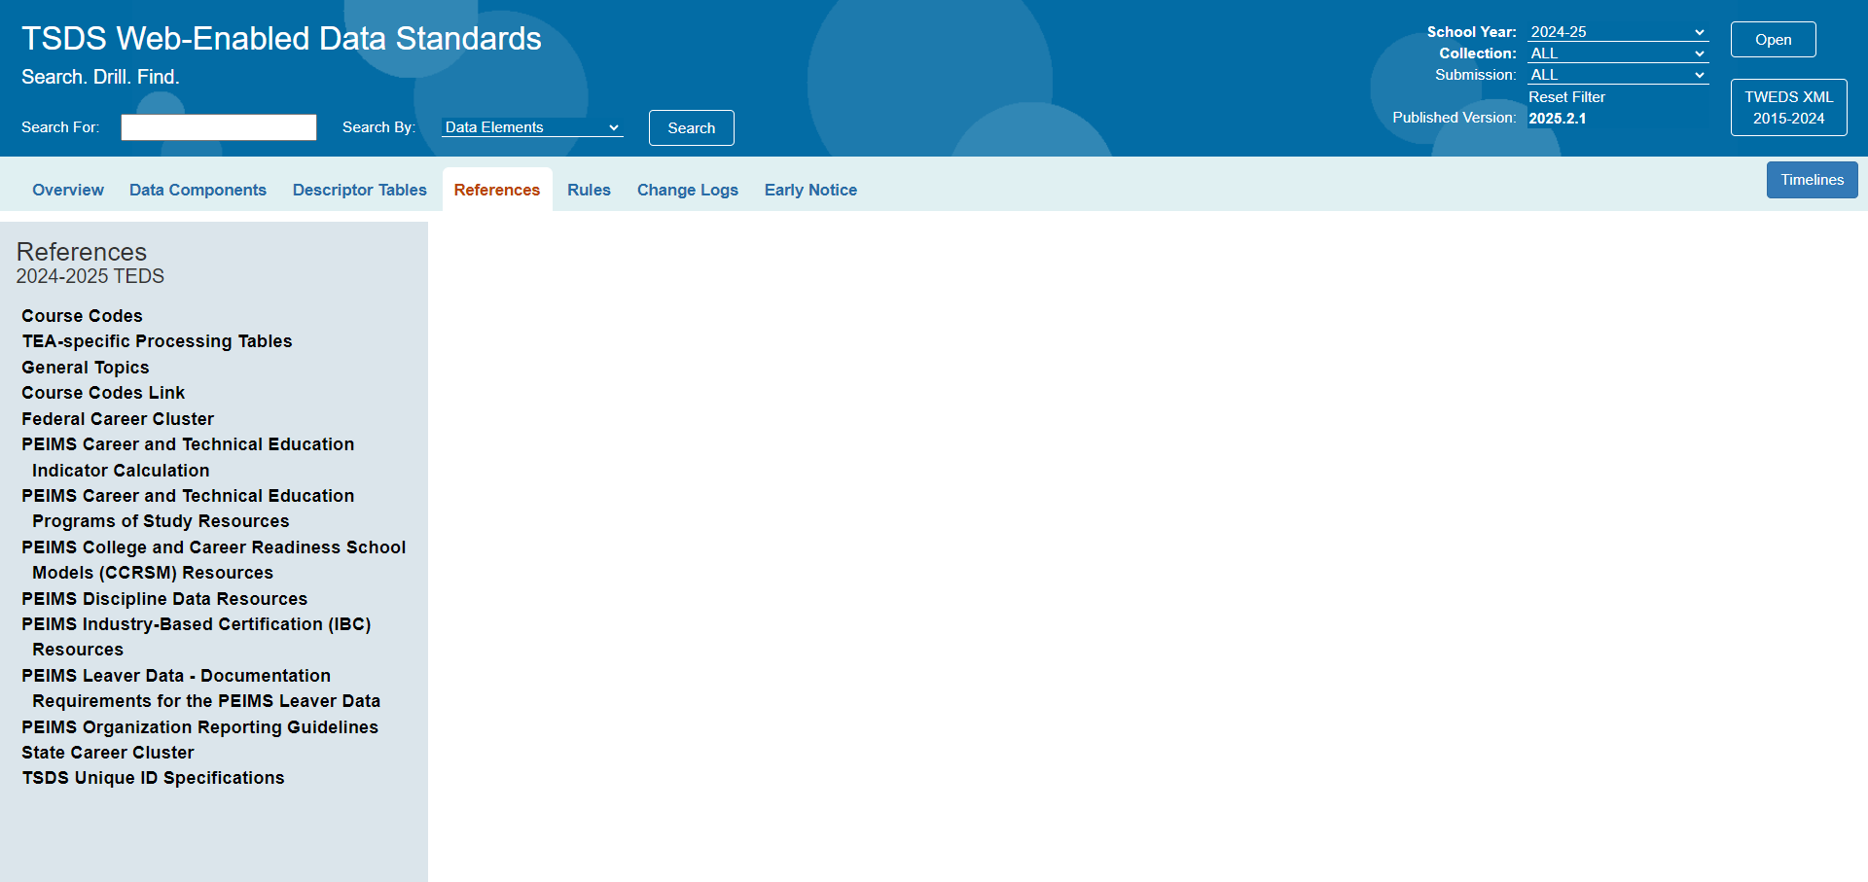
TWEDS – REFERENCES
The References tab provides links to information that offers guidance on reporting requirements.

Slide 29
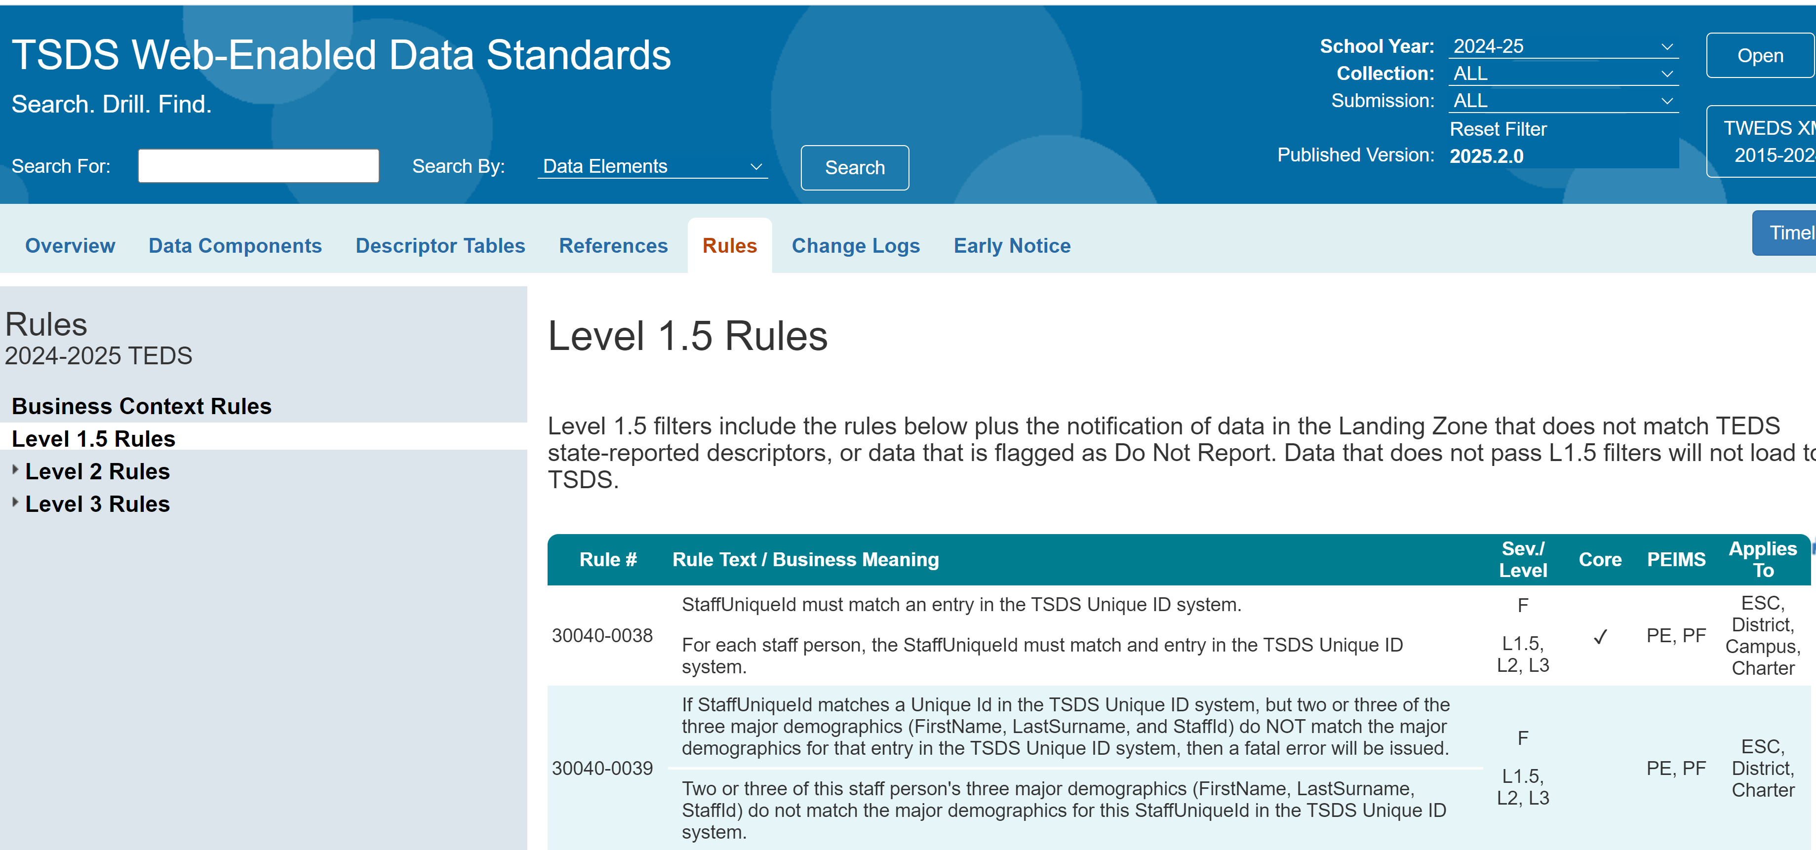
TWEDS – RULES
In each rule, a check mark in the Core column will show the Core collections for which the rule applies.
The PEIMS column will indicate PF = PEIMS Fall, PS = PEIMS Summer, etc.

Slide 30
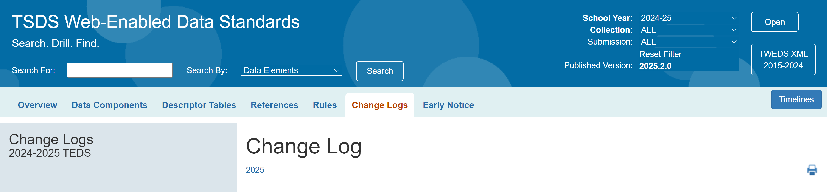

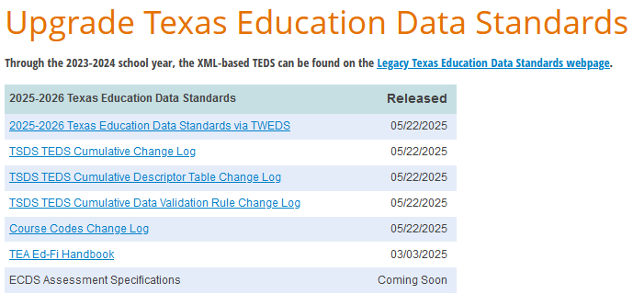
TWEDS – CHANGE LOGS
The Change Logs tab will have three change logs to show you the changes from one TEDS publication to the next.

Slide 31
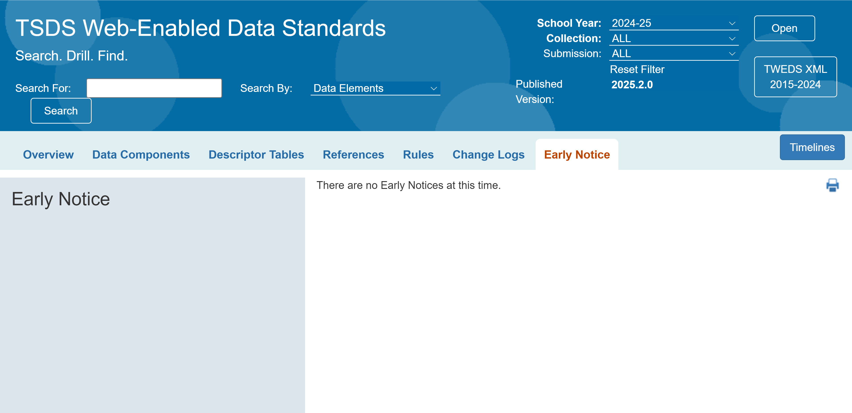
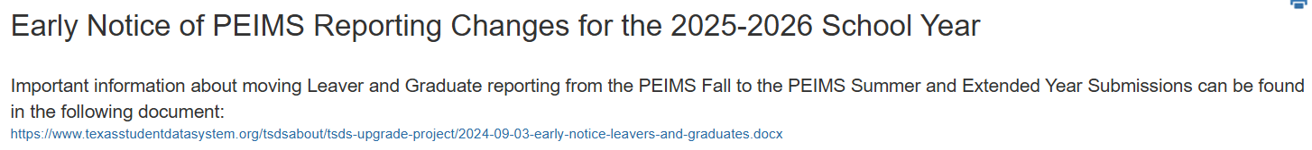
TWEDS – EARLY NOTICE
Early Notice:
  When TEA has a notice to provide to LEAs for future data collections, the notice will be displayed on this tab.

Slide 32
L2 VALIDATIONS

Slide 33
DEMONSTRATION 2
Login to TEAL Account.
Navigate to DMC.
Hover over Monitor Validations.
Click Schedule L2 Validation Job and schedule a job.
Click on View Scheduled L2 Validation.
Click on View L2 Validation Summary.
Click on View L2 Validation Details and determine how to resolve L2 Validations.
Click on View L2 Validation Rule Count.
Note: The Reference Guide (RG) is a resource that provides step-by-step instructions for Scheduling and Viewing L2 Validations.
Level 2 Validations Reference Guide
Notes:
Trainer: explain what are L2 validations and show the following information in the demo:
What are L2 Validations
Navigate to DMC
Schedule L2 Validation Job
View Scheduled L2 Validation
View L2 Validation Summary
View L2 Validation Details
View L2 Validation Rule Count

Slide 34
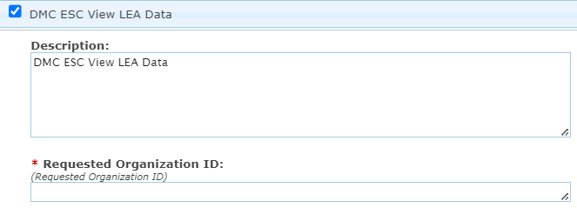
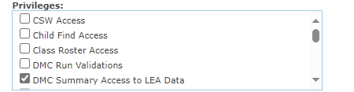

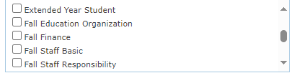
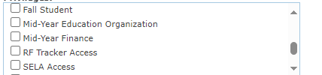

APPLY FOR DMC LEA L2 VALIDATIONS ROLE
DMC LEA L2 Validations Role
DMC LEA L2 Privileges
Ensure that users select only the privileges needed for their job responsibilities.
To Run and/or View L2 Validations the collection specific privilege(s) must be selected to match the user’s job responsibilities.

Slide 35
LEVEL 2 VALIDATIONS
L2 Validations are business rule validations that are viewed in the DMC on the data destined for TSDS.
  L2 Fatal, Special Warning, or Warning validation errors do not prevent data from being promoted to TSDS.
  L2 Validations can be scheduled and viewed anytime after the collection opens and prior to when the collection closes.
  Scheduling and viewing L2 Validations in the DMC is an optional (but highly recommended) step in the submission process.
    This step will allow the LEAs to begin reviewing and correcting errors prior to promoting the data to TSDS.

Slide 36

SCHEDULING L2 VALIDATIONS
  Users will schedule the L2 Validations in the DMC to run.
  L2 Validations are not available on-demand but rather are processed overnight.
  The L2 Validations must be scheduled prior to the cutoff time in order to run overnight as indicated on the Run L2 Validations screen in the DMC.
  Users will be able to schedule L2 Validations by:
    Collection
      Submission
        Category
          Subcategory

Slide 37
SCHEDULE RECURRING L2 VALIDATIONS
  Users will be able to schedule recurring L2 Validation jobs to run automatically on a set schedule in the DMC.
  Users will schedule L2 Validations by:
            Collection, Submission, Category, and Subcategory
          Users will be able to schedule L2 Validation jobs to run for a fixed future date.
          Users will be able to set a Recurrence Pattern for specific days of the week and the date range for a recurring job.
            Scenario: Let’s say the user meets with the PEIMS team and the HR/Finance team during November and December every Wednesday as they are working on PEIMS Fall. The PEIMS Coordinator can set the L2 Validations job to run every Tuesday during these two months so their team can review the L2 validation errors in their Wednesday meetings.

Slide 38
LEVEL 3 VALIDATIONS
Level 3 Validations are the same data validations that are run today in the PEIMS and Core applications.
  These validations are run from the PEIMS and Core applications
  They include Fatal, Special Warning, or Warning (excluding Core) validation errors
Level 3 Validations contain all Level 2 Validations, plus any additional validations required for the TSDS submissions.
  Include validations and calculations that require referential integrity and data dependencies.
    Example: If SPPI 11 Compliance (calculated value) is “y” then
    EvaluationDelayReason must be either not reported or "07".
  Fatal validation errors will prevent TSDS submissions from being completed or finalized.

Slide 39
TIMS

Slide 40
LEVELS OF SUPPORT – PART 1
Level | TEAL Role/Description | Description/Privileges
TSDS User | Any user with a role in one or more of the TSDS Portal applications | • Searches Knowledge Base for help • Submits incidents, questions, and requests for enhancements to TIMS, and view incidents submitted
Level 1 Support | TIMS Level 1 Support The first contact for questions by district or charter school users, who work with internal district source data experts to diagnose and resolve incidents | • Searches Knowledge Base for help • Submits incidents in TIMS • Monitors and manages the TIMS Level 1 queue • Resolves incidents • Escalates incidents to Level 2 Support when necessary
Level 2 Support | TIMS Level 2 Support Support personnel at the ESC or certified vendor who monitor and receive escalated incidents from Level 1 Support staff, and assist in diagnosing, resolving, or escalating incidents. | • Searches Knowledge Base for help •Submits incidents in TIMS • Monitors and manages incidents in TIMS for LEAs for whom they provide support • Escalates incidents to Level 3 Support when necessary
Notes:
Trainer Notes​
On this screen, you will learn about the TIMS TSDS User, TIMS Level 1 Support, and TIMS Level 2 Support roles.

Slide 41
LEVELS OF SUPPORT – PART 2
Level | TEAL Role/Description | Description/Privileges
Level 3 Support | Support staff at TEA who monitor and receive escalated incidents from Level 2 Support staff and assist in diagnosing, resolving, or escalating incidents. | • Searches Knowledge Base for help • Monitors and manages incidents in TIMS that have been escalated to Level 3 • Escalates incidents to Level 4 Support when necessary • Maintains the Knowledge Base Articles (KBAs) • Closes incidents that are resolved at Levels 1 and 2 • Provides triage support with appropriate TSDS staff
Level 4 Support | Appropriate roles needed for advanced TEA technical support | Monitors and manages incidents in TIMS for the specific component for which they provide support
Notes:
Trainer Notes​
On this screen, you will learn about the TIMS Level 3 Support and TIMS Level 4 Support roles.
NOTE:
Level 3 has the same privileges as Level 1 Support and Level 2 Support.
For Level 3 Support role, the support personnel close tickets which is different than resolving or providing a solution to an incident.

Slide 42
DEMONSTRATION 3
Process for Creating an Incident
From the dashboard homepage, click the Create button.
Click Auto-fill my name, telephone and email.
Click the Submitter Org dropdown menu and select the submitter’s organization from the list.
Click the appropriate Subsystem.
Click the appropriate Subcategory.
In the Summary field, enter a summary of the incident that identifies where the incident occurred.
Type a brief, but detailed description about the incident.
Click the Priority dropdown menu to select the severity of the incident.
To include an attachment, click browse or drag and drop files.
In the Environment field, type information about the user’s workspace such as browser type, URL link where the error occurred, software platform, or hardware information.
To escalate an incident when creating an incident, read the data use agreement, then click the box next to Escalation.
To submit the incident, click the Create button.
Notes:
Trainer Notes
Log in to TIMS and complete a demo. The steps to be included in the demo are covered on slides 35-43.

Slide 43
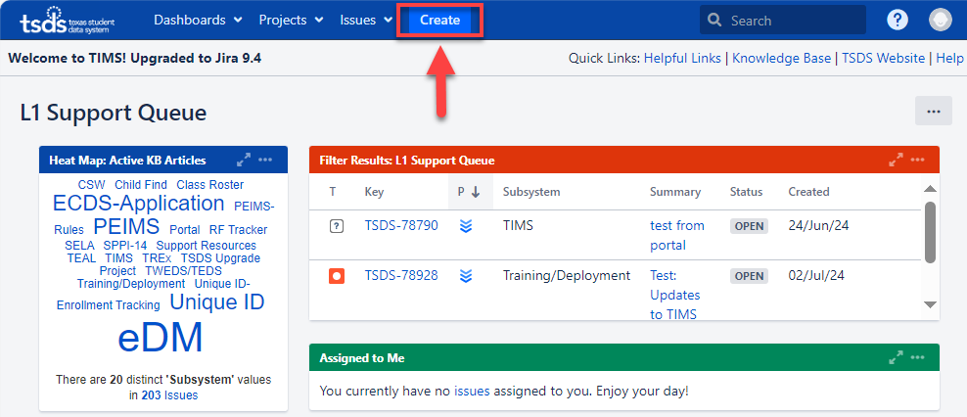
HOW TO CREATE AN INCIDENT
Notes:
Trainer Notes​
To create an incident in TIMS:
From the dashboard homepage, click the Create button.
This process is the same for TSDS users, except for the Subsystem and Subcategory dropdowns.

Slide 44
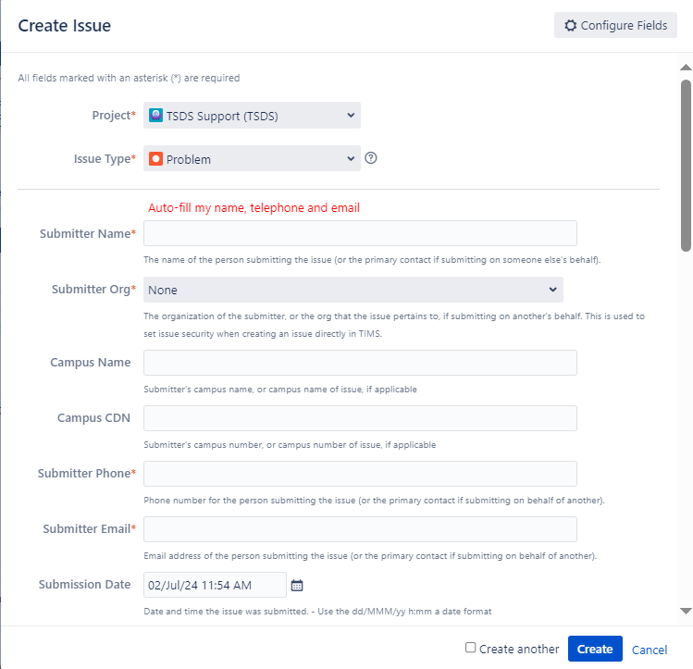
INCIDENT CREATION FORM
Notes:
Trainer Notes
This image shows a screen capture of the incident creation form that will appear once you click the Create button shown on the previous slide.

Slide 45
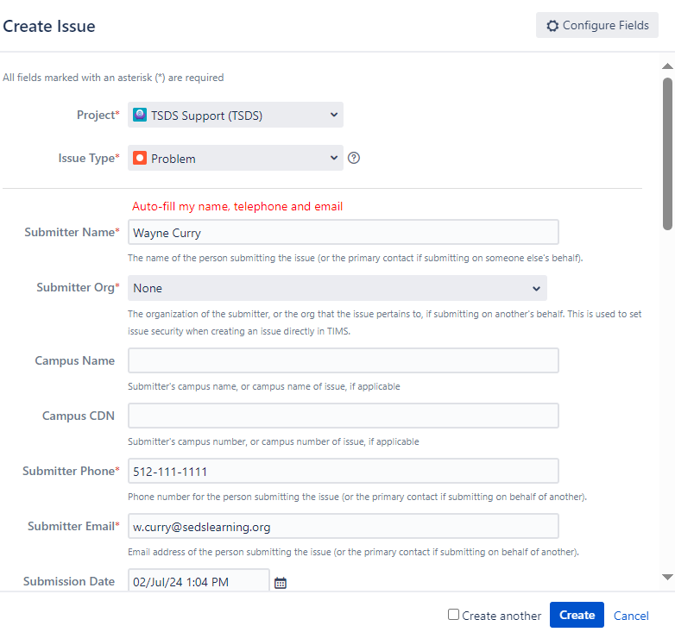
CREATING AN INCIDENT
Notes:
Trainer Notes​
​
Click Auto-fill my name, telephone and email.
If your information does not auto-populate, enter your name in Submitter Name, your phone number in Submitter Phone, and your email address in Submitter Email.
Click the Submitter Org dropdown menu and select the submitter’s organization from the list.
If you are creating an incident on behalf of another organization, select their organization from the dropdown menu.
Optional Steps
If applicable, in the Campus Name field, enter the name of the campus that was affected by the incident.
If applicable, in the Campus CDN field, enter the county-district number of the campus that was affected by the incident.
The Submission Date field is automatically set for the current date and time. If the incident occurred at a different date and time, click the calendar to select the correct date, and change the time at the bottom of the calendar.

Slide 46
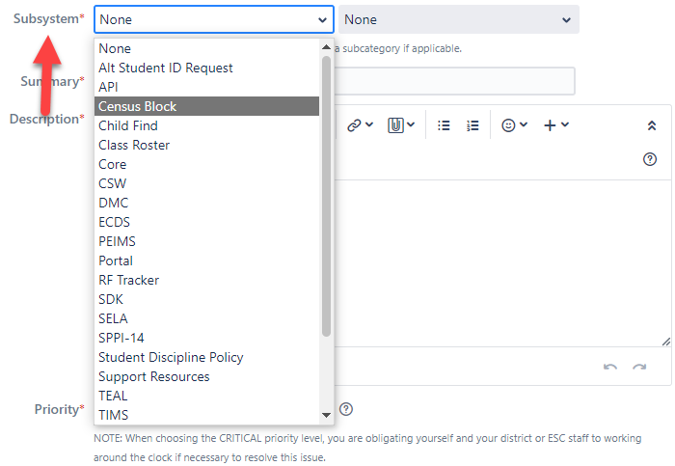

SUBSYSTEM AND SUBCATEORGY
Notes:
Trainer Notes
Top image
Click on the appropriate Subsystem.
The Subsystem has a list of applications and products to choose from based on where the incident occurred.
Bottom image
Click the appropriate Subcategory.
The Subcategory is the second dropdown menu next to the Subsystem dropdown.
This menu provides multiple options depending on the Subcategory.
Example: If you select the subsystem Census Block, the available subcategories are Calculator and Map.
For TSDS users, the Subcategory dropdown menu is intuitive.
Once you select the subsystem from the Subsystem dropdown menu, the Subcategory menu appears if there are subcategories available to choose.

Slide 47
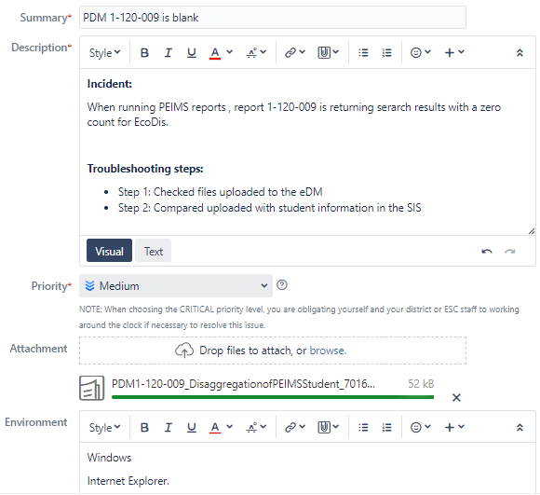
CREATING AN INCIDENT CONT.
Notes:
Trainer Notes​
In the Summary field, enter a summary of the incident that identifies where the incident occurred.
Example: PDM1-120-009 is blank.
Do not include personal identifying information in the summary field (student or staff names, social security numbers, student or staff IDs, DOB, addresses, etc).
Type a brief, but detailed Description about the incident.
Include what you were doing in the system when the incident occurred.
Include what troubleshooting steps you executed to try and resolve the problem.
If it is necessary to help resolve the incident, you may add personal identifying information in the description field, or you can create and refer to attachments that contain personal information.
Click the Priority dropdown menu to select the severity of the incident. See definitions on slide 44.
To include an attachment, click browse or drag and drop files.
In the Environment field, type information about the user’s workspace such as browser type, URL link where the error occurred, software platform, or hardware information.

Slide 48
INCIDENT PRIORITY LEVELS
  Low – questions, enhancement in functionality, or problems with the display or formatting of information
  Medium (default value) – application works but produces incorrect, incomplete, or inconsistent results, or impairs usability
  High – problem with a specific application functionality
  Critical – system failure

Slide 49
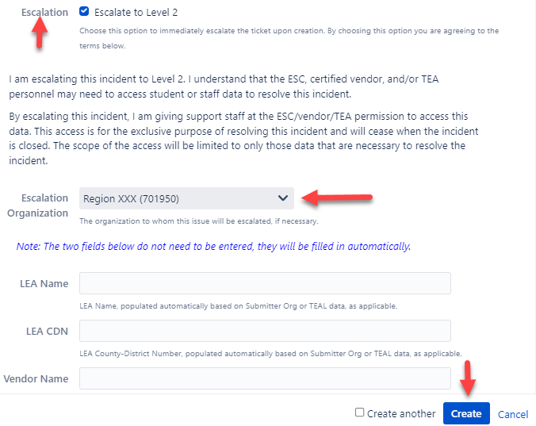
ESCALATION AND DATA USE AGREEMENT
Notes:
Trainer Notes
To escalate an incident when creating an incident, read the data use agreement, then click the box next to Escalation.
This will allow TIMS Level 1 Support to escalate the incident to TIMS Level 2 Support.
To submit the incident, click the Create button.

Slide 50
TIPS ON CREATING AN INCIDENT
Determine if it is a data or an application issue.
Search the Knowledge Base first.
Review the Known Issues Report.
When creating an incident:
  Attach screenshots and/or files.
  Include the error message.
  Describe the steps followed before the error occurred.
  Mention troubleshooting you already completed.
  Be concise but detailed in your description.
  Be specific about what you see.
  Provide any feedback on applicable Knowledge Base articles for potential future updates.

Slide 51
DEMONSTRATION 3
TIMS Workflow
Start progress on an incident
Add comments
Escalate an incident
Resolve an incident
Put an incident on hold
For ESCs/Vendors Only
Return an incident
Log data access
Log work
Submit incident on behalf of an LEA as TIMS Level 1 Support
Notes:
Trainer Notes
Log into TIMS and complete a demo. The steps for this Demo are covered on slides 48-59. Slides 57-59 are for ESC/Vendors only.

Slide 52
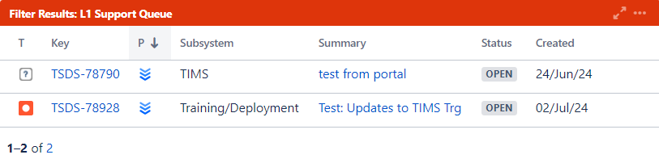
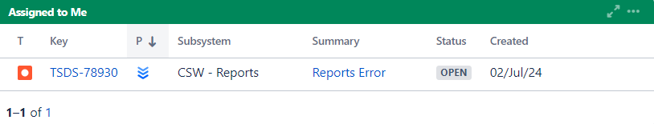
START WORK ON AN INCIDENT
Notes:
Trainer Note:
Top image
This image displays the L1 Support Queue with the incoming incidents that need to be worked.
Second image
This image displays the Assigned to Me queue where an incident will move to once it has been assigned to you to work.

Slide 53
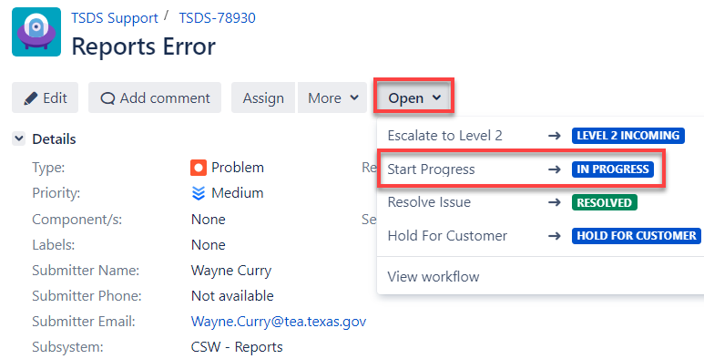
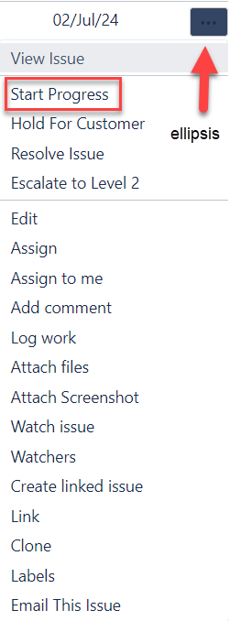
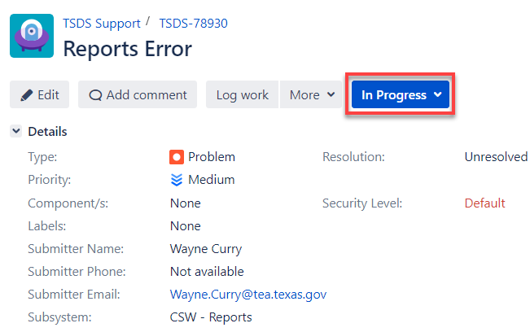
WORK ON AN INCIDENT
Notes:
Trainer Note:
Top image
To start work on an incident:
The initial status of the incident shows Open.
From the detail view of the incident, click the Open dropdown menu, then click Start Progress.
Right image
From the dashboard queues, hover over the right side of the incident, click the ellipsis, and click Start Progress.
Bottom image
Once you click Start Progress, the status changes to In Progress.

Slide 54
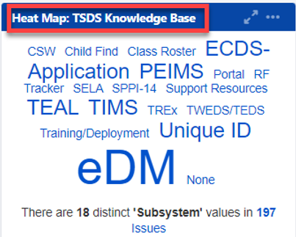
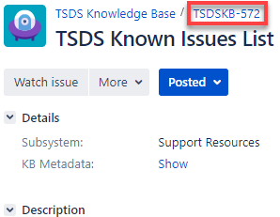
WORKING THE INCIDENT
When you are working an incident:
  Consult the Knowledge Base to see if a solution to the incident has been identified.
    To do so, go to the dashboard and click on the Subsystem from the Heat Map, use the Quick Search box, or the Knowledge Base quick link.
  Search the Known Issues Report to see if the incident you are working has been reported, has any troubleshooting steps, or a resolution timeframe. Click here to access.

Slide 55
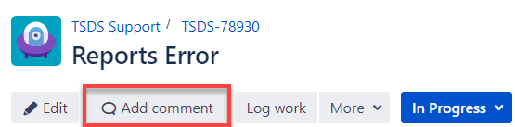
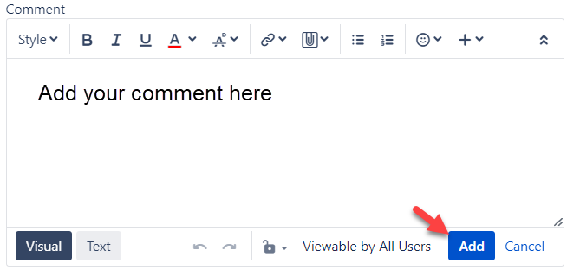
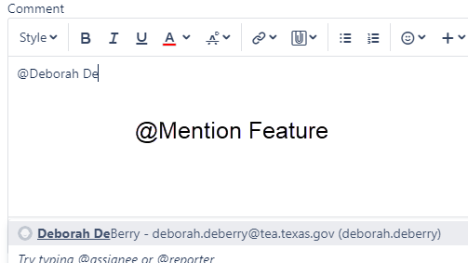
HOW TO ADD COMMENTS
To add a comment to an incident:
  In the detail view, click the Add Comment button, type in your comment, and click Add.
  From the queues, hover over the right side of the incident, click the ellipsis, select Add Comment, type in your comment, and click Add.
Note
  To notify a person of a comment via email, use the @mention feature.
    Enter the @ symbol, type in their name, and click on their name.
  You can restrict the view to a set of users by clicking the lock icon.

Slide 56
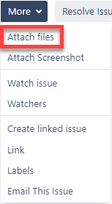
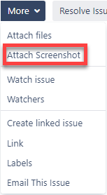

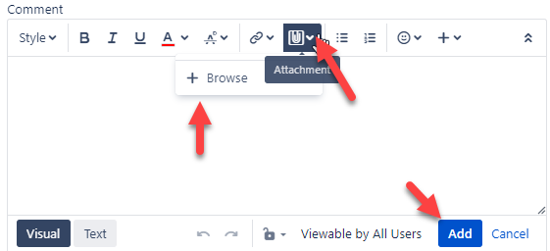
ADD ATTACHMENT OR SCREENSHOT
Notes:
Trainer Notes
Top left image
To attach a file:
Click on More, then click Add files.
From the queues, hover over the right side of the incident, click the ellipsis, and then click Attach files.
This will open a dialogue box where you can search your computer for the files you want to upload.
Once you have selected your file, click Open.
To delete a file, go to the Attachments section and click the trash can icon next to the file.
Top right image
To attach a screen capture:
Click on More, then click Attach Screenshot.
From the queues, hover over the right side of the incident, click the ellipsis, and then click Add Screenshot.
This will open a dialogue box where you can insert your screen capture.
You can insert your screen capture by dragging and dropping your image or copying and pasting your image in the box that says, ‘your image will be pasted here’.
Once you have your screen capture inserted, name your file, and then click Upload.
To delete a screen capture, go to the Attachments section and click the trash can icon next to the image.
Snipping Tool
If using Windows, the Snipping tool can capture a screenshot.
Use ctrl+c or copy the screenshot in Snipping Tool.
Then ctrl+v or paste to paste the image into the TIMS issue
Top Middle image
This image displays the option to drag and drop files in the Attachment section of an incident.
Bottom image
To use the attachment feature in the comments sections:
Click on Add Comment.
From the queues, hover over the right side of the incident, click the ellipsis, and then click Add Comment.
Click the attachment icon (paper clip symbol) and click +Browse.
This will open a dialogue box where you can search your computer for the files or image you want to upload.
Once you have selected your file, click Open.
You can restrict the view to a set of users by clicking the lock icon.
To delete a file, go to the Attachments section and click the trash can icon next to the file.

Slide 57
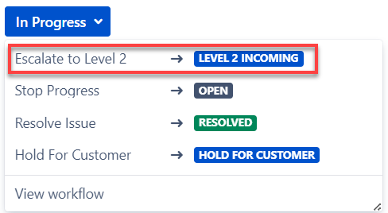
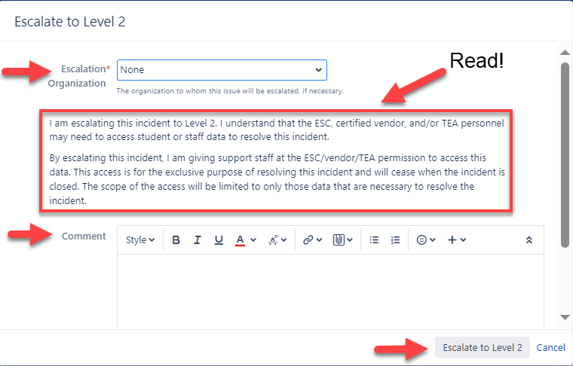
ESCALATE AN INCIDENT
To escalate an incident:
  From the In Progress dropdown menu, click Escalate to Level #.
  From the queues, hover over the right side of the incident, click the ellipsis, then select Escalate to Level #.
  When the dialogue box opens, choose the organization to which you are going to escalate the incident.
  Add an optional comment explaining why you are escalating the incident.
  Click Escalate to Level # to escalate the incident.
Notes:
Trainer Notes​
Be sure to remember FERPA and read the data use agreement.
This is where Level 1 gives authority for Level 2 along with TEA, to view the data specific to that incident.
For ESCs/Vendors ONLY:
Escalation reasons for escalating from Level 2 to Level 3 (image not shown):
Exhausted Troubleshooting Steps: Select this step after you have exhausted all options to resolve the incident.
Required for TEA Action: Select this if the reason you are escalating requires TEA assistance such as retiring a UID.
Need more Training: Select this if you require additional training related to the incident.
TEA Recommended Escalation:
Don’t Support this LEA: Select this if you do not have a support contract with this LEA or this LEA is not in your region.
Support Staff Unavailable: Select this if you lack the bandwidth to work this incident.
Other – See Comments: Select this and enter a comment if the reason you are escalating is not covered in any of the other available options.

Slide 58
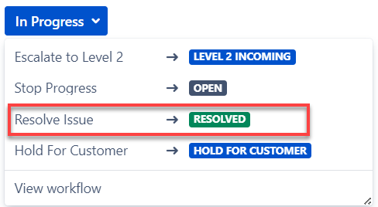
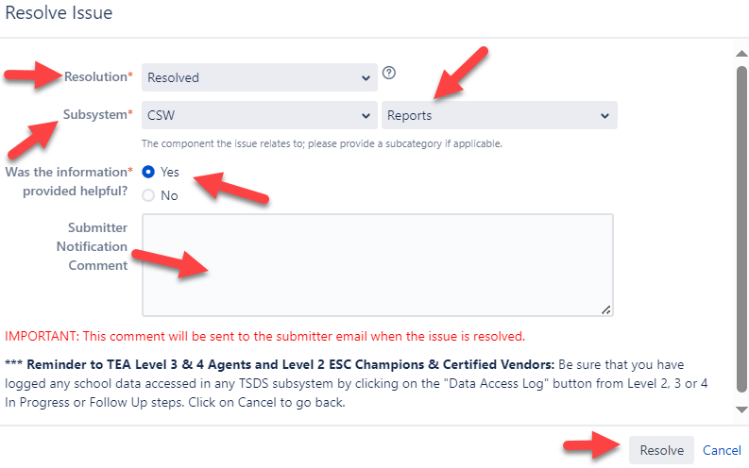
RESOLVE AN INCIDENT
To resolve an incident:
  From the In Progress dropdown menu, click Resolve Issue.
  From the queues, hover over the right side of the incident, click the ellipsis, and select Resolve Issue.
  Select the Resolution dropdown and select the appropriate resolution.
  The subsystem and subcategory will auto-populate with what was selected when the incident was created.
  Answer the question about the information being helpful.
  Add an optional comment regarding the resolution.
  Click Resolve.
Notes:
Trainer Notes
From the Resolution dropdown menu, select:
Resolved if a resolution has been found.
Work-around Provided to Customer if a workaround for the problem was found and provided to the customer.
Won’t Fix if the incident will not be fixed.
Duplicate if the incident is a duplicate of another incident.
Incomplete if there is not enough information has been provided to understand the incident.
Cannot Reproduce when attempts were made to reproduce the incident, they were not successful.

Slide 59
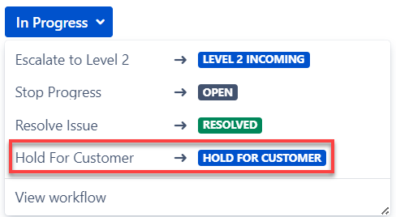

PUT AN INCIDENT ON HOLD
To put an incident on hold:
  From the In Progress dropdown menu, click Hold for Customer.
  From the queues, hover over the right side of the incident, click the ellipsis, and select Hold for Customer.
  Type a comment about why you are placing the incident on hold.
  Click Hold for Customer to put the incident on hold.
Notes:
Trainer Notes
The reason you would want to put an incident on hold is if you are working the incident and do not have enough information or need more clarification to help resolve the incident.
For levels higher than Level 1, you will click Level # Hold, where ”#” corresponds to your support level.
The dialogue box appears slightly different depending on whether it is opened from the detail view or queues.
You can restrict the view to a set of users by clicking the lock icon.

Slide 60


RETURN AN INCIDENT
FOR ESC or CERTIFIED VENDOR ONLY
To return an incident:
  From the detail view, click Workflow, and then click Return to Level 1.
  From the queues, hover over the right side of the incident, click the ellipsis, and click Return to Level 1.
  Select the Support Follow-up Reason to indicate why you are returning the incident.
  Add an optional comment detailing the reason for returning the incident.
  Click Return to Level 1.
Notes:
Trainer Notes
You would return an incident to get more information to help with resolving the incident.
Level 1 Support cannot Return to a lower level since they are the lowest level.
The options available to Level 1 Support are Hold for Customer or to resolve the incident.

Slide 61


LOG DATA ACCESS
FOR ESC or CERTIFIED VENDOR ONLY PART 1
To log data access:
  From the detail view, click More, and then click Log Data Access.
  From the queues, hover over the right side of the incident, click the ellipsis, and select Log Data Access.
Ensure the following:
  The inclusion of data meets the restrictions listed at the top of the Log Data Access window.
  Check the boxes that indicate the types of data that are included in the incident.
  Add an optional comment explaining the inclusion of data.
Notes:
Trainer Notes
This section does not apply to TIMS LEA (Level 1) Support.
The incident has to be in Progress for Level 2 to access Log Data Access.
To maintain compliance with TEA policies and with the FERPA:
The LEA or ESC data that is escalated beyond Level 1 (TIMS LEA) Support must be logged into the system by Level 2 Support or higher.
Once an incident that has student or teacher data attached to it reaches Level 2, 3, or 4 and is put in In Progress or Follow-up status, use Log Data Access to comply with this requirement.

Slide 62


LOG DATA ACCESS CONTINUED
FOR ESC or CERTIFIED VENDOR ONLY PART 2
To Log Work:
  From the detail view, click Log Work.
  From the queues, hover over the right side of the incident, click the ellipsis, and click Log Work.
  If you have already logged work, in the detail view, click the + icon next to Time Tracking.
  Type an estimate of the amount of time you spend on the incident.
  Add an optional description of the work you have done.
  Click Log to log your work.
Notes:
Trainer Notes
For the Remaining Estimate section, select one of the choices below for how you would like to update the work estimation.
Adjust automatically to have the system update the estimate as time is added.
Use existing time estimate of # minutes which will not track time worked.
Set to which allows the user to set a specific estimate for work time remaining.
Reduce by which reduces the estimate already entered that seems excessive.

Slide 63
FOR ESC OR CERTIFIED VENDOR
Submit an Incident on Behalf of an LEA
  ESC or Certified Vendor needs to fill out the incident creation form.
  For the Submitter Org, you will select the name of the LEA who incurred the problem.
  Click Auto-fill my name, telephone, and email as the point of contact.
  You will immediately be able to see and work the incident.
Notes:
Trainer Notes
If your information does not upload when you click the Auto-fill my name, telephone and email, enter your name in Submitter Org, your email address in Submitter Email, and your contact number in Submitter Phone.

Slide 64

TRAINING ACTIVITIES
Practice and Knowledge Checks

Slide 65
PRACTICE EXERCISE
Task 1: Search in TWEDS
Task 2: Schedule an L2 Validation.
Ready
Set
Go

Slide 66
KNOWLEDGE CHECK 1
The References tab provides links to information that offers guidance on reporting requirements.
      True
      False
Notes:
NOTE:
To see the answer, you must be in presentation mode.

Slide 67
KNOWLEDGE CHECK 2
Which of the below are not part of the Data Components tab in TWEDS?
      Domains
      Entities
      Categories
      Timelines
Notes:
NOTE
To see the answer, you must be in presentation mode.

Slide 68
KNOWLEDGE CHECK 3
TWEDS is the standard used by TEA to designate how and when data should be submitted by the LEAs and ESCs.
      True
      False
  Note: TSDS Web-Enabled Education Data Standards (TWEDS) is the tool where the standard is housed. Texas Education Data Standard (TEDS) is the standard.
Notes:
NOTE: To see the answer, you must be in presentation mode.

Slide 69
KNOWLEDGE CHECK 4
L2 Validations scheduled before the cutoff time, can be viewed the following day.
      True
      False
  Note: L2 Validations can be scheduled at any time prior to the cutoff time and can be viewed the following day. Validation jobs scheduled after the cutoff time may not be available the next day but should be available the following day.
Notes:
NOTE: To see the answer, you must be in presentation mode.

Slide 70
KNOWLEDGE CHECK 5
Level 1 Support (LEA) user can create an incident and immediately escalate it to Level 3 Support (TEA).
  True
  False
Notes:
NOTE
To see the answer, you must be in presentation mode.

Slide 71
KNOWLEDGE CHECK 7
When an ESC or Certified Vendor creates an incident on behalf of an LEA, the ESC or Certified Vendor should select the name of the LEA under the dropdown for Submitter Org.
  True
  False
Notes:
NOTE
To see the answer, you must be in presentation mode.

Slide 72
KNOWLEDGE CHECK 8
When an issue is identified in a TSDS application, which of the below is the first step a TIMS Level 1 Support user should take?
  Double check your TIMS role
  Send an email to Level 3 support staff
  Search the Knowledge Base for a resolution
  Submit a TIMS incident
Notes:
NOTE
To see the answer, you must be in presentation mode.

Slide 73

WRAP UP
Key Takeaways, Resources, and Next Steps

Slide 74

KEY TAKEAWAYS
TEDS is the standard and TWEDS is the tool used to view and navigate TEDS.
Viewing L2 Validations in the DMC will allow users to begin correcting errors prior to promoting their data in the Core Collection.
TRAINING RESOURCES
        Key Terms and Definitions
        Level 2 Validations Reference Guide

Slide 75
TECHNICAL RESOURCES
  Texas Education Data Standards Resources
    TSDS Web-Enabled Data Standards (TWEDS)
Notes:
TWEDS
Go to the TSDS website at https://www.texasstudentdatasystem.org
Hover over the TEDS Data Standards tab.
Next, click on ‘TWEDS Upgrade’
Finally, click on the “XXXX-XXXX Texas Education Data Standards via TWEDS” hyperlink.

Slide 76
NEXT STEPS
  Complete the Core Collection Part II Training

Slide 77
WRAP UP
  In this training we talked about:
The TEAL roles for TSDS Core Submissions.
How to navigate TWEDS.
How to run and view Level 2 validations.
How to promote, validate and complete Core Submission.
How to run and view TSDS Reports for Core Submission.
How to reset a submission.

Slide 78

QUESTIONS

