Slide 1

TITLE SLIDE: TSDS ODS 3.x Project
Updates
TEDS/TWEDS
Part II - TWEDS Overview

Slide 2
KEY TERMS
Data Element
Data Management Center (DMC)
Descriptor Table/Value
Domains
Ed-Fi Data Standard
Entities
Individual Operational Data Store (IODS)
Publish
Texas Education Data Standards (TEDS)
TSDS Web-Enabled Data Standards (TWEDS)
You can find the definitions to these key terms and more here: Link to Key Term Document

Slide 3
LEARNING OBJECTIVES
By the end of this course, the user will be able to explain:
How to use the TSDS Web-Enabled Data Standards (TWEDS) website to understand and interact with the Texas Education Data Standards (TEDS).

Slide 4
WHY IS THIS COURSE IMPORTANT
To provide an overview of the Texas Education Data Standards (TEDS).
The goal is to ensure the ESC/Certified Vendors understand and can teach TEDS to effectively support LEAs.

Slide 5

COURSE AGENDA
GETTING STARTED
Accessing TWEDS
Key Concepts
Demo and TWEDS Navigation
Training Activities
Practice, Troubleshooting, and Knowledge Checks
WRAP-UP
Key Takeaways, Resources, and Next Steps

Slide 6


GETTING STARTED
Accessing TWEDS

Slide 7

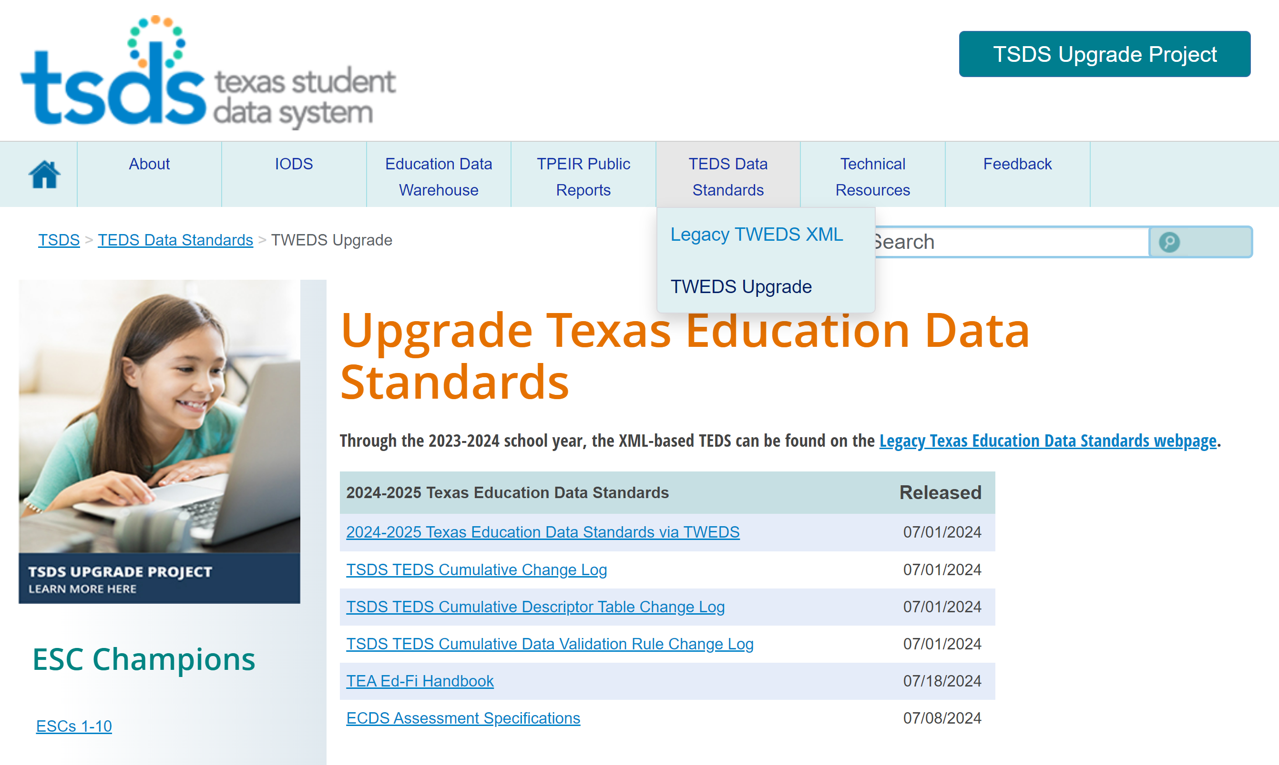
ACCESSING TWEDS
Go to the TSDS website at https://www.texasstudentdatasystem.org
Hover over the TEDS Data Standards tab.
Next, click on ‘TWEDS Upgrade’
Finally, click on the “2024-2025 Texas Education Data Standards via TWEDS” hyperlink.
Texas Education Data Standards
Notes:
TWEDS
Go to the TSDS website at https://www.texasstudentdatasystem.org
Hover over the TEDS Data Standards tab.
Next, click on ‘TWEDS Upgrade’
Finally, click on the “XXXX-XXXX Texas Education Data Standards via TWEDS” hyperlink.

Slide 8


KEY CONCEPTS
TWEDS Navigation

Slide 9
DEMONSTRATION
Navigate to the new TSDS Web-Enabled Data Standards (TWEDS).
TWEDS Tabs
Overview
Data Components
Descriptor Tables
References
Rules
Change Logs
Early Notice
Search Features

Slide 10
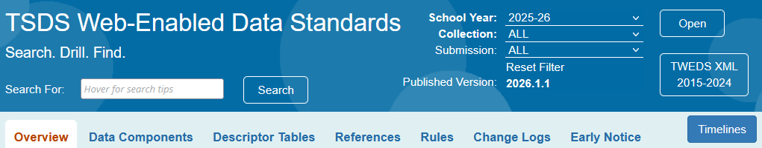
TWEDS – SETTING SEARCH CRITERIA
Year – You will specify the information you wish to view first by school year.
Collection – Next, you can select to view information for all collections or for a specific data collection.
Submission – If the collection selected has multiple submissions, you will select the submission, i.e., PEIMS Fall, ECDS-KG.
Published Version – You can see the current version of TEDS.
Open – You will be prompted to click “Open” to set the selected criteria.

Slide 11
TWEDS – SEARCH FEATURE
Use key words to find information across data elements, descriptor tables, entities, rules, categories, and more.
Use quotation marks to search for a whole phrase: “staff serving” only returns components containing the exact phrase “staff serving”.
Use an asterisk (*) to search for parts of words: educat* returns both EducatedAtResidentialFacility and EducationServiceCenterId. Currently, the system does not require an asterisk to search for a part of words.
Use multiple search terms with no quotation marks to return results for any of the search terms: emergent bilingual returns BilingualESLFunding, ParentalPermission, and EmergentBilingualIndicator, each containing only one of the search terms. The search is performed on the data element name and the data element definition.

Slide 12
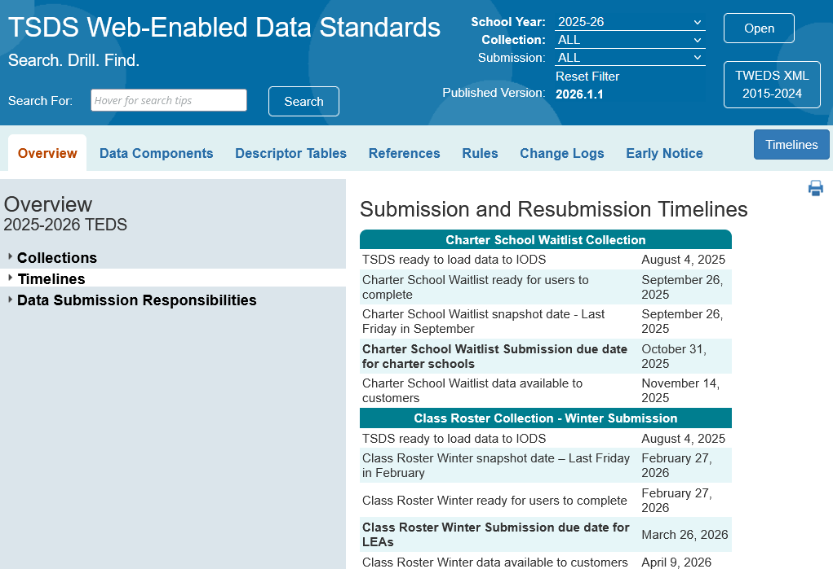
TWEDS – TIMELINES BUTTON
Timelines button provides easy access to the Submission and Resubmission Timelines.
12

Slide 13
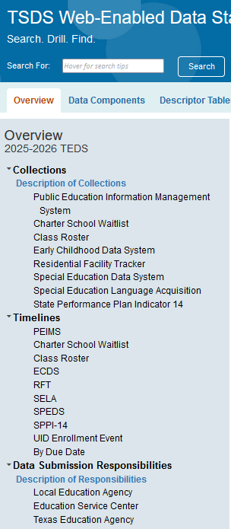
TWEDS – OVERVIEW
Overview Tab:
Collections menu provides a brief introduction to TEDS, PEIMS, and each of the TSDS Data Collections
Timelines menu provides the important dates for each data collection.
Data Submission Responsibilities menu provides data submission specifications and responsibilities for the LEA, ESC and TEA.

Slide 14
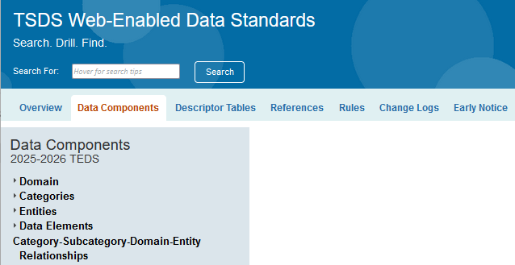
TWEDS – DATA COMPONENTS
Data Components Tab:
Domains: Lists all relevant Domains based on your selected criteria.
Categories: Shows all applicable Categories for your chosen criteria.
Entities: Summarizes Entities by their Submission details.
Data Elements: Lists all applicable Data Elements based on your selected criteria.

Slide 15
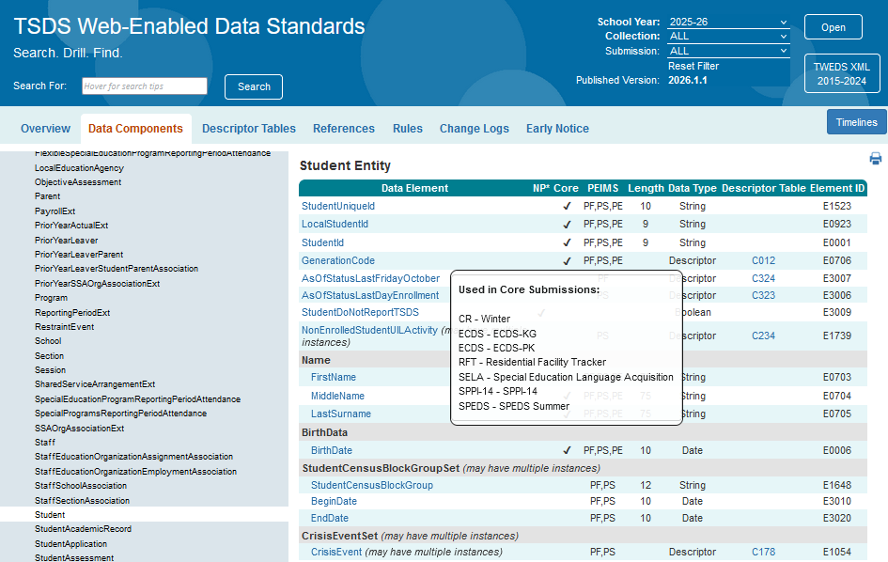
TWEDS – DATA COMPONENTS 1
Within each Entity, every data element will display to which Collection/Submission the data element will be reported for TSDS state reporting.

Slide 16
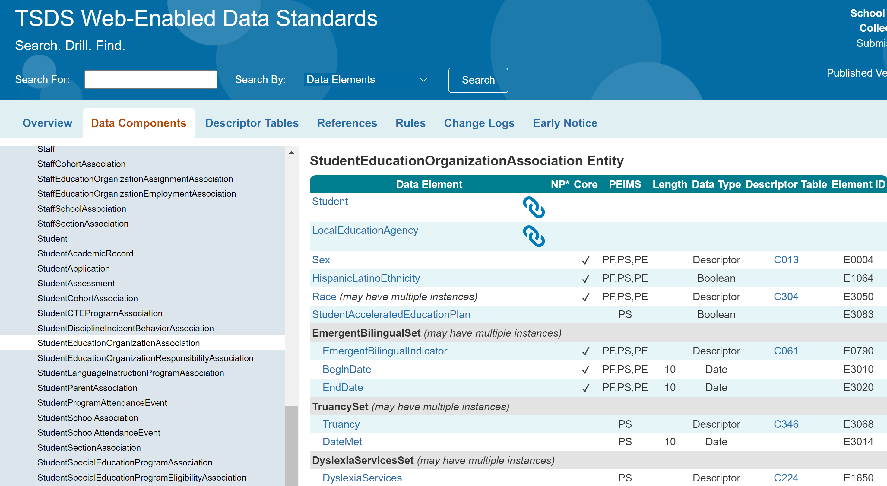
TWEDS – DATA COMPONENTS 2
The Reference icon means that the information for a data element will come from a previously published data element.
For example, the StudentEducationOrganizationAssociation entity will reference the Student Entity, which was previously published to the IODS, to capture basic information about a student. (Also referred to as Referential Integrity.)
16

Slide 17
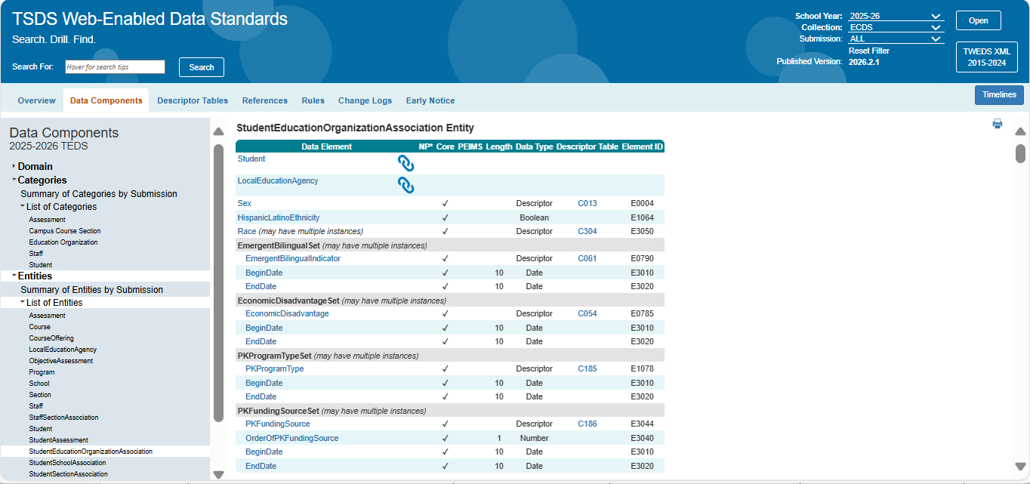
TWEDS – DATA COMPONENTS 3
May Have Multiple Instances: This means more than one set of this data may be reported in a single instance of this entity.
For instance, in this example, you can have multiple EconomicDisadvantageSet depending on if the student’s qualification changes.
17

Slide 18
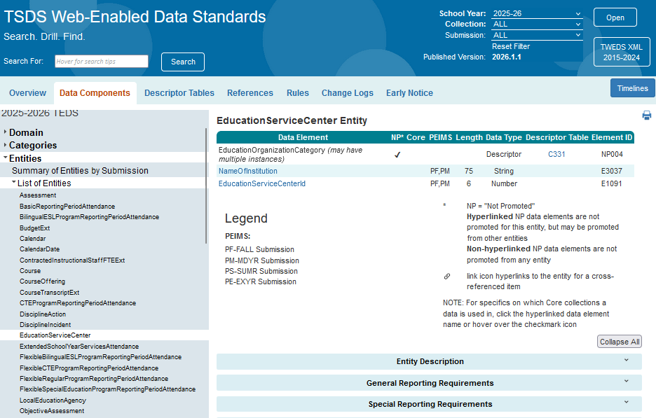
TWEDS – DATA COMPONENTS 4
NP* (Not Promoted Data Elements)
Data elements that are part of the key or mandatory for Ed-Fi but not used by TEA. These data elements will be loaded into the IODS but will not be promoted to the Core Collection Data Mart.
In this example, within the EducationServiceCenter Entity the EducationOrganizationCategory data element will not be promoted to TSDS since it has a check mark under the NP* column.

Slide 19
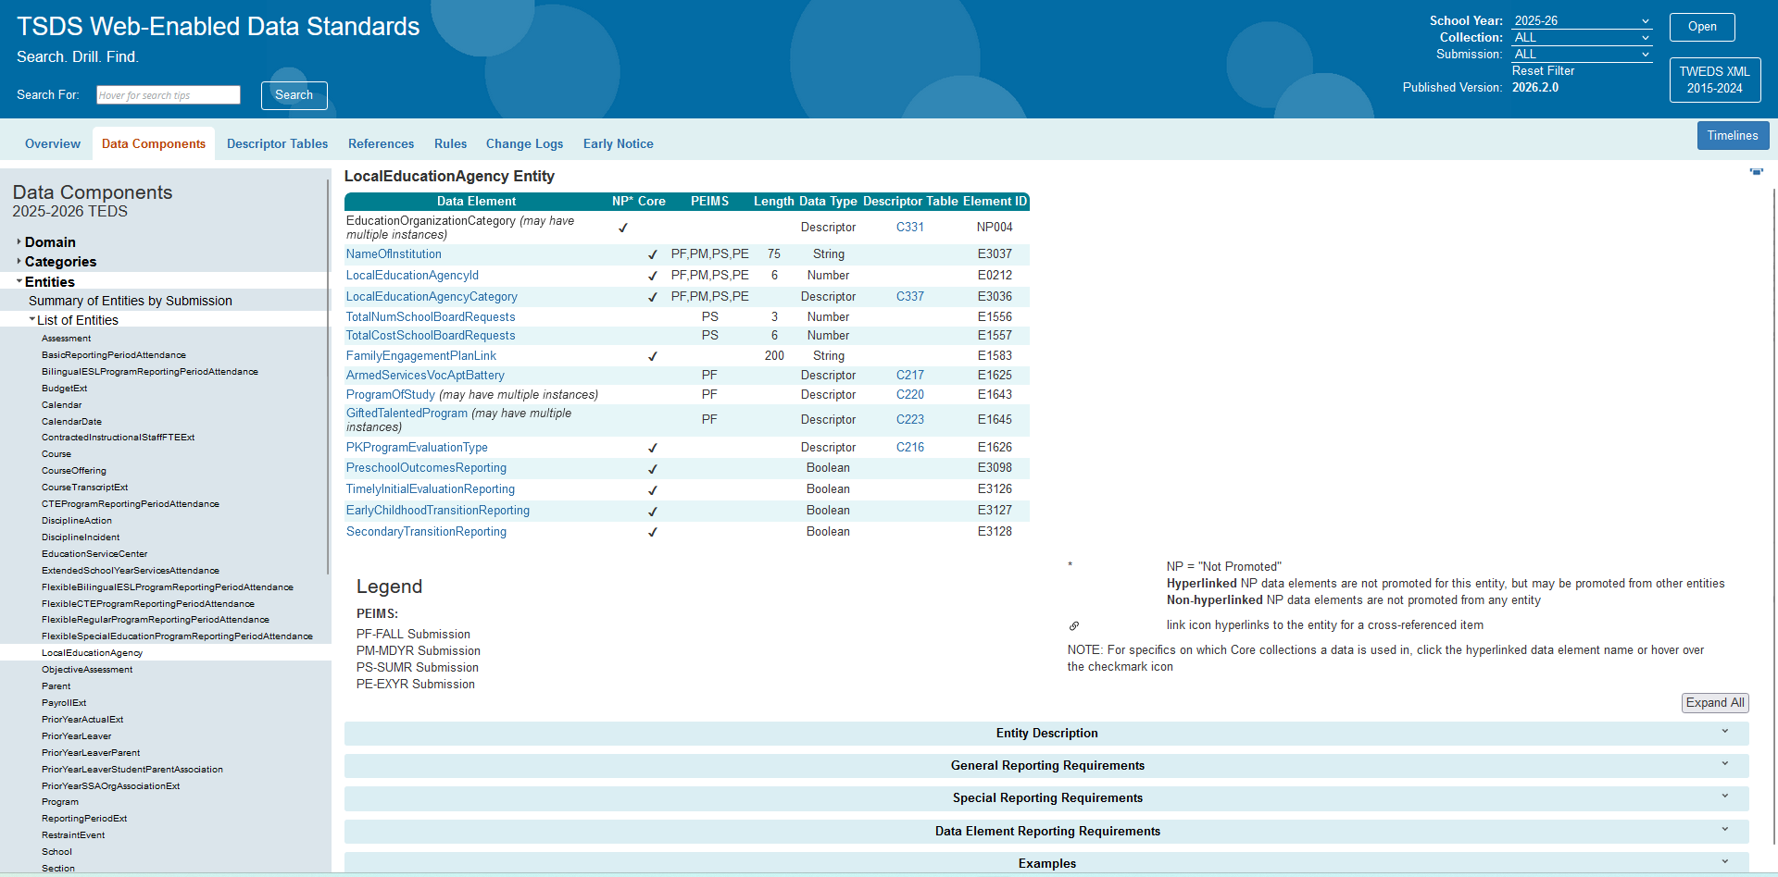
TWEDS – DATA COMPONENTS 5
The Data Submission Requirements information is included at the bottom of each entity.

Slide 20
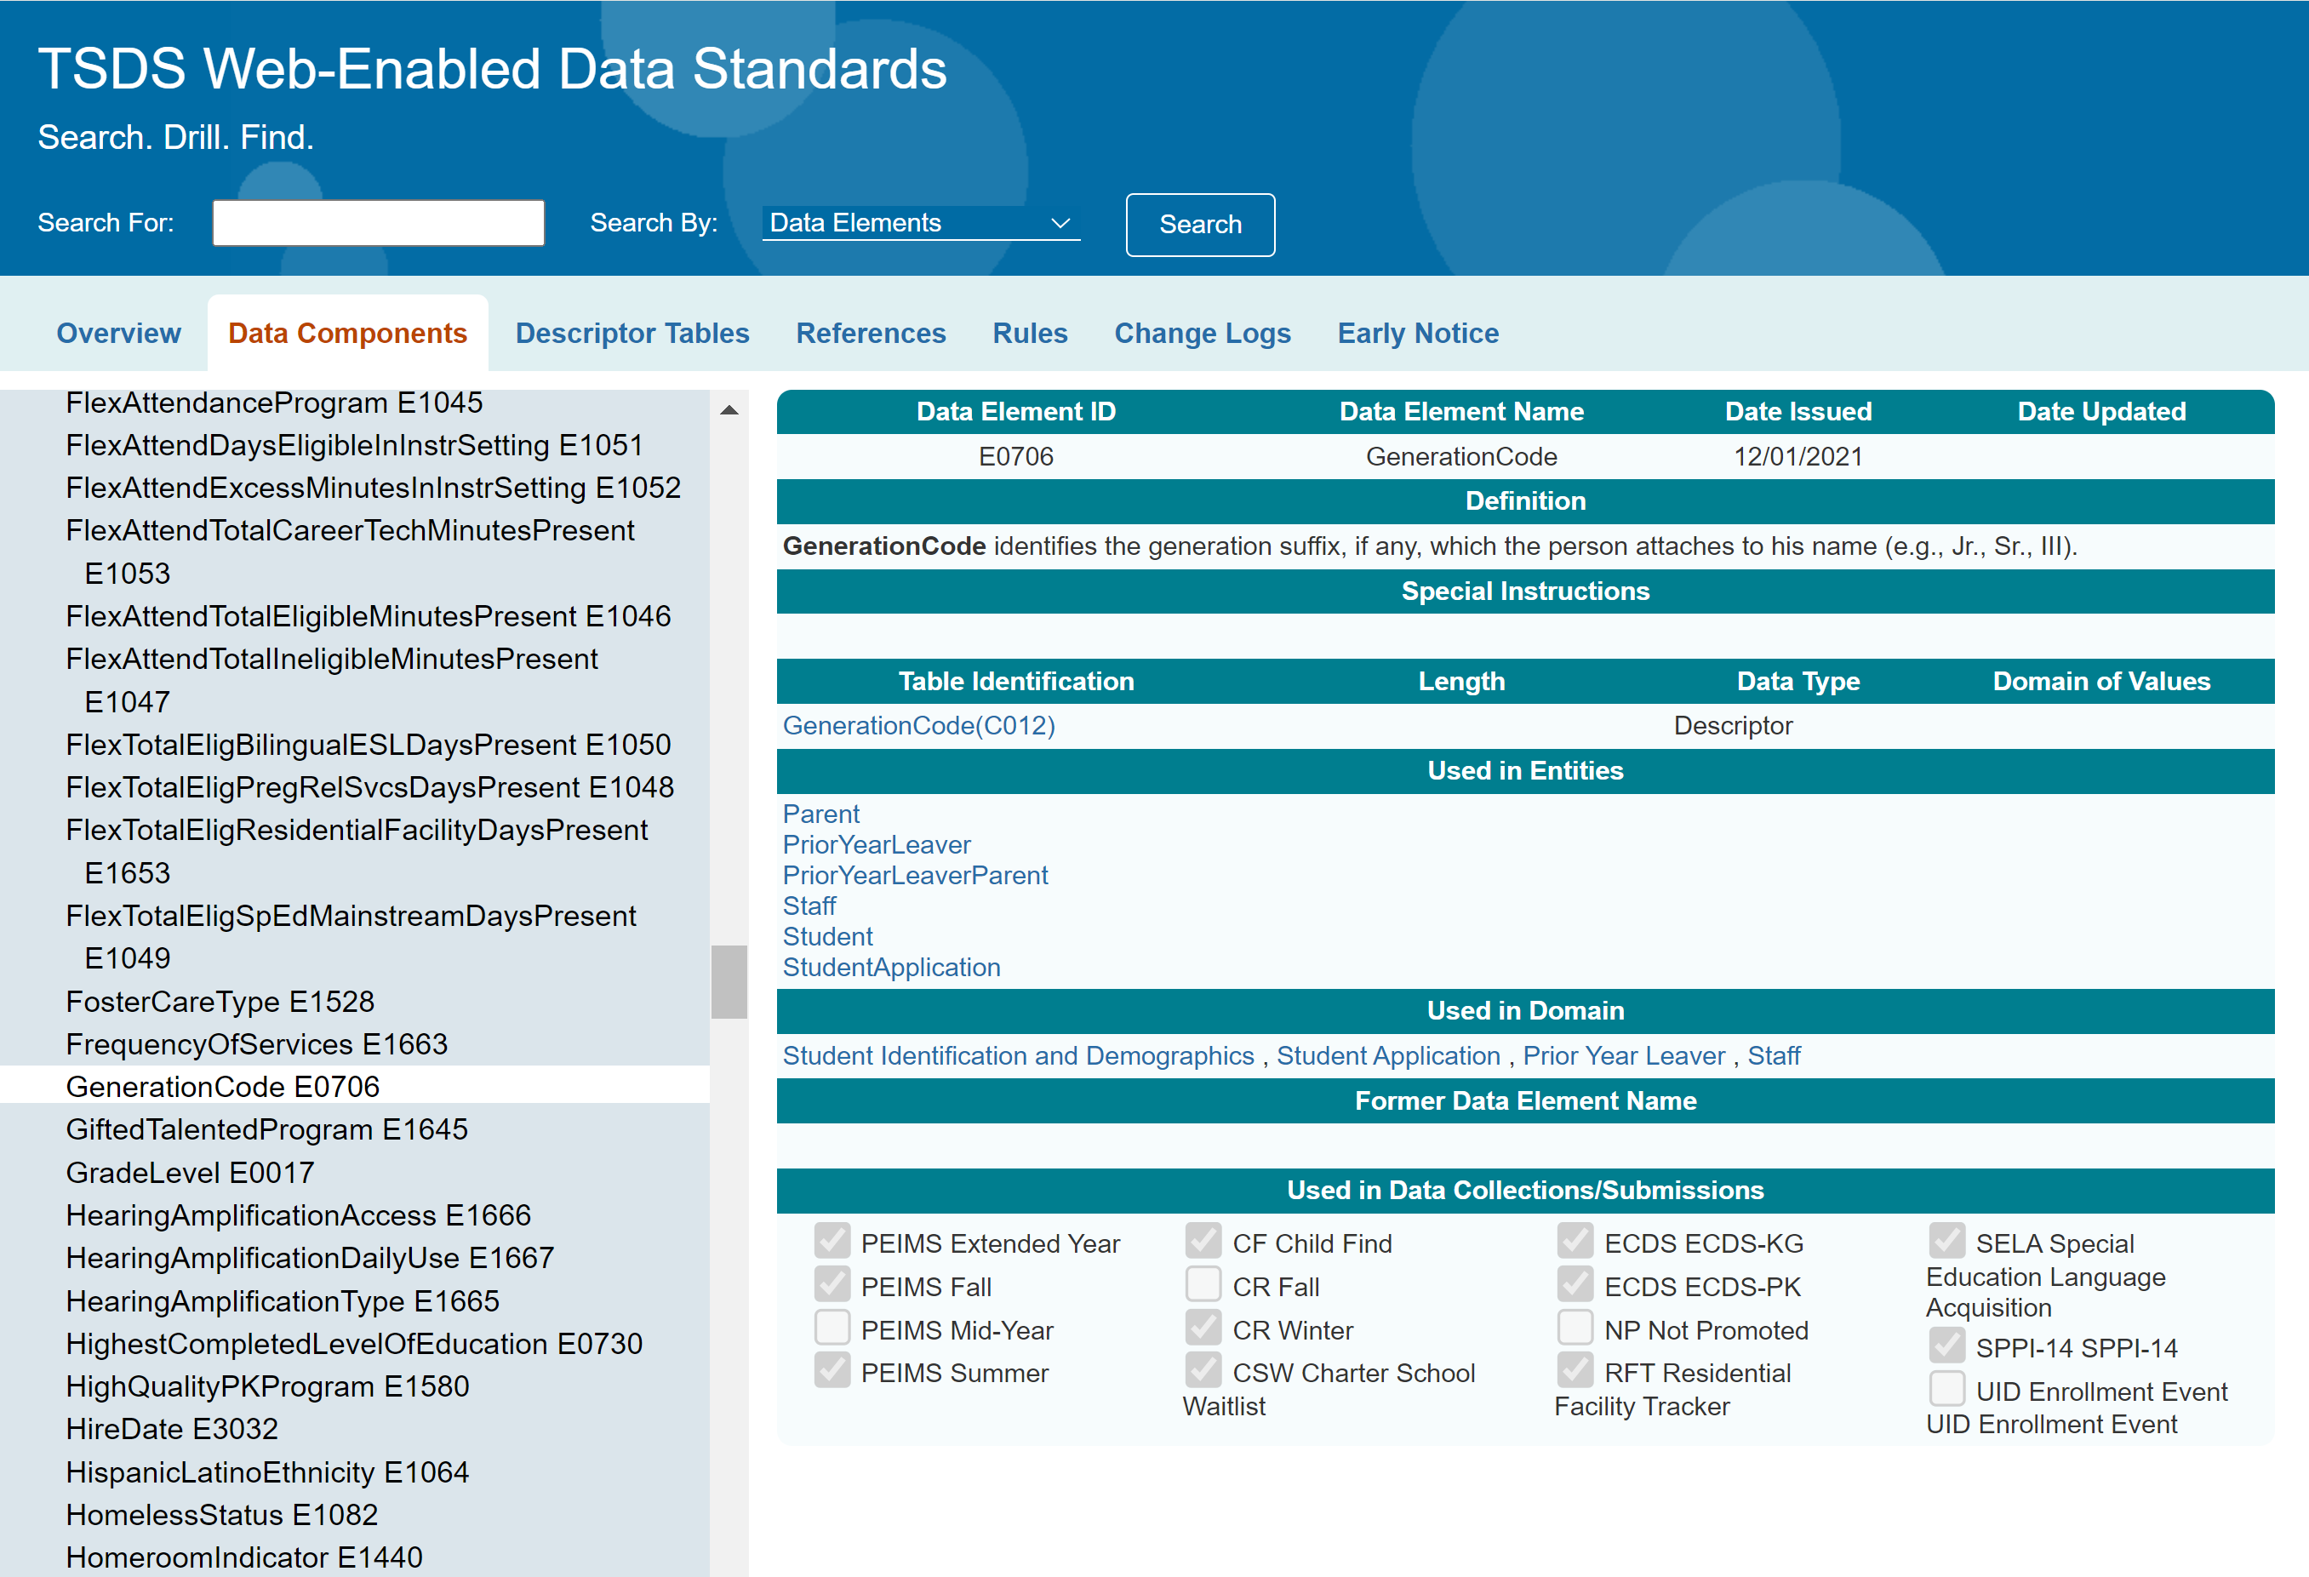
TWEDS – DATA COMPONENTS 6
Within each data element, you can see to which Collection/Submission the data element will be reported for TSDS state reporting.

Slide 21
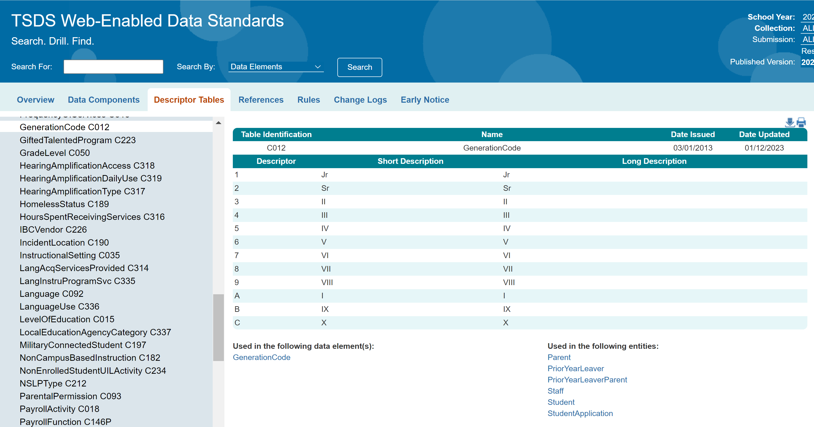
TWEDS – DESCRIPTOR TABLE
For example, for data element GenerationCode, the LEA’s vendor(s) should publish the descriptor value “1” to the LEA’s IODS, not “Jr”. If the vendor publishes "Jr" or any other local value that means "Jr" to the LEA's IODS, mapping will be required to promote the appropriate state descriptor value to TSDS.

Slide 22
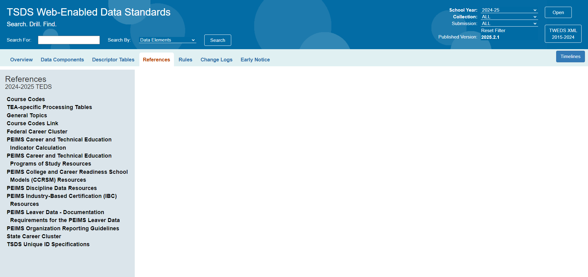
TWEDS – REFERENCES
The References tab provides links to information that offers guidance on reporting requirements.

Slide 23
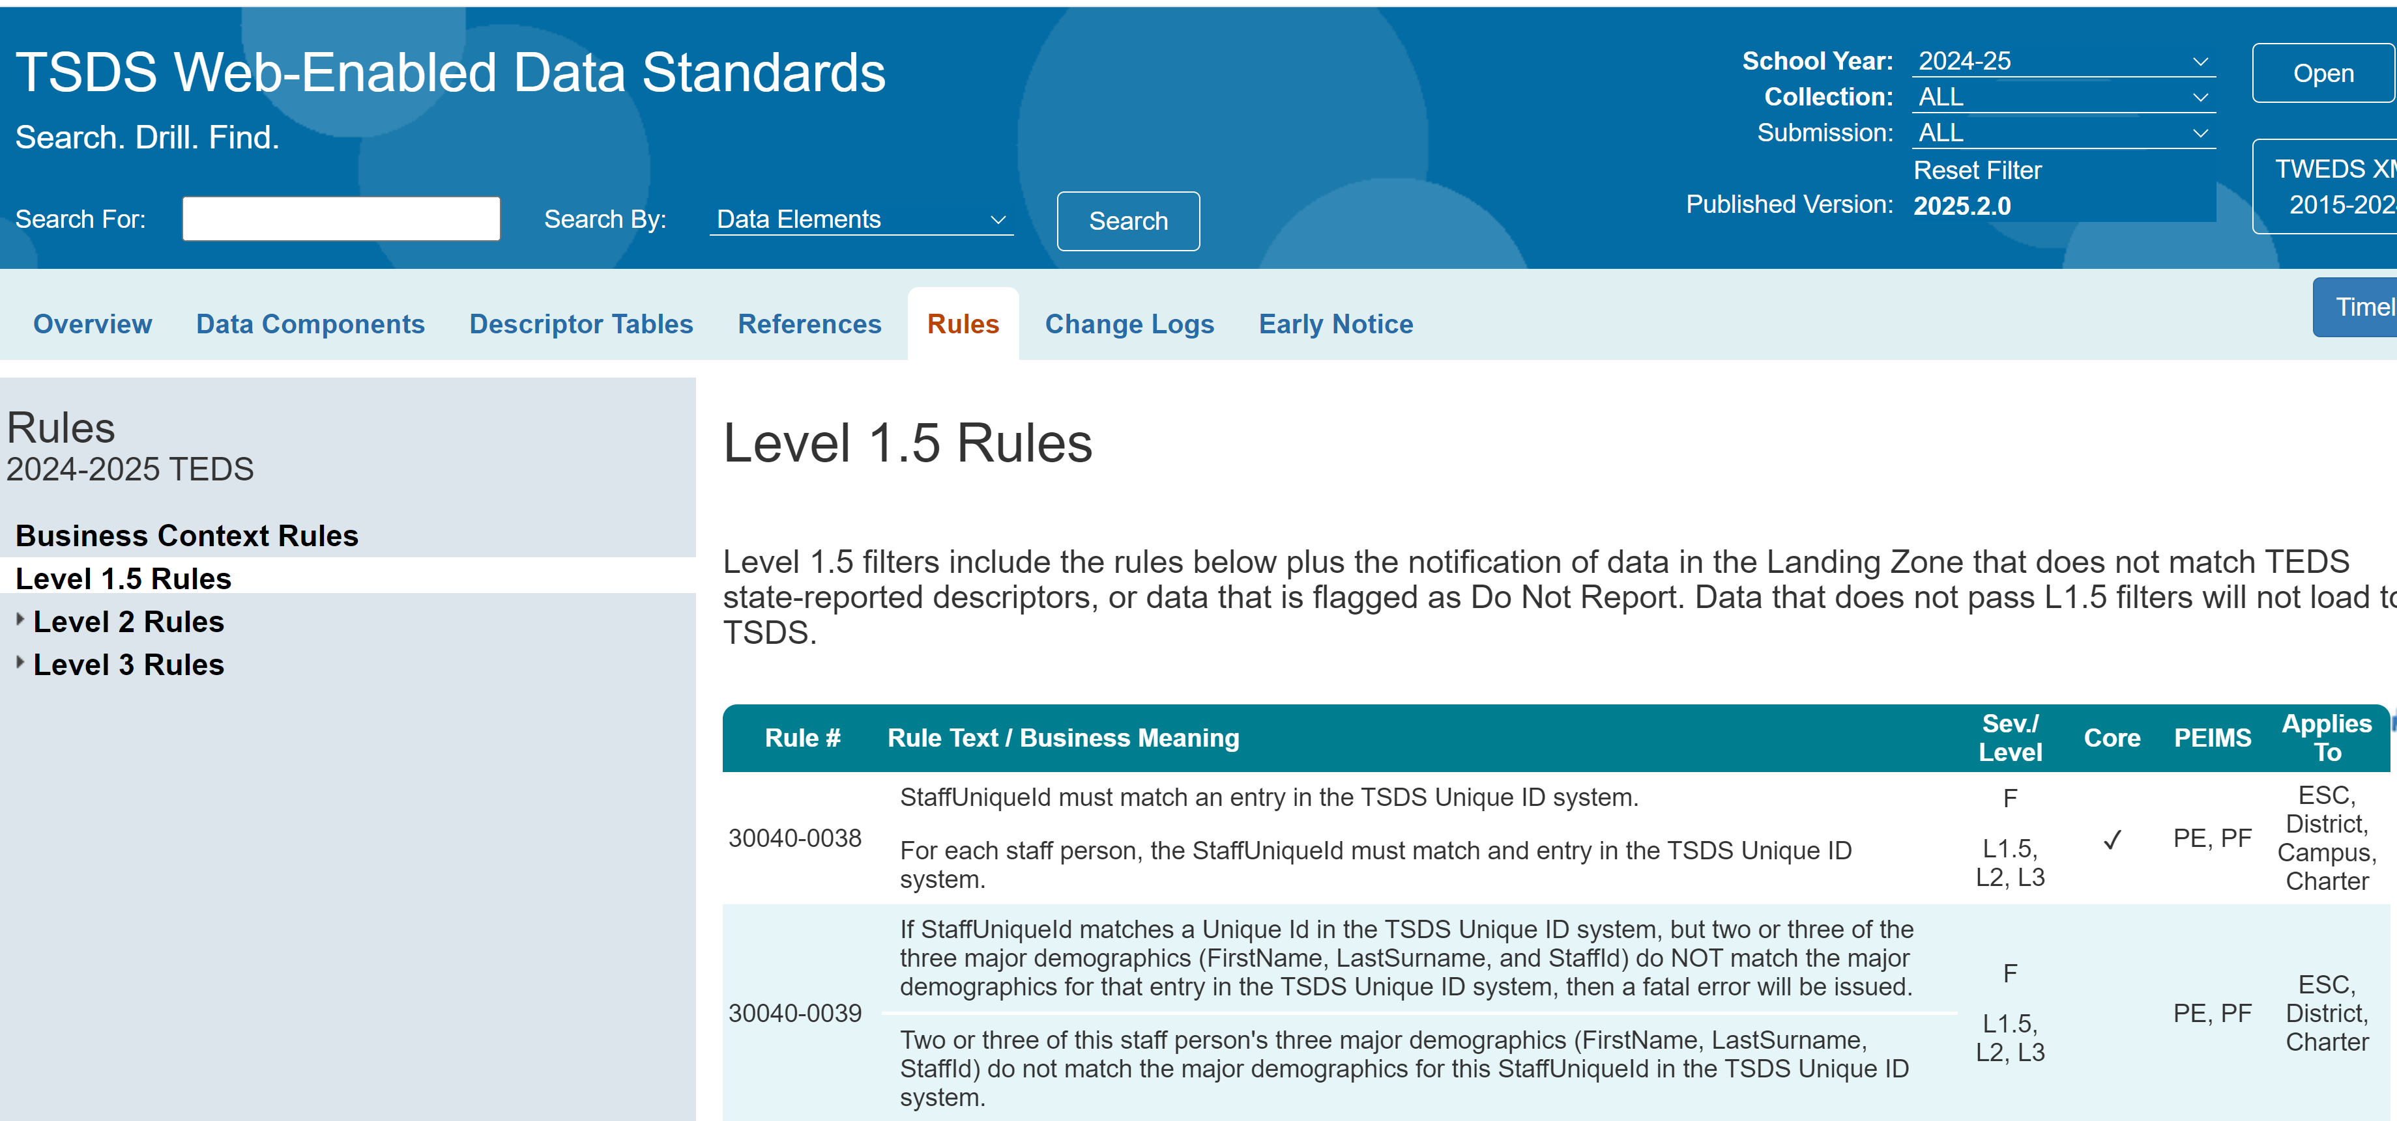
TWEDS – RULES
In each rule, a check mark in the Core column will show the Core collections for which the rule applies.
The PEIMS column will indicate PF = PEIMS Fall, PS = PEIMS Summer, etc.

Slide 24
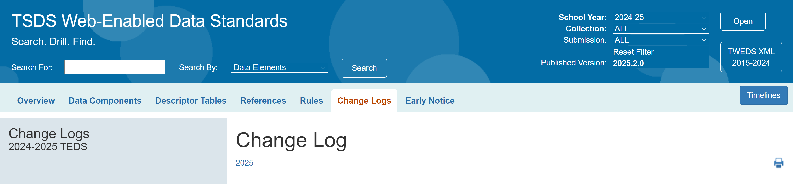

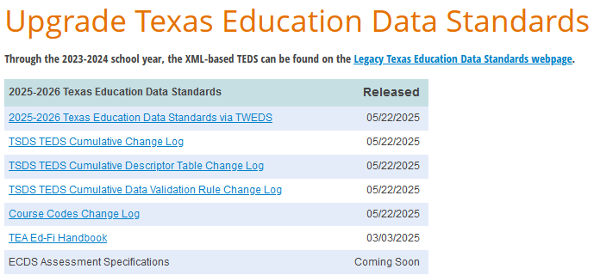
TWEDS – CHANGE LOGS
The Change Logs tab will have three change logs to show you the changes from one TEDS publication to the next.

Slide 25
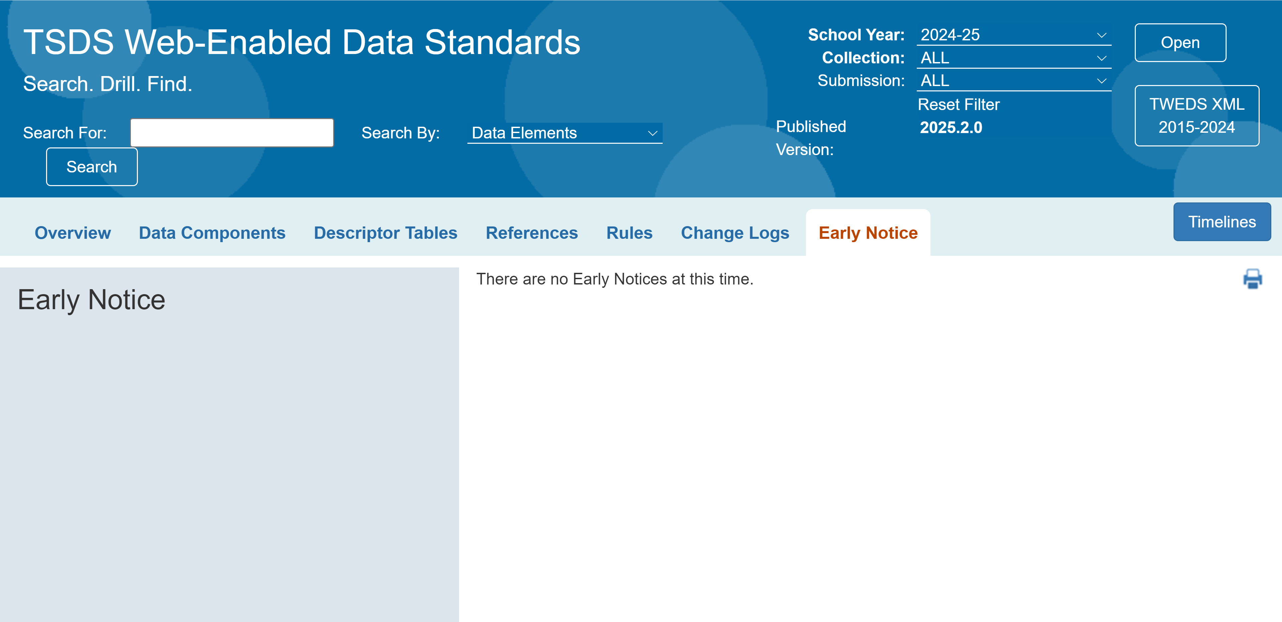
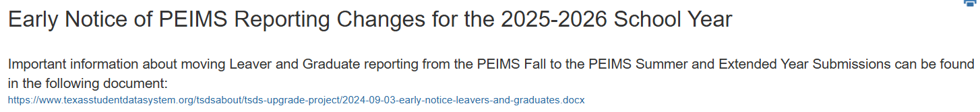
TWEDS – EARLY NOTICE
Early Notice:
When TEA has a notice to provide to LEAs for future data collections, the notice will be displayed on this tab.

Slide 26
TRAINING ACTIVITIES
Practice, Troubleshooting & Knowledge Checks

Slide 27
PRACTICE EXERCISE
Task 1: Navigate to the new TSDS Web-Enabled Data Standard (TWEDS).
Task 2: Navigate through the different tabs
Task 3: Search for a data element
Ready
Set
Go

Slide 28
TROUBLESHOOTING
Scenario 1: How do I search for the data element Behavior (E1006), formerly known as DISCIPLINARY-ACTION-REASON-CODE (E1006), in Ed-Fi 1.x?
Resolution Steps:
The data element name, DISCIPLINARY-ACTION-REASON-CODE (E1006), has been changed to Behavior (E1006) in the Ed-Fi 4.x standard. The definition remains the same and the descriptor table name is changed to Behavior (C165) also.
Navigate to the new TWEDS
In TWEDS, search for the new Ed-Fi 4.x data element Behavior (E1006).
From the search results, click on the data element Behavior (E1006) to see the details.
In the data element details, you will find the former data element DISCIPLINARY-ACTION-REASON-CODE (E1006) referenced in the Former Data Element field.

Slide 29
TROUBLESHOOTING
Scenario 2: Why can’t I find the data element AT-RISK-INDICATOR-CODE (E0919)?
Resolution Steps:
To align with the Ed-Fi 4.x data standards, TEA combined over 20 data elements that used the PARTICIPATION-INDICATOR-CODE (C088) into a single data element, StudentCharacteristic (E3063). This new data element will use the StudentCharacteristic (C344) table to capture important characteristics of the student's characteristics or program participation.
Navigate to the new TWEDS
Search for the data element StudentCharacteristic (E3063) in TWEDS.
Within the StudentCharacteristic (E3063) data element, click on the link to the StudentCharacteristic (C344) descriptor table to see all the descriptor values for the different programs and services used to report information about a student.
To report a student as ‘At-Risk’, the LEA will need to:
Use the StudentCharacteristic (E3063) data element
Use the ‘01’ descriptor value from the StudentCharacteristic (C344) descriptor table to indicate a student identified as At-Risk.
Report the BeginDate when the student first became At-Risk. Report the EndDate when the student is no longer classified as At-Risk.

Slide 30

WRAP UP
Key Takeaways, Resources, and Next Steps

Slide 31

KEY TAKEAWAYS
TWEDS is the main website for accessing and using Texas Education Data Standards (TEDS).
LEAs and ESCs should use TWEDS resources and ongoing trainings to stay updated and compliant.
TEDS now aligns with Ed-Fi 4.x, changing how student data and characteristics are reported.
TRAINING RESOURCES
Key Terms and Definitions

Slide 32
TECHNICAL RESOURCES
Texas Education Data Standards Resources
TSDS Web-Enabled Data Standards (TWEDS)
Notes:
TWEDS
Go to the TSDS website at https://www.texasstudentdatasystem.org
Hover over the TEDS Data Standards tab.
Next, click on ‘TWEDS Upgrade’
Finally, click on the “XXXX-XXXX Texas Education Data Standards via TWEDS” hyperlink.

Slide 33
NEXT STEPS
Plan to take the following trainings:
TEAL Roles (LEA & ESC)
Security and Administrative Features
Level 1.5 Filters
Descriptor Mapping
Level 2 Validations
Complete a Teach Back Exercise
Complete the Technical Certification Test
Attend TSDS Continuing Education Trainings (CET)
Participate in TSDS Just-in-Time Trainings (JIT)
Attend Field Coordination Network (FCN) webinars for updates and changes

Slide 34
WRAP UP
In this training we talked about:
How to use the TSDS Web-Enabled Data Standards (TWEDS)website to understand and interact with the Texas Education Data Standards (TEDS).
Notes:
What the Ed-Fi Data Standard is and how the Texas Education Data Standards (TEDS) are a subset of them.
Why TEA is updating TEDS to be consistent with the Ed-Fi Data Standard version 4.
How information about a student’s participation in a program and service will be reported differently in the TSDS Upgrade Project.
How to navigate through the new TSDS Web-Enabled Data Standards (TWEDS) to see some of the high-level changes from TWEDS 1.x to 4.x.

Slide 35

QUESTIONS

